Slide 1

SAR
(Synthetic Aperture Radar)

Slide 2
What is Sar?
SAR is a type of active data collection where a sensor produces its own energy and then records the amount of that energy reflected back after interacting with Earth.

Slide 3
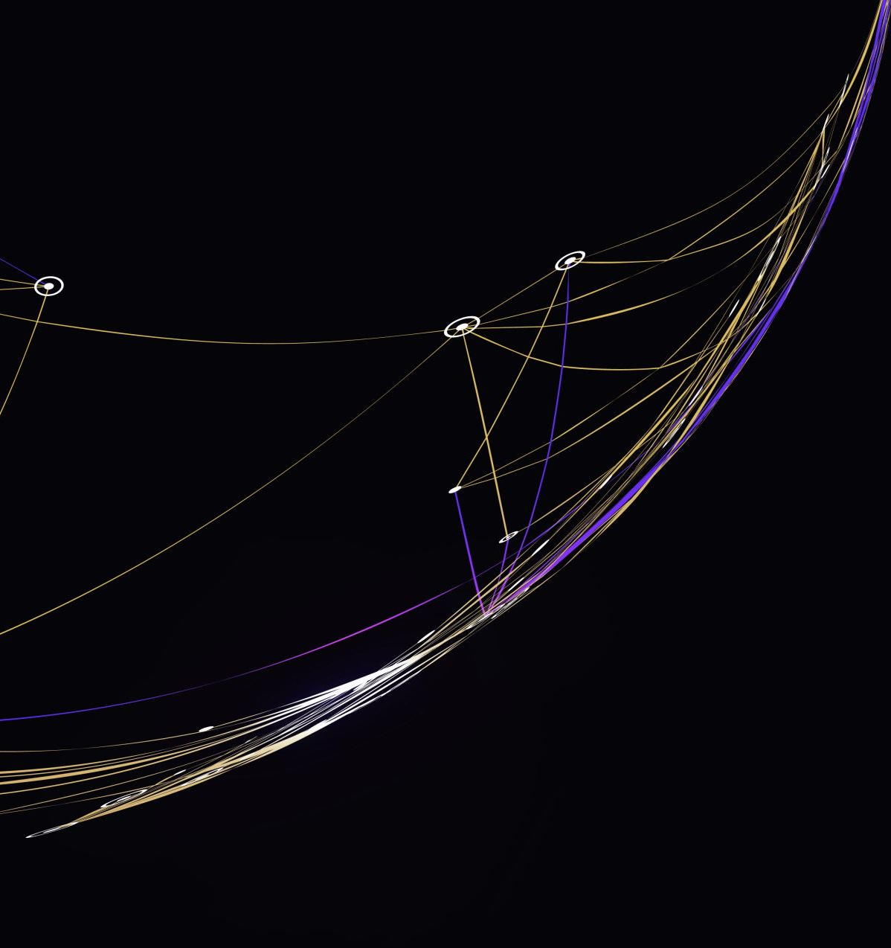
How it works?
The spatial resolution of radar data is directly related to the ratio of the sensor wavelength to the length of the sensor's antenna. Given the same wavelength a longer antenna will provide a higher resolution.
For example if we have an operating wavelength of about 5 cm (C-band radar), in order to get a spatial resolution of 10 m, we would need a radar antenna about 4,250 m long. Since that would be extremely impractical multiple acquisitions from a shorter antenna are combined to simulate the same result.

Slide 4
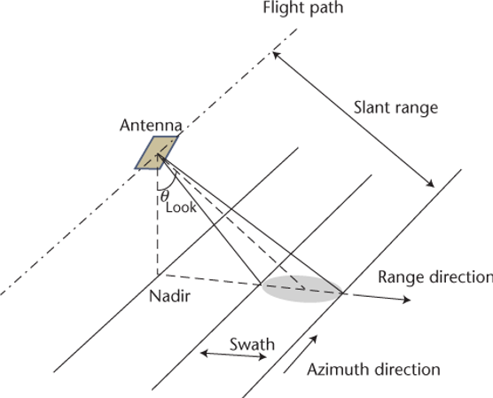
Why Sar?
A shorter antenna length corresponds to a wider beamwidth (beam footprint on the ground) and limits the spatial resolution in the azimuth. The development of advanced processing algorithms solved this problem, leading to a new generation of imaging radars called Synthetic Aperture Radar.
Synthetic Aperture Radar (SAR) To mitigate the poor azimuth resolution, the motion of the antenna along the azimuthal direction is utilized to “synthetize” the effect of a long antenna.

Slide 5
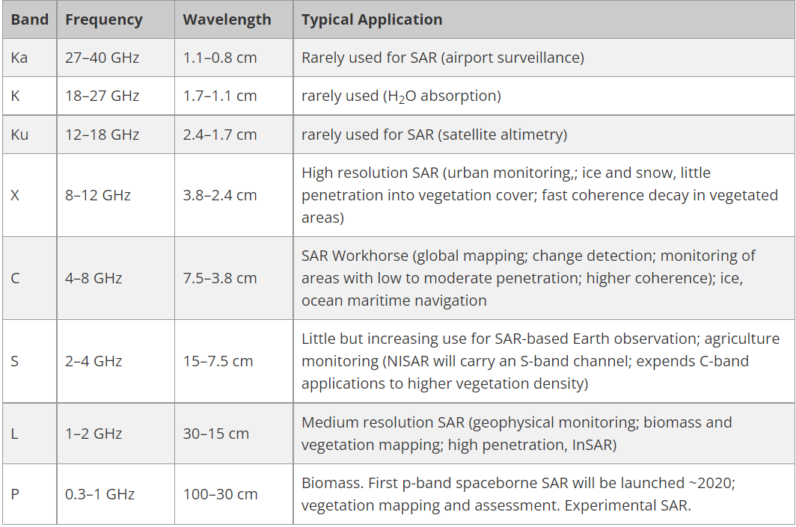
Frequency and Wavelength
Radar sensors utilize longer wavelengths at the centimeter to meter scale, which gives it special properties, such as the ability to see through clouds.

Slide 6
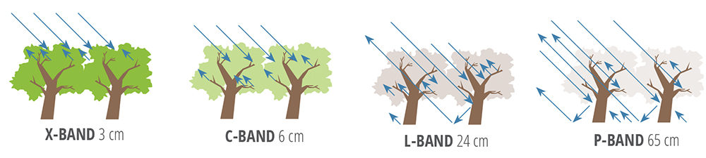
Wavelength is an important feature to consider when working with SAR, as it determines how the radar signal interacts with the surface and how far a signal can penetrate into a medium. For example, an X-band radar, which operates at a wavelength of about 3 cm, has very little capability to penetrate into broadleaf forest, and thus mostly interacts with leaves at the top of the tree canopy.
An L-band signal, on the other hand, has a longer wavelength of about 24 cm, achieving greater penetration into a forest and getting more interactions between the radar signal and large branches or tree trunks. Wavelength doesn't just impact the penetration depth into forests, but also into other land cover types such as soil and ice.

Slide 7

Polarization
Radar can collect signals in different polarizations, namely the orientation of the plane in which the transmitted electromagnetic wave oscillates. While the orientation can occur at any angle, SAR sensors typically transmit linearly polarized. The horizontal polarization is indicated by the letter H, and the vertical polarization is indicated by V.
Signal polarization can be precisely controlled on both transmit and receive

Slide 8
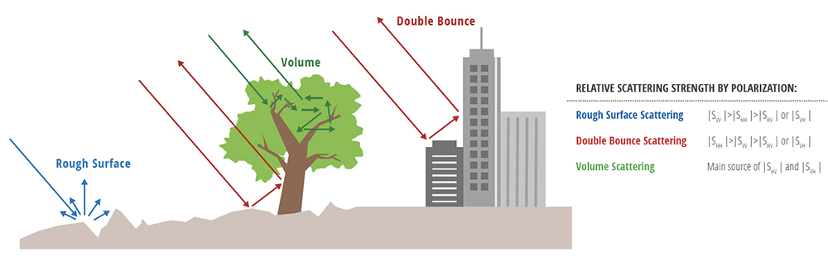
Rough surface scattering, such as that caused by bare soil or water, is most sensitive to VV scattering.
Volume scattering, for example, caused by the leaves and branches in a forest canopy, is most sensitive to cross-polarized data like VH or HV.
The last type of scattering, double bounce, is caused by buildings, tree trunks, or inundated vegetation and is most sensitive to an HH polarized signal.

Slide 9
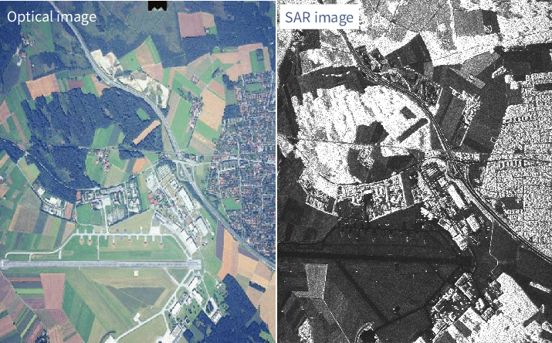
Optical vs Sar Images
While the images created by SAR can be rendered into a recognizable terrain map, there are important differences between optical imagery and SAR imagery.
SAR imagery is considered a non-literal imagery type because it does not look like an optical image which is generally intuitive to humans. These aspects must be understood for accurate image interpretation to be performed.

Slide 10
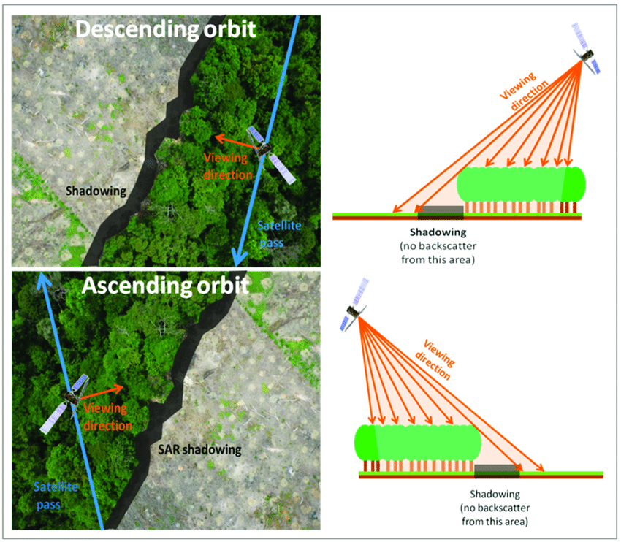
Shadowing
Often taking Satellite images can produce side effects as the shadowing.
On the shadowing areas we don’t have any information because there is no return signal.
To avoid this problem we can reduce the look angle or/and applying filter on the processing image step.

Slide 11
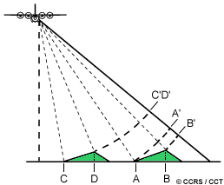
Foreshortening
When the radar beam reaches the base of a tall feature tilted towards the radar (e.g. a mountain) before it reaches the top foreshortening will occur. Since the radar measures distance in slant-range, the segment (A to B) will appear compressed and the length of the slope will be represented incorrectly (A' to B'). Depending on the angle of the surface in relation to the incidence angle of the radar beam, the impact of foreshortening will change.
The figure below shows a radar image of steep mountainous terrain with severe foreshortening effects. The foreshortened slopes appear as bright features on the image.

Slide 12
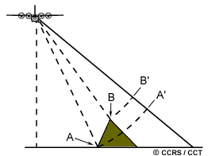
Layover
Layover is an extreme case of foreshortening, it occurs when the radar beam reaches the top of a tall feature (B) before it reaches the base (A). The return signal from the top of the feature will be received before the signal from the bottom. As a result, the top of the feature is displaced towards the radar from its true position on the ground, and "lays over" the base of the feature (B' to A'). Layover effects on a radar image look very similar to effects due to foreshortening. As with foreshortening, layover is most severe for small incidence angles, at the near range of a swath, and in mountainous terrain.

Slide 13
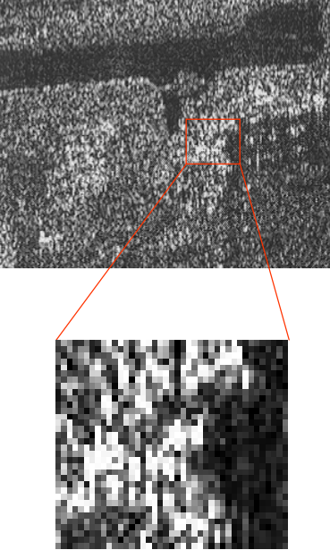
Speckle
Speckle is a “salt and pepper” variation in the pixel brightness that degrades the quality of the SAR images, making image interpretation more difficult.
Speckle occurs because there are often many individual scatters in a given pixel, which leads to positive (salt) and negative (pepper) interference across pixels with an otherwise constant backscatter return.

Slide 14
Sentinel-1
SENTINEL-1 constellation is an imaging radar mission providing continuous all-weather, day-and-night imagery at C-band with a centre frequency of 5.4 GHz.
SENTINEL-1 potentially images all global landmasses, coastal zones and shipping routes in European waters in high resolution and covers the global oceans at regular intervals. Having a primary operational mode over land and another over open ocean allows for a pre-programmed conflict-free operation. The main operational mode features a wide swath (250 km) with high geometric (typically 20 m Level-1 product resolution) and radiometric resolutions, suitable for most applications.

Slide 15
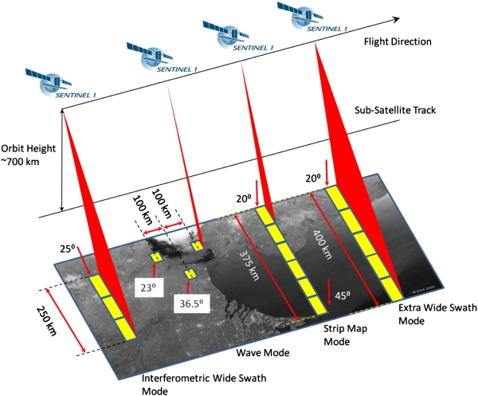
Acquisition Mode
The Sentinel-1 C-band SAR instruments supports operation in single polarisation (HH or VV) and dual polarisation (HH+HV or VV+VH), implemented through one transmit chain (switchable to H or V) and two parallel receive chains for H and V polarisation.

Slide 16
Acquisition mode
Stripmap (SM): A standard SAR stripmap imaging mode where the ground swath is illuminated with a continuous sequence of pulses, while the antenna beam is pointing to a fixed azimuth and elevation angle. Available in double or single polarisation.
Interferometric Wide swath (IW): Data is acquired in three swaths using the Terrain Observation with Progressive Scanning SAR (TOPSAR) imaging technique. In IW mode, bursts are synchronised from pass to pass to ensure the alignment of interferometric pairs. IW is SENTINEL-1's primary operational mode over land. Available in double or single polarisation.
Extra Wide swath (EW): Data is acquired in five swaths using the TOPSAR imaging technique. EW mode provides very large swath coverage at the expense of spatial resolution. Available in double or single polarisation.
Wave (WV): Data is acquired in small stripmap scenes called "vignettes", situated at regular intervals of 100 km along track. The vignettes are acquired by alternating, acquiring one vignette at a near range incidence angle while the next vignette is acquired at a far range incidence angle. WV is SENTINEL-1's operational mode over open ocean. Available only in single polarisation.

Slide 17
Processing Levels
Sentinel-1 data products acquired in SM, IW and EW mode are distributed at three levels of processing: Level-0, Level-1, Level-2.
The SAR Level-0 products consist of compressed and unfocused SAR raw data. Level-0 products are the basis from which all other high level products are produced.
Level-1 products can be one of two product types - either Single Look Complex (SLC) or Ground Range Detected (GRD). Level-2 Ocean (OCN) products can have different components available depending on the acquisition mode.

Slide 18
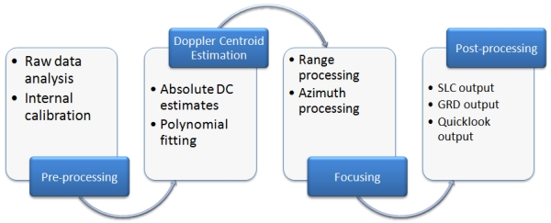
Level-1
Level-1 products are intended for most data users and are generally the most utilized
The Level-0 product (raw data) is transformed into a Level-1 product (SLC, GRD) by the Instrument Processing Facility (IPF) via the application of various algorithms.
Level-1 Single Look Complex (SLC) products consist of focused SAR data, geo-referenced using orbit and attitude data from the satellite, and provided in slant-range geometry.
Level-1 Ground Range Detected (GRD) products consist of focused SAR data that has been detected, multi-looked and projected to ground range using the Earth ellipsoid model WGS84.

Slide 19
Resolutions in a SLC product
Mode | Resolution | Pixel Spacing | Number of Looks | ENL (Equivalent Number of Looks)
SM | 1.7x4.3 m to 3.6x4.9 m | 1.5x3.6 m to 3.1x4.1 m | 1x1 | 1
IW | 2.7x22 m to 3.5x22 m | 2.3x14.1 m | 1x1 | 1
EW | 7.9x43 m to 15x43 m | 5.9x19.9 m | 1x1 | 1
WV | 2.0x4.8 m and 3.1x4.8 m | 1.7x4.1 m and 2.7x4.1 m | 1x1 | 1

Slide 20
Resolutions in a GRD product
A level-1 GRD product will be in 1 of 3 different spatial resolutions depending on which acquisition mode is used and how much precision is required.
Full Resolution (FR) is available only for StripMap mode, High Resolution (HR) for StripMap, Interferometric Wide and Extra Wide swath modes, while Medium Resolution (MR) is available for all modes.
Full Resolution table
Mode | Resolution | Pixel spacing | Number of looks | ENL
SM | 9x9 m | 3.5x3.5 m | 2x2 | 3.7

Slide 21
Resolutions in a GRD product
High Resolution table
Medium Resolution table
Mode | Resolution | Pixel spacing | Number of looks | ENL
SM | 23x23 m | 10x10 m | 6x6 | 29.7
IW | 20x22 m | 10x10 m | 5x1 | 4.4
EW | 50x50 m | 25x25 m | 3x1 | 2.7
Mode | Resolution | Pixel spacing | Number of looks | ENL
SM | 84x84 m | 40x40 m | 22x22 | 398.4
IW | 88x87 m | 40x40 m | 22x5 | 81.8
EW | 93x87 m | 40x40 m | 6x2 | 10.7
WV | 52x51 m | 25x25 m | 13x13 | 123.7

Slide 22

SNAP
SNAP is an earth observation data processing tool which allows for the analysis of satellite imagery data.
It was created by Copernicus ESA to allow for the processing, visualizing and transforming of data.
It is a powerful software package that Copernicus has given open and unlimited access to. Its original use was for the processing and analysis of Sentinel imagery but is also adapted to allow for other sensor data.

Slide 23
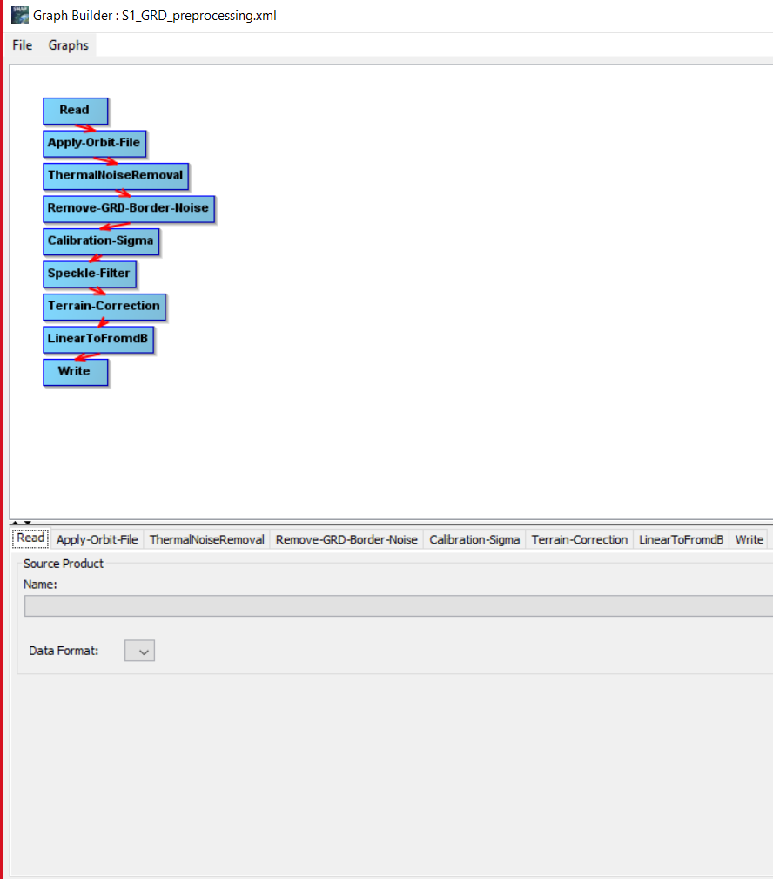
How it works?
Input:
Encrypted zip file(.SAFE) which contains the image to be processed.
Workflow, imported as a .xml if you already have one, or you can also create it from scratch with the internal graph builder.
Output:
Preprocessed satellite image
*On the left, an example of preprocessing presented as a graph, from Federico Filipponi.

Slide 24
Workflow & Blocks Here we’re going to talk in brief on some useful block previously used during the preprocessing.
Apply-Orbit-File: Orbit state vectors, contained within the metadata information of SAR products, are generally not accurate. This block allows to automatically download and update the vectors, providing accurate satellite position and velocity information.
ThermalNoiseRemoval: Sentinel-1 image intensity is disturbed by additive thermal noise, particularly in cross-polarization channel. The block’s action consists of subtracting, for each polarimetric channel, the estimated noise, in order to obtain the noise-free one.
Remove-GRD-Border-Noise: The Sentinel-1 GRD product has noise artefacts at the image borders, which are quite consistent at both left and right sides. Border noise removal algorithm, is designed in order to remove low intensity noise and invalid data on scene edges.

Slide 25
Workflow & Blocks
Calibration-Sigma: Calibration is the procedure that converts digital pixel values to radiometrically calibrated SAR backscatter (portion of radiometric onda that has come back). The information required to apply the calibration equation are included within the Sentinel-1 GRD product, specifically a calibration vector included as an annotation in the product
Speckle-Filter: Speckle, appearing in SAR images as granular noise, is due to the interference of waves reflected from many elementary scatterers. Speckle filtering is a procedure to increase image quality by reducing speckle.
Terrain-Correction: SAR data are generally sensed with a varying viewing angle greater than 0 degrees, resulting in images with some distortion related to side looking geometry. Terrain corrections are intended to compensate for these distortions so that the geometric representation of the image will be as close as possible to the real world.
LinearToFromdB: As last step of the preprocessing workflow, the unitless backscatter coefficient is converted to dB using a logarithmic transformation.

Slide 26
Credits
https://sentinels.copernicus.eu/web/sentinel/user-guides/sentinel-1-sar
SAR 101: An Introduction to Synthetic Aperture Radar - Capella Space
https://earth.esa.int/download/eoedu/Earthnet-website-material/to-access-from-Earthnet/2009_ROSA-ESA-DLR-Radar-Remote-Sensing-Course/SAR%20theory%20and%20apps%20-%20Reminder.pdf
https://sciforum.net/manuscripts/6201/manuscript.pdf
https://www.researchgate.net/figure/Optical-and-SAR-intensity-of-the-L-band-E-SAR-dataset_fig2_324266296

Slide 27
Thanks for your attention
Roberto Gnisci
Matteo Aicardi

