Slide 1

SAR
(Synthetic Aperture Radar)

Slide 2
What is Sar?
SAR is a type of active data collection where a sensor produces its own energy and then records the amount of that energy reflected back after interacting with Earth. While optical imagery is similar to interpreting a photograph, SAR imagery requires a different way of thinking in that the signal is based on surface characteristics like structure and moisture.

Slide 3
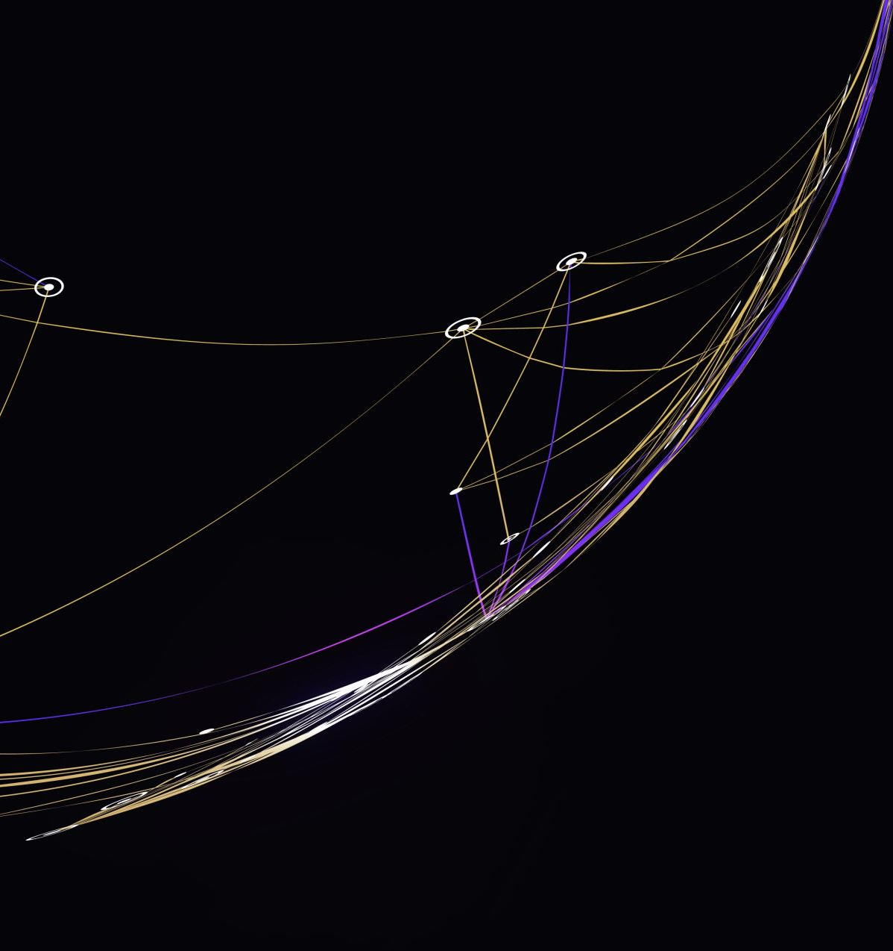
How it works?
The spatial resolution of radar data is directly related to the ratio of the sensor wavelength to the length of the sensor's antenna. For a given wavelength, the longer the antenna, the higher the spatial resolution. From a satellite in space operating at a wavelength of about 5 cm (C-band radar), in order to get a spatial resolution of 10 m, you would need a radar antenna about 4,250 m long. Since an antenna of that size is not practical for a satellite sensor in the space, short acquisitions from a shorter antenna are combined to simulate a much larger antenna, thus providing higher resolution data

Slide 4
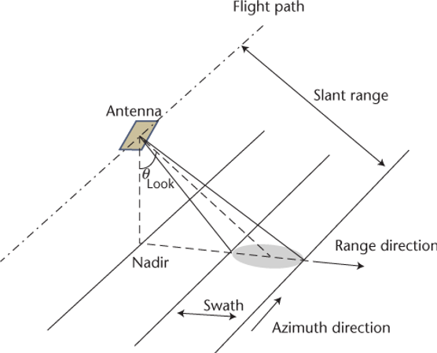
Why Sar?
A short antenna length corresponds to a wide beamwidth (beam footprint on the ground). Because flying an antenna large enough to generate a reasonable azimuth resolution, in space, is prohibitive, this limits the spatial resolution in the azimuth direction. The development of advanced processing algorithms solved this problem, leading to a new generation of imaging radars called Synthetic Aperture Radar.
Synthetic Aperture Radar (SAR) To mitigate the undesired effects of real aperture radar’s poor azimuth resolution, the motion of the antenna along the azimuthal direction is utilized to “synthetize” or give the effect of a long antenna.

Slide 5
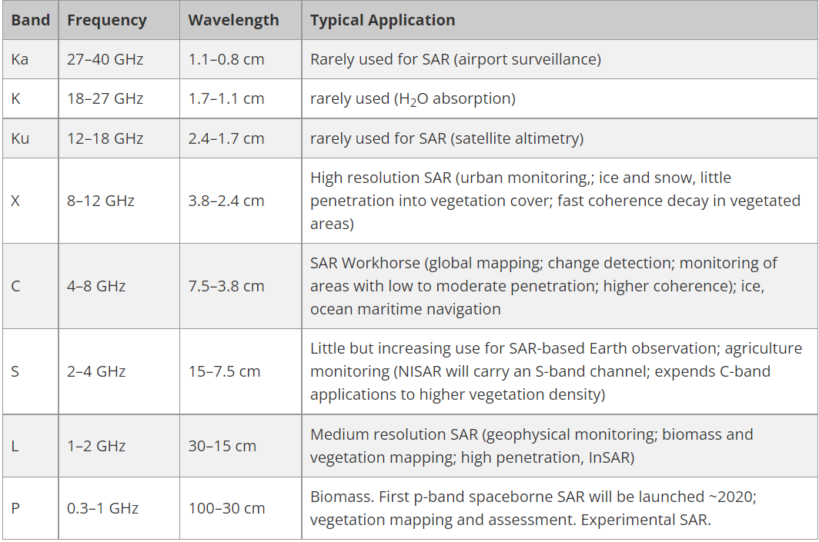
Frequency and Wavelength
Radar sensors utilize longer wavelengths at the centimeter to meter scale, which gives it special properties, such as the ability to see through clouds (view electromagnetic spectrum to the right). The different wavelengths of SAR are often referred to as bands, with letter designations such as X, C, L, and P.

Slide 6
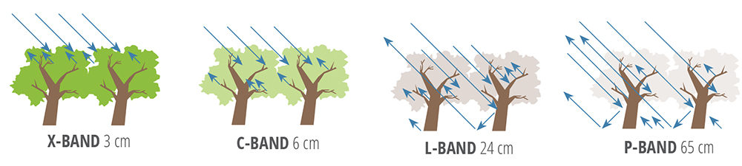
Wavelength is an important feature to consider when working with SAR, as it determines how the radar signal interacts with the surface and how far a signal can penetrate into a medium. For example, an X-band radar, which operates at a wavelength of about 3 cm, has very little capability to penetrate into broadleaf forest, and thus mostly interacts with leaves at the top of the tree canopy. An L-band signal, on the other hand, has a wavelength of about 23 cm, achieving greater penetration into a forest and allowing for more interaction between the radar signal and large branches and tree trunks. Wavelength doesn't just impact the penetration depth into forests, but also into other land cover types such as soil and ice.
C-band signal penetrates only into the top layers of the canopy of a forest, and therefore will experience mostly roughness scattering mixed with a limited amount of volume scattering. However a L-band or P-band signal will have much deeper penetration

Slide 7

Polarization
Radar can collect signals in different polarizations, it refers to the orientation of the plane in which the transmitted electromagnetic wave oscillates. While the orientation can occur at any angle, SAR sensors typically transmit linearly polarized. The horizontal polarization is indicated by the letter H, and the vertical polarization is indicated by V.
Signal polarization can be precisely controlled on both transmit and receive

Slide 8
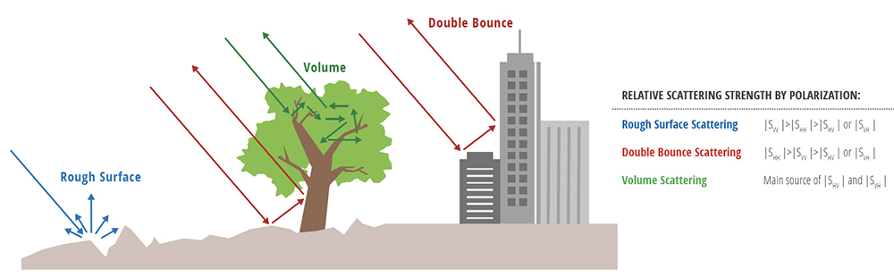
Rough surface scattering, such as that caused by bare soil or water, is most sensitive to VV scattering.
Volume scattering, for example, caused by the leaves and branches in a forest canopy, is most sensitive to cross-polarized data like VH or HV.
The last type of scattering, double bounce, is caused by buildings, tree trunks, or inundated vegetation and is most sensitive to an HH polarized signal.

Slide 9
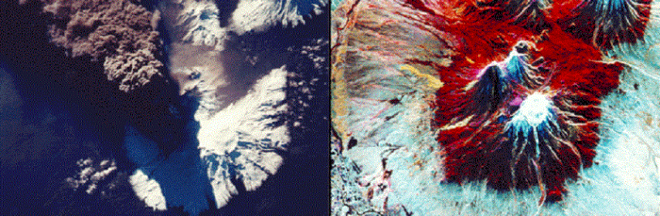
SAR Image
While the images created by SAR can be rendered into a recognizable terrain map, there are important differences between optical imagery and SAR imagery. SAR imagery is considered a non-literal imagery type because it does not look like an optical image which is generally intuitive to humans. These aspects must be understood for accurate image interpretation to be performed.

Slide 10
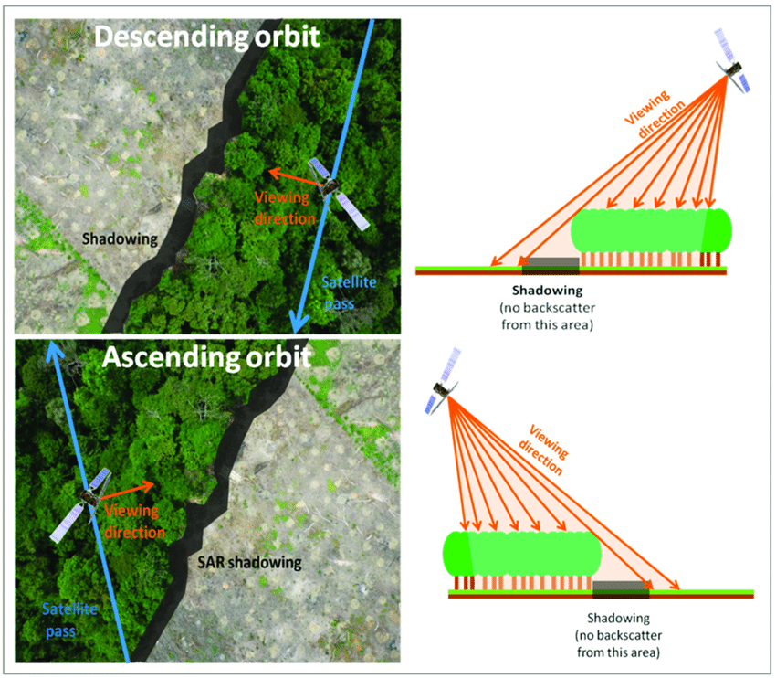
Shadowing
Often taking Satellite images can produce side effects as the shadowing.
On the shadowing areas we don’t have any information because there is no return signal.
To avoid this problem we can reduce the look angle or/and applying filter on the processing image step.

Slide 11
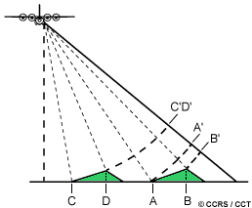
Foreshortening
When the radar beam reaches the base of a tall feature tilted towards the radar (e.g. a mountain) before it reaches the top foreshortening will occur. Again, because the radar measures distance in slant-range, the slope (A to B) will appear compressed and the length of the slope will be represented incorrectly (A' to B'). Depending on the angle of the hillside or mountain slope in relation to the incidence angle of the radar beam, the severity of foreshortening will vary. Maximum foreshortening occurs when the radar beam is perpendicular to the slope such that the slope, the base, and the top are imaged simultaneously (C to D). The length of the slope will be reduced to an effective length of zero in slant range (C'D'). The figure below shows a radar image of steep mountainous terrain with severe foreshortening effects. The foreshortened slopes appear as bright features on the image.

Slide 12
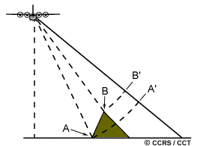
Layover
Layover is an extreme case of foreshortening, it occurs when the radar beam reaches the top of a tall feature (B) before it reaches the base (A). The return signal from the top of the feature will be received before the signal from the bottom. As a result, the top of the feature is displaced towards the radar from its true position on the ground, and "lays over" the base of the feature (B' to A'). Layover effects on a radar image look very similar to effects due to foreshortening. As with foreshortening, layover is most severe for small incidence angles, at the near range of a swath, and in mountainous terrain.

Slide 13
Sentinel-1
SENTINEL-1 constellation is an imaging radar mission providing continuous all-weather, day-and-night imagery at C-band with a centre frequency of 5.4 GHz.
SENTINEL-1 potentially images all global landmasses, coastal zones and shipping routes in European waters in high resolution and covers the global oceans at regular intervals. Having a primary operational mode over land and another over open ocean allows for a pre-programmed conflict-free operation. The main operational mode features a wide swath (250 km) with high geometric (typically 20 m Level-1 product resolution) and radiometric resolutions, suitable for most applications.

Slide 14
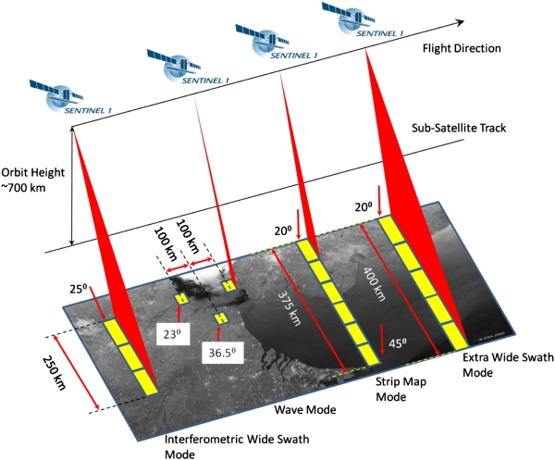
Acquisition Mode
The Sentinel-1 C-band SAR instruments supports operation in single polarisation (HH or VV) and dual polarisation (HH+HV or VV+VH), implemented through one transmit chain (switchable to H or V) and two parallel receive chains for H and V polarisation.
SM, IW and EW products are available in single (HH or VV) or dual polarisation (HH+HV or VV+VH). WV is single polarisation only (HH or VV)

Slide 15
Acquisition mode
Stripmap (SM): A standard SAR stripmap imaging mode where the ground swath is illuminated with a continuous sequence of pulses, while the antenna beam is pointing to a fixed azimuth and elevation angle.
Interferometric Wide swath (IW): Data is acquired in three swaths using the Terrain Observation with Progressive Scanning SAR (TOPSAR) imaging technique. In IW mode, bursts are synchronised from pass to pass to ensure the alignment of interferometric pairs. IW is SENTINEL-1's primary operational mode over land.
Extra Wide swath (EW): Data is acquired in five swaths using the TOPSAR imaging technique. EW mode provides very large swath coverage at the expense of spatial resolution.
Wave (WV): Data is acquired in small stripmap scenes called "vignettes", situated at regular intervals of 100 km along track. The vignettes are acquired by alternating, acquiring one vignette at a near range incidence angle while the next vignette is acquired at a far range incidence angle. WV is SENTINEL-1's operational mode over open ocean.

Slide 16
Processing Levels
Sentinel-1 data products acquired in SM, IW and EW mode which are generated by the PDGS operationally are distributed at three levels of processing: Level-0, Level-1, Level-2.
Level-1 products can be one of two product types - either Single Look Complex (SLC) or Ground Range Detected (GRD). Level-2 Ocean (OCN) products can have different components available depending on the acquisition mode.
The SAR Level-0 products consist of compressed and unfocused SAR raw data. Level-0 products are the basis from which all other high level products are produced.

Slide 17
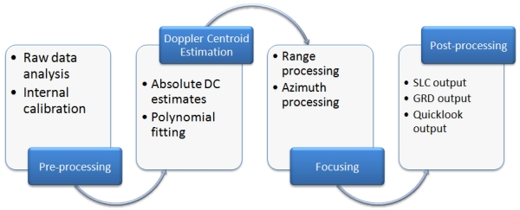
Level-1
We are now focusing on level 1, since these products are intended for most data users.
The Level-0 product (raw data) is transformed into a Level-1 product (SLC, GRD) by the Instrument Processing Facility (IPF) via the application of various algorithms.
Level-1 Single Look Complex (SLC) products consist of focused SAR data, geo-referenced using orbit and attitude data from the satellite, and provided in slant-range geometry.
Level-1 Ground Range Detected (GRD) products consist of focused SAR data that has been detected, multi-looked and projected to ground range using the Earth ellipsoid model WGS84.

Slide 18
SNAP

