Slide 1
SMART CITY ANALYSIS DASHBOARD
TEAM MEMBERS :
GNAANISHA N (23037377104220781)
GOPIKA SELVENTHIRAN(2303737710422082)
LAKSHANYA M (2303737710422092)
Department of Computer Science and Engineering
09/12/2025

Slide 2
ABSTRACT
The Smart City Analysis Dashboard is a Power BI–based solution used to visualize and analyze important city data for better management. It combines data from areas like traffic, energy, water supply, waste, healthcare, education, and public safety. The dashboard presents this data using charts, maps, and KPIs for easy understanding. Interactive filters help users explore data by location and time. The system helps government authorities monitor performance, identify problems, and take better decisions for building a smart, safe, and sustainable city.

Slide 3
EXCEL DATA SET EXPLANATION:
Structure of the Dataset
1. Traffic & Transportation Dataset-Date, City, State, Vehicle_Count, Traffic_Density, Average_Speed, Peak_Hour
2. Energy Usage Dataset-Date, City, State, Energy_Consumption, Renewable_Energy_Usage, Peak_Load
3. Water Management Dataset-Date, City, State, Water_Consumption, Water_Availability, Leakage_Percentage
4. Healthcare Dataset-Date, City, State, Patients_Visited, Bed_Occupancy_Rate, Emergency_Cases
5 Education Dataset-Date, City, State, Attendance_Rate, Digital_Learning_Usage, Performance_Index
6. Smart Infrastructure Dataset - Date, City, State, Smart_Lights_Functional, Waste_Collection_Efficiency, Maintenance_Issues

Slide 4
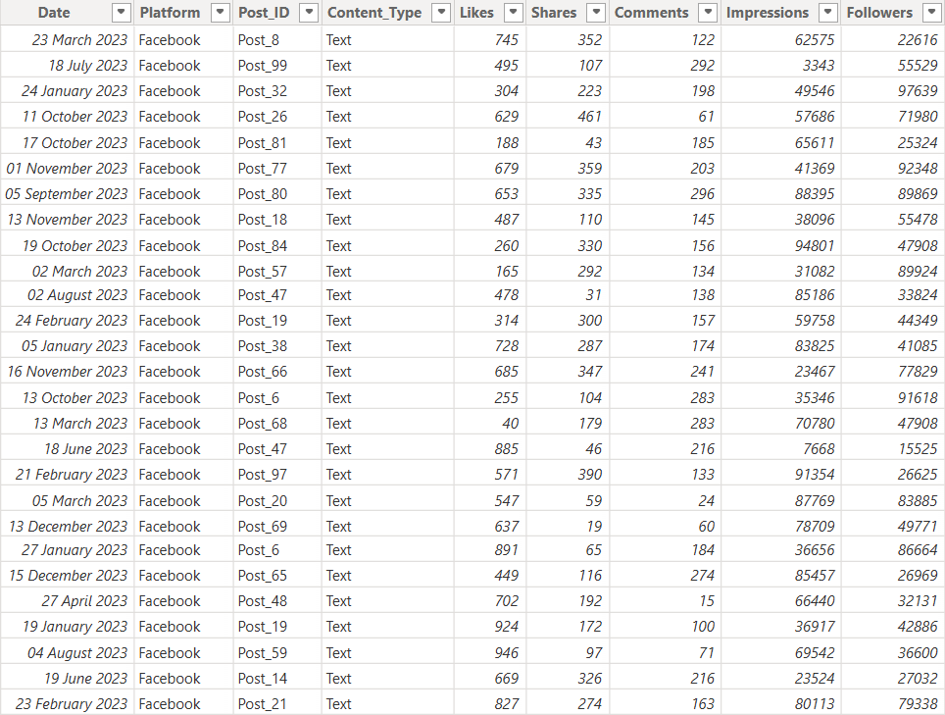
DATA SET

Slide 5
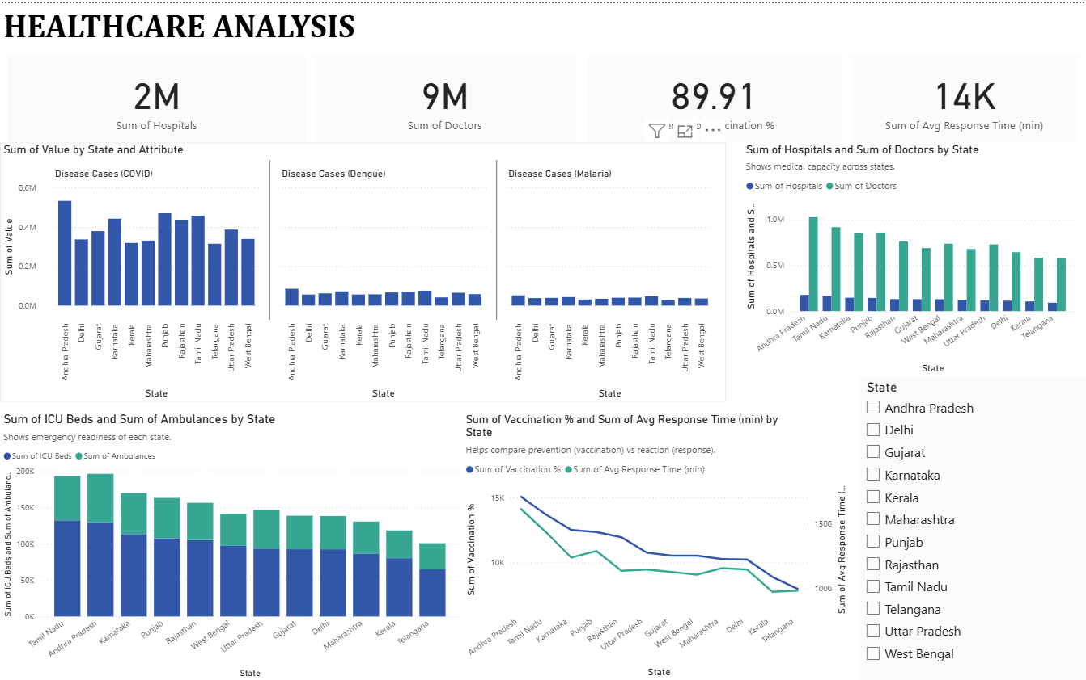
EXCEL DATA SET VISUALIZATION

Slide 6
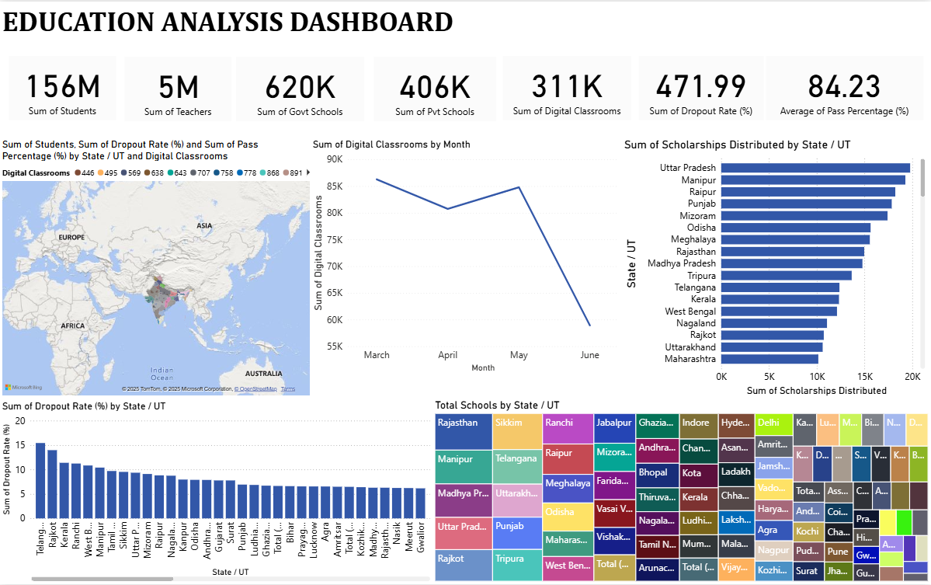

Slide 7
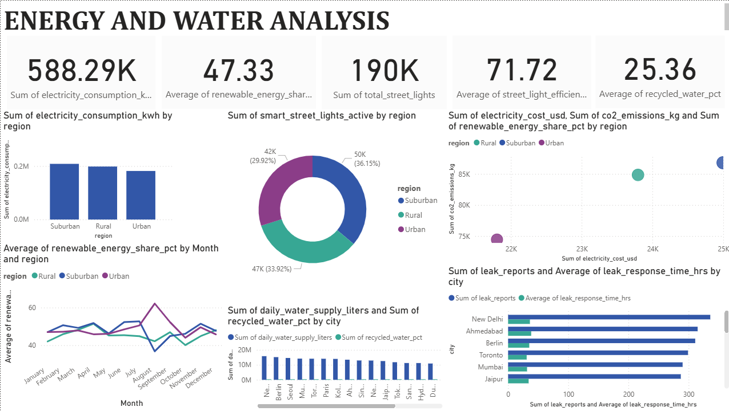

Slide 8
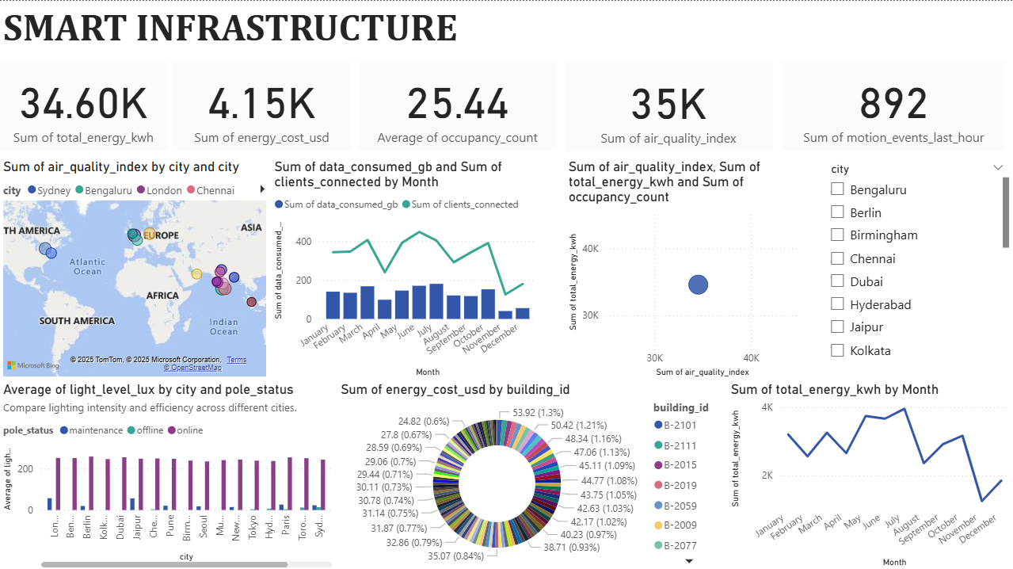

Slide 9
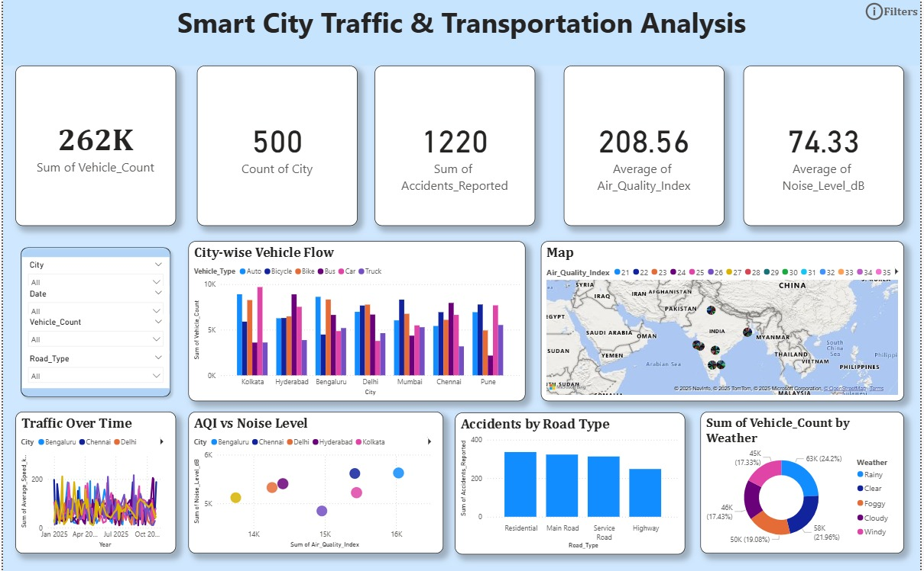

Slide 10
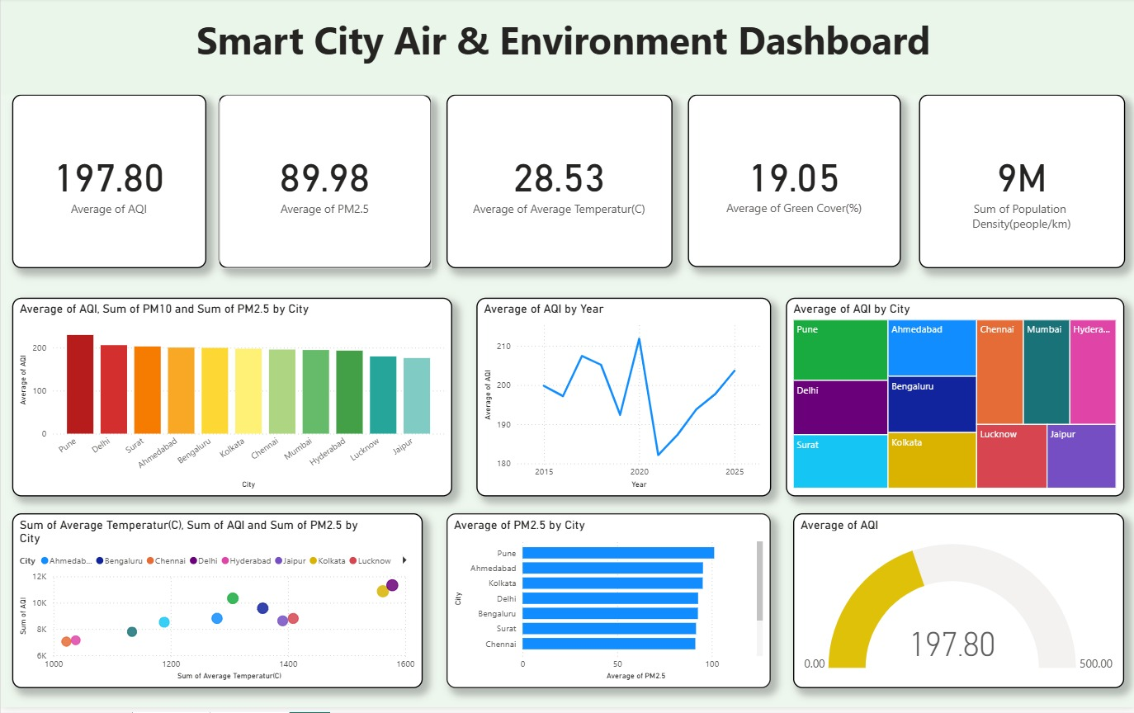

Slide 11
GITHUB DATA SET EXPLANATION:
The GitHub dataset is an open-source dataset downloaded from an online repository. It contains real-world healthcare and hospital waiting list–related data such as:
Patient Records – Source_Name, Archive_Date
Medical Department – Speciality_HIPE, Speciality_Name
Case Type – Day Case / Inpatient
Patient Category – Adult / Child
Age Profile – Age group of patients (e.g., 65+)
Waiting Time – Time_Bands (e.g., 12–15 Months)
Total Cases – Number of patients waiting
This dataset is already well-structured and clean, and it is used for reference and comparison with my Excel healthcare dataset in Power BI visualization.

Slide 12
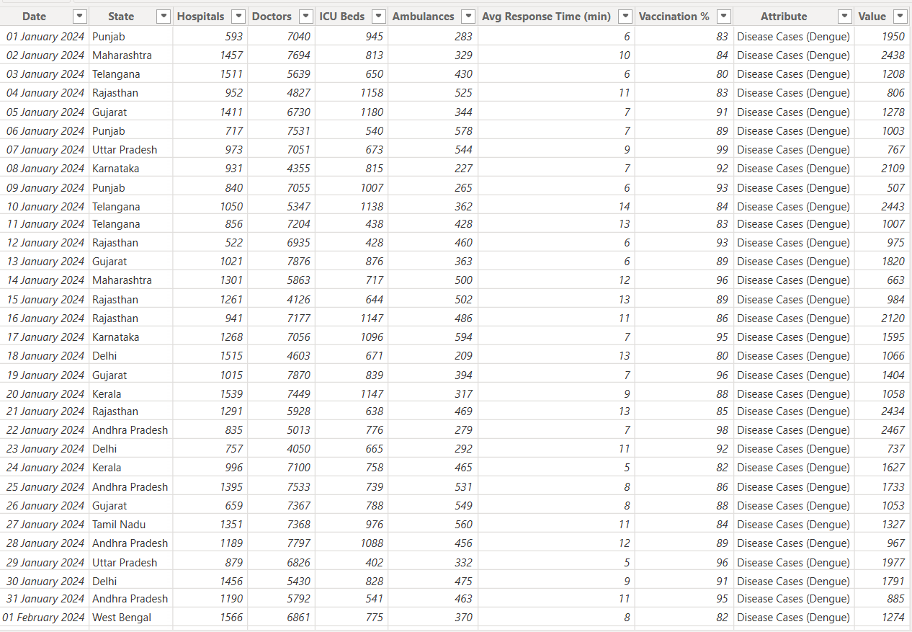
DATA SET

Slide 13
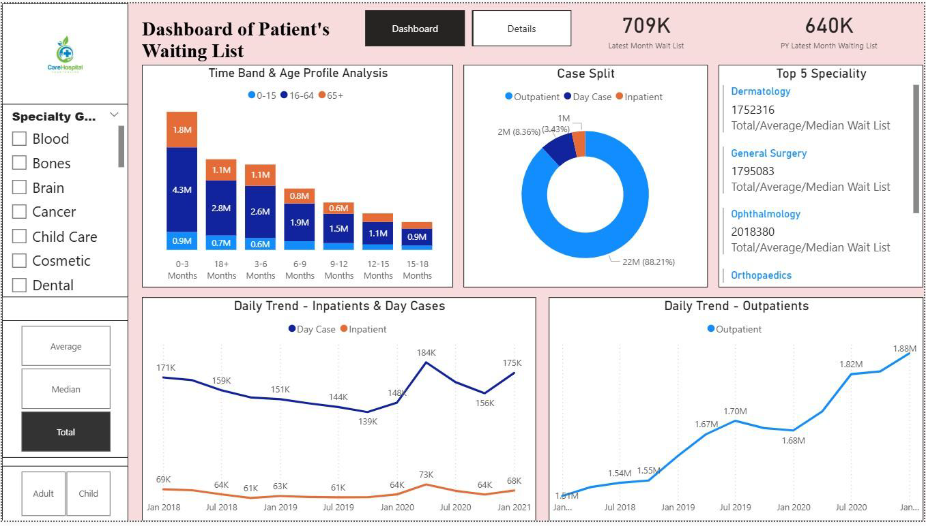
GITHUB DATA SET VISUALIZATION

Slide 14
COMPARISON
My Dataset | GitHub Dataset
Created manually | Downloaded from online source
Used for learning | Used as real reference data
Simple and clean | Large and complex
Limited size | Large size
Used for practice visuals | Used for realistic comparison
Both datasets are useful for Smart City analysis in different ways.

Slide 15
INTRODUCTION TO POWER BI
Microsoft Power BI is a business intelligence and data visualization tool used to turn raw data into interactive charts, reports, and dashboards.
Power BI supports:
Data import from multiple sources
Data cleaning using Power Query
Data modeling with relationships and DAX
Data visualization through charts and maps
Dashboard sharing for collaboration
It is widely used in government, business, healthcare, education, and smart city projects to monitor performance and make data-driven decisions.

Slide 16
HOW TO IMPORT EXCEL DATA INTO POWER BI
Steps to import Excel data into Power BI:
Open Power BI Desktop
Click on Get Data
Select Excel Workbook
Browse and select the Excel file
Click Load
Data will be imported into Power BI
After loading, the data is ready for visualization.

Slide 17


MATLAB CERTIFICATIONS

Slide 18

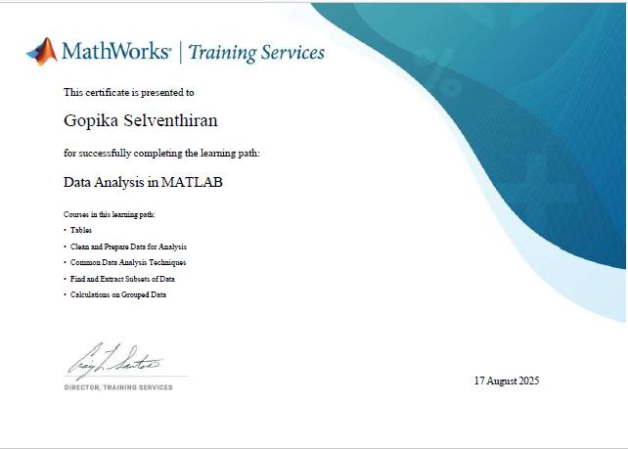
MATLAB CERTIFICATIONS

Slide 19

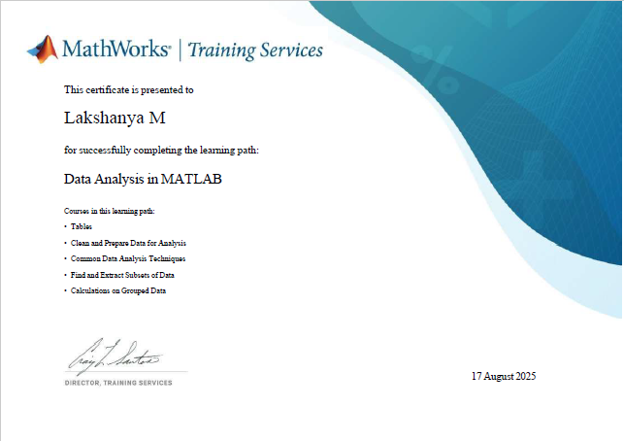
MATLAB CERTIFICATIONS

Slide 20
CONCLUSION
The smart city analysis demonstrates how tools like Microsoft Power BI help transform raw data into meaningful insights.
By visualizing trends in energy, water, traffic, healthcare, education, and infrastructure, decision-makers can better understand city performance and improve public services.
Power BI’s ability to clean, model, and visualize data makes it an essential tool for building smarter, more efficient, and future-ready cities.

Slide 21
Thank You !

