Slide 1
BANK CRM ANALYSIS
CAPSTONE PROJECT
BY
GNANA KISHORE NAIDU GAVIREDDI

Slide 2
Agenda
Problem statement
Data Description
Database Schema
Observations
Strategies to Decrease Churn Rate
Dashboard
Conclusion

Slide 3
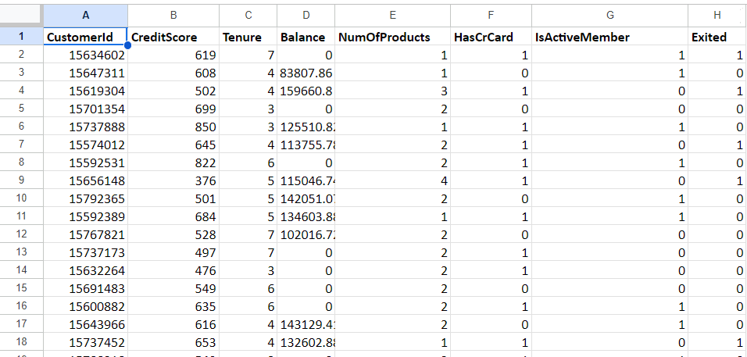
Problem Statement
You are an analytical CRM (Customer Relationship Management) specialist hired by a bank to extract meaningful insights from various customer-related datasets. The bank aims to reduce customer churn, improve service delivery, and enhance customer satisfaction. They have provided you with datasets including customer demographics, transaction details, customer exit information, and active customer profiles

Slide 4
Data Description
Row Number: The row number in the dataset, likely used for reference or indexing.
Customer Id: A unique identifier for each customer.
Credit Score: A numerical representation of the customer's creditworthiness.
Credit score:
Excellent: 800–850
Very Good: 740–799
Good: 670–739
Fair: 580–669
Poor: 300–579
Geography ID: A numerical identifier that likely corresponds to a geographical location, such as a country or region.
Gender ID: A numerical identifier for the customer's gender, where for example, '1' could represent male and '2' could represent female.

Slide 5
Age: The age of the customer.
Tenure: The number of years the customer has been with the bank.
Balance: Current balance in the customer's account.
Num Of Products: refers to the number of products that a customer has purchased through the bank.
Has Cr Card: denotes whether or not a customer has a credit card. This column is also relevant, since people with a credit card are less likely to leave the bank.
1 represents credit card holder
0 represents non credit card holder
Is Active Member: active customers are less likely to leave the bank (as per the criteria defined by the bank for identifying the activeness).
1 represents Active Member
0 represents Inactive Member
Estimated Salary: as with balance, people with lower salaries are more likely to leave the bank compared to those with higher salaries.
Exited: whether or not the customer left the bank.
0 represents Retain
1 represents Exit
Bank DOJ: date when the Customer associated/joined with the bank.

Slide 6
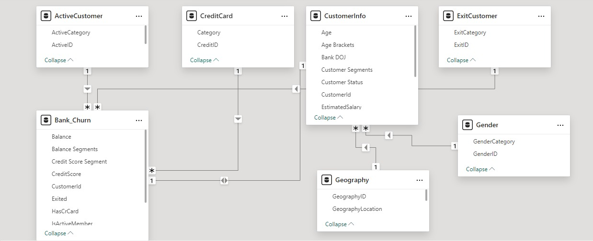
Database Schema

Slide 7
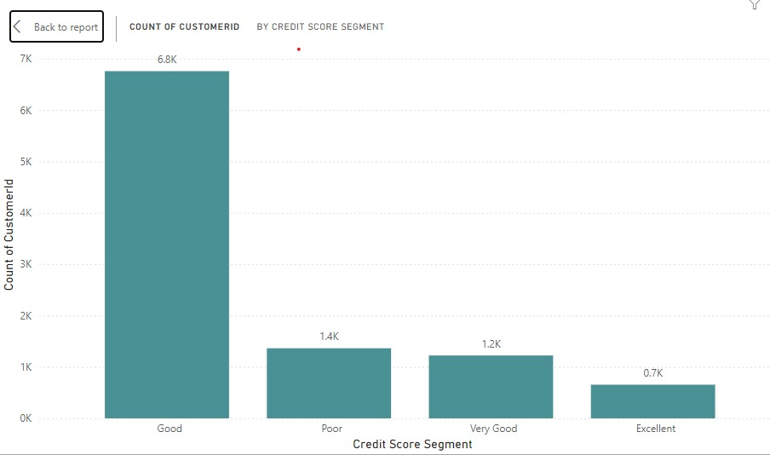
Observations
Out of all 10k Customers 6.8k customers fall in the Good and 1.4k customers are in the Poor credit score categories.
These customers could be a potential risk for the banks.
Analysis:
The customers with low credit scores are most likely to default on loans or miss on payments.

Slide 8
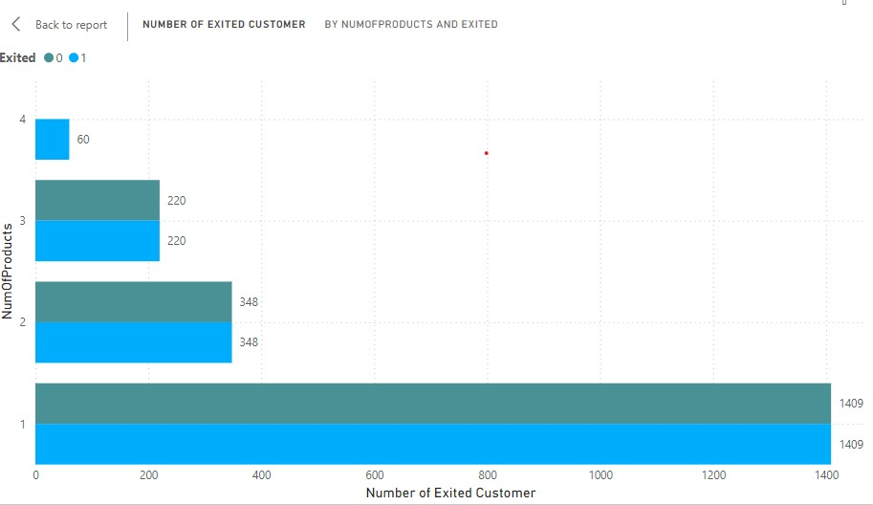
Observations
Customers using 1 product have highest churn count (1409).
Churn count decreases as the number of products used increases.
Analysis:
Customers using multiple products are more loyal, indicating a need to encourage product diversification.

Slide 9
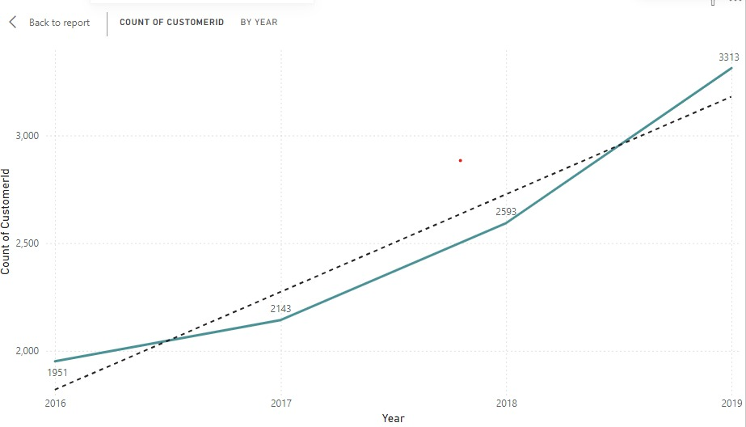
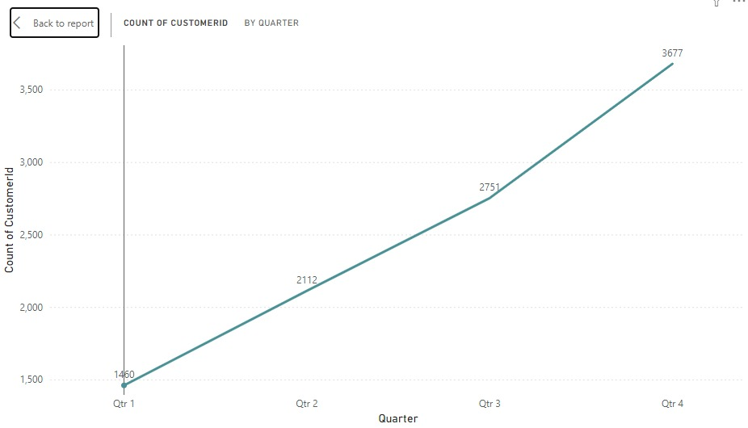
Observations
Customers joining the bank are increasing steadily over the year.
Lowest number of customers join the bank in Quarter 1 and the most customers join the bank in Quarter 4.
Analysis:
Target the Quarters with less joining and implement strategies to increase stability.

Slide 10
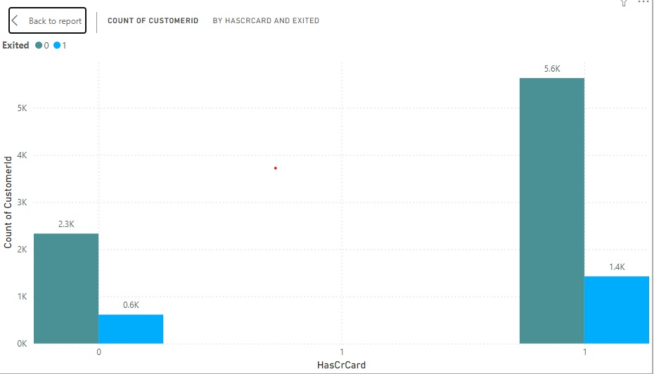
Observations
1.4k credit card customers have churned and 0.6k non credit card holders have churned.
Analysis:
Credit card Ownership significantly impact's customer retention rate.

Slide 11
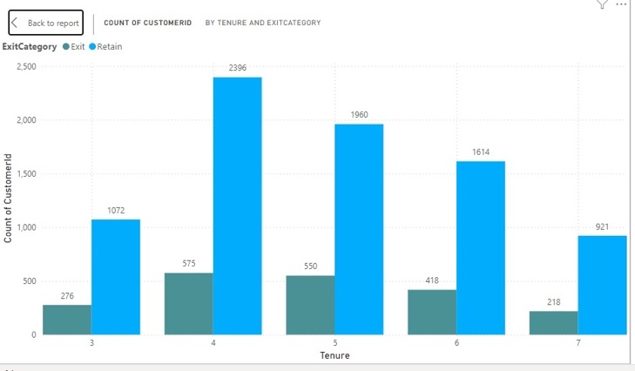
Observations
Customers with more than 4 years of tenure have retained more in the bank.
Analysis:
To decrease the churn rate we need to implement schemes to increase tenure of customers.

Slide 12
Strategies to Decrease Churn Rate
Offer Incentives on multiple product combos to attract single product customers.
Create new schemes for the customers to increase Tenure.
Improve customer engagement and enhance customer service.
Improve the products by taking feedback from the customers.
To increase profitability and decrease loan defaulters provide loans to the customers who have high credit score only.
Incentivize the customers who join the bank in Quarter 1 to increase customer base in the quarter.

Slide 13
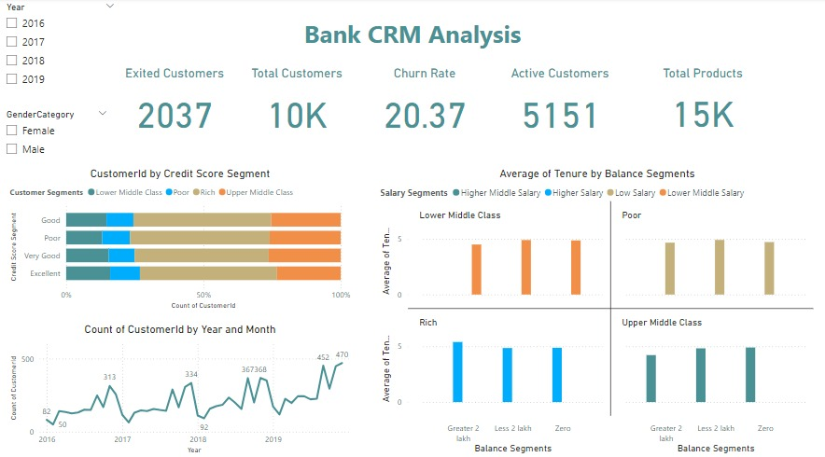
Dashboard

Slide 14
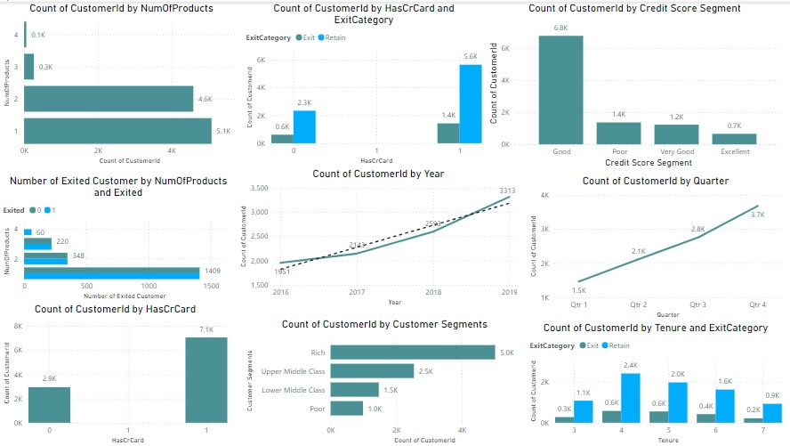
Dashboard

Slide 15
Conclusion
Customers with lower credit scores and those using fewer products are churning the most.
Bank has experienced a consistent churn rate over the years, despite a steady increase in customer acquisition.
Focus on customer engagement, feedback system, service enhancement for the customers who are likely to churn to improve the customer retention and which will enhance customer loyalty.
Provide combo offers on multiple products in the bank to increase higher usage of products by customers which decreases churn rate.

Slide 16
Thank You

