Slide 1
CHINOOK MUSIC DATASET ANALYSIS
BY
GNANA KISHORE NAIDU GAVIREDDI

Slide 2
Table of contents
Problem Statement
Overview of Data
Database Schema
Observations
Strategies to Boost Music Store Profitability
Conclusion

Slide 3
Problem Statement
You are hired as a data analyst at Chinook, and your objective is to analyze music record sales data to gain insights and make recommendations for the company's strategy in the physical music market.

Slide 4
Overview of Data
Total number of Distinct Customers are 59.
Total number of Distinct Artists are 275.
Total number of Distinct Albums are 347.
Total genres are 25.
Total employees are 8.

Slide 5
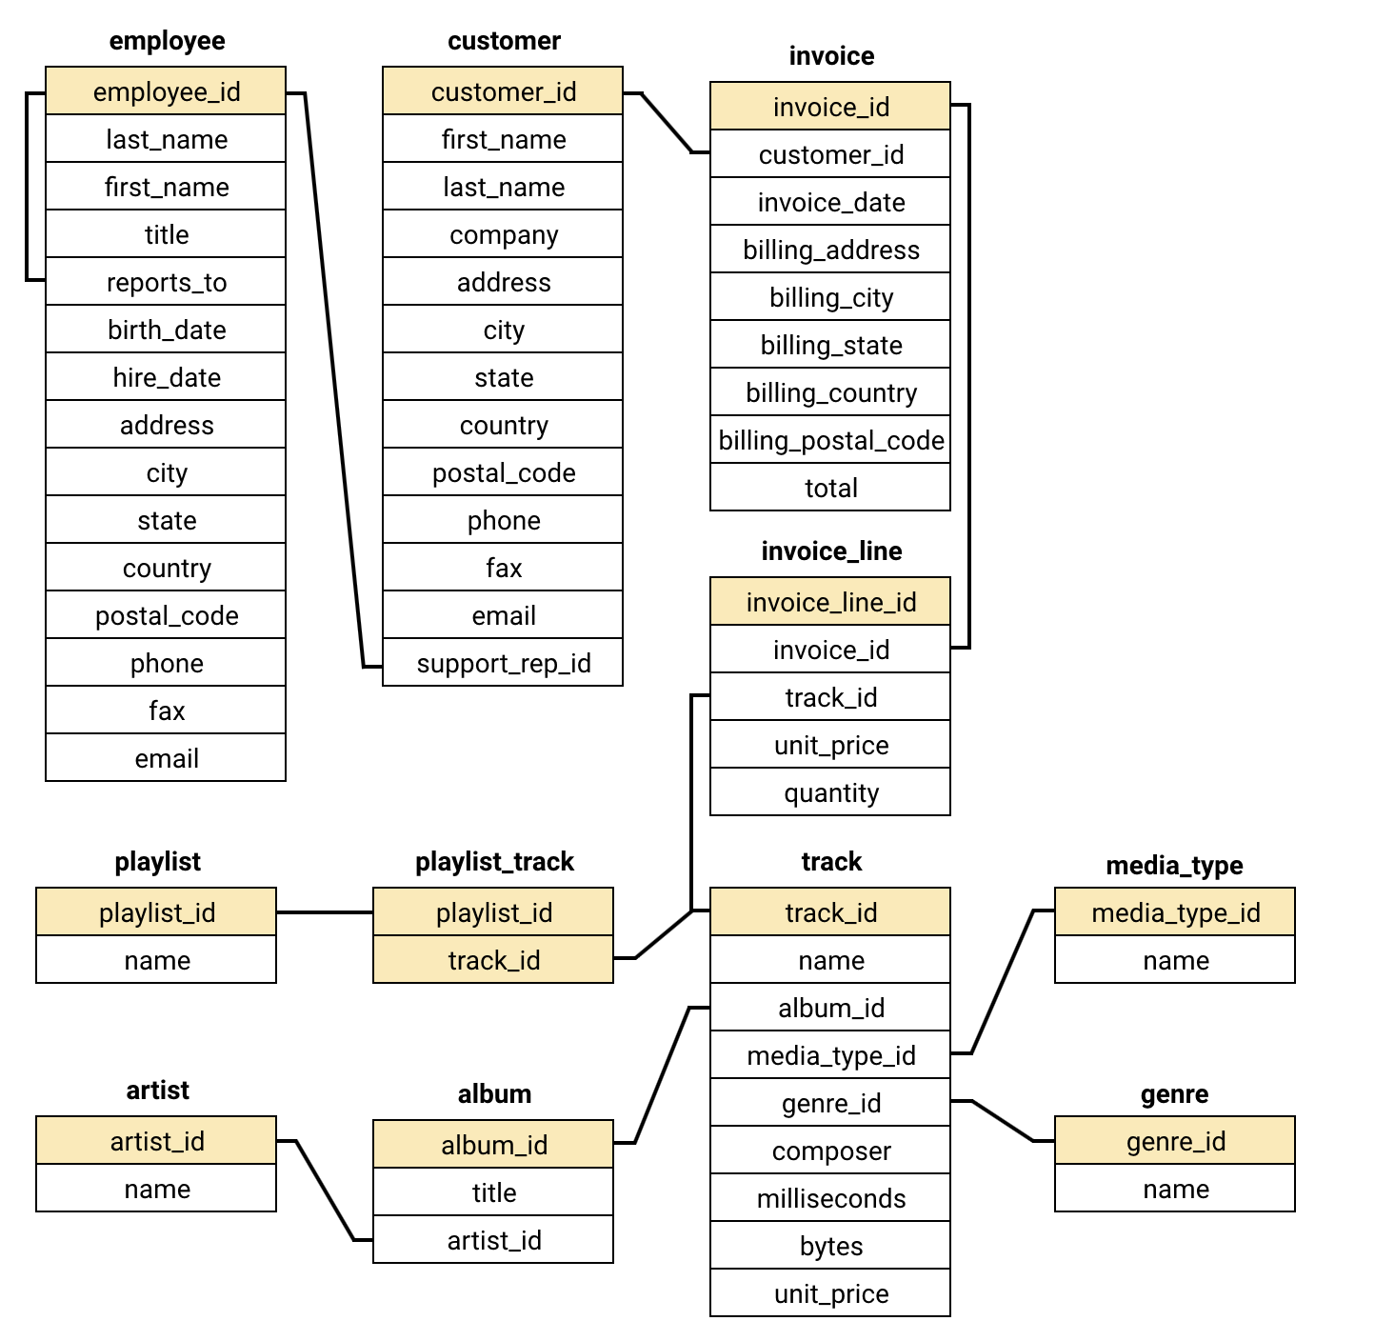
Database Schema

Slide 6
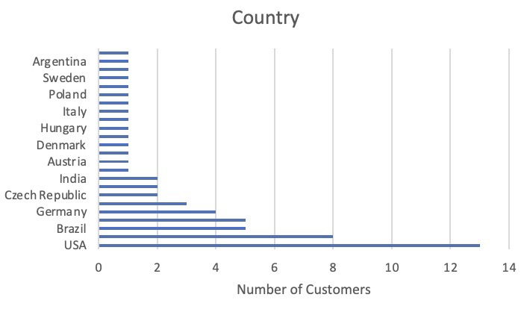
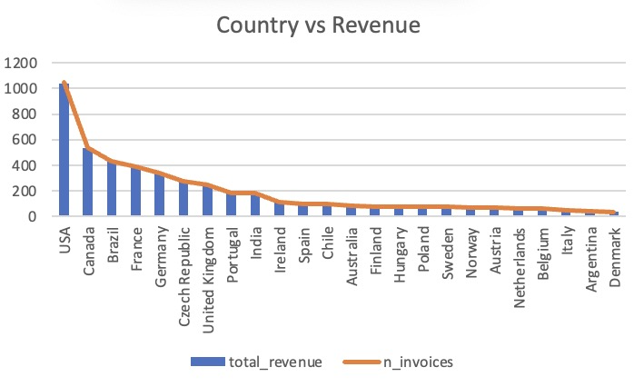
Observations
USA is the country where most of the customers are located followed by Brazil.
USA generates the highest revenue followed by Canada and Brazil.

Slide 7
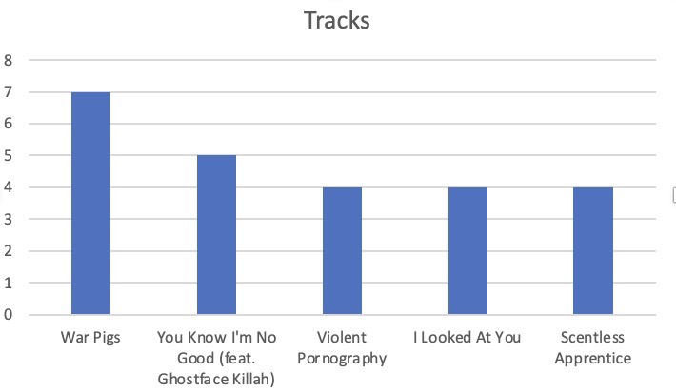
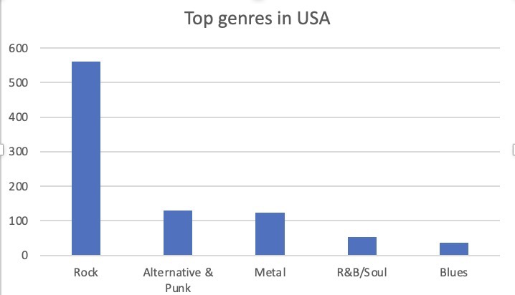
Observations
War Pigs is the most famous Track in USA.
Rock is the most popular genre in USA followed by Alternative & Punk and Metal.

Slide 8
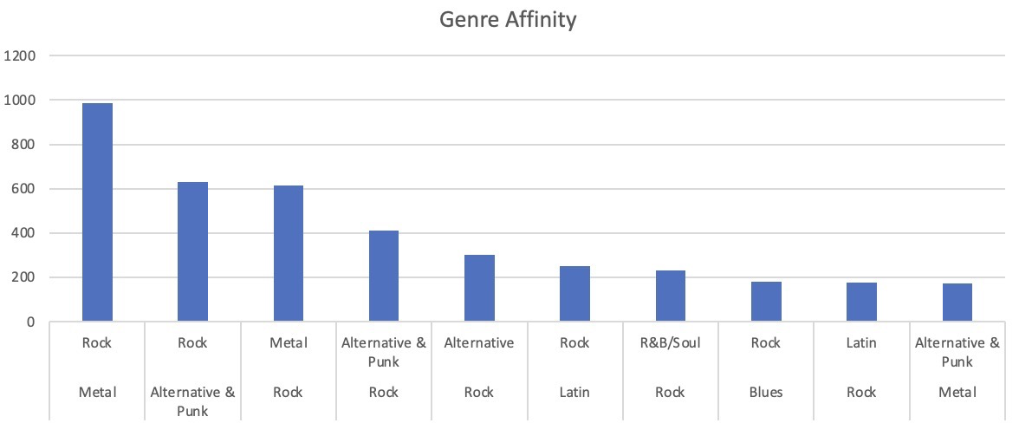
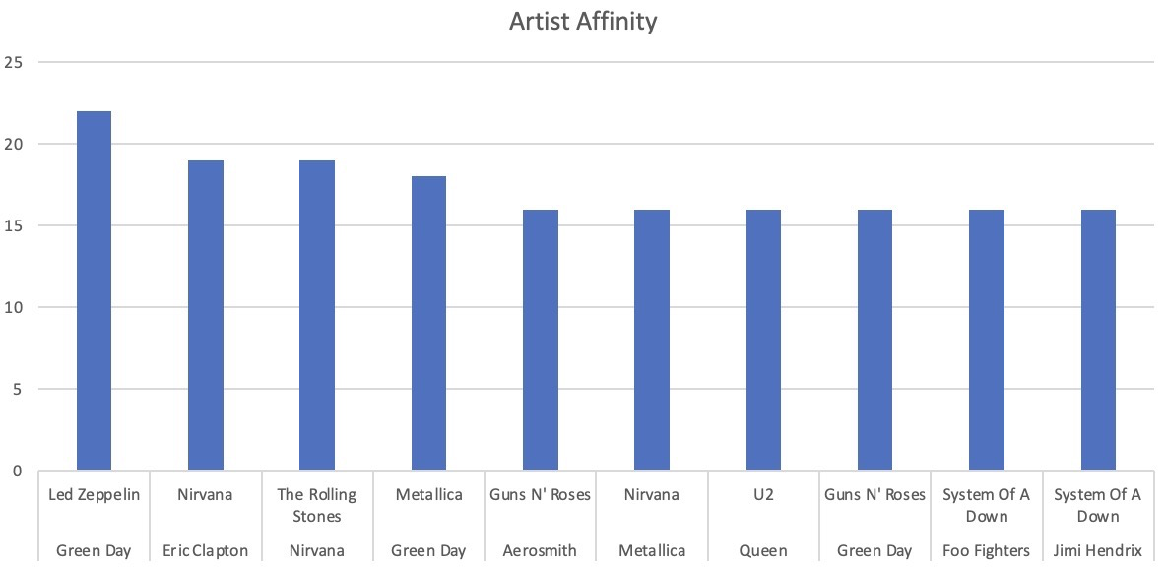
Observations
Rock and Metal are the genres which are sold together the most.
Led Zeppelin and Green Day are the artist are sold together the highest.

Slide 9
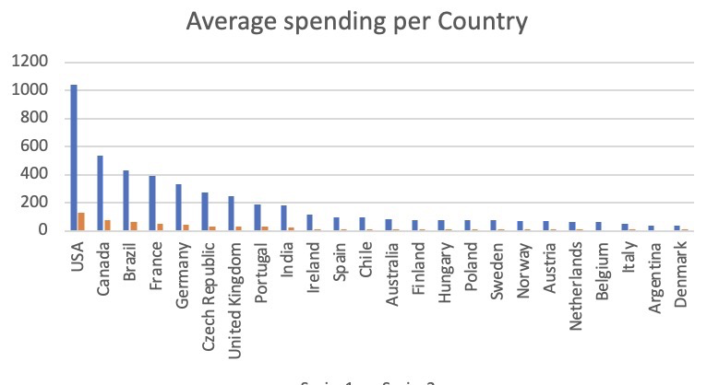
Observations
USA, Canada and Brazil are the top 3 countries with the highest average spending
customer base.

Slide 10
Strategies to Boost Music Store Profitability
Genres, Tracks and Artists with the highest affinity should be promoted together by running combo offers and selling them together as pairs
Feedback must be taken from the countries with the low valued customers to convert them to high valued customers and increase the userbase.
Subscription method can be initiated and additional benefits could be provided to the customers with a subscription which would in turn increase the revenue of the store.
Provide sponsorships for concerts of the artists to perform together to get more reach to the brand and increase brand value.

Slide 11
Conclusion
Top artist is Van Halen and the country with the highest customer base is USA.
Long-term customers exhibit higher purchase frequency and spending, indicating strong loyalty.
Rock music dominates globally, with exceptions like Brazil showing a preference for Alternative & Punk and Metal.
Genres, Tracks and Artists with the highest affinity should be promoted together by running combo offers and selling them together as pairs
Feedback must be taken from the countries with the low valued customers to convert them to high valued customers and increase the userbase.

Slide 12
Thank You

