Slide 1

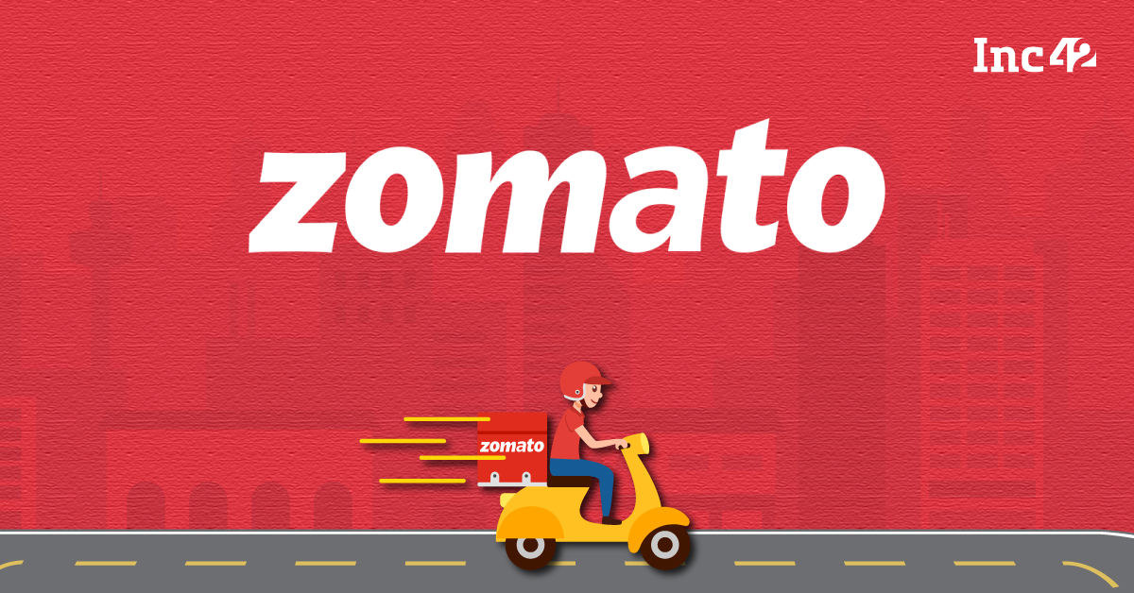
BY
GNANA KISHORE NAIDU GAVIREDDI

Slide 2
About Zomato
Zomato is a food service industry that assists people in locating, ordering, and dining in at restaurants.
The objectives of this project are to:
Analyze existing data on the food industry.
Draw insights to understand current trends and sentiments in the food industry.
Identify trends and opportunities for investment and the potential for opening new restaurants.

Slide 3
Overview of Data
TOTAL RESTAURANTS
TOTAL COUNTRIES
9551
15
TOTAL CUISINES
TOTAL CITIES
1825
141
Project aims to open newer restaurants with lesser competition based on the data given.

Slide 4
Methodology
Data Cleaning
- Raw source data was cleaned for accurate analysis and to minimize errors using Excel functions like VLOOKUP, DATE, and STRING FUNCTIONS.
Data Analysis
- Cleaned data was analyzed in both objective and subjective manners using various aggregation functions and logic to derive insights and suggestions based on the data.
Deriving Insights
- Based on the analysis, insights and conclusions were obtained for further business workup.
Further Suggestions and Operations
- Suggestions regarding further actions and advice were made for the successful establishment of the business.

Slide 5
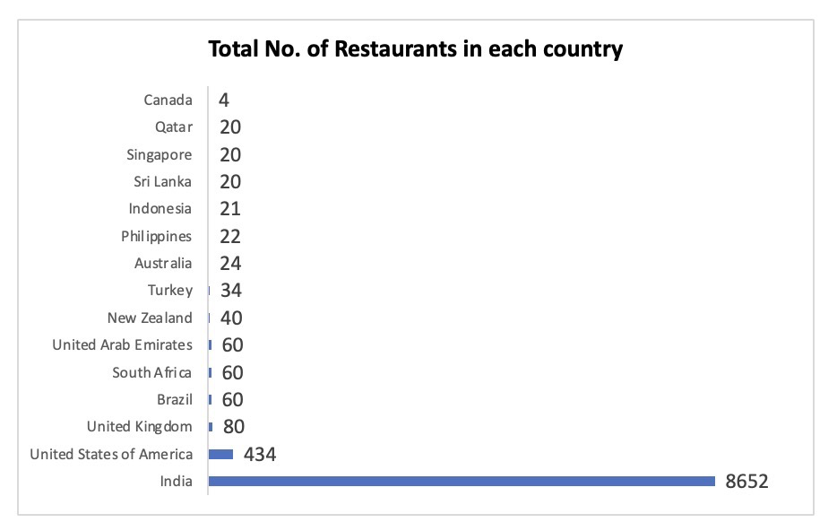
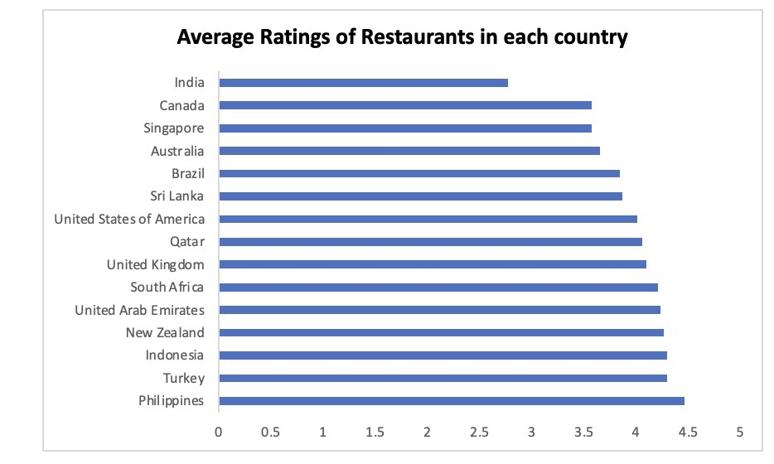
Observations
Lowest number of restaurants are present in Canada,
Australia, Brazil, Singapore, Sri Lanka, Qatar, NZ, Ph.
Average of Lowest rated restaurants are present in Canada, Australia, Brazil, Singapore, Sri Lanka, India.

Slide 6
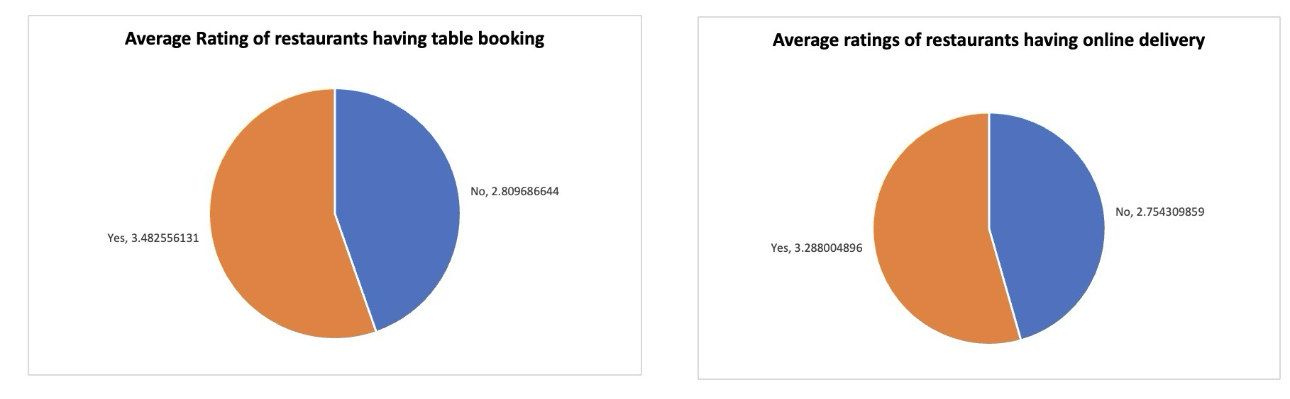
Observations
By comparing the Restaurants which have table booking, online delivery and the ones which doesn’t provide them
We can conclude that having Table booking, Online delivery helps to achieve better Rating.

Slide 7
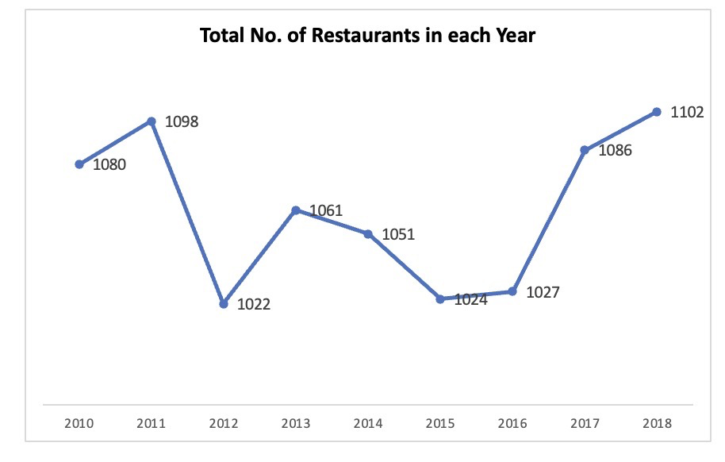
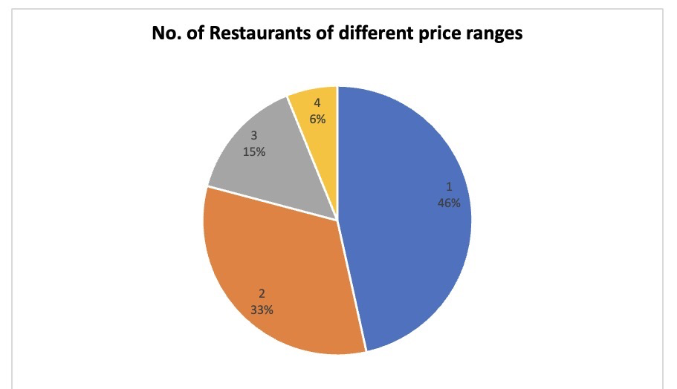
Observations
Lowest number of Restaurants are opened in the year 2012.
Highest number of Restaurants are opened in the year 2018.
Distribution of Restaurants based on Price range

Slide 8
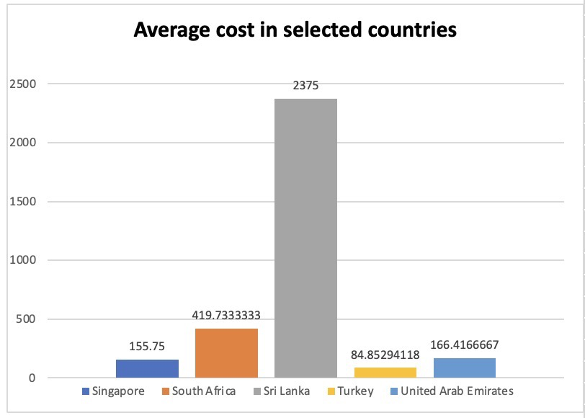
Key Findings
Average Cost in selected countries
The following states have been selected based
on the lowest ratings within each country:
Australia: Montville, Paynesville, Mayfield, Balingup, Penola
Brazil: Brazilia
Canada: Consort, Yorkton
Singapore: Singapore City
Sri Lanka: Colombo City

Slide 9
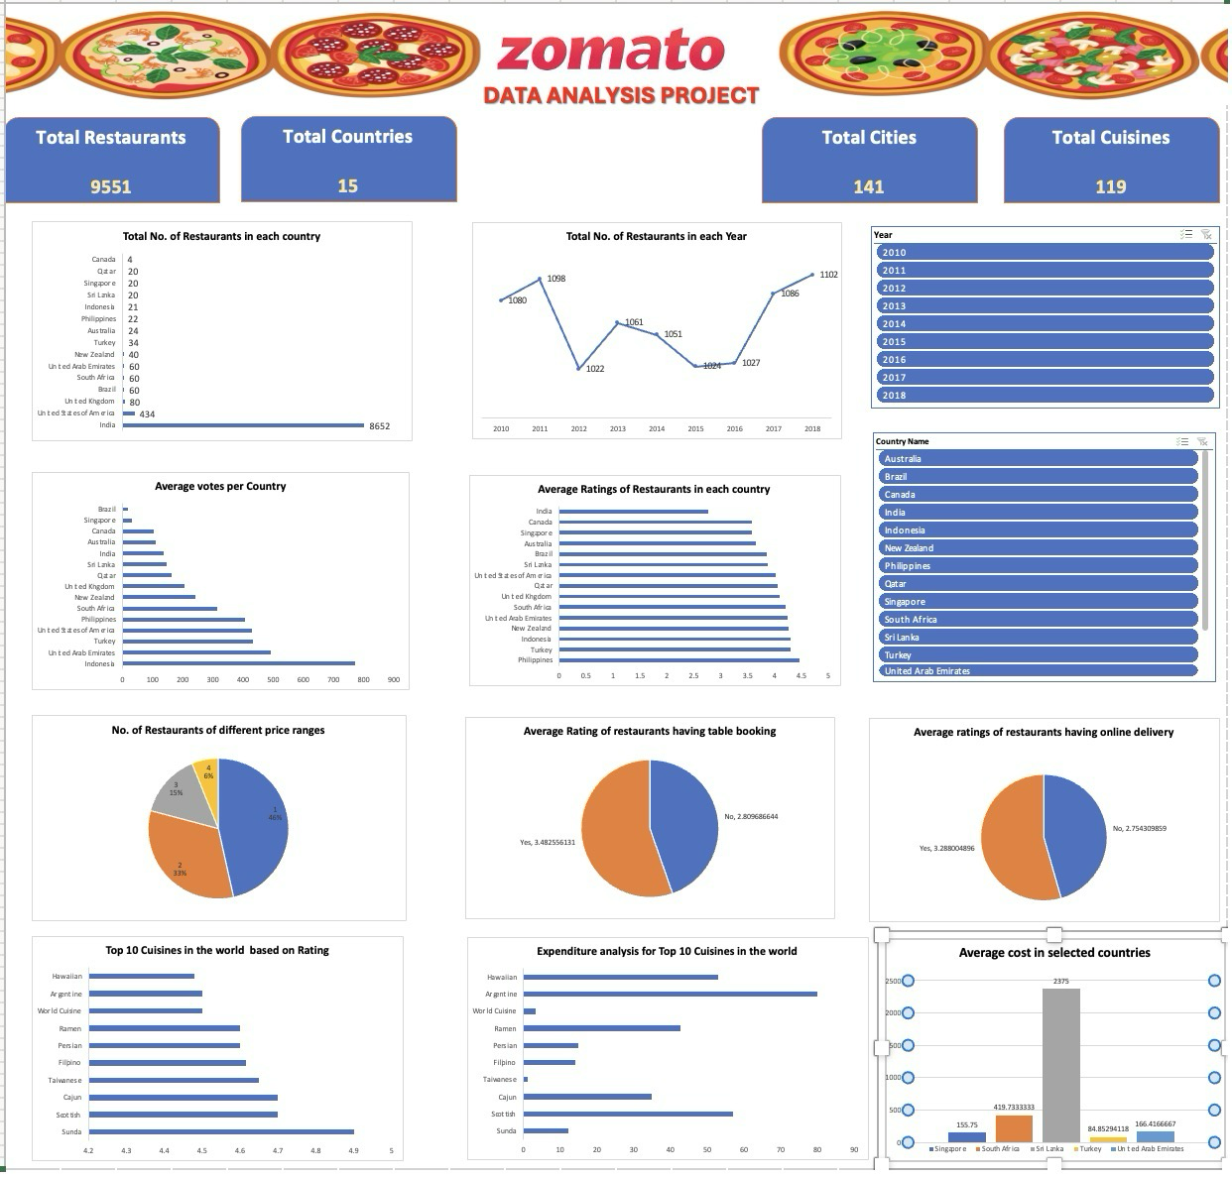
DASHBOARD AND VISUALIZATION

Slide 10
Strategy
Ratings indicate service gaps that existing restaurants fail to address, making it essential to identify these gaps.
- Services/factors identified in these gaps can be addressed through:
- **Pre-planning in hotel management**: Ensuring efficient and effective operations.
- **Advanced food production techniques**: Providing high-quality meals at minimal costs.
- This approach will attract customers by offering improved services within the same price range, capitalizing on business volume and leading to profitability.
- Additionally, logistical support and modern services like online booking, online presence, and delivery must be implemented to achieve higher ratings, increase restaurant popularity, and enhance profitability.

Slide 11
Conclusion
Countries to invest.
AUSTRALIA,CANADA, SRI LANKA, BRAZIL & SINGAPORE.
Based on existing counts and ratings.
Avail Modern
Technology
Provide both online delivery and table bookings to improve rating.
Services like take away, on time delivery helps in increasing restaurants reputation.

Slide 12
THANK YOU

