Slide 1

Web Automation And Business Intelligence
Done At
SHRUTI BHADORIYA
141100007

Slide 2
Project Overview
Project mostly revolved around the domains of business intelligence, web automation ,database and data cubes. The work was divided into three phases as follows:
Gather data and dump it into database.
Clean the data and make data cubes over the data present in database.
Create the interactive visual reports using Power-BI.

Slide 3
Automating the data pull process
The data that was required for building the visual report was huge and to dump this data into database manually would involve resources of the organisation both human and financial.
To overcome this problem and to enhance the efficiency of the project, the data pull process was automated
This solution improved the productivity and increased the effectiveness of the project. It has cut down the total time taken almost by a factor of 2.5.

Slide 4
Technologies Used for Automation
Selenium Web Driver
SQL
SSMS (SQL Server Management Studio)
Java
JDBC (Java DataBase Connectivity)
Making use of all the above technologies ,an executable JAR(Java Archive) file was created in which the selenium script of 8 data source sites were integrated.
This executable JAR file was wrapped with a batch file so that it could be scheduled as per the requirement of the project.

Slide 5
Data pull using Selenium
Essentially Selenium is a web automation tool basically used for testing but not limited to only testing.
Selenium makes use of DOM(Document Object Model) structure of the website to locate the elements.
How do you locate element in a website?
Selenium Locator offer various method to locate the GUI elements such as:
Locating by ID
Locating by class
Locating by Xpath
Locating by name
Locating by link text and partial link text
Locating by CSS selector

Slide 6
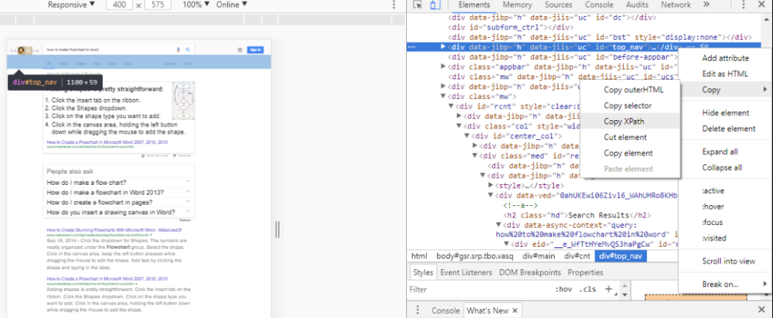
Figure 1:Selenium Locators

Slide 7
Wait Time In Selenium:
Suppose there is a text on the website and it takes a lot of time to load and you try to read the text before it is loaded, what would happen?
Selenium will throw ElementNotVisibleExpception. In order to deal with such issues selenium uses wait conditions:
Implicit Wait: In this the web driver waits for certain amount of specified time before throwing exception. By default the wait value is 0.
Explicit Wait: In this the web driver waits for the certain condition to happen before going further into the code. Some of the expected conditions are as follows:
elementToBeClickable(By locator)
elementToBeVisible(By locator)
elementToBeSelected(By locator)

Slide 8
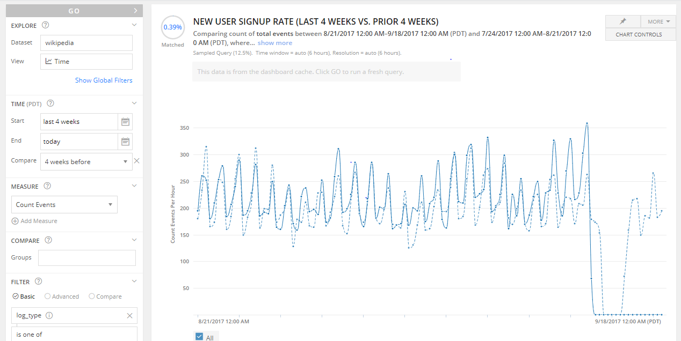
Figure 2:Figure similar to the data source sites

Slide 9
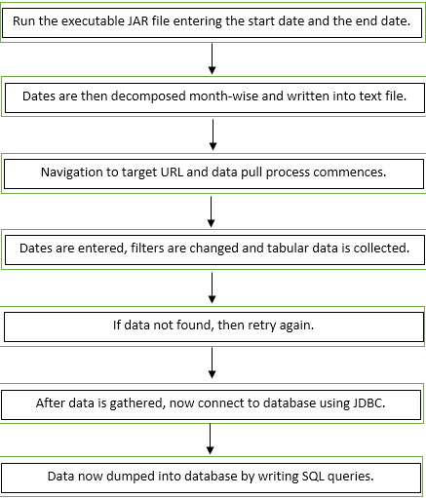
Working of the Selenium Script and the JAR file

Slide 10
Retry Mechanism: In case some data in not found on the website due to various reason like: internet connectivity issue, issues with server, maintenance issues etc., then the selenium script would try again to locate that element. Retrying is done so that no important data is missed.
Log File for tracking error and exceptions : If some error occurs, it is written into a error log file which is created programmatically every time the solution is run. This file is critical in finding the issues and errors with the script, which could then be rectified.

Slide 11
Issues Faced
1. Data can be collected from the site using one of the two methods:
Download the excel file(if less than 30000 rows).
Directly pull from the UI.(if very less or more than 30000 rows present)
As the name of the downloaded file was not known, to recognise the correct excel file from many of the already present excel files was a major issue.
This issue was resolved using the lastModified() function along with file operations on it to return the latest file in directory.
2. Selenium can only capture the elements that are visible on screen, i.e. if you try to access the element which are not currently visible on the screen of your PC, it would throw elementNotVisibleException.
This issue was solved using ScrollIntoView() function used in JavaScript.
3. Downloading more than 100 files of same name would start creating the temporary files, which couldn’t be read as csv files. This issue was resolved by creating a custom folder and deleting it every time before the solution was run.

Slide 12
Thank You

