Slide 1
Rail delay infographics and prediction system
Shruti bhadoriya(141100007)
Pedapati gnanadeep(141100041)

Slide 2


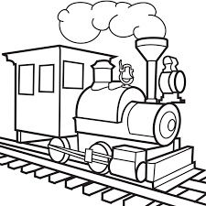

Motivation
You plan a trip!
Search for feasible alternatives
Get a long list of alternatives from which you couldn’t select
You are confused now!!

Slide 3
Problem Formulation
The main goal of the project is to develop application which would be helpful to the targeted audience in selecting better alternative from the available options.
We intend to develop interactive visual based reports which can be customized as per the need using power bi.
Prediction of the best trains for a given route using machine learning and artificial intelligence.

Slide 4
process
Pull data from the site (NTES) for various trains.
Dump the data into database as per database schema.
Create multi-dimensional data cubes over the database.
Create interactive, customizable visual report using Power BI.
Use machine learning to train the model to predict better alternatives.

Slide 5
BRIEF INTRODUCTION ABOUT THE MAJOR TECHNOLOGIES USED
Selenium Web driver: selenium is used to automate browsers. Basically, it is used as tool for automating web applications for testing purposes, but it is not limited to that only.
Web-based administration tasks which tends to be tedious and consuming manpower can be automated as well with the help of selenium.
Locate elements on the web-page by:
ID
Link-text
CSS selector
DOM

Slide 6
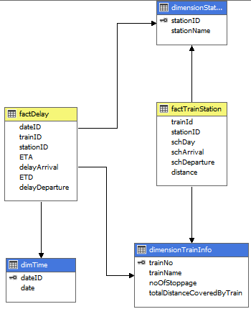
Data cubes: data cubes are multi-dimensional database, in other word they are extension to the 2 dimensional relational table.
This is the schema of the cube which was developed.
This schema is a star schema for cube.
The ID in dimension tables are primary key.
The fact table has foreign key.
Attribute in dimension are features that categorizes the data.
While fact table contains measures which are aggregated values.

Slide 7
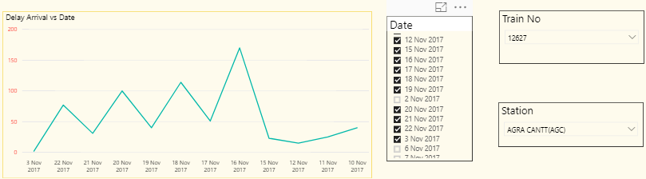
Power BI: Power BI is a suite of business analytics tools to analyse data and share insights.
Using the power BI gateways, you can connect SQL server databases, analysis services models, and many other data sources to your same dashboards in power bi.
With the help of power bi you can create interactive, customized visual reports where a live connection could also be established.
There are numerous visuals offered by power bi like pie chart, line chart, bar graph, stacked bar graph, column charts, cards, funnel charts etc. from which you could select the ones suitable for your requirements.

Slide 8
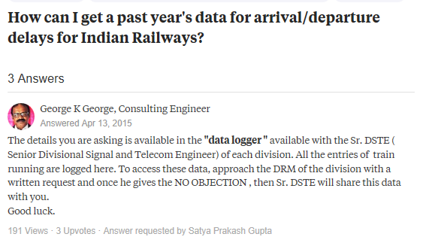
Are there any application which is similar to application that we are going to develop?
There has been discussions on public forums regarding the absence of the historical data with respect to running status and delay of the trains:
Link1:https://www.quora.com/how-can-i-get-a-past-years-data-for-arrival-departure-delays-for-indian-railways

Slide 9
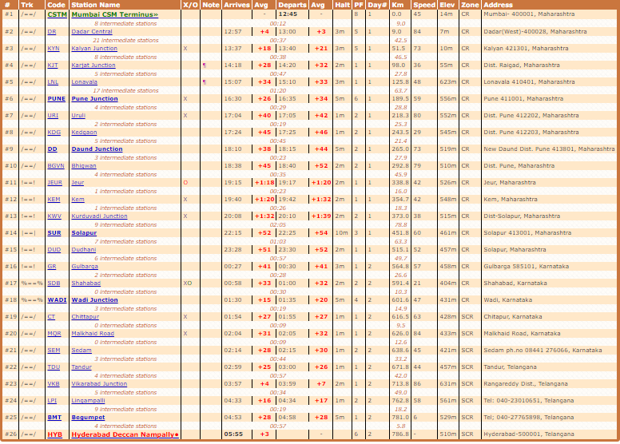
Link2:http://www.indiamike.com/india/indian-railways-f10/indian-railway-ontime-performance-train-delay-t139389/
There are few sites which provide data for past few runs, they are listed below:
Indianrailinfo: https://indiarailinfo.com/

Slide 10
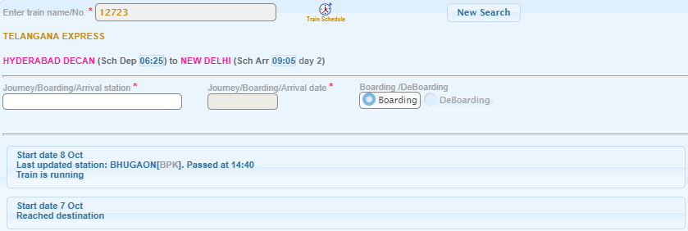
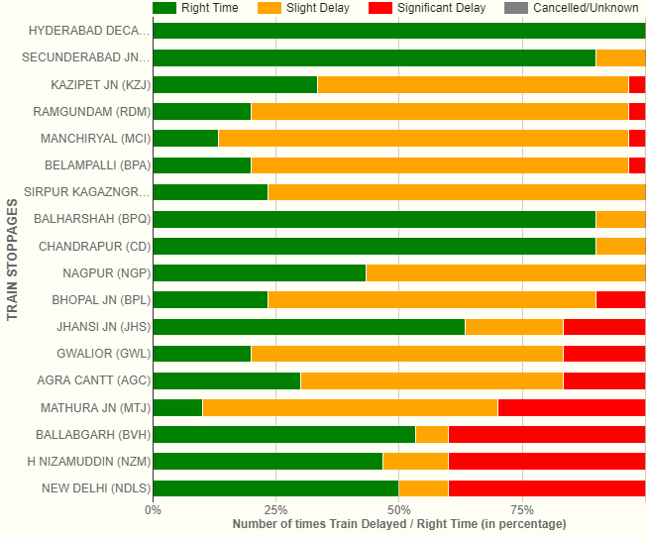
NTES: https://enquiry.indianrail.gov.in/ntes/
etrain : http://www.erailinfo.in/

Slide 11
Project Implementation
Major steps towards implementation of project is as follows
1.Collection of data
-Why selenium?
-Jar file created was scheduled to run twice a day.
-Multithreading has been done to reduce the effective time taken for pulling the data.
-A text file is created so that errors are logged.
-Retry mechanism has been applied.
2. Database design and normalization
3.Data cleaning and formatting
-Redundant and duplicate data has been removed.
- Handled missing values.

Slide 12
4. Multidimensional data cubes
-Why data cubes?
-Dimension and fact tables were created.
-Stored procedures were written to populate the fact and dimension tables.
5.Visual reports
-Power BI used to create interactive and dynamic reports.

Slide 13
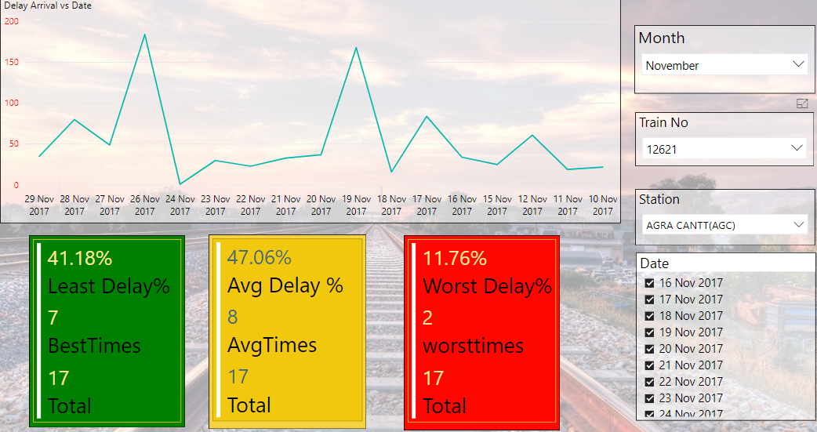
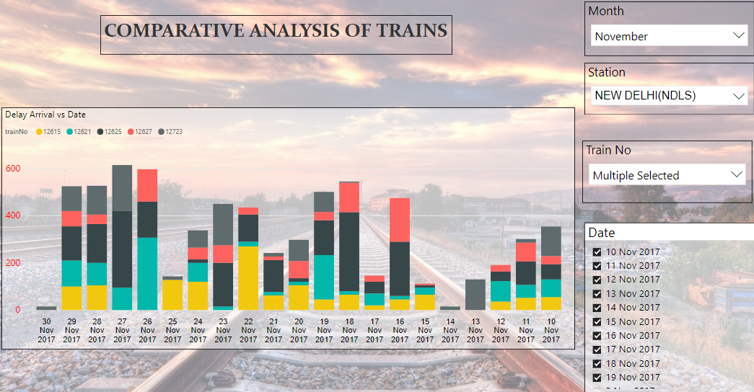
Result and conclusion
Results obtained from the visual reports have been added below:

Slide 14
Conclusion:
1)The visual reports developed are interactive, user-friendly and customizable.
2)The user can view the delay trends for a particular station for given range of dates.
3)The user can view both the absolute and comparative delay analysis of one or more trains.
4)Data at our disposal is accurate as data is collected from the official website of Indian railways, CRIS (central rail information system).
Future scope:
1) Machine learning can be used further for given data for prediction purpose.
2) Enhancing the level of granularity.
3) The power BI reports can have user defined flags for delay percent rather than static values.

Slide 15
THANK YOU!

