Slide 1
Azure Data Engineering
ADF and ADB

Slide 2
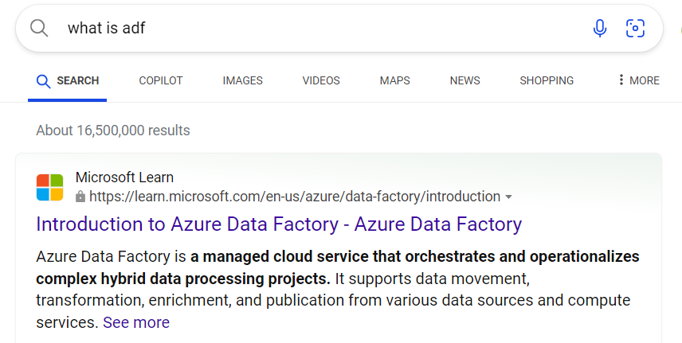
Azure Data Factory
Azure Data Factory is the cloud-based ETL and data integration service that allows you to create data-driven workflows for orchestrating data movement and transforming data at scale

Slide 3
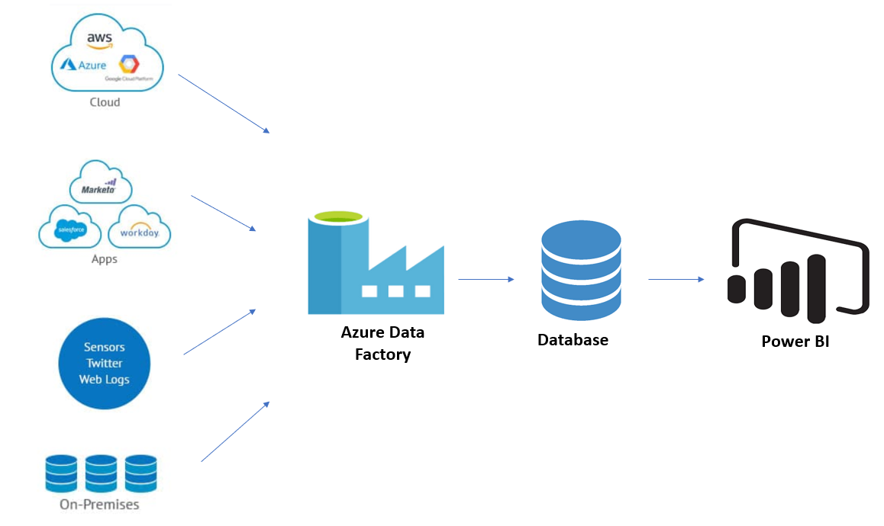
How ADF Works – Simple Architecture

Slide 4
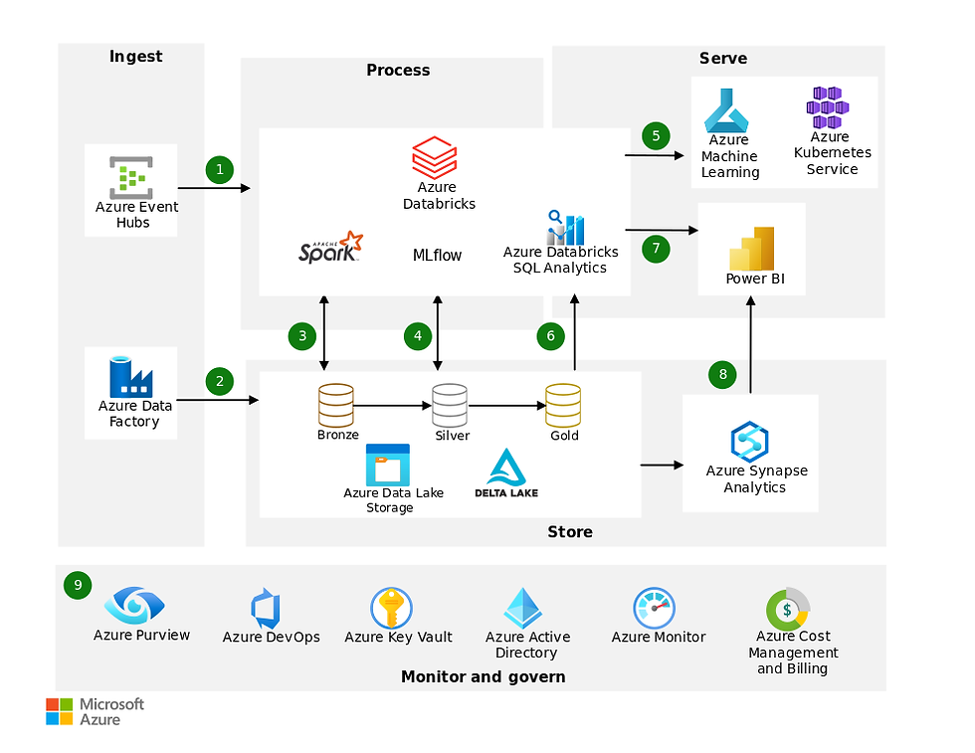
How ADF Works – Complex Architecture

Slide 5
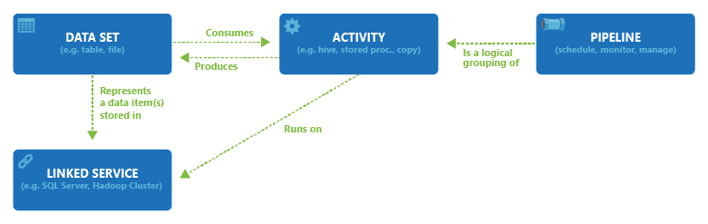
How ADF Works

Slide 6
ADF Components
Integration Runtime
Linked Service
Dataset
Activities
Pipeline

Slide 7
ADF – Integration Runtime
In Azure Data Factory (ADF), an Integration Runtime (IR) is the compute infrastructure that provides data integration capabilities across different network environments
Types of IR
Azure Integration Runtime
Self-hosted Integration Runtime
Azure-SSIS Integration Runtime

Slide 8
ADF – Linked Service

