Slide 1

SQL
Structured Query Language

Slide 2
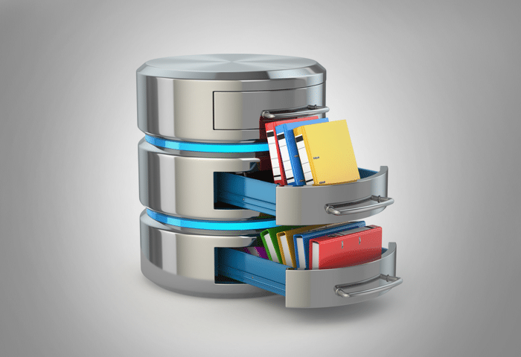
Applications,
Users
SQL

Slide 3
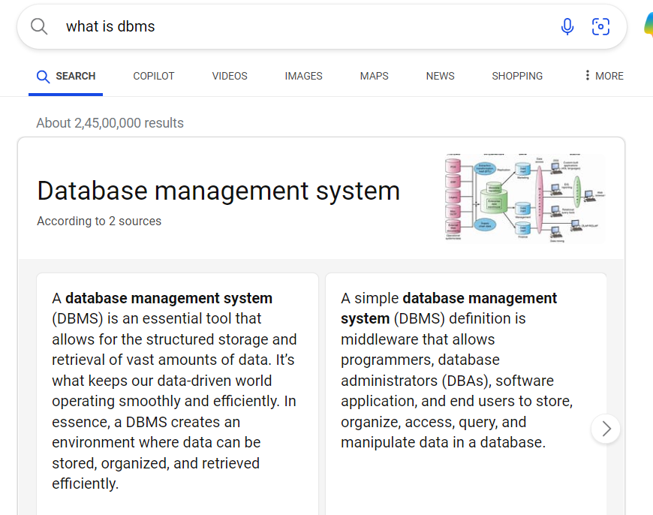
DBMS – Database Management System
In Simple term DBMS is a system that enables you to store, modify and retrieve data in an organized way

Slide 4
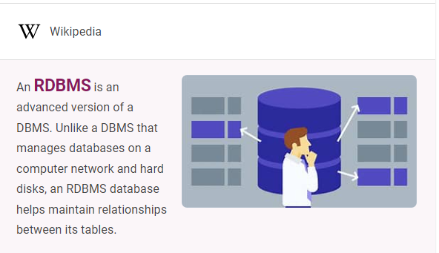
RDBMS – Relational Database Management System
In other words – RDBMS is a type of DBMS which is focused on database with tables relationship. SQL is RDBMS language.

Slide 5
SQL – Table

Slide 8
SQL

