Slide 1
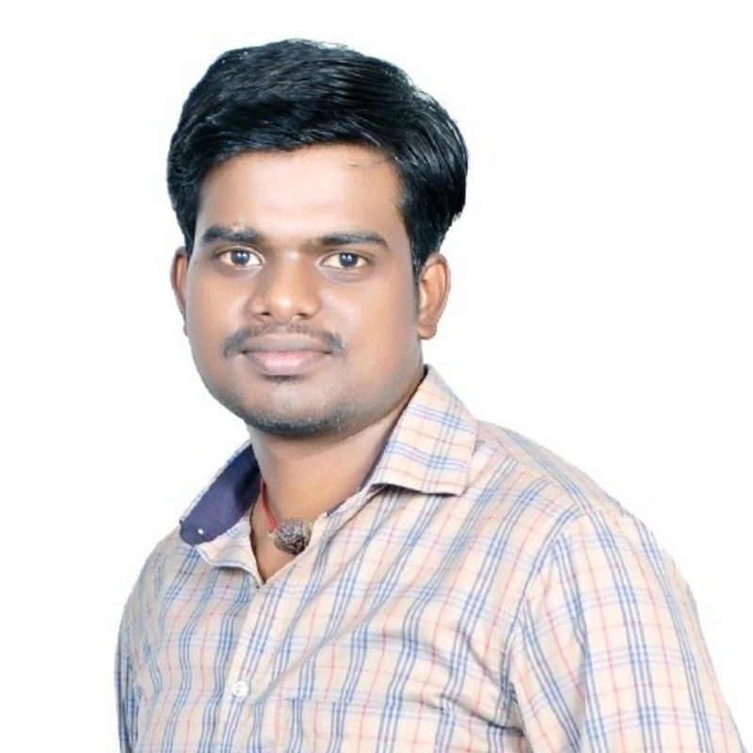
Gnanasekaran G
Data Engineer

Slide 2
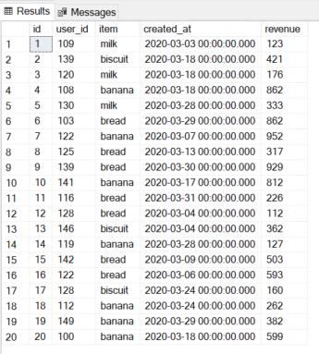



#1 SQL Interview Question

