Slide 1
Smart Grocery Smart Assistant
BY
M. Gnana Prasoona
R. Vandana
A. Pooja

Slide 2
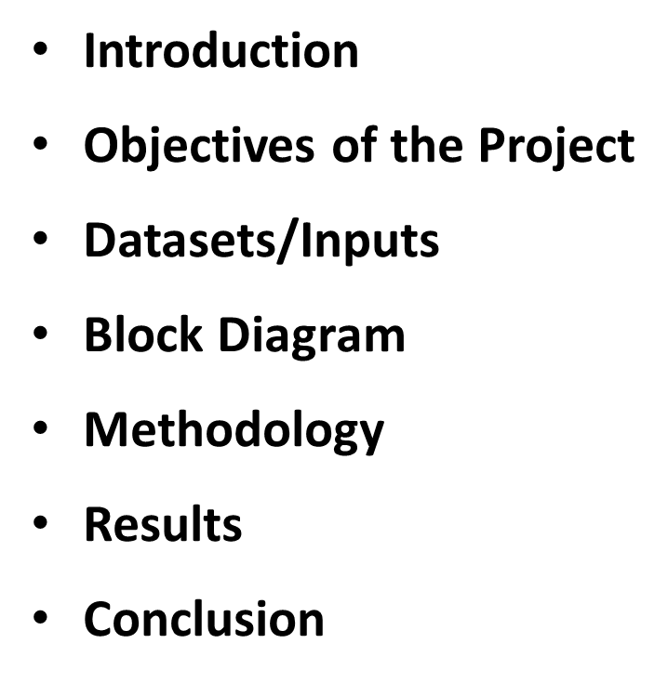

Slide 3
Introduction:
The proposed project focuses on the development of a content-based recommendation system with a Flask-based user interface for an e-commerce platform. Unlike traditional recommendation systems that rely solely on user behavior data, the content-based approach leverages textual breadcrumbs associated with products to generate recommendations. By analyzing the hierarchical categories to which each product belongs, the system aims to offer personalized recommendations based on user interests and preferences.

Slide 4
Objectives of the Project
Create a recommendation system that suggests products to users based on the textual breadcrumbs associated with each product.
Improve the user experience by providing personalized product recommendations tailored to each user’s preferences and interests.
Ensure that the recommendation system is scalable and efficient, capable of handling large volumes of data and delivering real-time recommendations to users.

Slide 5
Datasets/Inputs:
The dataset used is the Knee Grocery Dataset with tuples – Name, Brand, Price, Discount, Category, Subcategory, Quantity, Description, Breadcrumbs.
Each entry in the dataset should contain relevant information about a product, such as its name, description, and category breadcrumbs.
Name: The name or title of the product.
Description: A brief description or summary of the product.
Breadcrumbs: The hierarchical categories to which the product belongs, represented as a string separated by a delimiter

Slide 6
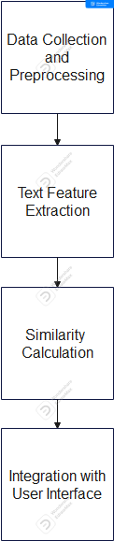
Block Diagram

Slide 7
Methodology
Preprocess the dataset to handle missing values, clean the textual data, and ensure consistency in formatting.
Utilize techniques such as TF-IDF (Term Frequency-Inverse Document Frequency) to convert textual breadcrumbs into numerical representations. TF-IDF captures the importance of each term in the context of the entire dataset, providing a meaningful representation of the textual data.
Calculate pairwise similarities between products based on their numerical representations derived from TF-IDF. Use cosine similarity as a similarity metric to quantify the similarity between pairs of products.
Develop a user interface using Flask or other web frameworks to interact with the recommendation system.

Slide 8
Results
With proper implementation, the content-based recommendation system can significantly enhance user satisfaction, drive sales, and improve overall platform engagement. By providing users with relevant and personalized product suggestions, the system contributes to a more fulfilling shopping experience and fosters customer loyalty and retention.

Slide 9
Conclusion
In conclusion, the development of a content-based recommendation system with a Flask-based user interface offers a promising solution to the challenge of providing personalized product recommendations in e-commerce platforms. By leveraging textual breadcrumbs associated with products and implementing advanced machine learning techniques, the system can deliver tailored recommendations based on user preferences and interests.

Slide 10
Thank You

