Slide 1
PDF Chatbot using Llama-2
Chat with Your Documents using AI
Presented by:Gnanapriya R

Slide 2
Introduction
• This project allows users to upload PDFs and ask questions.
• AI chatbot powered by Llama-2 extracts relevant answers.
• Uses FastAPI backend and Streamlit frontend.
• Integrates FAISS for efficient document search.

Slide 3
Problem Statement
• Reading PDFs is time-consuming.
• Searching for specific information manually is inefficient.
• Need a fast and accurate AI-based document assistant.

Slide 4

Technology Stack
• Frontend: Streamlit
• Backend: FastAPI
• AI Model: Llama-2
• Vector Search: FAISS
• Embedding Model: Sentence-Transformers
• Deployment: Docker

Slide 5
How It Works (Workflow)
1. Upload PDF
1
2. Process & Store in FAISS
2
3. Ask Question
3
4. Get Answer from Llama-2
4

Slide 6
Features
✅ Upload PDF
✅ AI-powered search
✅ Uses FAISS for efficient retrieval
✅ Chatbot powered by Llama-2
✅ Lightweight & easy to use

Slide 7
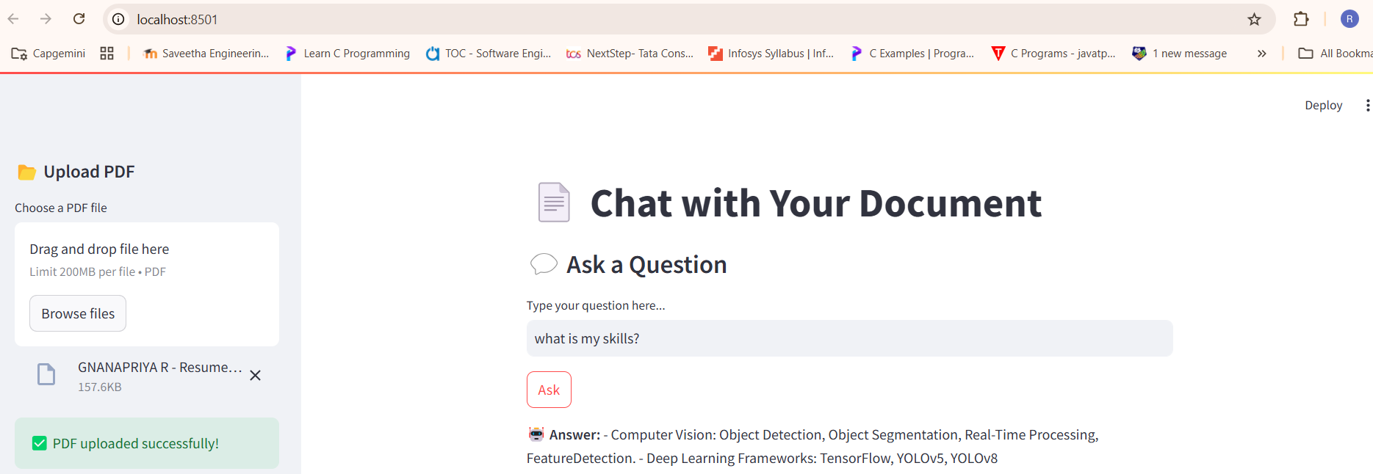
Demo Screenshots

Slide 8
Code Overview
• Frontend: Streamlit handles UI and user interaction.
• Backend: FastAPI processes requests and interacts with FAISS.
• FAISS: Stores processed text for fast retrieval.
• Llama-2: Generates responses based on document content.

Slide 9
Future Enhancements
• Support multiple PDFs
• Improve response accuracy with better embeddings
• Deploy on cloud (AWS/GCP)
• Optimize performance for large documents

Slide 10
Conclusion
• PDF Chatbot simplifies document interaction with AI.
• Uses FAISS and Llama-2 for fast and accurate responses.

