Slide 1
B.TECH CAPSTONE PROJECT
AI-Powered Supply Chain
Disruption Assistant
Data-driven disruption analysis, historical case retrieval, machine learning predictions, and AI-assisted recommendations.
DISRUPTION
RETRIEVAL
PREDICTION
RECOMMENDATION
React • FastAPI • LangGraph • MySQL • ChromaDB • BM25 • Scikit-learn
01 / 07

Slide 2
Problem Statement & Objectives
Why disruption analysis needs a structured, data-driven workflow
THE PROBLEM
PROJECT OBJECTIVES
Disruptions can affect production, revenue, supplier continuity, and recovery time.
01
Analyze
Accept and process disruption details.
02
Retrieve
Find similar historical incidents.
• Historical incidents may be difficult to review efficiently.
• Impact and recovery estimates require evidence and analysis.
• Decision-makers need relevant cases and practical response options.
• Results should be presented consistently and validated.
03
Predict
Estimate supported disruption outcomes.
04
Synthesize
Combine evidence into an AI-assisted analysis.
05
Present
Show results and recommendations in one interface.
Goal: support informed mitigation and recovery decisions—not guarantee outcomes.
AI-POWERED SUPPLY CHAIN DISRUPTION ASSISTANT
02 / 07

Slide 3
Proposed Solution & Advantages
A unified workflow combines data retrieval, predictive models, and AI-assisted synthesis
USER INPUT
HYBRID RETRIEVAL
ML PREDICTIONS
AI ANALYSIS
Disruption details
ChromaDB + BM25
Four supported tasks
Synthesis + fallback
KEY ADVANTAGES
Evidence-led
Modular
Multi-task
Uses historical incidents alongside predictions.
Specialized agents separate workflow responsibilities.
Supports impact, loss, recovery-time, and supplier-change predictions.
Resilient routing
Centralized view
Persistent records
Configured LLM fallback can help handle provider failures.
Presents analysis, evidence, and recommendations together.
Stores applicable application and analysis records.
Intended value: improve the consistency and accessibility of disruption decision support.
AI-POWERED SUPPLY CHAIN DISRUPTION ASSISTANT
03 / 07

Slide 4
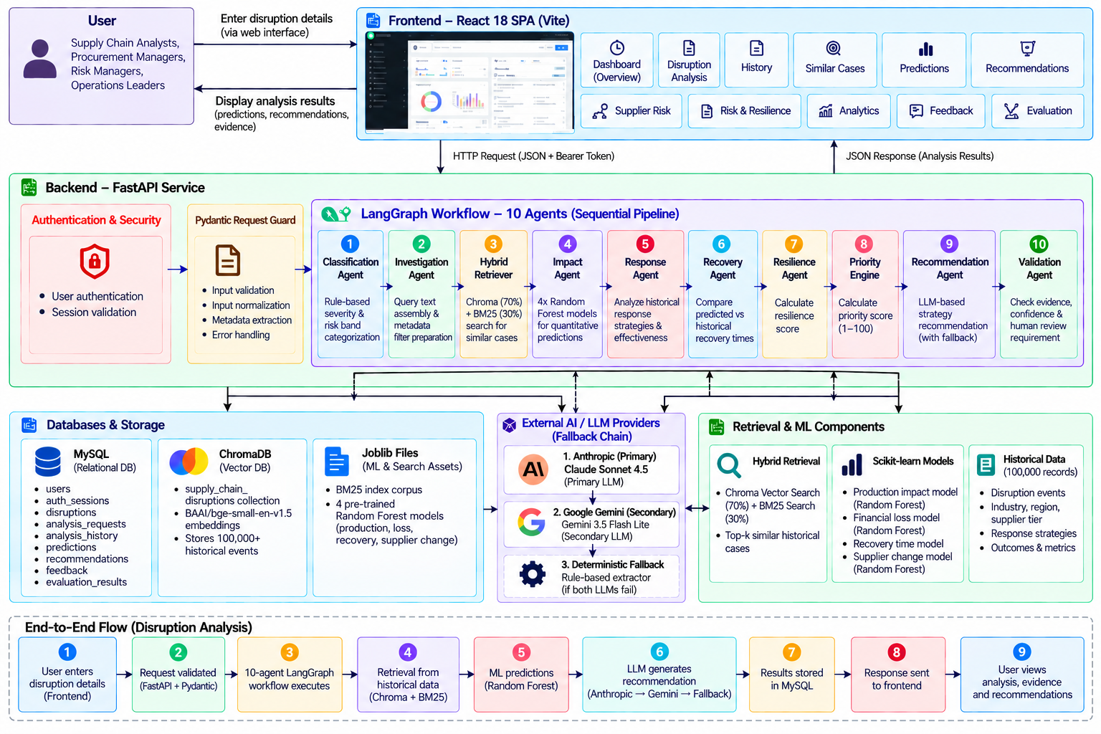
AI-POWERED SUPPLY CHAIN DISRUPTION ASSISTANT
04 / 07

Slide 5
End-to-End Disruption Analysis Flow
From user-submitted disruption details to validated results
1 USER INPUT
2 FASTAPI
3 LANGGRAPH
4 HYBRID RETRIEVAL
Enter disruption details
Validate request
Run sequential agents
ChromaDB + BM25
Provider failure → fallback
8 RESULTS
7 VALIDATE & STORE
6 AI SYNTHESIS
5 ML PREDICTIONS
Evidence + recommendations
Check output; persist records
Configured LLM + fallback
Impact • loss • recovery • change
The sequential agent workflow coordinates classification, retrieval, impact assessment, response, recovery, resilience, prioritization, recommendations, and validation.
USER SUBMISSION → EVIDENCE + PREDICTIONS → DECISION SUPPORT
AI-POWERED SUPPLY CHAIN DISRUPTION ASSISTANT
05 / 07

Slide 6
Prediction Capabilities & Conclusion
How model outputs complement historical evidence and AI-assisted analysis
FOUR PREDICTION TASKS
PRACTICAL VALUE
01
Production impact
Regression
• Structured assessment of disruption impact
• Faster review of comparable historical incidents
• Data-driven estimates for selected outcomes
• Analysis and recommendations in one interface
• Support for mitigation and recovery discussions
02
Revenue loss
Regression
03
Full recovery time
Regression
04
Permanent supplier change
Classification
Turn historical disruption data into actionable decision support.
Predictions are decision-support estimates; they should be interpreted with context and available evidence.
LIMITATIONS
Predictions depend on historical data quality and may not capture every real-world disruption. Model estimates are uncertain; recommendations need human review. LLM output and provider availability can vary, and evaluation coverage may be limited by available test evidence.
Conclusion: retrieval + machine learning + agent orchestration + LLM-assisted synthesis in one workflow.
AI-POWERED SUPPLY CHAIN DISRUPTION ASSISTANT
06 / 07

Slide 7
Thank You!
AI-Powered Supply Chain Disruption Assistant
Turning historical disruption data into actionable decision support.
RETRIEVE
PREDICT
VALIDATE
RECOMMEND
Questions & discussion
07 / 07

