Slide 1

C.ABDUL HAKEEM COLLEGE OF ENGINEERING AND TECHNOLOGY, MELVISHARAM. DEPARTMENT OF COMPUTER SCIENCE AND ENGINEERING
TripGUY: RealTime Geo-Tracking and Social Itinerary Management with Integrated AI Assistance
Team Members:
Bala murugan S(510622104013),
Gnanasekaran D(510622104026),
Badrinath M (510622104012)
Guided By:
Mr K A Suhail Ahmed
AP/ CSE

Slide 2
Introduction
This unified, cross-platform travel companion eliminates app fragmentation by seamlessly combining itinerary planning, social sharing, and offline-first functionality. Built on a scalable Clean Architecture, it delivers cost-efficient live geolocation tracking and high-end map interactivity without relying on expensive proprietary APIs. To further support budget-conscious explorers, the platform also features a secure, context-aware Generative AI chatbot that provides dynamic travel guidance and budget management.

Slide 3
Abstract
Trip-GUY combines trip planning, live navigation, social sharing, and AI into a single, high-performance iOS and Android app, eliminating the need for fragmented tools.
Built with Flutter and Clean Architecture, the app relies on a serverless Firebase backend, open-source mapping tools (OpenStreetMap/MapLibre), and Google Gemini Pro for AI assistance.
Travelers currently struggle with a fragmented experience, forced to juggle disconnected apps for planning, navigation, and sharing, which causes data duplication and inefficiency

Slide 4
Literature Review:
VOYAGER – Smart Travel Guidance Cross Platform Mobile Application
Authors: W.A.K.D. Wijesinghe
Published Year: 2021 (ICAC - IEEE)
Functionality:
Integrates map APIs for dynamic routing and shortest path options.
Track's locations with built-in emergency guidance.
Builds social networking features, including in app chat and travel journals.
Limitations:
High battery drain during continuous live tracking.
Fragmented architecture lacks strict separation of concerns, hindering scalability.

Slide 5
Literature Review:
Traveler’s Navigator Application
Authors: Vishal Jaiswal, Krutika Shahane, Ojas Kund, Prerna Rathi
Published Year: 2023 (IJERCSE)
Functionality:
Implements Map APIs for optimal pathfinding.
Generates personalized, location-based recommendations.
Connects users through built in social networking features.
Limitations:
Relies heavily on static routing and rigid recommendation algorithms.
Lacks offline first capabilities, rendering it unusable in low network travel zones.
No generative AI context for dynamic travel budgeting or sudden itinerary shifts.

Slide 6
Literature Review:
A Design and Structure of Travel SNS Application
Authors: Kyeonhoon Kwak, Hankyu Lim
Published Year: 2016 (NAUN)
Functionality:
Targets backpackers by forming dedicated travel communities.
Captures continuous user ''footprints'' (live location tracking).
Streamlines the travel note and diary creation process.
Limitations:
Utilizing traditional databases for continuous ''footprint'' tracking triggers skyrocketing cloud read/write costs.
Economically unsustainable for a growing user base on free or low tier infrastructure.

Slide 7
Literature Review:
Smart Travel Guide Application for Android
Authors: Deepthi.K, Gayathiri.M, Latha sree.P, Leena Raj
Published Year: 2021 (JETIR)
Functionality:
Architects a cohesive multifeatured guide.
Combines trip planning with continuous geolocation tracking.
Retrieves location-based information dynamically.
Limitations:
Tightly coupled codebase making it extremely difficult to maintain, test, or scale efficiently.
Suboptimal state management leads to UI lag during heavy data operations.

Slide 8
Literature Review:
Travel Diary Methodologies (Deriving Weeklong Activity-Travel Diary...)
Authors: Melvyn Li, Kaili Wang, Yicong Liu, Khandker Nurul Habib
Published Year: 2023 (arXiv) / 2024 (Transportation Journal)
Functionality:
Captures raw user movement autonomously via GPS.
Transforms raw location history into meaningful, annotated travel journals.
Limitations:
Heavy resource and processing consumption on the mobile device.
Fails to reconcile conflicting data when multiple users attempt to annotate shared trips offline.

Slide 9
Summary of Literature
Consolidated Analysis of Existing Research:
1. High Cloud Infrastructure Costs: Traditional databases fail under the weight of continuous GPS footprint tracking.
2. Monolithic Architectures: Existing solutions suffer from tightly coupled code, making them difficult to scale or test.
3. Network Dependency: Severe lack of robust offline first synchronization for remote travel environments.
4. Battery & Resource Drain: Unoptimized background tracking algorithms heavily deplete mobile resources.
5. Intelligence Gap: Current apps provide static routing but lack conversational, context aware Generative AI for dynamic assistance.

Slide 10
Existing System
Existing real-world systems rely on fragmented applications, forcing users to constantly juggle separate apps to manage their travel needs such as using WhatsApp for chatting, Google Maps for routing, and Notes for keeping travel diaries.
Disadvantages:
Travelers are forced to use multiple, disconnected apps for planning, socializing, navigation, and journaling, leading to a frustrating experience.
these tools don't communicate, AI assistants lack personal trip context, and social platforms lack structured trip organization.
Inability to adapt to live travel changes without manual user intervention and multiple app switches.

Slide 11
Proposed System: TripGUY
TripGUY unifies travel management through a testable Clean Architecture, utilizing cost-optimized Firebase live tracking and offline-first caching for seamless use in zero-network zones. Additionally, the system embeds context-aware Google Gemini AI to dynamically resolve routing constraints, budgets, and emergencies.
Advantages:
Consolidates planning, social features, diaries, and AI into one high-performance Flutter app for iOS and Android.
Delivers interactive 3D vector maps, routing, and POI discovery using MapLibre GL and open-source APIs instead of expensive proprietary services.
Drastically reduces cloud expenses by utilizing free map tools and storing diary photos as Base64 strings to bypass Firebase Storage fees

Slide 12
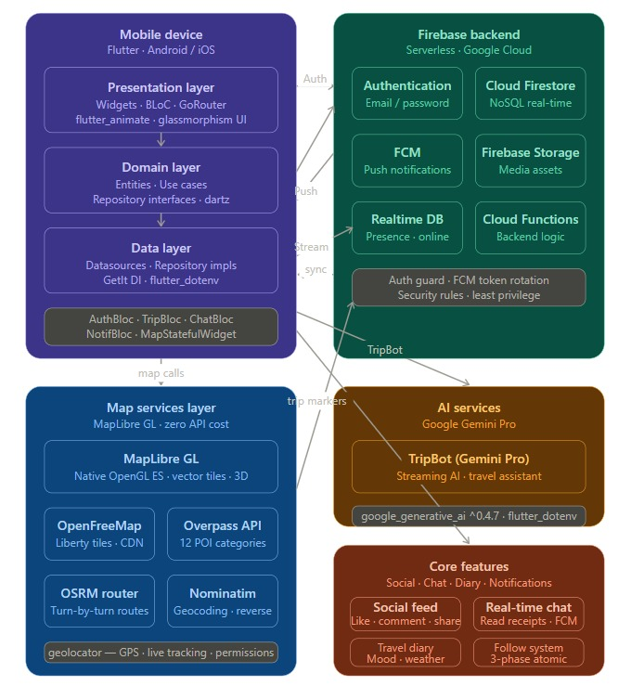
Architecture Diagram

Slide 13
Implementation
Programming Language: Dart.
Frontend SDK: Flutter SDK, utilizing BLoC for state management and MapLibre GL for native OpenGL ES map rendering.
Backend Services: Google Firebase (Cloud Firestore, Authentication, and Cloud Messaging). Note: Firebase Storage was phased out in favor of Base64 encoding to reduce costs.
External APIs & Integrations: Google Gemini Pro (AI Assistant), EmailJS (OTP Verification), OpenFreeMap, Overpass API, and OSRM (Routing).
DevOps & IDE: GitHub Actions for CI/CD, developed using Visual Studio Code / Android Studio.
Hardware Requirements: Standard Android (minSdk 21+) and iOS mobile devices for deployment.

Slide 14
Module 1: User Account & Authentication
Authentication Gateway: Secure, OTP-gated registration and login using Firebase Auth and EmailJS to completely prevent duplicate accounts.
Profile Management: Guided onboarding allows users to set unique usernames, bios, and upload Base64 profile pictures directly to Firestore.
Privacy Controls: Robust settings to toggle trip visibility between Public, Friends-Only, and Private, heavily secured by Firestore Rules.

Slide 15
Module 2: Trip Management & Travel Diary
Trip Creation & Sharing: Dynamic forms to post new trips with strict validation, alongside one-tap social sharing via WhatsApp and SMS deep-links.
Interactive Diary: A timeline-based UI allowing users to document their journey with rich text, mood/weather metadata, and Base64 image uploads.
Offline-First Architecture: Utilizes local caching to ensure users can log diary entries in zero-network zones, synchronizing automatically when reconnected.

Slide 16
Module 3: Real-Time Geolocation & Messaging
Advanced Live Navigator: Upgraded to MapLibre GL for high-performance, native OpenGL ES vector maps featuring 3D buildings and turn-by-turn routing.
Intelligent POI Discovery: Integrates Overpass API to dynamically fetch and sort 12 categories of nearby points of interest based on real-time GPS.
Social Messaging: 1-to-1 real-time chat with delivery status, read receipts, and push notifications powered by Firebase Cloud Messaging (FCM).

Slide 17
Module 4: AI Chatbot Assistant
Generative AI Integration: Powered by the Google Gemini Pro API to provide dynamic, conversational travel assistance through the TripBot interface.
Context-Aware Guidance: AI reads the user's current trip data (budget, destination) to offer highly personalized itinerary suggestions and emergency info.
Secure Execution: API calls and keys are managed securely via runtime environment variables, with architecture ready for Cloud Function proxying.

Slide 18
Module 5: Advanced Map System Modals
Reverse Geocoding Address Sheet: Tapping anywhere on the MapLibre GL map triggers a bottom modal displaying the exact road, city, country, and distance from the user, complete with one-tap "Pin Location" and "Navigate" actions.
Turn-by-Turn Navigation Sheet: A draggable modal that parses OSRM routing data, presenting clear step-by-step directions with intuitive turn icons and exact distances.
Nearby POI Quick Strip & Expansion Sheet: A dynamic horizontal strip overlaying the map that displays the 5 closest Points of Interest, which can be expanded into a full, scrollable sheet sorted precisely by distance.

Slide 19
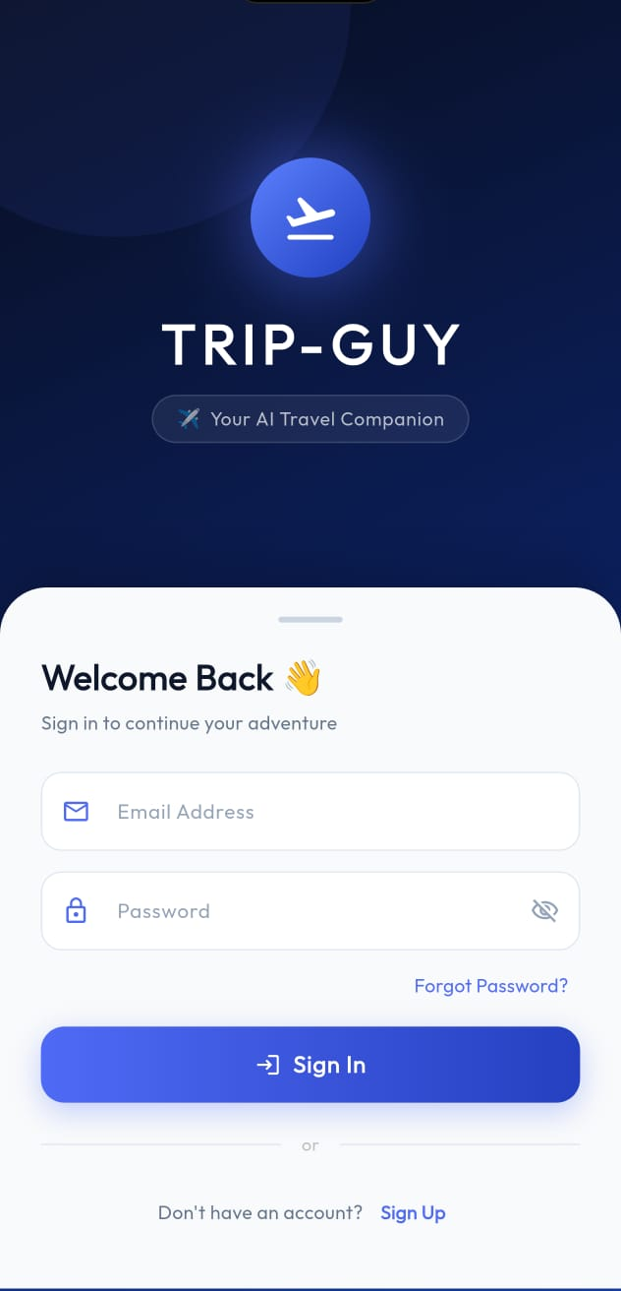
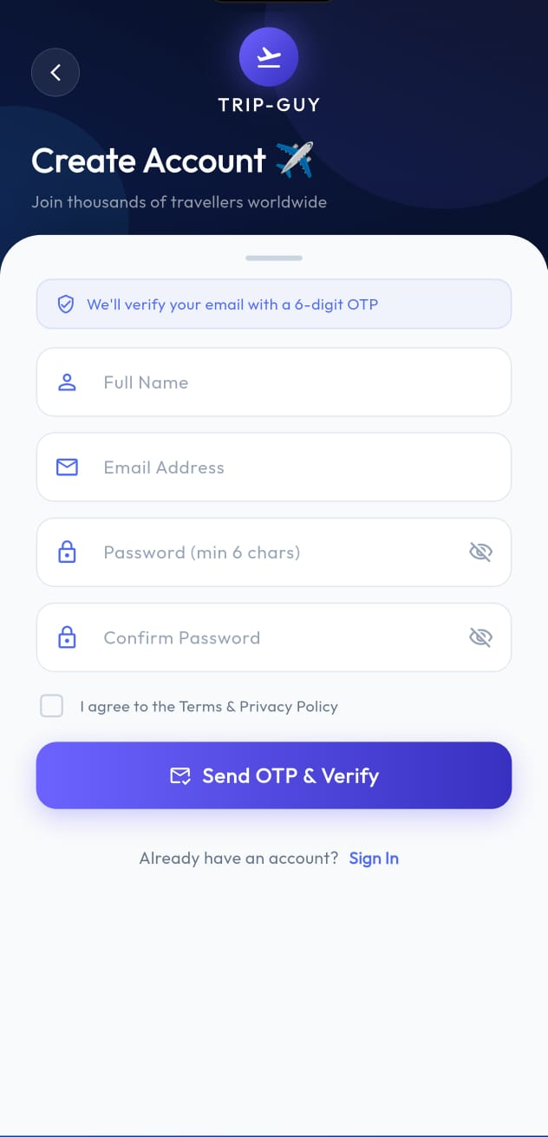
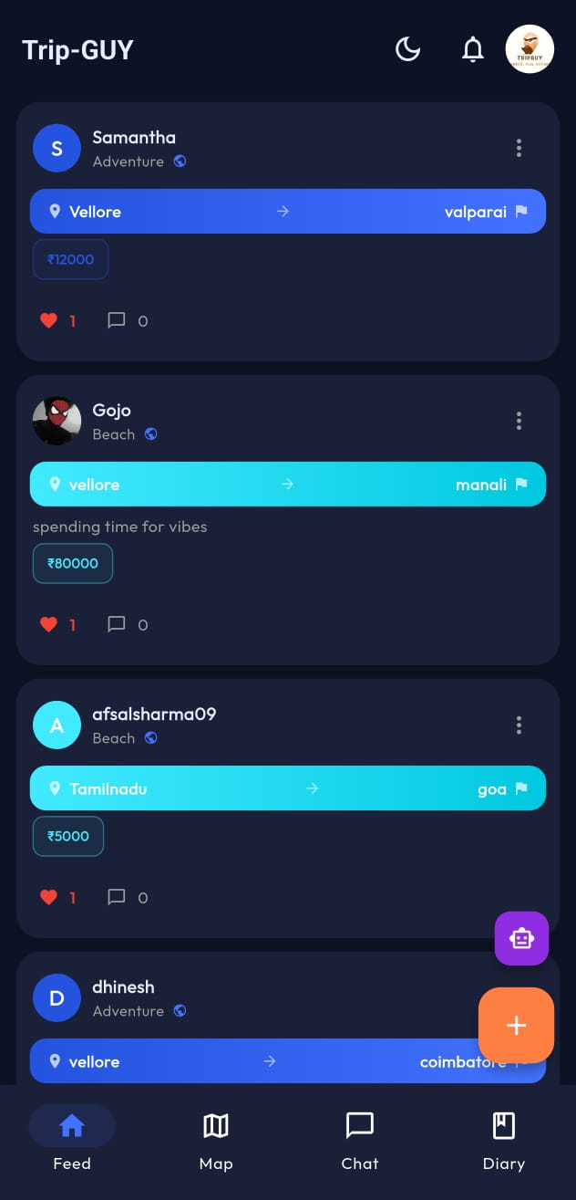
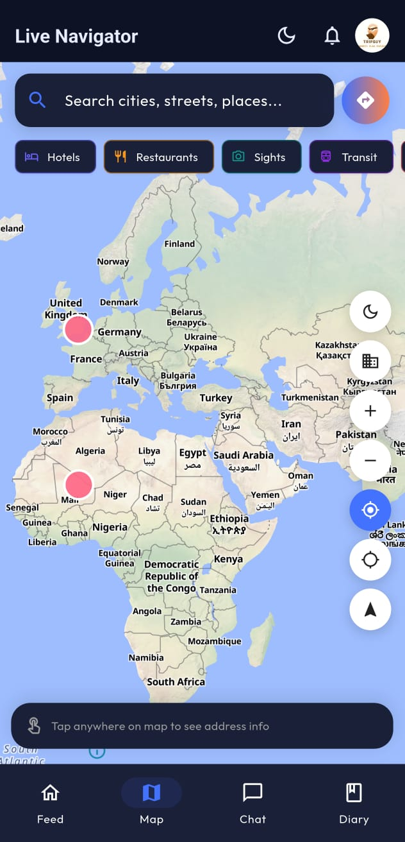
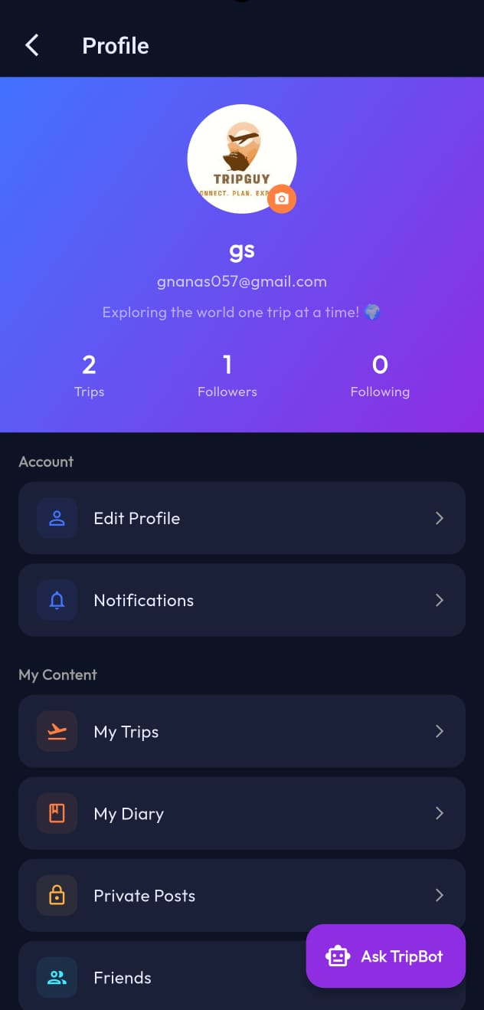

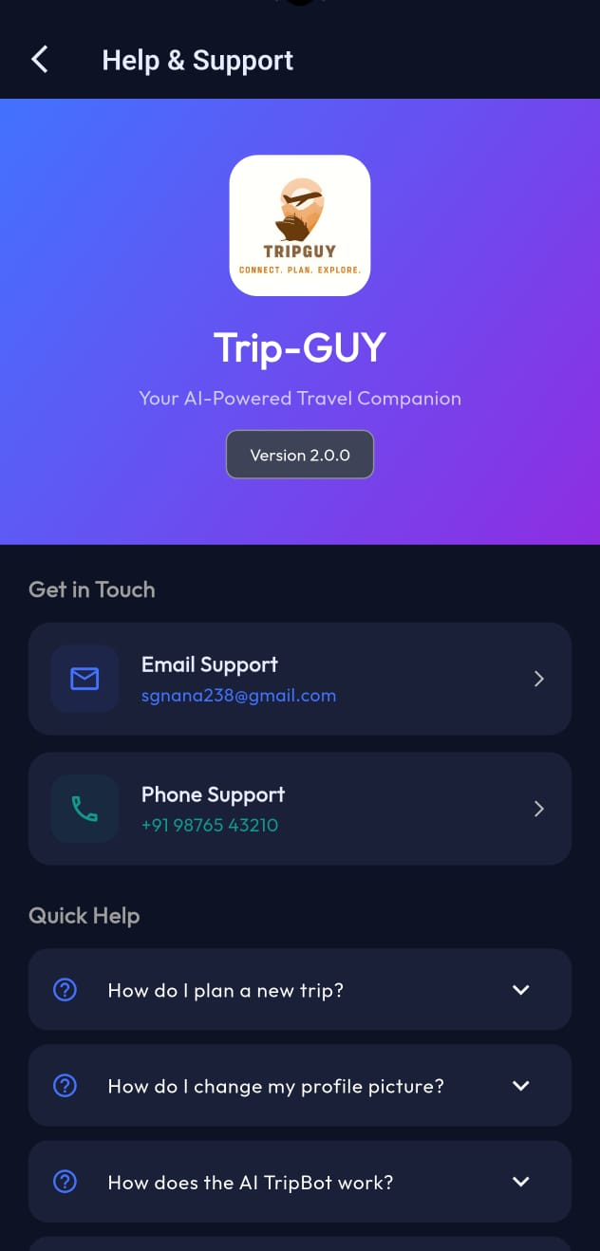
Result :

Slide 20
Conclusion & Future Work
Achievements:
Successfully engineered and delivered a highly scalable, Realtime application while strictly resolving the cost and architectural limitations found in existing travel software.
Future Improvements:
Integrating automated receipt parsing for seamless budget management.
Enabling group-based geolocation sharing for multiuser trips.
Expanding deployment to broader App Stores and adding multilanguage support.

Slide 21
References
Kaur, P., & Sharma, M. (2021). Analysis of NoSQL cloud databases: Firebase Realtime Database vs. Cloud Firestore for mobile applications. International Journal of Computer Applications, 178(10), 1521.
Nour, M., & Chikh, A. (2019). Evaluating the implementation of clean architecture in mobile apps. ACM SIGSOFT Software Engineering Notes, 44(3), 2530.
Sommer, A., & Krusche, S. (2020). Evaluation of cross platform frameworks for mobile applications. Proceedings of the IEEE (ICST), 120130.
Wang, X., & Li, Y. (2023). Context aware AI assistants for mobile tourism applications using large language models. IEEE Transactions on Mobile Computing, 22(8), 45014515.
Zhuang, Z., Kim, K. H., & Singh, J. P. (2010). Improving energy efficiency of location sensing on smartphones. MobiSys, 315330.

Slide 22
Bibliography
Books:
Martin, R. C. (2017). Clean architecture: A craftsman's guide to software structure and design. Prentice Hall.
Moroney, L. (2017). The definitive guide to Firebase: Build Android, iOS, and Web applications. Apress.
Windmill, E. (2020). Flutter in action. Manning Publications.
Websites & Official Documentation:
Google. (2024). Cloud Firestore documentation. Firebase. https://firebase.google.com/docs/firestore
Google. (2024). Gemini API documentation. Google AI for Developers. https://ai.google.dev/docs
Google. (2024). State management in Flutter. Flutter Documentation. https://docs.flutter.dev/dataandbackend/statemgmt

Slide 23
Thank You

