Slide 1
PROJECT TITLE
AI-Driven Crop Disease Prediction and Management System
CSE7101- Capstone Project
Review-5
Batch Number:CSE_39
Roll Number | Student Name
20221CSE0431 20221CSE0722 20221CSE0329 | Gundluri Gnana Sree Soujanya Jambagi Mounika A
Under the Supervision of,
Dr./Mr./Ms./Prof. Dr .Aarif Ahmed S
Professor / Associate Professor / Assistant Professor
School of Computer Science and Engineering
Presidency University
Name of the Program: Computer Science And Engineering
Name of the HoD: Dr.Blessed Prince
Name of the Program Project Coordinator: Dr . Jayavadivel Ravi
Name of the School Project Coordinators: Dr. Sampath A K , Dr. Geetha A

Slide 2
Content
Problem Statement
Objectives
Background and Related work for title Selection
Analysis of Problem Statement
Innovation or Novel Contributions
Git-hub Link
Timeline of the Project
Results
References

Slide 3
Problem Statement Number: PSCS_282
Organization: Ministry of Agriculture and Farmers Welfare
Category (Hardware / Software / Both) :Software
Problem Description: Farmers often struggle to identify crop diseases early, leading to delayed treatment and reduced yields. Manual diagnosis is slow, error-prone, and inaccessible in many rural areas. This project aims to build an AI-powered system that detects crop diseases from leaf images, predicts risk using environmental data, and provides timely treatment recommendations—all through a simple mobile/web interface.

Slide 4
Objectives:
1.Develop an Automated Leaf Disease Detection System
Build and train a deep-learning model using leaf images to classify crops as healthy or identify specific diseases with high accuracy.
2. Improve Prediction Accuracy Through Data Preprocessing & Augmentation
Enhance model performance by applying image preprocessing steps such as resizing, normalization, and augmentation (rotation, flip, brightness variation) to handle limited datasets.
3. Deploy a Practical, Farmer-Friendly Prediction Platform
Create a simple web application where users can upload leaf images and instantly receive disease predictions along with model confidence scores.
4. Integrate Backend Model Serving With Flask
Implement a Flask backend that loads the trained model.

Slide 5
5. Enable Real-Time Decision Support With Treatment Suggestions
Provide basic, actionable recommendations for identified diseases (e.g., suitable pesticides/fertilizers, preventive measures) directly inside the application.
6. Build an Accurate and Efficient System Suitable for Low-Resource Use Cases
Optimize the model and interface so farmers with low-end devices or limited connectivity can still use the system easily and reliably.
7. Lay the Foundation for Future Multi-Crop & Multi-Disease Extension
Design the architecture in a modular manner, allowing future expansion to support additional crops, diseases, and risk forecasting features.

Slide 6
Background and Related Work:
Crop diseases are a major threat to agricultural productivity, especially in regions with limited access to expert diagnosis.
Traditional detection methods rely on manual inspection, which is slow, subjective, and not scalable.
AI and computer vision offer powerful tools for automating disease identification and management.
Integrating machine learning with mobile/web platforms can provide farmers with real-time insights and actionable recommendations.
The goal is to build a holistic software system that combines image analysis, environmental data, and user-friendly interfaces to support timely and informed decision-making.

Slide 7
Innovation or Novel Contributions:
Dual-Mode Prediction System
Combines image-based CNN models with environmental/tabular data models (e.g., weather, soil features via Scikit-learn).
Enables more accurate and context-aware disease identification.
Early Detection & Decision Support
Empowers farmers with actionable Predictions, reducing crop loss and improving yield.
Supports precision agriculture by integrating AI with traditional farming knowledge
Cloud-Based Training & Deployment
Uses platforms like Google Colab for model training and Flask for deployment.
Farmer-Friendly Web Interface
Offers an intuitive UI for farmers to check crop health without technical knowledge.
Allows easy access through browser-based interaction for fast decision-making.

Slide 8
Technology Stack Components:
1.Frontend:
HTML , CSS, JavaScript.
2.AI/ML Model
Google Colab,Spyder – Train and test models in the cloud.
Tensorflow – Use CNNs for image classification
Scikit -learn – Handle tabular data like weather or soil features
3.Backend:
Flask-Connect frontend to model, handle image uploads and predictions

Slide 9
Github Link
The Github link provided should have public access permission.
https://github.com/Aicropdiseasemanagementandprediction

Slide 10
Analysis of Problem Statement
Software Requirements and Hardware Requirements:
Software Requirements | Hardware requirements
Operating System: Windows 10/Linux | Processor :Intel Core i5 or higher
IDE: vscode / Googlecolab / Jupyter notebook | Ram:8gb or more
Database Tools:Mysql Workbench | Storage:256GB SSD or higher
Web browsers(chrome/ Firefox) | Internet:Stable Connection(5mbps or more)

Slide 11
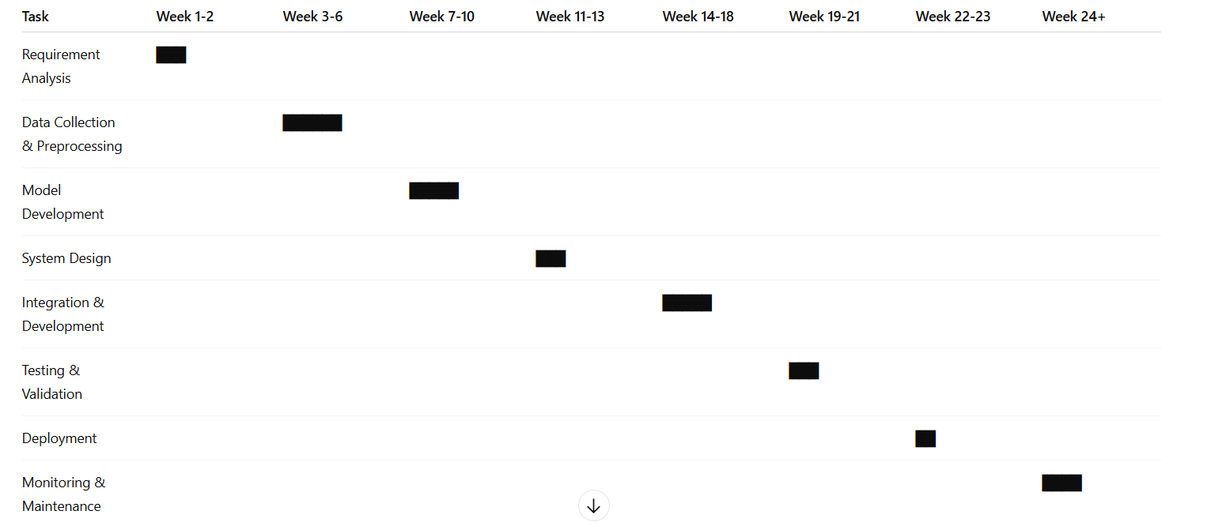
Timeline of the Project (Gantt Chart)

Slide 12
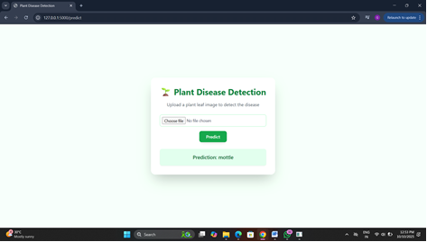
Results :

Slide 13
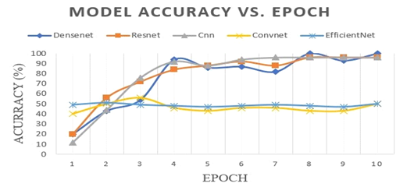

Slide 14
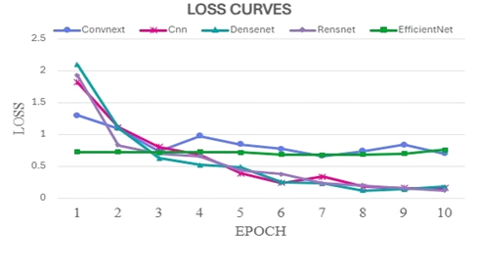

Slide 15
References (IEEE Paper format)
[1] S. R. Prasad, M. K. Reddy, and A. S. Rao, “Convolutional Neural Networks based Classification and Detection of Plant Disease,” Proc. 2022 Int. Conf. on Computing Methodologies and Communication (ICCMC), pp. 1–6, Mar. 2022. DOI: 10.1109/ICCMC53470.2022.9753846
[2] V. Ivanov , D. Petrov , and A. Smirnov, “Building Deep Neural Networks for solving Machine Learning Problems in Agricultural Production,” Proc. 2023 Int. Russian Smart Industry Conf. (SmartIndustryCon), pp. 1–5, Mar. 2023. DOI: 10.1109/SmartIndustryCon57312.2023.10110765

Slide 16


