Slide 1

Introduction to object detection
Team members:
Charith Dasari - CB.SC.U4AIE24014
T M S K maheshwar - CB.SC.U4AIE24058
Ravala Gnanasri Chowdary - CB.SC.U4AIE24064
Rohin Reddy M - CB.SC.U4AIE24065
by Gnanasri chowdary

Slide 2
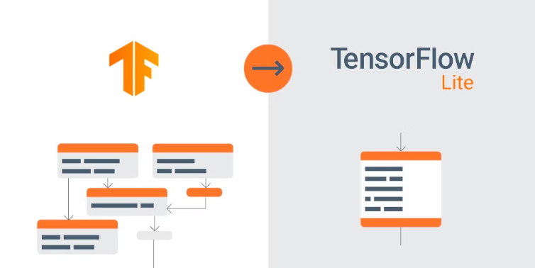
Introduction
Object detection using MobileNet and TensorFlow offers a lightweight yet efficient solution for identifying objects in real-time on mobile and edge devices. MobileNet, a compact Convolutional Neural Network (CNN) optimized for low-power environments, serves as a feature extractor in object detection models like SSD-MobileNet (Single Shot MultiBox Detector). By leveraging TensorFlow’s Object Detection API, developers can deploy SSD-MobileNet for applications requiring a balance between speed and accuracy, such as augmented reality, smart cameras, and IoT-based surveillance systems. The combination of MobileNet’s depthwise separable convolutions and TensorFlow’s efficient processing framework enables real-time object detection on resource-constrained devices, making AI-driven vision more accessible for everyday applications.

Slide 3
Objectives
Develop a Real-Time Object Detection System
Optimize for Mobile and Edge Deployment
Achieve a Balance Between Speed and Accuracy
Train and Fine-tune the Model for Custom Datasets
Ensure Robustness in Different Environments
Enable Easy Integration into Real-World Applications

Slide 4
Tensor Flow
TensorFlow is an open-source machine learning framework developed by Google that allows developers to build and deploy machine learning models efficiently. It provides a comprehensive, flexible ecosystem of tools, libraries, and community resources that help researchers and developers push the state-of-the-art in machine learning
Features of tensor flow
Use of Tensor Flow
Scalability: Can run on CPUs, GPUs, and TPUs, allowing deployment on various devices.
Performance Optimization: TensorFlow leverages advanced hardware acceleration.
Ecosystem Support: Supports multiple APIs such as TensorFlow Lite and TensorFlow.js (for JavaScript-based applications).
Pre-trained Models: Includes state-of-the-art models for object detection.
Cross-platform Compatibility: Supports deployment on mobile, edge devices, cloud, and web.
Automatic Differentiation: Uses computational graphs for automatic differentiation, making deep learning training efficient.
Customizability: Allows fine-tuning and training custom object detection models.
Pre-trained Models: TensorFlow Hub and TensorFlow Model Garden provide pre-trained models for tasks like object detection, image classification, and NLP.

Slide 5
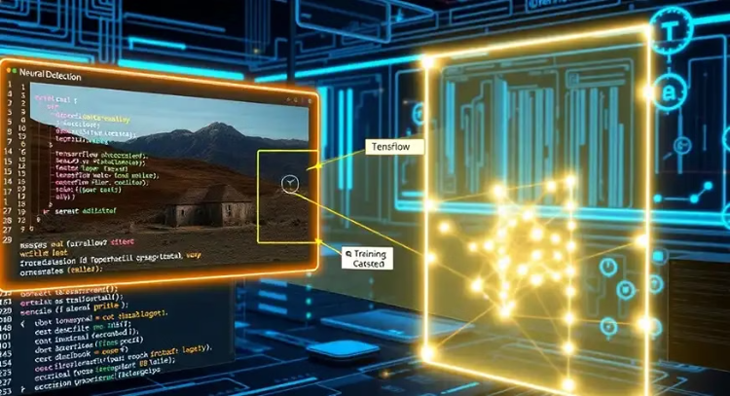
Mobile Net
MobileNet is a family of lightweight Convolutional Neural Networks (CNNs) designed for mobile and edge devices. Developed by Google, it is optimized for speed and efficiency while maintaining high accuracy in tasks like image classification, object detection, and segmentation.
Key Features:
Uses Depth wise Separable Convolutions to reduce computation while preserving accuracy.
Lightweight architecture with fewer parameters and lower memory requirements.
Optimized for mobile and embedded systems, ensuring fast inference speeds.
Multiple Variants.

Slide 6
Single Shot MultiBox Detector (SSD)
SSD-MobileNet is a fast and efficient object detection model that combines Single Shot MultiBox Detector (SSD) with MobileNet as its backbone. It is designed for real-time applications on mobile and edge devices like smartphones, IoT devices, and embedded systems
Methodology
1.Feature Extraction with MobileNet
The input image is passed through MobileNet, which extracts important features using depth wise separable convolutions to reduce computational cost
2.Multi-Scale Feature Maps Generation:
Unlike traditional models that use only the final layer, SSD applies multiple convolutional layers at different depths to detect objects of different sizes.
3. Bounding Box Predictions:
SSD generates multiple default anchor boxes (predefined shapes/sizes) for each feature map location.
It predicts object class and box offsets (adjustments to anchor boxes).
4. Non-Maximum Suppression (NMS):
Multiple bounding boxes may overlap for the same object.
NMS removes redundant boxes, keeping only the most relevant one with the highest confidence score.
5. Final Object Detection Output:
The model outputs detected objects with their class labels and bounding box coordinates

Slide 7
SSD
Features of SSD
Lightweight & Fast – Designed for low-power devices and runs in real-time.
Efficient Computation – Uses depth wise separable convolutions, reducing computation while maintaining accuracy.
Pre-trained Models Available – Can be fine-tuned using TensorFlow’s Object Detection API.
Cross-Platform Deployment – Easily deploys with TensorFlow Lite, Android, Raspberry Pi, and edge AI devices.
Uses
Real-time Object Detection in mobile apps (e.g., Google Lens).
Surveillance Systems for security and monitoring.
Autonomous Vehicles & Drones for object recognition.
Augmented Reality (AR) Applications for interactive experiences.

Slide 8
Compatibility of models
Feature
Faster R-CNN
YOLO (You Only Look Once)
SSD (Single Shot Detector)
Architecture
Two-stage detector (Region Proposal + Classification)
One-stage detector (Directly predicts bounding boxes & class probabilities)
One-stage detector (Predicts objects in a single forward pass)
Speed (FPS)
Slow (5-10 FPS)
Very Fast (30-150 FPS)
Fast (30-70 FPS)
Accuracy
High (Best for complex scenarios)
Moderate to High (Depends on YOLO version)
Moderate to High
Detection Type
Good for small and overlapping objects
Best for large objects, performs poorly on small objects
Handles small and large objects well but less accurate than Faster R-CNN
Computation
High (Requires powerful GPU)
Medium (Efficient with good speed-accuracy tradeoff)
Low (Optimized for real-time applications)
Use Cases
Autonomous driving, medical imaging, surveillance
Real-time applications like video surveillance, robotics
Mobile devices, embedded systems, AR applications
Deployment Suitability
Works best on high-end GPUs
Works on both CPU & GPU efficiently
Optimized for mobile & edge devices
Pre-trained Models
Available (TensorFlow, PyTorch)
Available (Darknet, TensorFlow, PyTorch)
Available (TensorFlow, TensorFlow Lite)
Best For
High-accuracy tasks where speed is not a major concern
Real-time detection with a good speed-accuracy balance
Mobile & Edge AI applications

Slide 9
Literature review
Performance Analysis of TensorFlow2 Object Detection API Models for Engineering Site Surveillance Applications
​
Attribute
Details
Paper Title
Performance Analysis of TensorFlow2 Object Detection API Models for Engineering Site Surveillance Applications
Year Published
2023
Methodology
- Evaluated six object detection models from TensorFlow2 Object Detection API. - Used models: CenterNet, EfficientDet, SSD MobileNet v2, Faster R-CNN, etc. - Tested on motion capture images from SitePro Inc. under various weather & lighting conditions. - Models analyzed for classification accuracy & performance across different object categories. - Assessed computational efficiency of different models for engineering site surveillance.
Metrics Used
- Accuracy - Precision & Recall - F1 Score - Misclassification Rate (to measure errors in detection).
Limitations
- Struggles with small movements triggering motion capture, increasing image processing load. - Some models misclassified vehicles and animals due to dataset limitations. - Cloud-based models (e.g., Microsoft Vision) incurred high operational costs.

Slide 10
Advancements in Animal Tracking: Assessing Deep Learning Algorithms
Attribute
Details
Paper Title
Advancements in Animal Tracking: Assessing Deep Learning Algorithms
Year Published
2024
Methodology
- Compared YOLO models (YOLOv5, YOLOv7) with TensorFlow Model Zoo architectures (Faster R-CNN ResNet152 & SSD ResNet101). - Used a dataset containing animal images labeled with different postures (standing, eating, laying, etc.). - Applied data augmentation techniques to enhance dataset diversity and size. - Trained models using pre-labeled animal tracking datasets. - Evaluated real-time detection performance for wildlife monitoring applications.
Metrics Used
- Mean Average Precision (mAP) (YOLOv5 achieved the highest mAP of 97.5%). - Precision-Recall Curves to assess model confidence. - Intersection over Union (IoU) to measure bounding box accuracy.
Limitations
- TensorFlow-based models (Faster R-CNN, SSD) lag behind YOLO models in accuracy and speed. - Object occlusions in videos impacted model effectiveness. - Lighting conditions and animal movement introduced variability in detection accuracy.
​

Slide 11
Object Detection Techniques: Overview and Performance Comparison
Attribute
Details
Paper Title
Object Detection Techniques: Overview and Performance Comparison
Year Published
2019
Methodology
- Compared Faster R-CNN, YOLO, and SSD object detection algorithms. - Evaluated trade-offs between speed (FPS) and accuracy (mAP). - Implemented TensorFlow Object Detection API for model training and testing. - Assessed Microsoft Azure Cloud API vs. TensorFlow API for object detection efficiency. - Used standard datasets & real-world test cases for benchmarking model performance.
Metrics Used
- Mean Average Precision (mAP) (higher values indicate better accuracy). - Execution Speed (Frames Per Second - FPS). - Detection Confidence Scores for assessing model predictions.
Limitations
- Faster R-CNN is computationally expensive, making it unsuitable for real-time applications. - YOLO has lower accuracy for small objects compared to Faster R-CNN. - Microsoft Azure Cloud API relies on a constant network connection, limiting offline usability.

Slide 12
Limitations
While TensorFlow's Object Detection API with SSD-MobileNet offers excellent efficiency and real-time performance, it also has some limitations
Accuracy Trade-off for Speed
Limited Detection of Small Objects
Requires High-Quality Training Data
High Computational Requirements for Training
Sensitivity to Lighting and Background Variations
Limited Customization for Complex Applications

Slide 13



Methodology
Creating a virtual environment to manage dependencies for TensorFlow object detection.
Capture images using webcams, video devices, or microscope cameras for real-world scenarios
Select a pre-trained SSD-MobileNet model from TensorFlow’s Model Zoo
Use Google Colab or a local GPU for training
Use venv or conda to isolate dependencies, preventing conflicts with other Python libraries
Use LabelImg or Roboflow to create XML annotations (PASCAL VOC format) for object labeling
Train SSD-MobileNet with transfer learning using COCO-pretrained weights
Install CUDA and cuDNN for GPU acceleration
Maintain a clean folder structure with separate directories
Adjust hyperparameters like learning rate, batch size, and detection threshold
Verify TensorFlow’s compatibility with GPU drivers to optimize performance
Convert labeled dataset into TensorFlow Record (TFRecord) format
Analyze precision-recall curves to assess detection quality

Slide 14



Methodology
Use precision, recall, and mAP (mean Average Precision) for performance assessment.
Optimize SSD-MobileNet using TensorFlow Lite (TFLite) for mobile and embedded applications
Apply SSD-MobileNet to face detection, sign language recognition, and movement tracking
Test the model on validation and unseen test images
Apply quantization (INT8/Float16) to reduce model size while maintaining accuracy
Use directional movement detection for gesture-based applications
Increase training data with additional diverse samples to improve robustness
Use OpenCV to implement live detection via webcam for quick prototyping
Collect feedback from real-world performance and fine-tune the model
Adjust anchor box sizes, feature extractor layers, and augmentation techniques
Use IBM Cloud CLI for efficient cloud storage management
Optimize for low-light conditions, occlusions, and small object detection

Slide 15
Conclusion
Object detection using TensorFlow and SSD-MobileNet provides an efficient, lightweight, and real-time solution for identifying and classifying objects in images and videos. By utilizing TensorFlow’s Object Detection API, we can train and fine-tune models for various applications, such as face recognition, sign language interpretation, and movement tracking. The integration of SSD (Single Shot MultiBox Detector) with MobileNet ensures a balance between speed and accuracy, making it ideal for mobile and embedded devices. Through data annotation, model training, and performance evaluation, the system can be optimized to work in diverse environments, improving detection accuracy even in challenging conditions.
Despite some limitations—such as difficulty in detecting small or overlapping objects—these challenges can be mitigated through data augmentation, hyperparameter tuning, and additional training on diverse datasets. Converting the model to TensorFlow Lite enables low-latency inference, making it suitable for deployment on edge devices like Raspberry Pi and Jetson Nano. By leveraging cloud storage solutions such as IBM Cloud, object detection models can also be scaled for larger applications. In conclusion, TensorFlow-based SSD-MobileNet object detection is a powerful, flexible, and deployable AI solution for real-time object recognition in various industries, including security, healthcare, and automation

