Slide 1

Project Title - Seasonal Agriculture Performance Analysis
[Student Name-Repalle Gnaneswar
College Name-Amrita Vishwa Vidyapeetham, Bengaluru]
AICTE STU ID : STU6a6c86017de091785497089

Slide 2

PROBLEM STATEMENT
Agricultural activities are influenced by seasonal variations in environmental conditions, farming practices, resource availability and market conditions. As a result, agricultural performance may differ from one season to another.
However, raw agricultural data does not clearly explain how agricultural performance changes across seasons or what patterns can be observed in different seasonal conditions.
The problem is to analyze the given agricultural dataset and investigate seasonal differences in agricultural performance by identifying meaningful patterns, trends, relationships and variations within the available data.

Slide 3
Project Description
Seasonal Agriculture Performance Analysis is a data analytics project that studies how agricultural performance changes across Kharif, Rabi, and Zaid seasons. The project analyzes factors such as crop yield, rainfall, temperature, water consumption, irrigation methods, operating cost, profit, and resource utilization to identify important seasonal patterns and relationships.
The project involves data cleaning and preprocessing, exploratory data analysis, statistical hypothesis testing, seasonal comparison, regional and crop-level analysis, outlier/anomaly detection, data visualization, and evidence-based recommendations.

Slide 4
Project Description
The analysis identifies how environmental conditions and farming practices influence agricultural productivity, profitability, and water efficiency. Statistical techniques such as ANOVA, Kruskal-Wallis, post-hoc tests, effect-size analysis, and interaction testing are used to validate the observed differences. The final outcome is a set of data-driven insights and recommendations for better seasonal agricultural planning.

Slide 5

WHO ARE THE END USERS?
Farmers – To select suitable crops, irrigation methods, and farming practices for different seasons.
Agricultural Planners and Agronomists – To understand seasonal productivity and crop-specific patterns.
Government and Agricultural Departments – To support evidence-based agricultural policies and seasonal planning.
Water Resource Managers – To monitor seasonal water consumption and improve irrigation efficiency.
Agricultural Researchers – To study relationships between environmental conditions, farming practices, and crop performance.
Agri-businesses and Cooperatives – To evaluate production costs, profitability, and seasonal opportunities.

Slide 6

Technology Used
Programming and Development
Python
Jupyter Notebook
Data Analysis
Pandas
NumPy
Data Visualization
Matplotlib
Seaborn

Slide 7
Technology Used
Statistical Analysis
SciPy
Statistical models
ANOVA
Kruskal-Wallis Test
Tukey HSD
Mann-Whitney U Test
Effect Size Analysis

Slide 8
Technology Used
Data Processing
Data Cleaning and Preprocessing
Feature Engineering
Outlier Detection using IQR and Modified Z-Score
Dataset
Seasonal agricultural data containing crop, environmental, resource, production, and economic attributes.

Slide 9
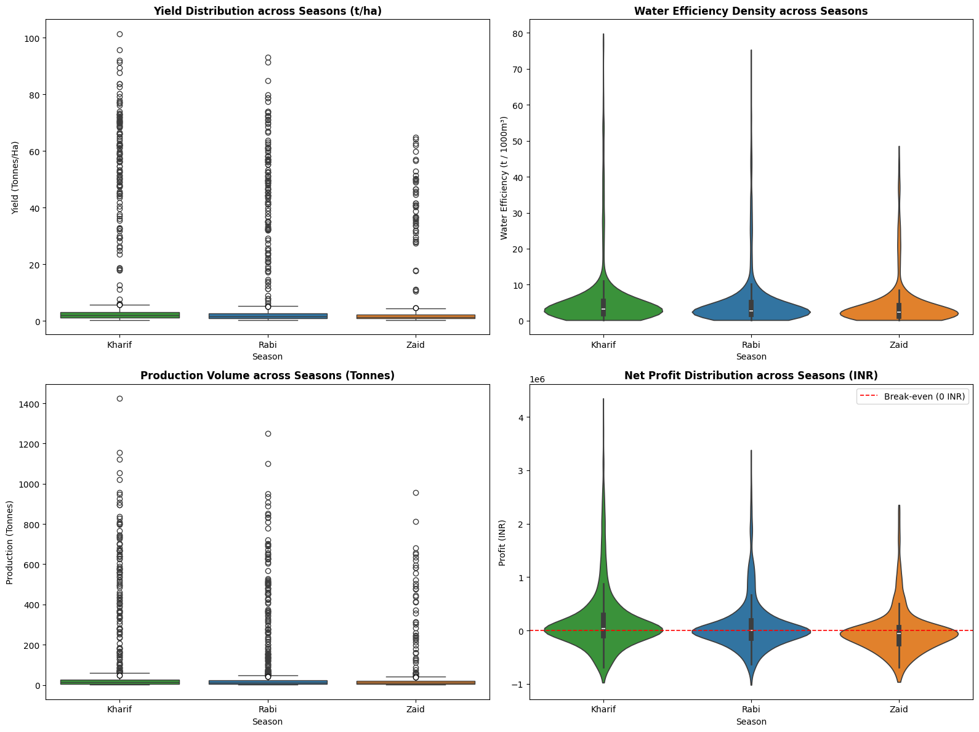
RESULTS
Box plot of Yield (Tonnes/Ha) across Kharif, Rabi, and Zaid seasons showing extreme high-value outliers.
Violin plot of Net Profit (INR) across seasons highlighting distribution density and a red dashed break-even line (0 INR).

Slide 10
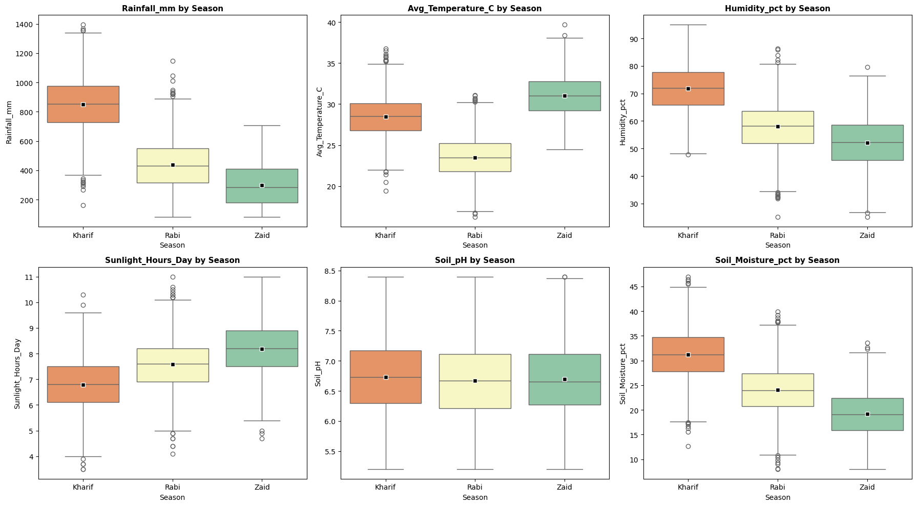
RESULTS
Box plot of Seasonal Rainfall (mm) showing median, interquartile range (IQR), and mean markers.
Box plot of Seasonal Average Temperature (°C) across Kharif, Rabi, and Zaid.

Slide 11
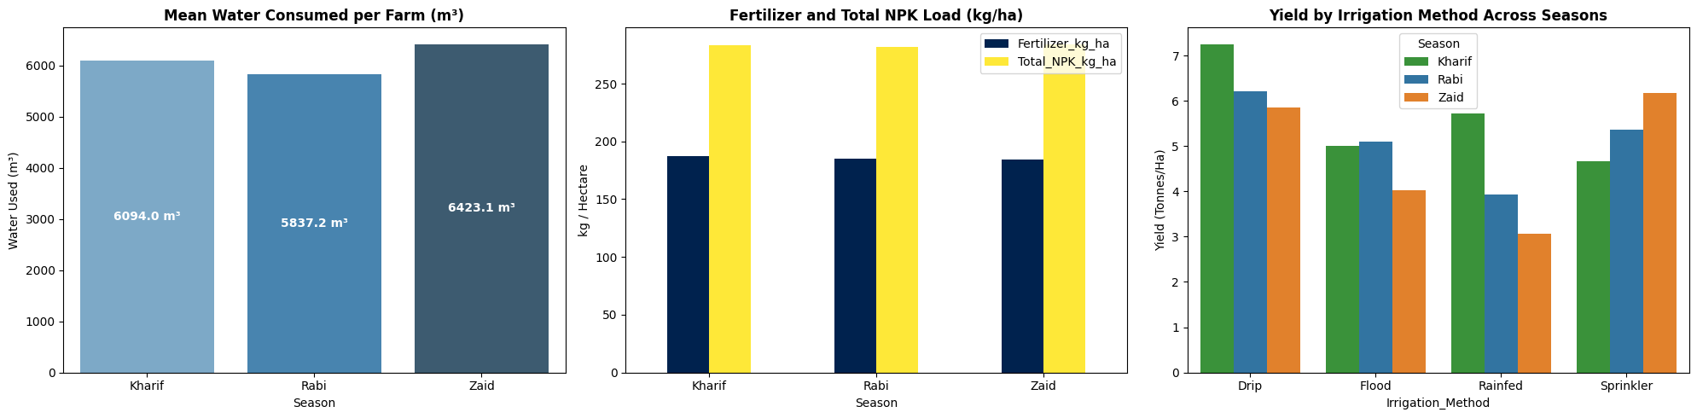
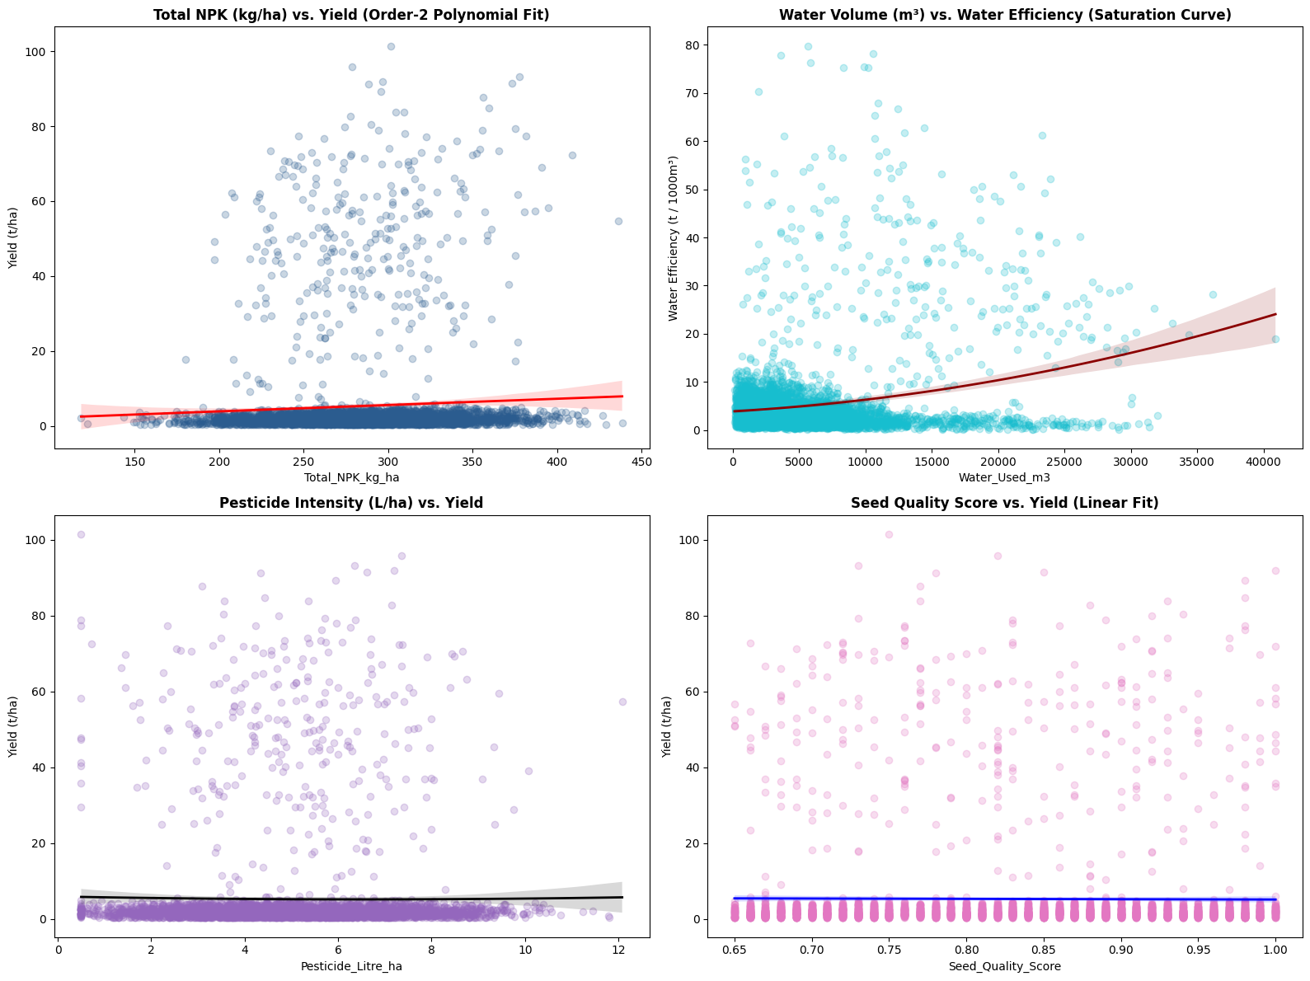
RESULTS
Bar chart showing Mean Water Consumed per Farm (m³) across Kharif, Rabi, and Zaid.
Scatter plot and non-linear regression curve for Water Volume (m³) vs. Water Efficiency (t / 1,000m³).

Slide 12
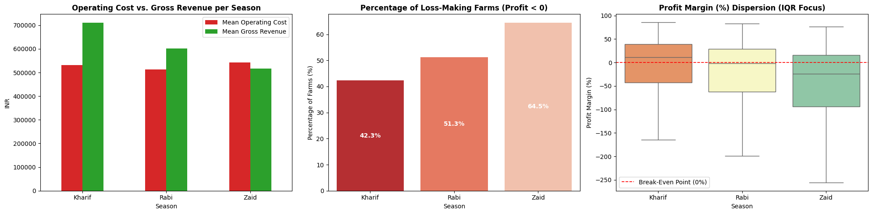
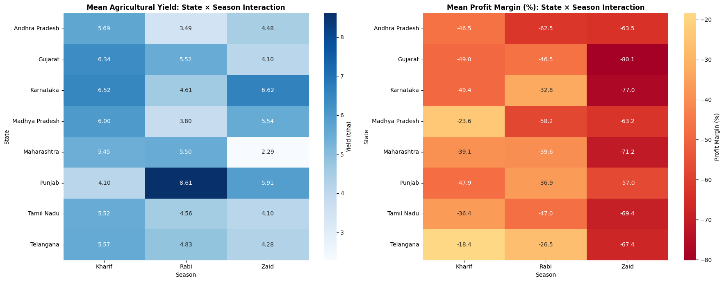
RESULTS
Bar chart illustrating the percentage of loss-making farms (Profit < 0) across seasons.
State × Season interaction heatmap displaying mean agricultural yields (t/ha).

Slide 13
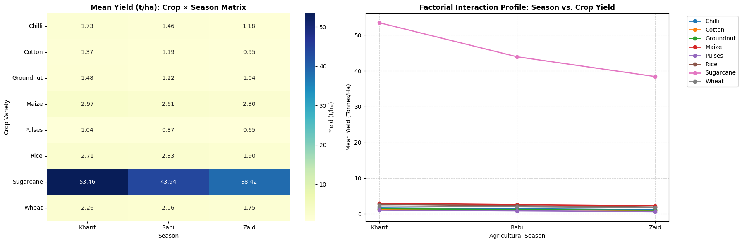
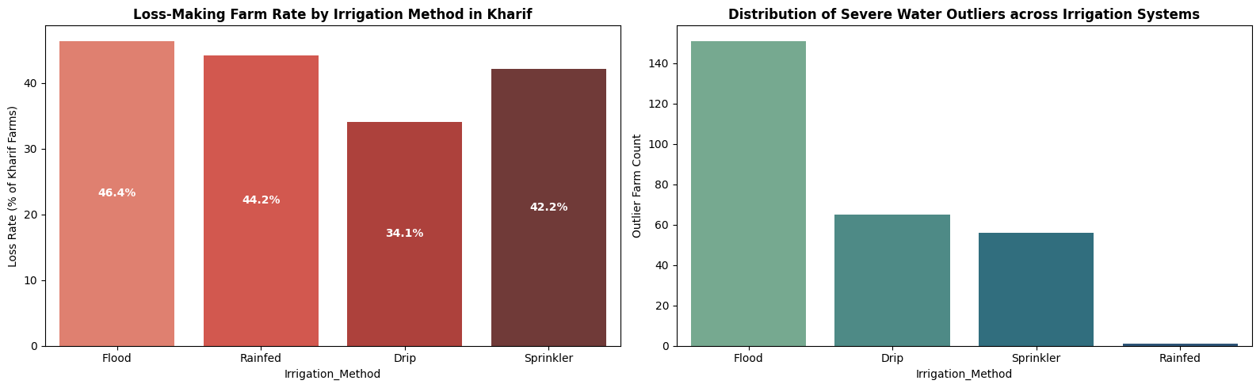
RESULTS
Factorial interaction line plot comparing mean yields (t/ha) of eight crops across Kharif, Rabi, and Zaid.
Bar chart showing the count of severe water consumption outliers by irrigation method.

Slide 14
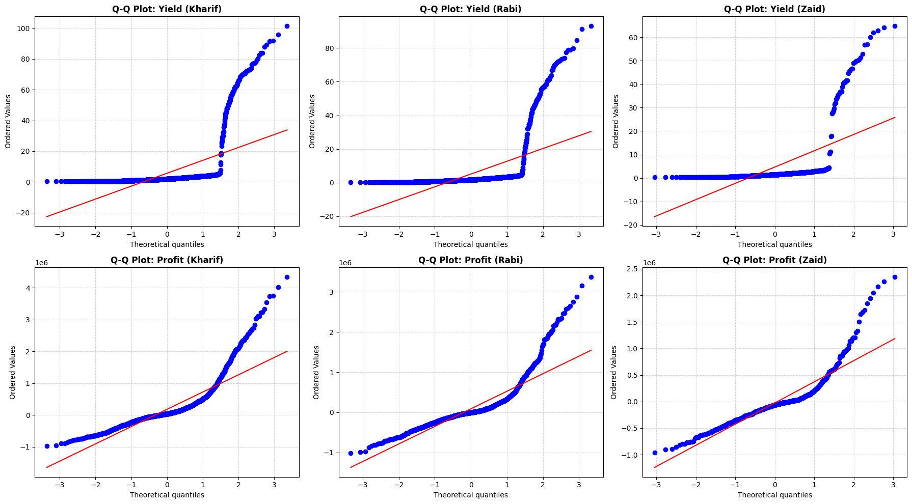
RESULTS
Top Row: Quantile-Quantile (Q-Q) plots for Yield distribution across Kharif, Rabi, and Zaid.
Bottom Row: Q-Q plots for Net Profit distribution across Kharif, Rabi, and Zaid against theoretical normal quantiles.

Slide 15
Future scope
Machine Learning Prediction: Develop models to predict crop yield, profit, and water requirements for upcoming seasons.
Crop Recommendation System: Recommend suitable crops based on season, soil, rainfall, temperature, and water availability.
Smart Irrigation: Integrate IoT sensors and real-time weather data to optimize irrigation and reduce water wastage.
Real-Time Monitoring: Build a dashboard for continuously monitoring agricultural performance and environmental conditions.

Slide 16
Future scope
Weather Integration: Incorporate live weather forecasts to improve seasonal crop planning.
Geographical Analysis: Integrate GIS and satellite data to provide location-specific agricultural insights.
Early Risk Detection: Develop systems to identify potential crop losses, water stress, and abnormal agricultural conditions at an early stage.
Decision Support System: Convert the analytical findings into an intelligent tool that provides farmers and agricultural authorities with actionable recommendations.

Slide 17
GitHub Link
https://github.com/Gnaneswar0906/Seasonal-Agricultural-Performance-Analysis.git

Slide 18

VOIS Course completion certificate - Course name- Data Visualization

Slide 19
Thank you
.

