Slide 1

Investigating the Relationship Between Location-Based Factors and Health Using Machine Learning
Bhanu Patlori
Gnaneswar Rao Goddu
Ngbede Acheme
Vineetha Burra

Slide 2

Introduction
Chronic conditions such as asthma and hypertension are influenced by multiple factors beyond genetics, notably the environments where people live. This presentation explores how location-based factors – such as environmental and sociodemographic - impact health outcomes in England using the comprehensive MedSat dataset. We aim to reveal the key variables shaping public health patterns. Similar work has been done by Shao, Xu, and Wu (2021), they used a spatial
regression technique called geographically weighted regression (GWR) to predict COVID-19 cases in China based on
population flow variables, geolocation, and socioeconomic
data. Also, Scarpone et al. (2020) used GAMs to
identify variables associated with COVID-19 at the county
Scale; and Sun et al. (2023) applied GAMs to predict respiratory disease mortality using air pollution and weather factors.

Slide 3
Objectives
1.Identify Predictors: Use variable importance techniques to pinpoint key factors affecting health.
2.Spatial Analysis: Apply Generalized Additive Models (GAMs) and Multiscale Geographically Weighted Regression (MGWR) to uncover spatial relationships between geographic variables and disease patterns.
3.Policy Insights: Generate data-driven recommendations to inform and improve public health policies. It can be inferred from
This study that some pollution related projects like thermal plants for generating electricity, while powering big cities, could be
contributing to health risks where those plants are located. This may call for some form of compensation or regulation.

Slide 4
MedSat Dataset: Composition and Importance
Dataset Overview
Dataset Variables
MedSat is a public health dataset for England linking medical prescriptions with environmental, sociodemographic, and satellite imagery features.
Medical outcomes: Prescription rates per capita for chronic diseases like diabetes, asthma, and anxiety.
Environmental features: Air pollutants NO₂ and PM2.5, solar radiation, vegetation indices.
MedSat contains 67,510 records and 169 variables from 2019 to 2020, including pre- and during-COVID periods.
Socioeconomic indicators: Income levels, occupation types, ethnicity, commuting patterns.
This rich dataset enables spatial and temporal analysis at the Local Authority District (LAD) level to examine how local environments and population characteristics relate to health outcomes across England.
Satellite imagery: Sentinel-2 statistics for London (Spring 2019) enable spatial and temporal analyses by Local Authority District (LAD).

Slide 5

Feature Engineering and Data Preparation
Data Cleaning
Handling Data Gaps
Income Categorization
Merged datasets from 2019 and 2020, standardized column names, and addressed missing values using median and mean imputations.
Filled prescription quantity gaps with regional and national medians to ensure consistent modeling inputs.
Created four income brackets—Low, Medium, High, Very High—to capture socioeconomic gradients in health analysis.

Slide 6
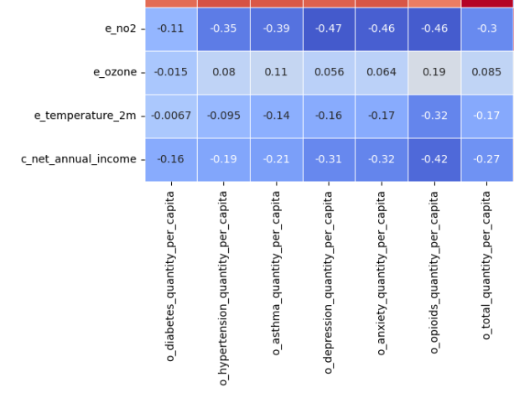
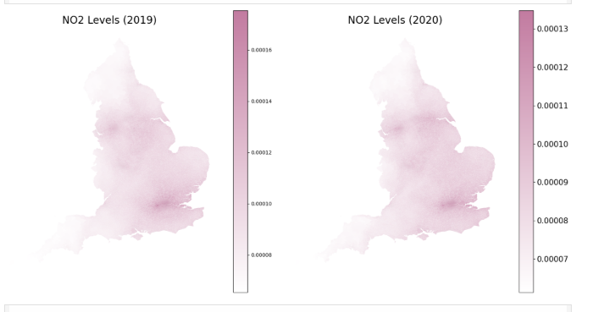
A peek at Feature Engineering outcome
Heat map
NO2 Distribution

Slide 7
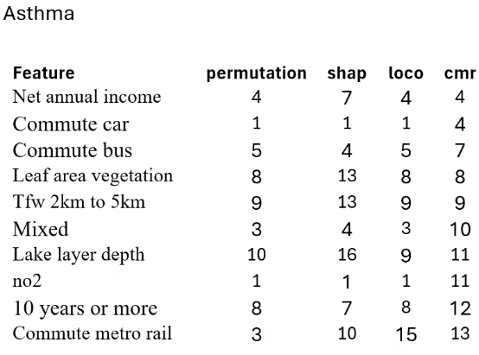
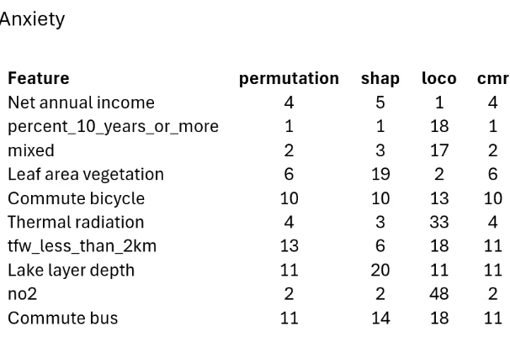
Variable Selection and Importance Analysis Techniques
Knockoff Filtering
Modeling Approaches
Reduced predictor variables by controlling false discovery rate (FDR) to identify meaningful features.
Implemented XGBoost and Rahomon models, selecting top performing algorithms for each health outcome.
Examined feature importance through methods like SHAP, LOCA, Permutation, and CMR to identify top 10 variables.

Slide 8



Global Relationships via Generalized Additive Models (GAMs)
Statistical Significance
Provided p-values and effect magnitudes for key predictors, confirming their global relevance across England.
2
Non-Linear Effects
GAMs uncover complex, smooth relationships between predictors and health outcomes beyond simple linear trends.
1
Visual Shape Functions
Shape plots illustrated how variables like air pollution and income influence diseases in a nuanced manner.
3

Slide 9
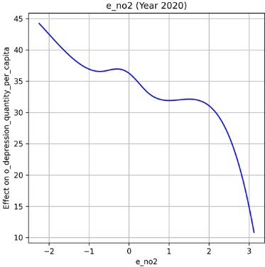
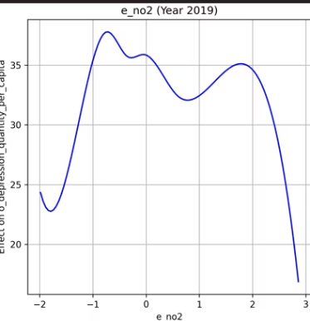
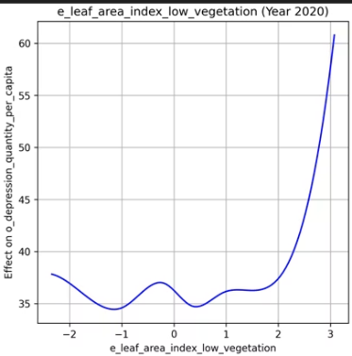
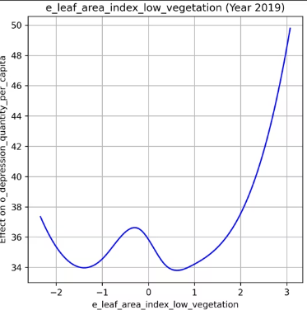

Slide 10
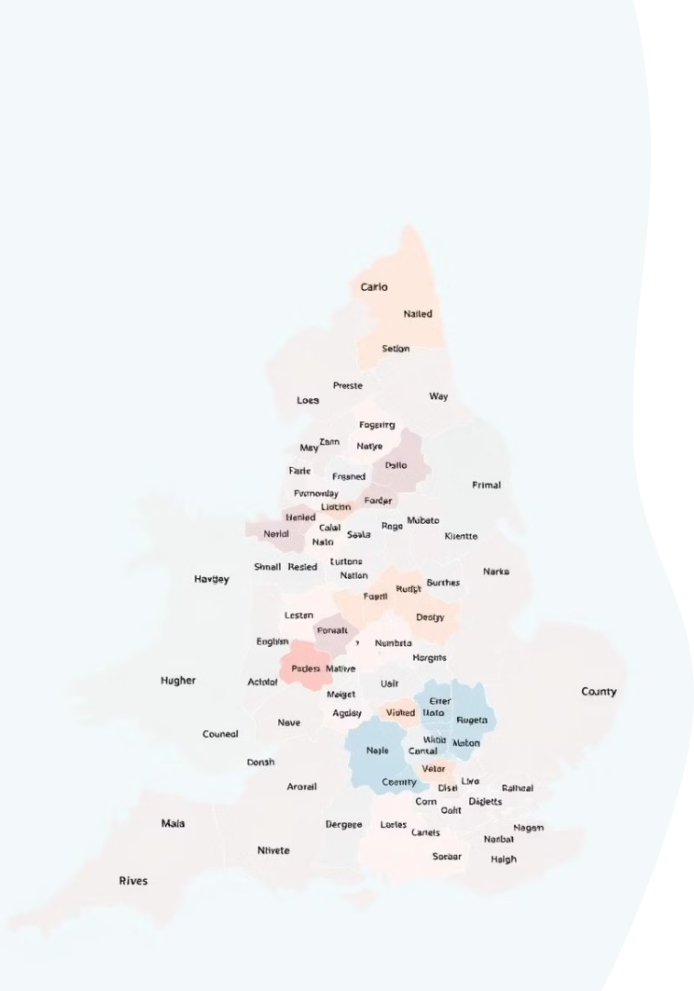



Spatial Variation with Multiscale Geographically Weighted Regression (MGWR)
Applied Multiscale Geographically Weighted Regression (MGWR) to assess how predictors influence health outcomes based on location.
MGWR assigns a separate coefficient and bandwidth to each predictor, allowing detection of both local and widespread effects.
Found significant regional variation in predictor impact—e.g., income had a strong negative effect on diabetes in some areas, but weaker or slightly positive in others.
Other variables like smoking rate, education level, and air pollution also showed varying effects depending on geography.
To validate MGWR results, used locally weighted linear regression for each Local Authority District (LAD) with spatial weighting.
Local models confirmed that predictor influence differs across locations.
Extracted and compared region-specific coefficients across LADs using plots and summary statistics.

Slide 11
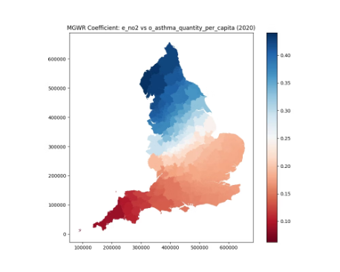
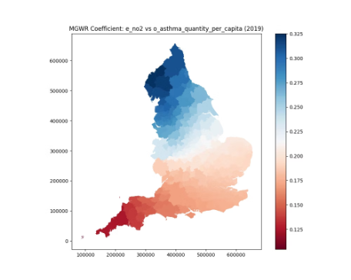
Both maps show a similar trend, with higher coefficients (darker colors) in the northern and southwestern regions, and lower coefficients (lighter colors) in the eastern and central regions.
The northern regions (e.g., Cumbria, Lancashire) show an increase in coefficient values from 2019 to 2020, indicating a stronger relationship between NO₂ and asthma in these areas.
The southwest (e.g., Cornwall, Devon) maintains high coefficients but with a slight decrease in the upper range (from 0.175 to 0.15).
Eastern regions (e.g., East Anglia) remain relatively stable with lower coefficients (around 0.20 to 0.25).
Overall, the 2020 map indicates a generally stronger association between NO₂ and asthma per capita across northern England, while the southwest remains a consistent high-association area, with slight variations in intensity.

Slide 12

Future Directions and Research Opportunities
Expand Dataset Temporal Scope
Incorporate additional years to capture long-term trends and COVID-19 impacts on chronic health outcomes.
Integrate Additional Variables
Include behavioral factors, healthcare accessibility, and genetic information to enhance model comprehensiveness.
Refine Spatial Models
Develop dynamic spatial-temporal frameworks for monthly or quarterly surveillance and prediction of health risks.

