Slide 1
Inter-Software Communication
What? Why? Who?
A talk by Matan Shtepel. Originally given to the Las Positas College CS club, 4/2/21

Slide 2
A Though (provoking) Exercise
“Abstraction is the price of generality”
On broad terms, what does software do?

Slide 3
My opinion
“The purpose of computation is insight, not numbers.” Richard Hamming, 1962.
On broad terms, what does software do?
1 : arithmetic operations
information processing (of any type) boils down to +,-,%,*,…
2 : read/write data
Lower level: to memory (RAM or Disk) or other hardware
Higher level: Between programs

Slide 4
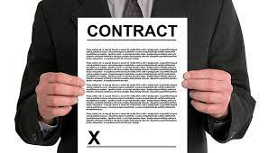
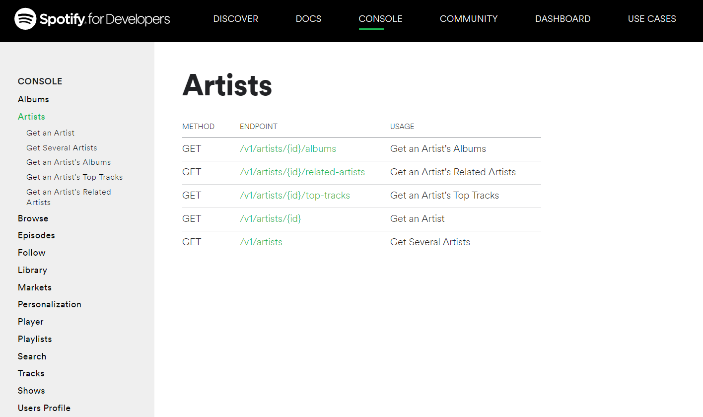
API (Application Programming Interface)
Remember, all contracts are based on trust.
As a contract
Between Humans:
Between Software:
APIs come in many models. Today, RESTful APIs are the most-common, particularly in

Slide 5
Example #1:
We will revisit this API in example #3!
The simplest API on the internet
Go to: https://random-word-api.herokuapp.com/home
Then: https://random-word-api.herokuapp.com/word?number=20
Finally: https://random-word-api.herokuapp.com/all

Slide 6
Main Components
Note: our focus in on modern user-aimed (web) applications.
So… what did we just see?
Of inter-software communication
1) HTTP: delivers the data
Hyper Text Transfer Protocol.
A stateless transmitter of resources, request-response model
2) JSON: is (often) the data
JavaScript Object Notation.
Language-independent, human-readable, wildly-supported, data-interchange format.

Slide 7
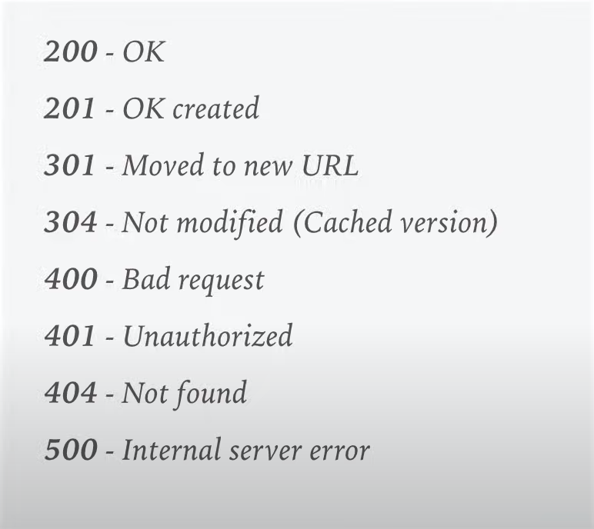
HTTP
HTTP Protocols can get very intricate. Yet developers are often concern only a small portion.
Brief overview:
Stateless
Methods:
GET, POST, PUT, DELETE, …
Two parts: head and body.
Status codes: in ranges
Authorization
HTTPS: man-in-the-middle attacks
protects the communications against eavesdropping and tampering

Slide 8
Example #2:
Don’t be intimidated by the headers!
Real HTTP(S) on the internet!
Open the chrome developer tools: CTRL + SHIFT + I or on right click.
=> Network => Load up any site

Slide 9
JSON
Like with HTTP, there are many levels of abstraction set-up that until you care, you don’t have to.
Brief overview:
C-style syntax
2 structures:
Collection of key-value pairs; object or dictionary.
Ordered list of values; array or list.
4 data types: number, string, bool, null.
Advantages: modern, easy-to-think-in-terms, wildly supported

Slide 10
JSON:
https://p.scdn.co/mp3-preview/e7ea8a13f7caf6942c5447e9cd96aac2a076d85a?cid=774b29d4f13844c495f206cafdad9c86 to rock out!
Examples:
"href": "https://api.spotify.com/v1/tracks/4PRGxHpCpF2yoOHYKQIEwD",
"id": "4PRGxHpCpF2yoOHYKQIEwD",
"is_local": false,
"is_playable": true,
"name": "Rock and Roll - Remaster",
"popularity": 69,
"preview_url": "https://p.scdn.co/mp3-preview/....
"track_number": 2,
"type": "track",
"uri": "spotify:track:4PRGxHpCpF2yoOHYKQIEwD"
},
{
"error": {
"status": 401,
"message": "No token provided"
}
}
Response for an unauthenticated
Spotify API request
A small slice of the response for Led Zeppelin's top-tracks (aren’t they all?)
["gabby","husky","anthelixes","relatives","sniggerer","perestroikas","compleat","excerpters","neurofibril","pyas"]
Response for a 10-word request from the random-word API

Slide 11
Example #3:
Even though our examples might be silly, consider the immense potential!
The next unicorn start-up: Matan’s Random-Words
AKA: How to make a billion dollars and land a job at Google.

Slide 12
Example #4:
Yay we get to code!
The next unicorn start-up: Matan’s Random-Words
AKA: How to make a billion dollars and land a job at Google.
Challenge for the able: could you display the user’s repositories?
Hint: you shouldn’t have to look at the API docs!

Slide 13
Example #4:
Yay we get to code!
The next unicorn start-up: Matan’s Random-Words
AKA: How to make a billion dollars and land a job at Google.
Challenge for the able: could you display the user’s repositories?
Hint: you shouldn’t have to look at the API docs!

Slide 14
Node.js
: the corner stone of the JS revolution
Node v8 JS engine
Ryan Dahl in 2009,
Js EVERYWHERE!
Unify backend and frontend
Blocking vs non blocking, threading, event based, asynchronous
So what's the goal? (networking apps)
Deno

Slide 15
Example #5:
Yay we get to code!
Let’s play with node!
Run JS Outside the browser

Slide 16
Example #6:
Yay we get to code!
Introduction to node modules
Yay! The JS ecosystem!

Slide 17
Example #7:
Yay we get to code!
Our first server
Wow… I can’t believe we got so far 😢😊

Slide 18
Thank You for your time.

