Slide 1
Department of MCA
AI-ENCHANCED DATA VISUALIZATION BY USING POWER BI Under the Guidance of Dr.Kalimuthu
By :
Gorantla Naveen
2401600196
Dept. of MCA. KL University.

Slide 2
Introduction:
Problem statement :
Nowadays, a large amount of data is generated, but it is difficult to understand in raw form. Traditional tools cannot easily show clear insights, and many users face problems in analyzing data. This leads to poor decision-making.
Why this project?:
This project is used to make data simple and easy to understand using Power BI with AI features.
To convert raw data into clear visuals
To provide smart insights and predictions
To help users understand data easily
To improve decision-making

Slide 3
Objectives:
To change raw data into simple charts
To make data easy to understand
To use AI for better insights
To create dashboards in Power BI
To help in making good decisions

Slide 4
Literature Survey:
Many researchers have worked on data visualization to make data easy to understand. Traditional tools help in creating charts and graphs, but they do not provide smart insights.
Recent studies focus on using AI with data visualization. AI helps in finding patterns, predicting trends, and giving better insights. Tools like Power BI provide features such as dashboards, reports, and real-time analysis.
From the study, it is clear that combining AI with visualization improves decision-making and makes data more useful

Slide 5
Methodology:
Collect data from different sources
Clean and organize the data
Load data into Power BI
Create charts and dashboards
Use AI features for insights and predictions
Analyze results and make decisions

Slide 6
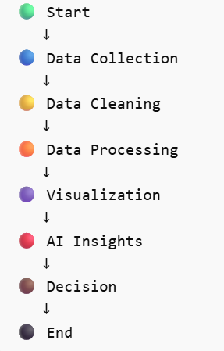
Flow Chart:

Slide 7
Technologies Used
Power BI – For data visualization and dashboard creation
Microsoft Excel / CSV – For data storage and input
AI Features (Power BI AI) – For insights and predictions
Power Query – For data cleaning and transformation
DAX (Data Analysis Expressions) – For calculations and analysis.

Slide 8
Implementation
Data Collection Module
This module collects COVID-19 data from different sources such as Excel files, CSV files, or online datasets. It ensures that the required data like cases, recoveries, and deaths is gathered properly for analysis.
Data Cleaning Module
In this module, the collected data is cleaned by removing duplicate values, handling missing data, and correcting errors. This step improves the quality and accuracy of the data.
Data Visualization Module
This module uses Power BI to create charts, graphs, and dashboards. It helps in presenting the data in a clear and easy-to-understand format for users.
AI Insights Module
This module uses Power BI AI features to identify patterns, trends, and predictions. It helps users to understand future outcomes and supports better decision-making.

Slide 9
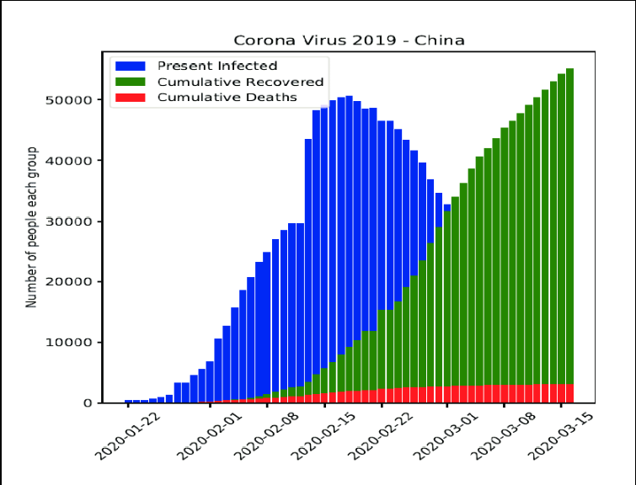
Results & Output:
Sample Outputs:
Interactive dashboards created in Power BI
Charts like bar graph, pie chart, and line chart
Reports showing trends and patterns
Graphs / Performance:
Clear and easy-to-understand visualizations
Fast performance with real-time data updates
Improved data analysis and decision-making

Slide 10
Advantages:
Makes data easy to understand through visualizations
Saves time by automating data analysis
Provides AI-based insights and predictions
Helps in better and faster decision-making
Interactive dashboards improve user experience
Handles large amounts of data efficiently

Slide 11
Limitations:
Depends on the quality of input data
Requires basic knowledge of Power BI
AI insights may not always be 100% accurate
Limited customization in free version
Large datasets may affect performance

Slide 12
Future Scope:
Can use more advanced AI features
Can work with live (real-time) data
Can be used in different fields
Can improve accuracy
Can create better dashboards

Slide 13
Conclusion:
This project shows how data can be converted into simple and meaningful visualizations using Power BI. By using AI features, it helps to find patterns, trends, and useful insights. The project makes data easy to understand and supports better decision-making.
It also reduces manual effort in data analysis and saves time. Interactive dashboards allow users to explore data easily and get quick results. Overall, this project improves data analysis efficiency and helps organizations make smart and data-driven decisions.

Slide 14
THANK YOU

