Slide 1
Department of MCA
Slide 1:Title
AI-Enhanced Data Visualization for COVID-19 Analysis
Under the Guidance of : Dr.Kalimuthu Sir
By :
Student Name:Gorantla Naveen
Roll No:2401600196
Dept. of MCA.
KL University.

Slide 2
Slide 2: Problem Statement
During the COVID-19 pandemic, a large amount of data was generated daily across different regions. Most of this data is presented in numerical or tabular formats, which makes it difficult for users to clearly understand the information. Existing systems mainly provide static reports without interactive visual support. Because of this, analyzing trends and identifying patterns becomes challenging for users. Visual representation is required to simplify complex COVID-19 data. Therefore, an interactive and intelligent data visualization system is needed to effectively analyze and present the data.

Slide 3
Slide 3 : Scope of the Project
The system focuses on collecting and analyzing historical COVID-19 data from reliable sources. It provides interactive visualizations of confirmed cases, deaths, and recoveries to help users understand the data easily
The system does not support real-time or live COVID-19 data updates. It is not designed for medical diagnosis, patient-level prediction, or clinical decision-making.
The system is designed for students, researchers, and data analysts who want to study COVID-19 trends and patterns. It is also useful for government officials and policymakers for analytical reference and reporting.

Slide 4
Slide 4 – Proposed Solution
This project presents an interactive COVID-19 data visualization system to address the difficulty of understanding large amounts of numerical data. The system transforms complex COVID-19 datasets into clear and meaningful visual dashboards. It helps users easily analyze trends, patterns, and comparisons across different regions and time periods. Interactive charts and basic AI-based trend analysis improve data interpretation and reduce manual effort. Overall, the solution makes COVID-19 data analysis simple, effective, and user-friendly.
The innovation of this project is the integration of interactive data visualization with basic AI-based trend analysis to simplify complex COVID-19 data. It enables users to easily identify patterns and insights without relying on static reports.

Slide 5
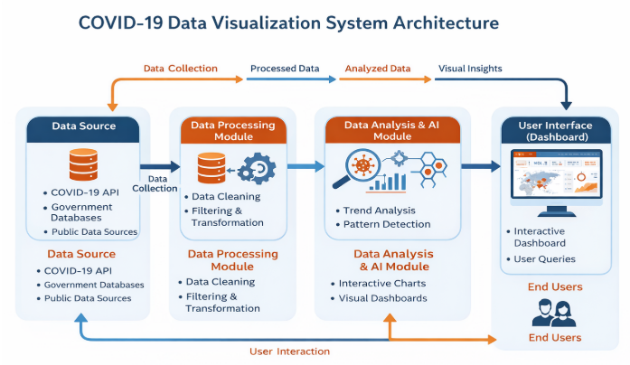
Slide 5 :System Architecture
The system follows a structured data flow for analysis and visualization.
Components explanation
• COVID-19 Data Source (CSV/Excel)
• Data Cleaning and Processing
• Power BI Dashboard
• AI Insight Engine
Data flow overview
Data Flow: Data Collection → Processing → Visualization → AI Insights → User

Slide 6
Slide 6 – Technologies Used
Frontend: Power BI Dashboard
Backend: Power BI Data Processing Engine
Database:CSV / Excel files
Tools & Libraries:
• Microsoft Power BI
• Microsoft Excel

Slide 7
Slide 7 – Module Description
Module 1 – Data Collection:
Collecting COVID-19 data from reliable public sources such as government websites and official health organizations to ensure accuracy, consistency, and credibility of the dataset used for analysis and visualization.
Module 2 – Data Processing:
This module focuses on cleaning, filtering, and organizing the collected COVID-19 data by handling missing values, correcting errors, and transforming the data into a suitable format. The processed data is then prepared for accurate analysis and effective visualization in the dashboard
Module 3 – Visualization & AI Insights:
This module focuses on creating interactive dashboards and visualizations using Power BI to represent COVID-19 data clearly. AI-assisted features are applied to generate insights, identify trends and patterns, and support better understanding and decision-making.

Slide 8
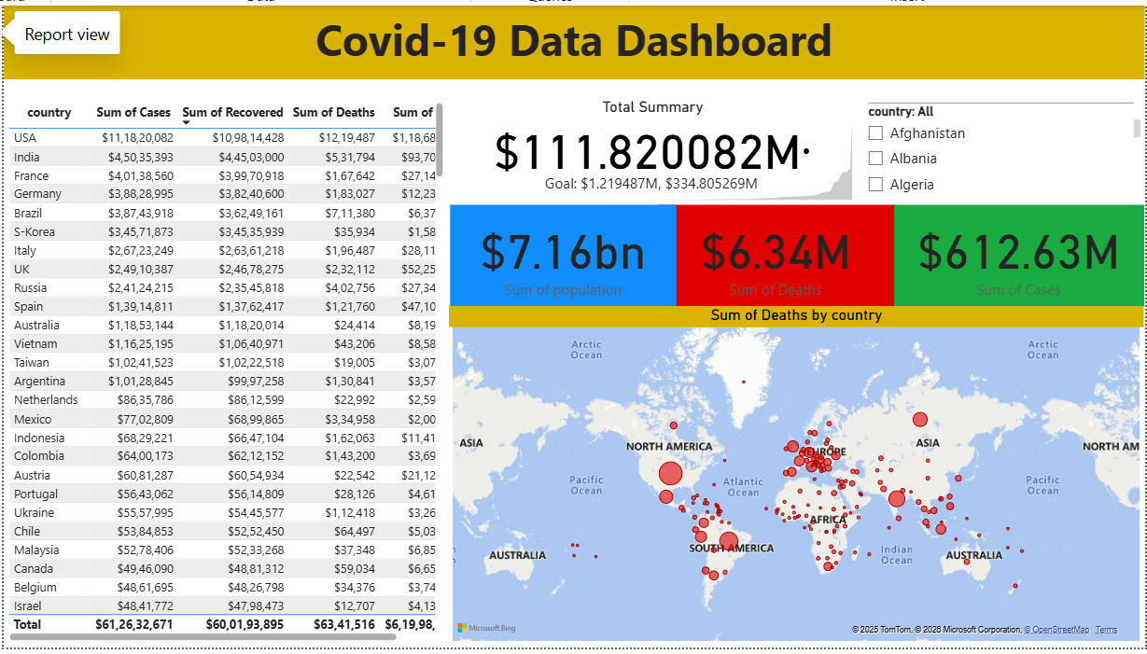
Slide 8 – Implementation Status
Completed modules
Data collection
• Data preprocessing
• Dashboard creation

Slide 9
Slide 9 – Conclusion
The project successfully converts complex COVID-19 data into meaningful and easy-to-understand visual insights. By using AI-enhanced visualization techniques, the system improves data analysis and helps users identify trends and patterns more effectively. The developed dashboards are useful for students, researchers, and decision-makers to understand the impact of COVID-19. Overall, the project achieves its objectives and demonstrates the effectiveness of AI-based data visualization

