Slide 1
DevOps External Online Course Final Project Presentation Theme: CI/СD Pipiline PetClinic Sinelnik Igor

Slide 2

I’m Head System Administrator in middle company.
My experience about 7 years.
Since I was yang – I interested in electronics, mechanics and other technical things.
Now, IT technologies is most interesting for me as hobbies as my future professional way!

Slide 3
Motivation
I wanted get knowledge in DevOps practices and use it on practice! It’s project more simpler than I wanted made, but it works now!
Destination
My project shows opportunity get more simpler process between developing app and publication it on differents destination servers.
In depended on needed servers lifecycling - they can work all time or will creating to some jobs - example build project and after that will be remove. This approach for Cloud infrastructure help save money.

Slide 4



Main infrastructure
Instances: Server –Jenkins / Terraform Server - WEB

Slide 5



Start work process
Creating WEB Server
JOB - Create WEB Inf Schedule - Start in the morning
WEB Server Ready to APP
Node
If node does not exist – creating node through - Amazon EC2 plugin
JOB FromGit_EC2_PetClinic Starting Build APP in more powerful Node
Build APP
JOB Petclinic_as_service Take APP.JAR and run one in WEB Server as service
Copy APP.JAR to WEB Server and made service

Slide 6
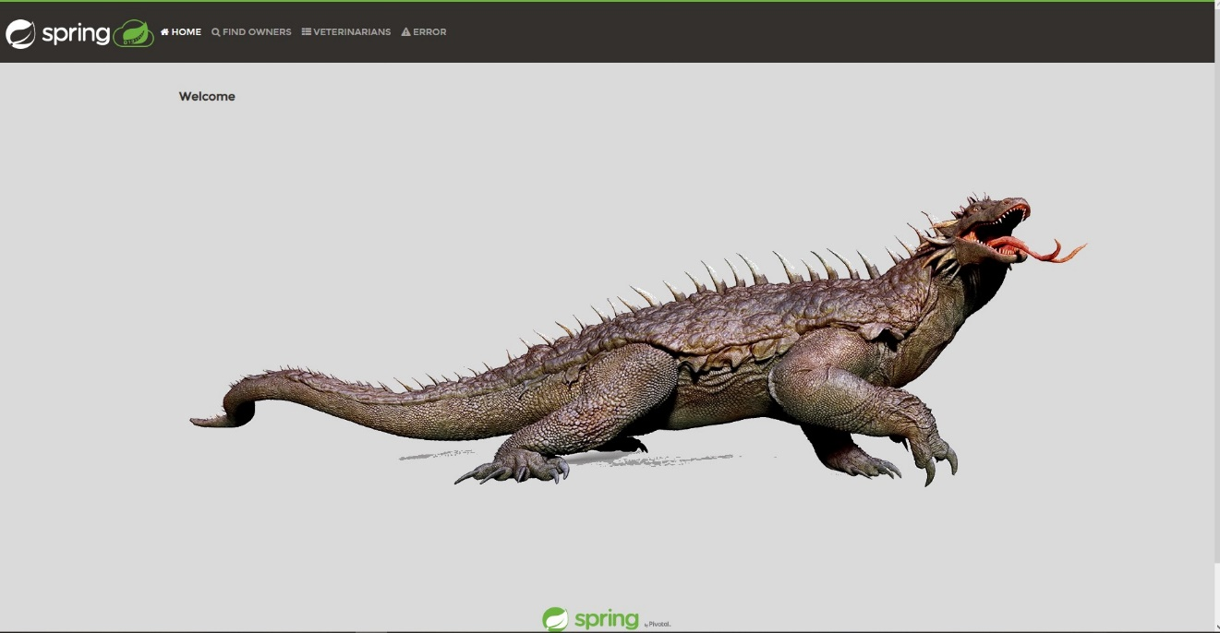

Git Hook
Node
WEB Server Show APP
Changes code Git Commit Git Push
JOB FromGit_EC2_PetClinic Get Git Hook and start build APP
JOB Petclinic_as_service Take APP.JAR and run one in WEB Server as service
Check new commit Take Git Hook to Jenkins

Slide 7
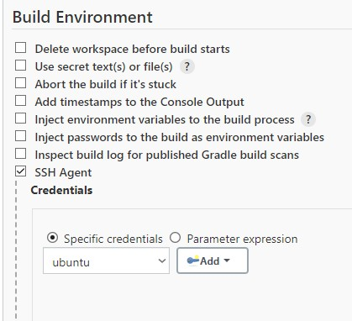
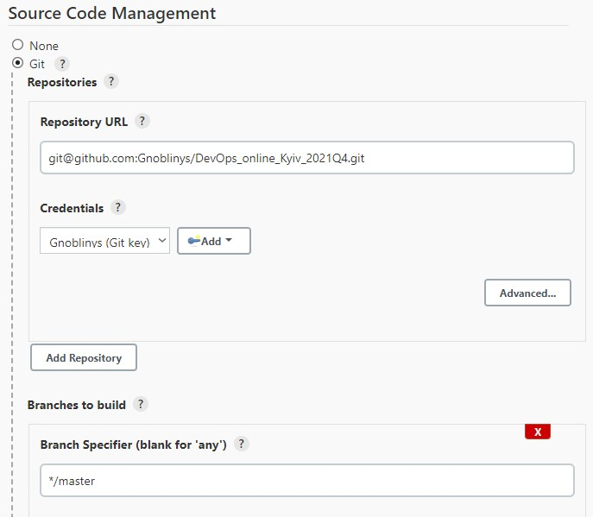
Credentials
GitHub
Git app with Jenkins credentials tools
SSH
Jenkins SSH agent plugin
Terraform export AWS_ACCESS_KEY_ID=
Jenkins host export AWS_SECRET_ACCESS_KEY=

Slide 8

Creating WEB Server
Schedule starting first job “Create_WEB_Inf”
cd m1/final_project/terraform_jenkins/
#!!!Before add variables KEY under jenkins user!!!
terraform init
terraform apply -auto-approve
terraform show | grep WEB_2_publick_ip > temp
touch WEB_2_publick_ip.txt
grep -o '[0-9]\{1,3\}\.[0-9]\{1,3\}\.[0-9]\{1,3\}\.[0-9]\{1,3\}' temp > WEB_2_publick_ip.txt
git add /var/lib/jenkins/workspace/Create_WEB_Inf/m1/final_project/terraform_jenkins/* :!/var/lib/jenkins/workspace/Create_WEB_Inf/m1/final_project/terraform_jenkins/.terraform/*
git commit -m "job terraform upd"
#Save IP address WEB server into WEB_2_publick_ip.txt
#Push updated Terraform files back to Git

Slide 9

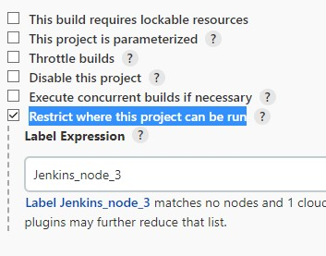
Build APP and Creating Jenkins Node
Git Hook starting first job “FromGit_EC2_PetClinic”
Amazon EC2 plugin Started Launch Instance
t2.medium
Idle termination time 180 min
user data:
#!/bin/bash
sudo apt update
sudo apt install openjdk-11-jdk -y
sudo apt install -y maven
sudo timedatectl set-timezone Europe/KievIdle
Node
If Node doesn’t exist – it will be create
cd m1/final_project/petclinic/
chmod +x ./mvnw
./mvnw package
scp -o StrictHostKeyChecking=no ubuntu@172.31.28.59:/var/lib/jenkins/workspace/Create_WEB_Inf/m1/final_project/terraform_jenkins/*.txt ~/workspace/FromGit_EC2_PetClinic/m1/final_project/terraform_jenkins/
export WEB2IP=$(cat ~/workspace/FromGit_EC2_PetClinic/m1/final_project/terraform_jenkins/WEB_2_publick_ip.txt)
echo $WEB2IP
scp -o StrictHostKeyChecking=no ./target/*.jar ubuntu@$WEB2IP:/home/ubuntu/
Build Java APP
#copy WEB_2_publick_ip.txt from main Jenkins to workspace in Node
Create variables from WEB_2_publick_ip.txt
Start Build Java APP
Copy .JAR to WEB Server

Slide 10
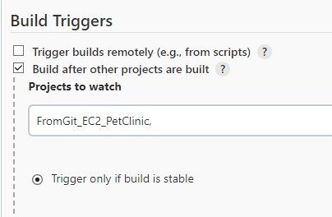
JOB for Publication java app as Service
Node
cat > petclinic.sh <<EOF
#!/bin/sh
java -jar /home/ubuntu/*.jar
EOF
chmod a+x petclinic.sh
cat > petclinic.service <<EOF
[Unit]
Description=Run petclinic.sh
[Service]
ExecStart=/home/ubuntu/petclinic.sh
[Install]
WantedBy=multi-user.target
EOF
cat > petclinicservice.sh <<EOF
# remove prev. service
sudo systemctl stop petclinic.service
sudo systemctl disable petclinic.service
# move service to dst dir
sudo mv petclinic.service /etc/systemd/system/
# start service
sudo systemctl daemon-reload
sudo systemctl enable petclinic.service
sudo systemctl start petclinic.service
sudo systemctl status petclinic.service
EOF
chmod a+x petclinicservice.sh
export WEB2IP=$(cat ~/workspace/FromGit_EC2_PetClinic/m1/final_project/terraform_jenkins/WEB_2_publick_ip.txt)
echo $WEB2IP
scp -o StrictHostKeyChecking=no ./petclinic.* ubuntu@$WEB2IP:/home/ubuntu/
scp -o StrictHostKeyChecking=no petclinicservice.sh ubuntu@$WEB2IP:/home/ubuntu/
ssh -o StrictHostKeyChecking=no ubuntu@$WEB2IP ./petclinicservice.sh
Script for run Java APP
Start job “Petclinic as service” if previously job ended right!
Create variable with WEB server address
File of service which run prev. script
Script which manage petclinic.service
Copy scripts and petclinic.service to web server

Slide 11
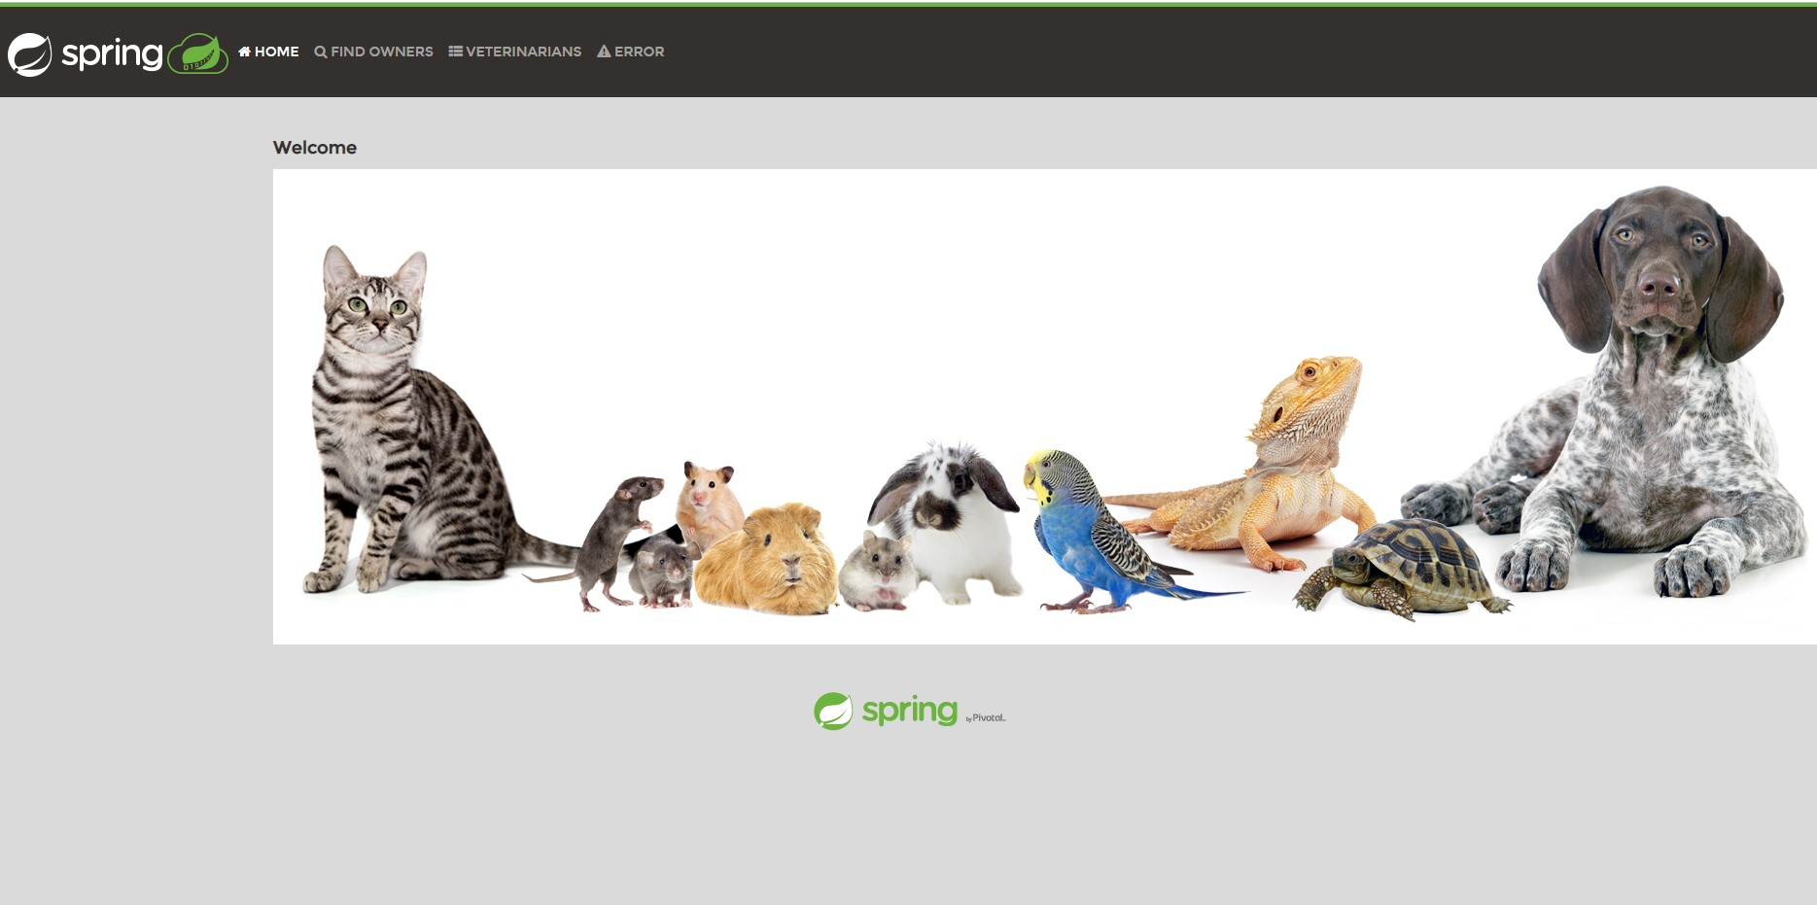
It Works!

