Slide 1
DevOps External Online Course Final Project Presentation Theme: CI/СD Pipiline PetClinic Sinelnik Igor

Slide 2

I’m Head System Administrator in middle company.
My experience about 7 years.
Since y was yang – I interested in electronics, mechanics and other technical things.
Now, IT technologies is most interesting for me as hobbies as my future professional way!

Slide 3
Motivation
I wanted get knowledge in DevOps practices and use it on practice! It’s project more simpler than I wanted made, but it works now!
Destination
My project shows opportunity get more simpler process between developing app and publication it on differents destination servers.
In depended on needed servers lifecycling - they can work all time or will creating to some jobs - example build project and after that will be remove. This approach for Cloud infrastructure help save money.

Slide 4


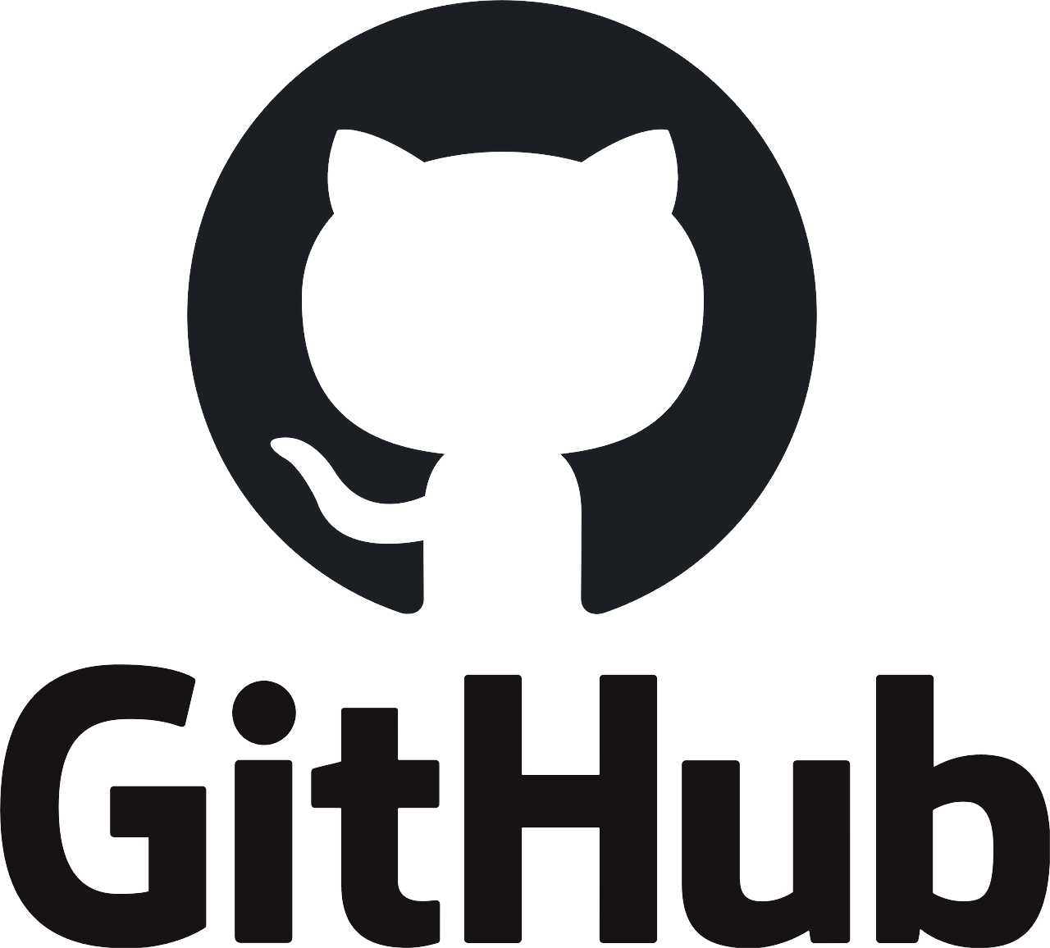
Main infrastructure
Instances: Server -Jenkins Server - WEB

Slide 5



Work process in the morning
Node
Creating WEB Server
JOB - Create WEB Inf Schedule - Start in the morning
WEB Server Ready to APP
If node does not exist – creating node through - Amazon EC2 plugin
JOB FromGit_EC2_PetClinic Starting Build APP in more powerful Node
Build APP
JOB Petclinic_as_service Take APP.JAR and run one in WEB Server as service
Copy APP.JAR to WEB Server and made srvice

Slide 6
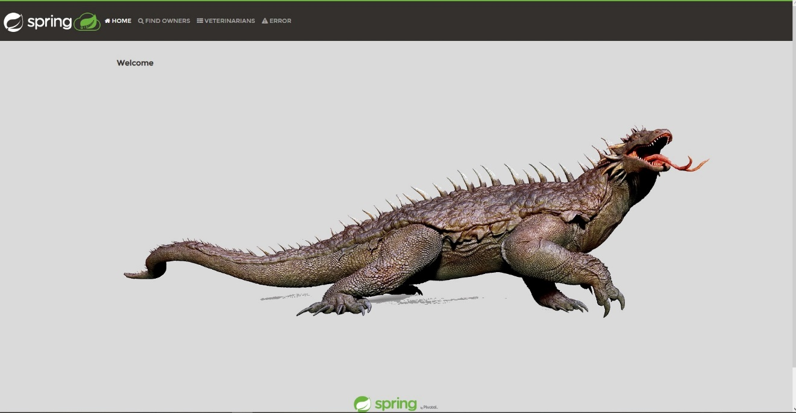
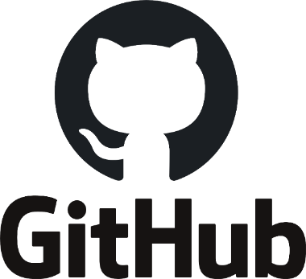
Git Hook
Node
WEB Server Show APP
Changes code Git Commit Git Push
JOB FromGit_EC2_PetClinic Get Git Hook and start build APP
JOB Petclinic_as_service Take APP.JAR and run one in WEB Server as service
Check new commit Take Git Hook to Jenkins

Slide 7
Security
I use Jenkins credentials tools for saving all credentials from AWS AMI, SSH and GitHub

Slide 8

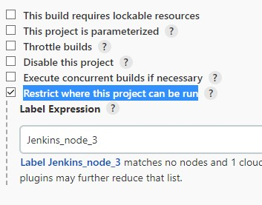
Creating Jenkins Node
Git Hook starting first job “FromGit_EC2_PetClinic” Step 1 – create Jenkins Node
Amazon EC2 plugin Started Launch Instance
t2.medium
Idle termination time 60min
user data:
#!/bin/bash
sudo apt update
sudo apt install openjdk-11-jdk -y
sudo apt install -y maven
sudo timedatectl set-timezone Europe/KievIdle

Slide 9
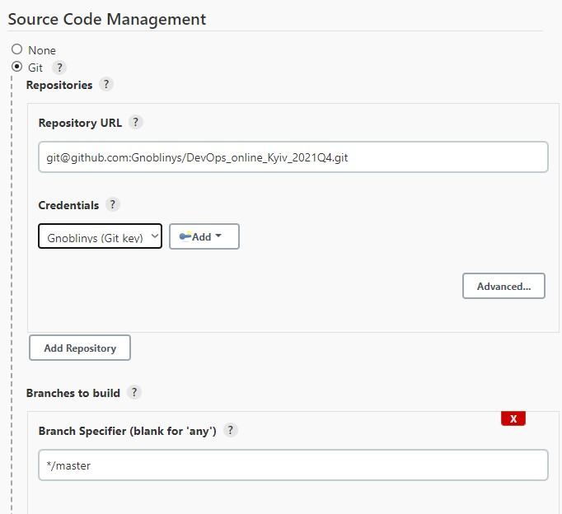
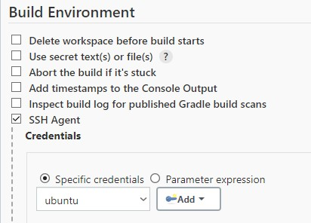
Build project in Node
Git Hook starting first job “FromGit_EC2_PetClinic”
Step 2 - Get project from Git and Build
Start Build and copy artefact to WEB server
echo "======Build Started======"
cd m1/petclinic/
chmod +x ./mvnw
./mvnw package
scp -o StrictHostKeyChecking=no target/*.jar ubuntu@172.31.22.175:/home/ubuntu/
echo "======Build Finished====="

Slide 10
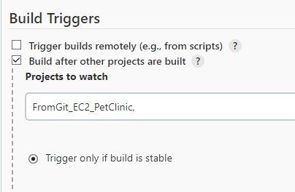
Publication java app as Service
cat > petclinic.sh <<EOF
#!/bin/sh
java -jar /home/ubuntu/*.jar
EOF
chmod a+x petclinic.sh
cat > petclinic.service <<EOF
[Unit]
Description=Run petclinic.sh
[Service]
ExecStart=/home/ubuntu/petclinic.sh
[Install]
WantedBy=multi-user.target
EOF
cat > petclinicservice.sh <<EOF
# remove prev. service
sudo systemctl stop petclinic.service
sudo systemctl disable petclinic.service
# move service to dst dir
sudo mv petclinic.service /etc/systemd/system/
# start service
sudo systemctl daemon-reload
sudo systemctl enable petclinic.service
sudo systemctl start petclinic.service
sudo systemctl status petclinic.service
EOF
chmod a+x petclinicservice.sh
# copy new file to web server
scp -o StrictHostKeyChecking=no ./petclinic.* ubuntu@172.31.22.175:/home/ubuntu/
scp -o StrictHostKeyChecking=no petclinicservice.sh ubuntu@172.31.22.175:/home/ubuntu/
ssh -o StrictHostKeyChecking=no ubuntu@172.31.22.175 ./petclinicservice.sh
Start job “Petclinic as service” if previously job ended right!

Slide 11
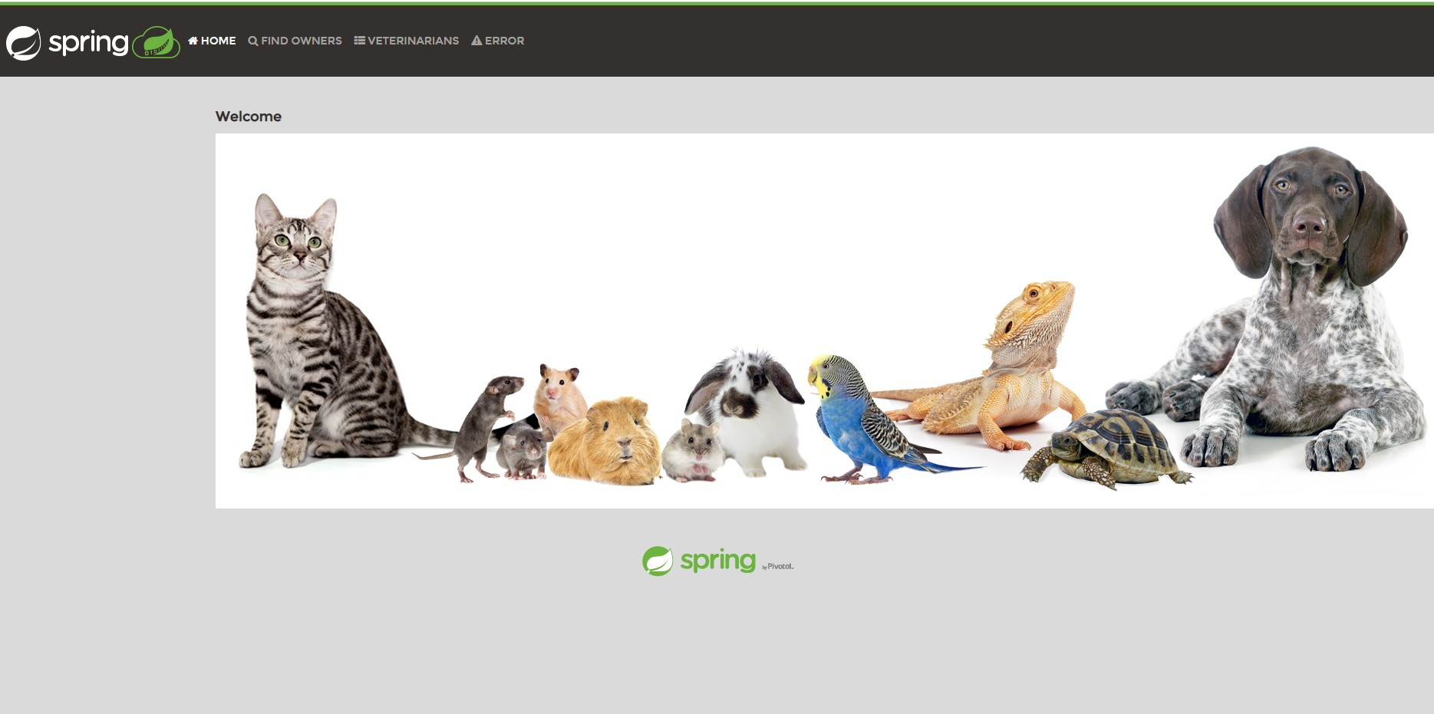
It Works!

