Slide 1
Project Milestone #1
Andrew Yu, Arthur Cheong, Marco Widodo

Slide 2
How should predominantly text-based social media platforms moderate content, to strike a balance between free speech and moderating hate speech?
Why is this compelling?
From the U.S Department of Justice (DOJ): “reported hate crime incidents increased 11.6% — from 8,210 in 2020 to 9,065 in 2021” Not particularly speech, but these crimes can be thought as the action associated with or as the effect of the hate speech circulation online Figures are likely to be underestimated, since these are only the crimes that were actually reported
A 2023 annual survey by ADL/YouGov on “Online Hate and Harassment” reports individuals being harassed online within the past year, up from 23% in 2022 to 33% in 2023 for adults and 36% to 51% for teens. “Overall, reports of each type of hate and harassment increased by nearly every measure and within almost every demographic group.”
Recent incidents of political figure Donald Trump de-platformed by Twitter, Facebook and Youtube for “using his accounts to share false information and inciting his voter base to violence in the wake of the insurrection at the Capitol”

Slide 3
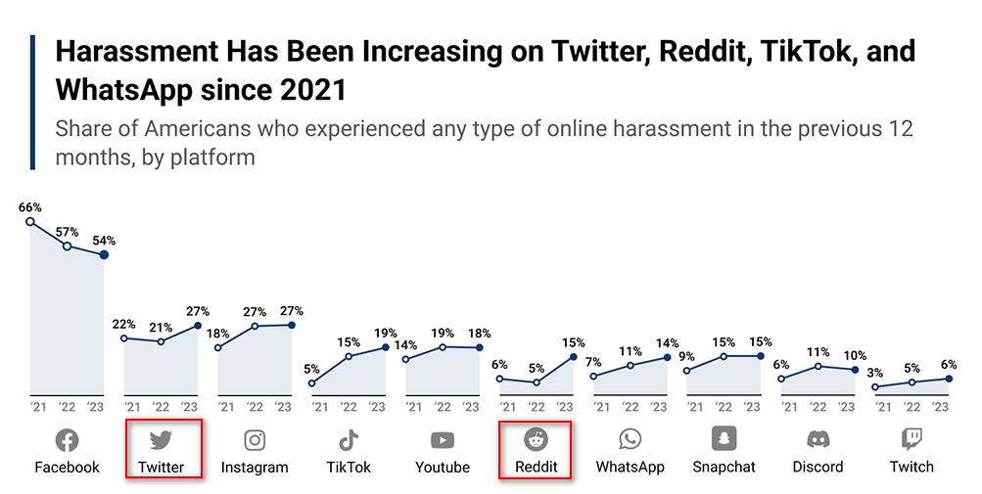
“In the case of Facebook, its artificial intelligence engineers tried to reduce polarization by tweaking the platform’s algorithms but their work was reportedly deprioritized when it hindered the company’s goal of maximizing user engagement. Users are drawn to controversial, outrageous content so limiting its spread runs counter to Facebook’s reported ambitions for growth.”
- ADL/YouGov Annual “Online Hate and Harassment” 2021 Survey
Choice of Platform for analysis
Predominantly text-based, which is perfect for the scope of this project as image or video would require machine learning and more time-consuming analysis This eliminates Instagram, Tiktok, Youtube and Twitch
Social media platform, focusing on posts. This eliminates messaging platforms like WhatsApp, Snapchat or Discord as it is not possible to acquire information of the message content legally and infringes heavily on user privacy
This leaves Facebook, Twitter and Reddit. However, Twitter and Reddit are more accessible in terms of their APIs for information gathering. Coincidentally, harassment on these platforms have also been increasing, and is in fact 2 of the highest increases in the graph most recently from 2022 to 2023 (28.6% and 200% respectively) As a bonus, Twitter and Reddit are also some of the older platforms, founded in 2006 and 2005 respectively, thus they have a more established user-base and a reliable stream of content for the project

Slide 4
What would solving this problem allow?
Eliminating/Reducing hate speech
Greater understanding of how hate speech manifests in relation to times of identity-based conflict
Understanding how hate speech translates to online mediums (e.g. more or less pervasive?)
creates a safe and inclusive online environment
protects vulnerable individuals and communities while preserving freedom of expression
enhances trust and user engagement on the platforms
ultimately improves social cohesion
Why is this a difficult problem to solve?
Challenging to determine the line that demarcates acceptable and harmful speech, as usage of language is subjectively complex and varies across cultures, contexts, and laws/regulations
Immense volume of content, that could be generated by a real user or bots, making it difficult and time-consuming to manually review and moderate each piece effectively. This calls for automation, but automation relies on clear definitions being set => previous point
Hate Speech can be cleverly disguised as an opinion, does not necessarily use profanities (hard to detect and easily bypass filters) and even circumvent automated moderation efforts through a misspelling strategy, or “l337 speak”
Tactics used by social media platforms to maximize user engagement are inherently problematic in the circulation of hate speech - Homogeneous networks connect individuals with same beliefs, leading to false perception that views are uniformly held and gather support for a slanted view - Filter bubbles select information individuals agree with, reinforcing views with slanted information while avoiding to recommend any information on the other side that may challenge beliefs

Slide 5
Stakeholders: Ultimately responsible for/invested in outcome
Social Media Platform Company
Ultimately responsible for setting content moderation policies and implementing them
Invested in maintaining a positive user experience, attracting and retaining users, and adhering to legal and regulatory laws
Ensure a healthy online environment to mitigate potential reputational risks and loss of user-base
Content Moderators (Platform admins, moderators)
Responsible for reviewing and making decisions on reported or flagged content
Invested in ensuring the platforms remain safe, inclusive, and free from hate speech as part of their job
Governments
Invested in ensuring that social media platforms in their country comply with their laws and regulations
In times of crises/distress, ensure social media platforms do not lead to any unnecessary incitement or escalation before they have a chance to address them
Concerned about potential threats to national security or governmental bodies
Activists
Invested in ensuring platforms effectively combat hate speech while respecting free speech rights in their advocating for human rights and anti-discrimination
Able to provide valuable feedback, highlight shortcomings, and advocate for further improvements in content moderation policies
Parents of children using these platforms
Desire a platform that promotes freedom of expression for their children to learn from and express themselves, while protecting them from hate speech and harassment
Particularly concerned about the safety and well-being of their children, and desire to protect them from radicalization or negative influence

Slide 6
Who is affected specifically?
Society at large
Hate speech contributes to the spread of misinformation, propaganda, and extremism
Can create more divisions due to increased polarization, undermine social cohesion due to the erosion of trust, and even contribute to offline conflicts and violence
Marginalized Communities
Racial & ethnic, sexual orientation, religions, gender identity, disabilities, gender, age, socio-economic status
Hate speech can further perpetuate stereotypes, and contribute to a more hostile environment for them
Users
Exposure to hate speech, or inability to express freedom of speech can harm the self-esteem, emotional well-being, and mental health
Younger users such as children or adolescents are particularly vulnerable to the negative effects of hate speech and even self-radicalization
Content Creators and Influencers
Improper handling of the balance can limit/slow down creativity and more importantly the diversity of voices on social media and therefore content and entertainment

Slide 7
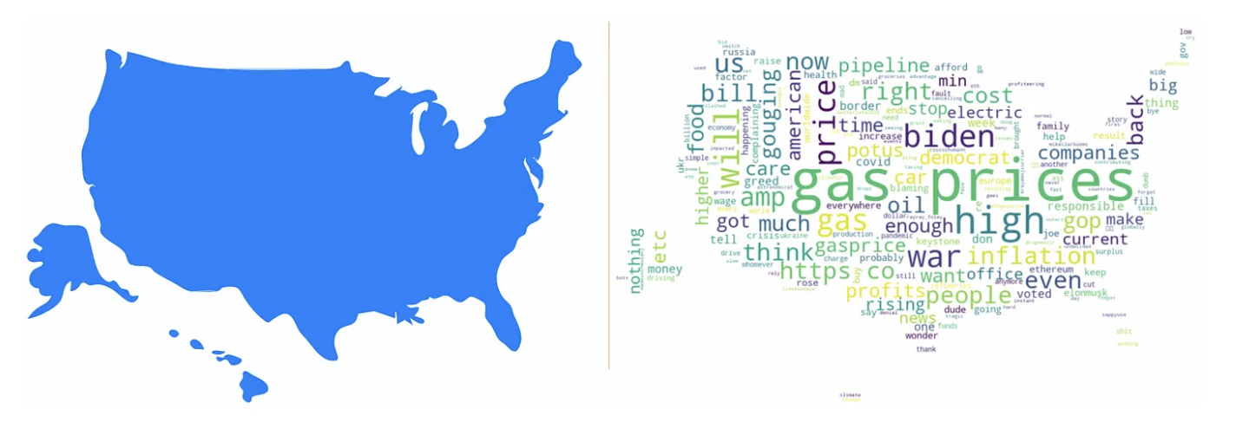
Where can you find data about your problem?
Twitter API (rate-limited, pay-walled, obsolete APIs/Scrapers)
Reddit API (rate-limited, pay-walled, obsolete APIs/Scrapers)
Kaggle: Covid19 Tweets By Phases Covid19 Tweets Xenophobia Covid19 Reddit Posts BLM Tweets
Twint = Twitter scraping tool that bypasses Twitter API
collect_tweets function
collect_tweets_per_location function

Slide 8
How might you narrow your topic?
Twitter and Reddit both offer a wealth of information on various issues and movements in history. We can narrow our topic by the criteria below.
Category of hate: In most recent hate crime statistics released by the U.S Department of Justice, the greatest bias motivation for hate crimes was reportedly Race/Ethnicity (64.5%), followed by Sexual Orientation (15.9%), then Religion (14.1%). Therefore, hate speech posts can be searched by Race/Ethnicity first.
Event/Movement: There are significant events that occur every year such as Covid19, #BLM, #MeToo, Refugees of Rohingya, Legalization of same-sex marriages, 2020 U.S Presidential Elections, Russia vs Ukraine that generate and direct hate at a certain group of categories listed above. We can narrow down to either the most influential or most recent event first
Platform: Twitter and Reddit might have too much information for our limited time of analysis. We can narrow down to using the easier platform, or the platform that would give us the more relevant information. Furthermore, some APIs allow you to narrow your search to specific threads/hashtags.
Geographic: It is difficult to narrow down to a geographic location, as hate speech is pervasive and can come from anywhere and directed at anyone anywhere. However, based on country population and therefore quantity of data points, the United States would be a good starting point.

Slide 9
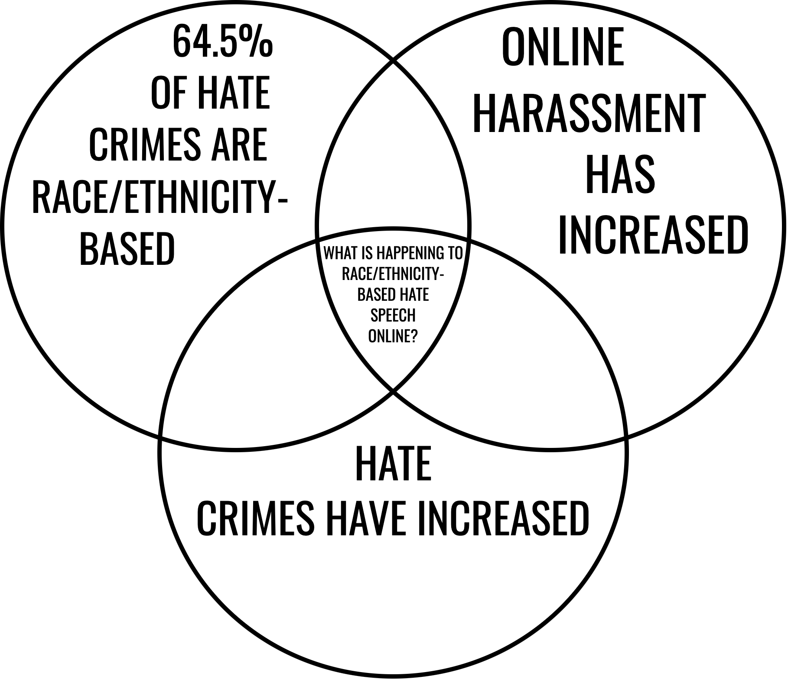
Cross-Platform Analysis:
Twitter attempts hate speech moderation
Vs.
Reddit has minimal hate speech moderation
Key Events To Examine:
Hate Group Goyim Defense League
BLM Movement (discrimination against African-Americans)
Covid-19 Outbreak (discrimination against Asian-Americans)

Slide 10
Possible issues to watch out for
Privacy concerns: We will and can only access public tweets, and thus do not think we will be violating anyone’s privacies.
Underrepresented populations: Underprivileged populations and those with limited/no access to internet Older generations that do not use these platforms Non-English posts
Other confounding variables (e.g. Twitter/Reddit altering their policies on/mechanisms for hate speech moderation)

