Slide 1
Project Milestone #2
Andrew Yu, Arthur Cheong, Marco Widodo

Slide 2
Lived Experiences (~3-5 slides):
Who has lived experience related to your problem?
What insights did you gain by considering the lived experiences of those closest to the problem?
What were the most impactful sources of information about lived experiences?
Literature Review (~3-5 slides):
What approaches have been used to study this problem?
What was discovered?
What were the limits of these approaches?
Please synthesize and summarize the themes you discovered in your literature review, rather than simply listing papers.
Data Update & Exploratory Data Analysis (~3-5 slides):
What are the most promising data sources for your problems?
What are the strengths of this/these datasets?
What are the limitations of these datasets?
Please include at least one graph, figure or table from our Exploratory Data Analysis Project Lab. Also describe your interpretation of these initial results.
Bibliography of the sources that you consulted when gathering information. Your bibliography should also include links to materials that can be accessed online. Please have a separate section for each type of knowing: lived experience, academic knowledge (Literature Review) and data.

Slide 3
Deeper analysis of our problem statement…
How should predominantly text-based social media platforms moderate content, to strike a balance between free speech and moderating hate speech?
During periods of unrest, people often flock to social media platforms to express themselves.
Hate speech while dangerous in itself, is easily overwhelmed by the magnitude of opinions and posts and thus has low visibility and consequence generally.
It is only when this hate speech is circulated (easily on these platforms), whether for legitimate or malicious reasons, that individuals encounter, internalize, and engage in discussions about it. This is when the seed of hate spreads, takes root, and begins to grow, causing harm and division within communities, all the while potentially creating a hate community around it.
Trending words or phrases emerge, and algorithms take them one step further to increase viewership on their platforms, heightening visibility and attention.
Typically, these words are not those in standard dictionaries. Rather, they are coined and shared within communities that share a common bond and understanding of their meanings, and therefore easily bypass modern hate detection algorithms.
Strength in numbers amplifies the hate and therefore underscores the significance of targeting hate communities in general over individual actors.
We wish to create something that will help discern between free and hate speech and their respective categories of hate using these community-created words, and easily enable the banning of their variations.

Slide 4
Lived Experiences
Who has lived experience related to your problem?
Hate speech victims:
People who have lived experience related to our problem are typically individuals belonging to protected classes (gender, religion, ethnicity, race, disabilities, etc.)
Example:
Amina Yousaf - German activist, target of far-right activists following a publication about being a woman of colour in Germany
Online abuse
She ended up being doxxed, address leaked
Afraid family would be targeted (sister looked similar to her)
Prosecutors Of Online Hate Speech (Law Enforcement)
Ex. In Germany, law enforcement have started pressing charges against people spreading hate speech
51 year-old man arrested by police after spreading fake information about a politician
Notes:
https://www.adl.org/resources/report/online-hate-and-harassment-american-experience-2021
https://www.adl.org/resources/press-release/asian-americans-experience-rise-severe-online-hate-and-harassment-adl

Slide 5
Live Experiences (cont.)
What insights did you gain by considering the lived experiences of those closest to the problem?
There has been a recent uptick of hate speech incidents on social media for groups in 2021; most significantly, against Asian-Americans, with slight increases in reported amounts by other groups (Jewish-Americans, African-Americans). (Anti-Defamation League).
In other countries, such as Germany, their law-enforcement has started to prosecute people engaging in hate-speech / defamation
Considering the lived experiences of those affected, we realize that there is a lot more nuance in monitoring hate speech; even defining what hate speech means social media platforms and the algorithms they use can influence how many people are being affected as well as what groups of people are affected disproportionately
Notes:
https://www.nytimes.com/2022/09/23/technology/germany-internet-speech-arrest.html

Slide 6
Live Experiences (cont.)
What were the most impactful sources of information about lived experiences?
Anti-Defamation League
Anti-hate organization
Conducted surveys / studies regarding hate speech
News Outlets (e.g. New York Times)
Presents the stories of certain victims of hate speech
Presents the experiences of law enforcement and how deal with hate speech
FBI
They gave a legal definition of what constitutes a hate crime. E.g. Biases against a certain race, religion, disability, sexual orientation, ethnicity, gender, gender identity
They have data pertaining the hate-crime statistics.
Can use this to see how hate speech may influence the number of hate crimes
Notes:
https://www.fbi.gov/how-we-can-help-you/more-fbi-services-and-information/ucr/hate-crime

Slide 7
Literature Review - Context
Social Media platforms currently use a combination of various methods to detect hate speech on their platforms, and each method is used to varying degrees within their larger content moderation system
Contextual Analysis
Machine Learning
Keyword-based Filtering
Sentiment Analysis
That said, most (if not all) social media companies have focused on developing machine learning neural networks that detect hate speech on their own. They use either traditional classifiers, deep learning and transfer learning based classifiers or a combination of both types of classifiers. Most literature on hate speech detection analyzes the efficiency of different detection algorithms.
User Reports
Human Content Moderators

Slide 8
Literature Review - Two Main Approaches Used So Far
Singular Performance Analysis
Comparative Analysis
Some publications focus on one algorithm in particular
These tend to compare the performance of the algorithm to predetermined standards or expectations
Sometimes the publications compare different internal features or settings of the algorithm itself to see which is optimal for their hate speech detection objectives (e.g. comparing domain-specific use or large-scale implementation)
Other publications compare various competing hate speech detection algorithms such as Naïve Bayes, Multi Level Perceptron, BERT, AdaBoost Classifier, Decision Tree, and Support Vector Machine
They compare the performances of the algorithms to data that had already been manually labeled by either human moderators or the researchers themselves

Slide 9
Main Findings: Inconclusive!
Problem 1: Definitional Challenges
“Efficiency”
Bias
It is difficult to decide on one definition of a metric to measure an algorithm’s “efficiency”
Some publications measure this efficiency through scalability and speed, which puts large-scale machine learning methods on top while ignoring accuracy
Other publications measure efficiency through how accurately the software can match manually predetermined hate speech databases; these can take comparatively longer, putting other algorithms on top
What counts as hate speech?
One problem with publications that compare the accuracy of algorithms to predetermined datasets is that humans are choosing what to label as hate speech
We have a classic problem if garbage-in/garbage-out because these algorithms are either trained on or compared to inherently biased data
Several studies have found great risks of hate detection algorithms replicating racial biases

Slide 10
Main Findings: Inconclusive!
Problem 2: Machine Learning Integration
Machine Learning is still very new
Balance
With Machine Learning being a relatively new and under-researched field, some publications have mentioned how it is difficult to measure its efficiency
Additionally, more challenges arise when thinking about how Machine Learning algorithms should wrangle raw data from these social media platforms, whether to search for words, phrases, sentences, or even entire threads
Comparing the different hate speech detection systems of different social media platforms is difficult because they use a combination of human and AI methods
How “accurate” a social media platform’s hate detection system is can depend on the degree of human involvement rather than the machine learning algorithm itself

Slide 11
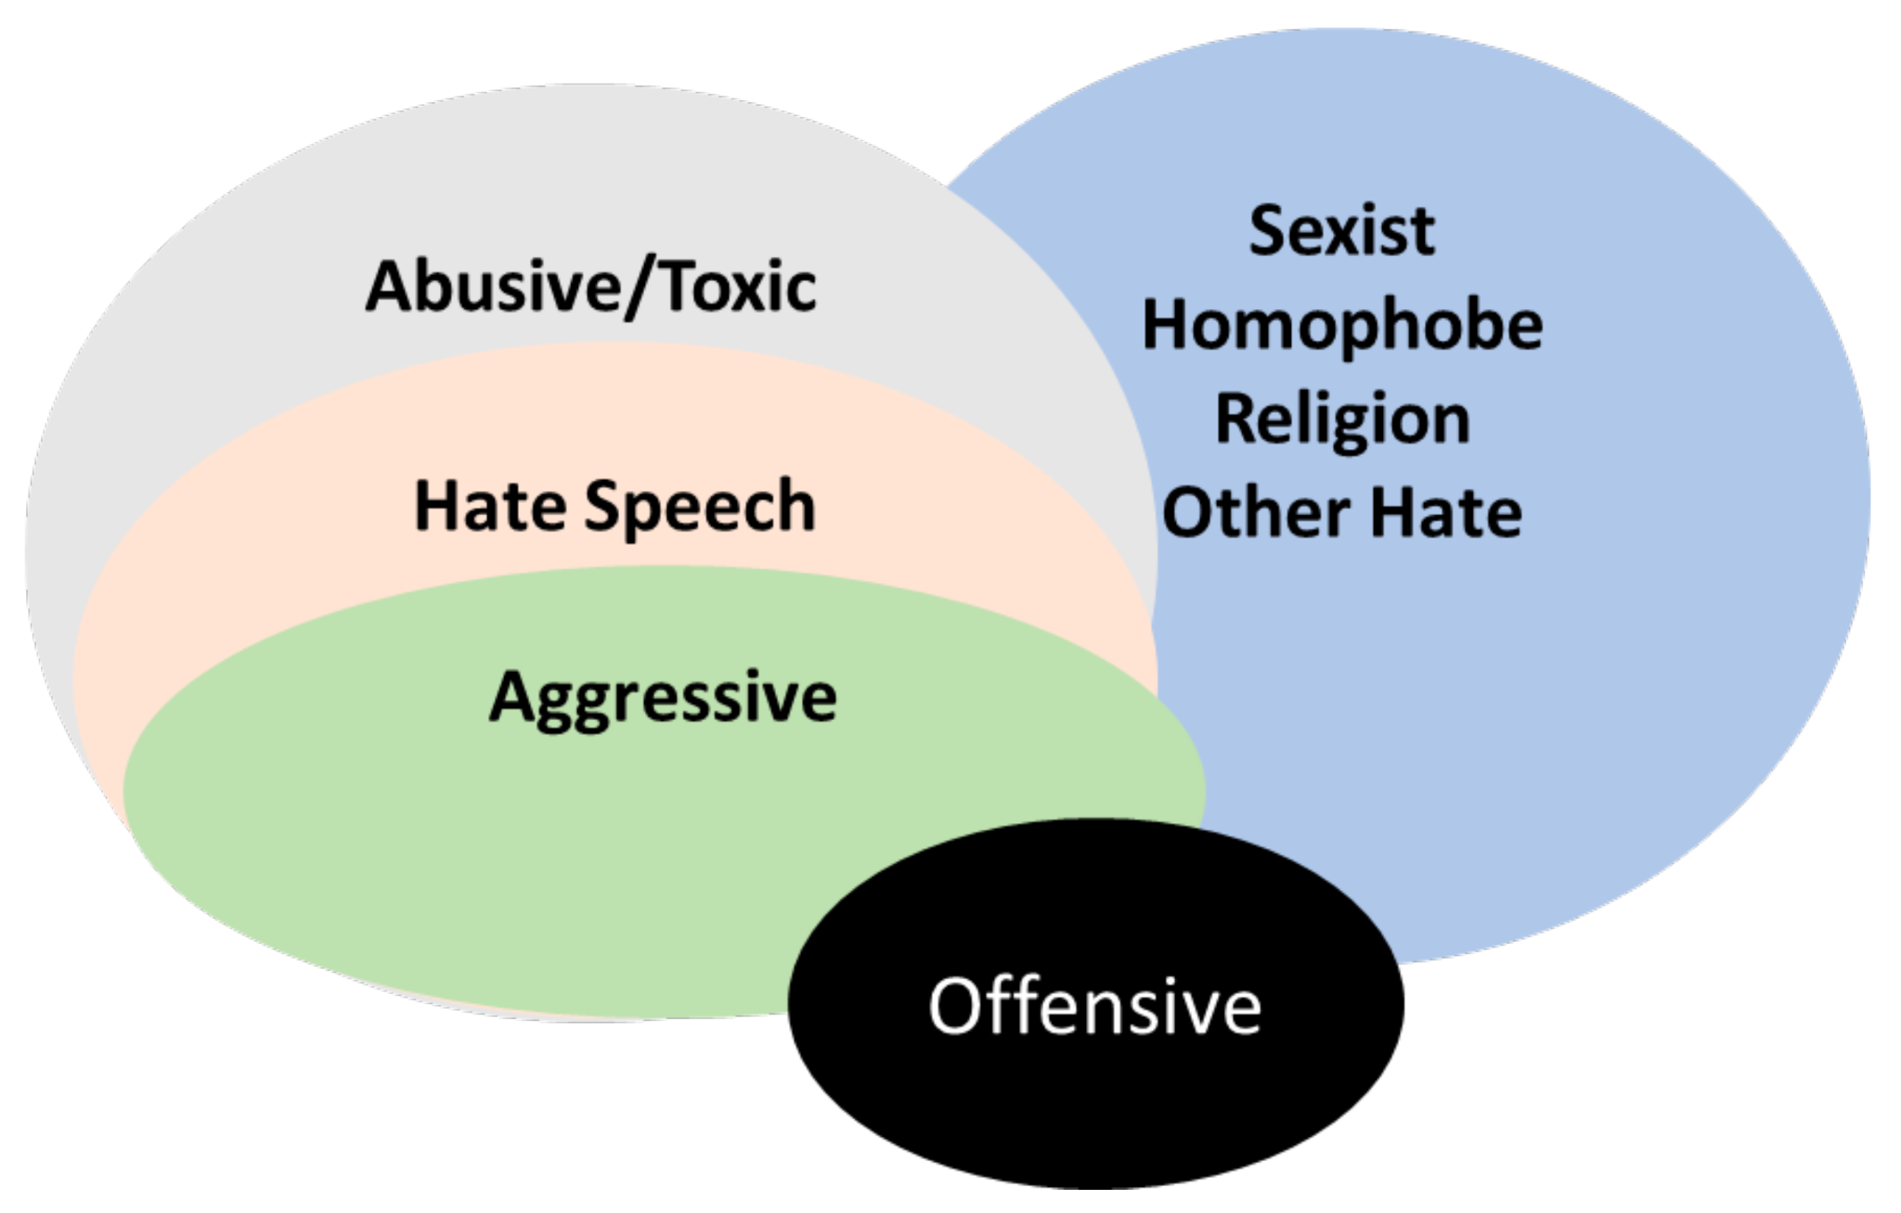
Main Findings: Inconclusive!
Problem 3: More Definitional Challenges :(
Defining Hate Speech
There are lots of different ways to define what classifies as hate speech; different researchers, social media platforms, and algorithms will likely disagree on what does and does not count (e.g. Directed vs Generalized Hate Speech)
Simplifying the classification of hate speech down to a keyword-basis runs into problems because words that could be considered normal in one context could be “hate speech” in another and vice versa

Slide 12
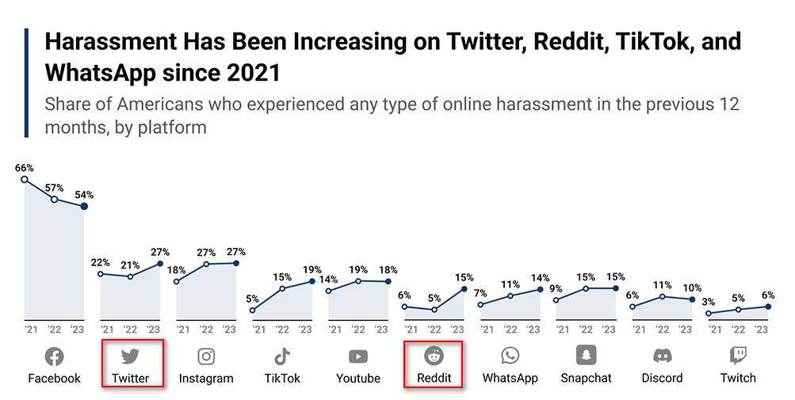
Data Update & Exploratory Data Analysis
Choice of Platform for analysis
Predominantly text-based, which is perfect for the scope of this project as image or video would require machine learning and more time-consuming analysis This eliminates Instagram, Tiktok, Youtube and Twitch
Social media platform, focusing on posts. This eliminates messaging platforms like WhatsApp, Snapchat or Discord as it is not possible to acquire information of the message content legally and infringes heavily on user privacy
This leaves Facebook, Twitter and Reddit. However, Twitter and Reddit were more accessible in terms of their APIs for information gathering. Coincidentally, harassment on these platforms have also been increasing, and is in fact 2 of the highest increases in the graph most recently from 2022 to 2023 (28.6% and 200% respectively) As a bonus, Twitter and Reddit are also some of the older platforms, founded in 2006 and 2005 respectively, thus they have a more established user-base and a reliable stream of content for the project

Slide 13
“were”
Twitter and Reddit APIs and even scrapers are not functional due to the most recent API changes, rate-limiting (∴ small-scale) and pay-walling. Complete datasets on Kaggle are unusable as they need to be “hydrated”, also requiring usage of these APIs to access readable content for analysis.
However, we managed to source for a few datasets on Kaggle that would be sufficient for our analysis centred on race/ethnicity issues during the
Covid-19 Outbreak (discrimination against Asians)
BLM Movement (discrimination against African-Americans)
on
Twitter
Reddit
We have thus isolated the following datasets
Covid19 Tweets By Phases
Covid19 Tweets Xenophobia
Covid19 Reddit Comments
BLM Tweets

Slide 14
“Covid19 Tweets By Phases”
How data was collected: Collected worldwide Covid19 related English tweets at a rate of almost 10k per day in three phases 19 April - 20 June 2020 (Phase 1), 20 August - 20 October 2020 (Phase 2) and 26 April - 27 June 2021 (Phase 3)
How variables may be used: 'id', 'lang': dropped 'created_at': plot relationships vs time 'source' => ‘platform’: plot popular platforms by userbase 'original_text': derive community-created words 'favorite_count', 'retweet_count': plot popularity of tweet vs tweet content ('original_text') 'original_author', 'user_mentions': plot frequency of authors vs tweet content, gives an idea of their community based on tweet content 'hashtags': derive community-created words 'place': pinpoint geographical locations, plot place vs tweet content
Strengths: 1) Data segmented into phases, thus conveying more meaning about each period (Eg. Frequency of tweets per day per phase gives an idea of covid19’s particular impact during that period 2) Since we are targeting communities that may form around hate, ‘original_author’ and ‘user_mentions’ are especially helpful for the use stated above 3) 147k (Phase 1), 120k (Phase 2), 144k (Phase 3) data values
Limitations: 1) Phases are arbitrarily determined, not purposefully defined, thus some important content might have been lost in the gaps of time 2) ‘place’ is a user-set field on Twitter, thus may reflect actual places or places users actually live at
Primary agenda
Secondary agenda

Slide 15
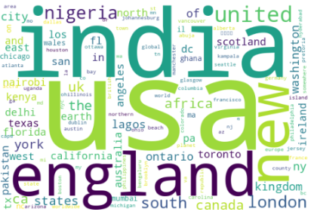
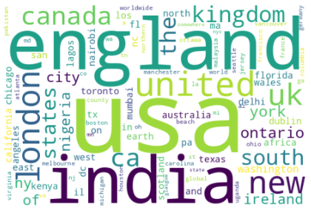
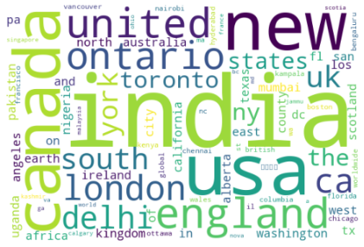
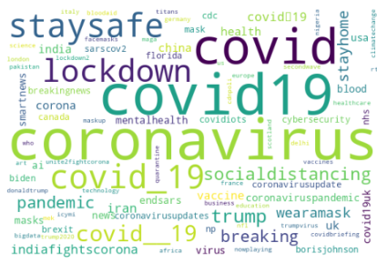
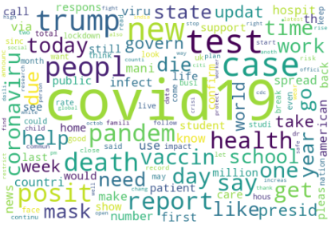
Initial interpretation:
Depicts spread of Covid19, as people from more countries talk about it
Phase 1
Phase 2
Phase 3
At first glance, cleaned text does not seem to have obvious hate speech. However, this could be due to many dictionary words taking up the spotlight.
There are a however a few community-created words like #covidiots and #trumpvirus, that although are not targeting race/ethnicity, could get out of control. This means further text-cleaning is necessary
Hashtags
Cleaned Text

Slide 16
“Covid19 Tweets Xenophobia”
How data was collected: Scraping Twitter from 6 March - 20 May 2020
How variables may be used: 'status_id', 'statuses_count': dropped 'created_at': plot relationships vs time 'text': derive community-created words 'favourite_count', 'retweet_count': plot popularity of tweet vs tweet content ('text') 'location': pinpoint geographical locations, plot place vs tweet content 'followers_count', 'friends_count': plot popularity of user vs xenophobic tweet content
Strengths: 1) Can complement the previous Phases dataset to provide a more complete coverage of the covid19 period 2) 4 million data values
Limitations: 1) Covers a very short time period, potentially limiting internal validity of trends against time, as this period can be considered phase 1, when little was known about the virus except it originated from China, etc.
Primary agenda
Secondary agenda

Slide 17
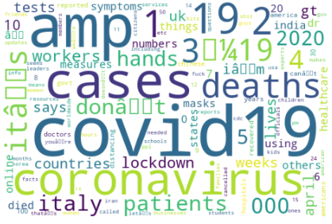
Initial interpretation:
Also at first glance, nothing really stands out.
There however seems to be quite a high frequency for italy, china and donaldtrump.
Cleaned Text
(stopwords + dictionary words, but without lemmatization)

Slide 18
“Covid19 Reddit Comments”
How data was collected: A comprehensive collection of comments mentioning COVID in their title and body text respectively, procured using SocialGrep, up to 25 October 2021
How variables may be used: 'id', 'subreddit.id', 'subreddit.nsfw', 'permalink', 'domain', 'url', 'selftext', 'type': dropped 'subreddit.name': gives an idea of their community based on subreddit ‘created_utc': plot relationships vs time 'body'”: derive community-created words 'score': upvotes - downvotes, plot popularity of comment vs comment content
Strengths: 1) 'subreddit.name' is very useful to determining the community of users, as compared to Twitter that does not have a certain specific topic, etc 2) As 'score' is net (upvotes - downvotes), it can be negative, which then can be interpreted as an unpopular, rejected opinion. This is in contrast to Twitter that has no “dislike” option 3) 17 million data values
Limitations: 1) ‘created_utc' requires conversion back into YYYY-MM-DD format 2) No geographic location
Primary agenda
Secondary agenda

Slide 19
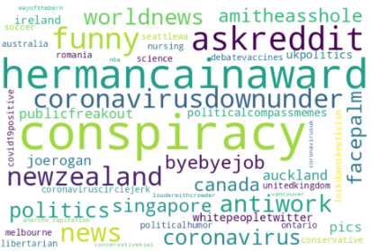
Initial interpretation:
Subreddit Names
Subreddits like “conspiracy”, “hermancainaward” give some possibilities of hate communities or misinformation that would be worth investigating

Slide 20
“BLM Tweets”
How data was collected: Scraped tweets with #blacklivesmatter
How variables may be used: ‘tweets’: derive community-created words ‘location’: pinpoint geographical locations, plot place vs tweet content
Strengths:
Limitations: 1) Only 1000 data values, may not be sufficient for a thorough or intended analysis
Primary agenda
Secondary agenda

Slide 21
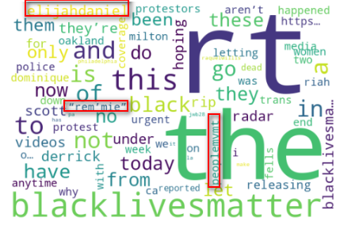
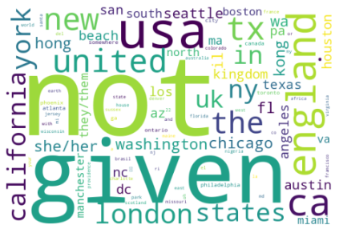
Initial interpretation:
Tweets
Location
Most are not given, which makes sense given that Twitter is an online platform and the location field is user-set
There are also many U.S states involved in the discussion, as #BLM did originate from the U.S over George Floyd’s murder
“rem’mie” might be worth investigating
elijahdaniel is a rapper-influencer, and investigating tweets containing this text might be fruitful

Slide 22
Intended Flow
1. Mine the text in the datasets
2. Clean them (removal of stop words + omissions of any foreign characters/symbols > lemmatization + stemming > removal of dictionary words)
3. (Extra) TF-IDF weighing to highlight significance of terms in a corpus compared to other corpuses
Intuition:
High frequency, non-dictionary words are key identifiers of a community-created word.
To then narrow down to those conveying hate, we will use the human-in-the-loop approach This means moderators get to decide which words to ban, ultimately becoming the fine line that differentiates free from hate speech.
Eg.
✅#loveandpeace (positive)
✅#blacklivesmatter (neutral/positive)
❌#kungflu (hate) => Ban, and any other variations of it (Eg. ulfgnuk, kungf1u, kung71u, etc)

Slide 23
Bibliography
Lived Experience
https://www.adl.org/resources/report/online-hate-and-harassment-american-experience-2021
https://www.adl.org/resources/press-release/asian-americans-experience-rise-severe-online-hate-and-harassment-adl
https://www.nytimes.com/2022/09/23/technology/germany-internet-speech-arrest.html
https://www.fbi.gov/how-we-can-help-you/more-fbi-services-and-information/ucr/hate-crime
Exploratory Data
2023 annual survey by ADL/YouGov
Covid19 Tweets By Phases
Covid19 Tweets Xenophobia
Covid19 Reddit Comments
BLM Tweets
Academic knowledge (Literature Review)
The Risk of Racial Bias in Hate Speech Detection
Racial Bias in Hate Speech Datasets
Vox article about Racial Bias in Hate Speech Detection Algorithms
Example of Singular Performance Analysis
Example of Comparative Analysis
Challenges of Hate Speech Detection in Social Media
Hate Speech Detection Challenges
Machine Learning Benefits and Limitations for Hate Speech Detection in Social Media
Review of Hate Speech Detection Methods and Datasets
Research on Anti-Hate Speech Protocols Implemented by Reddit
Different Types of Hate Speech

