Slide 1
Project Milestone #3
Andrew Yu, Arthur Cheong, Marco Widodo

Slide 2
Define your causal question (~1-2 slides)
What is your research question? A research question is different from a topic in that it clarifies the treatment (X) and outcome (Y) variables. Since it is a question, it should be falsifiable, meaning that there could theoretically be a “yes” or “no” answer. There should be enough specificity to it, such that a reader looking at the question can broadly understand what the research would be about.
Not a research question: Social media and protests
Better, but could be more specific: Does social media cause protests?
Good: Did the introduction of Facebook increase protests in the Arab Spring?
Propose a design draft (~2-3 slides)
What type of causal analysis is appropriate to use to test your hypothesis? That is, should you use a randomized control trial or a natural experiment? Why? What potential confounds might exist? This is the answer to the question, “Why can’t we just take the correlation between X and Y and call it a day?”

Slide 3
“Does Twitter’s Hate Speech Detection Algorithm disproportionally decrease Black representation on their platform?”
This article we explored in the previous Project Milestone was the inspiration for how social media platforms’ algorithms moderate user’s posts regarding other races differently, based on the user’s race. “... a black woman was banned from Facebook for posting the same “Dear White People” note that many of her white friends posted without suffering any consequences.” - Vox
We do not believe this incident to be isolated to Facebook. As Twitter is similar in many aspects, we expect Twitter to also have the same issue, thus “to what extent” is used as opposed to “does”.
Treatment: Twitter’s identification and moderation of ‘hate speech’ algorithms Outcome: outputs skewed by racial bias
We started off wanting to measure the efficiency of hate speech detection algorithms and comparing the different methods used by different social media platforms.
But, after extensive literature review, we learned that our initial idea was faced by a definitional challenge; would a “better” or “more efficient” algorithm be one that was faster, more thorough, more nuanced, or measured by some other factor?
We then found out that an under-researched issue with today’s machine-learning-based hate detection algorithms is a problem of bias where algorithms would flag words or phrases that may be discriminatory in one context but hate-less vernacular among certain communities.
From this, we wanted to design a causal question that would investigate the underlying question: to what extent is implicit racial bias salient in identifying and moderating “hate speech”?

Slide 4
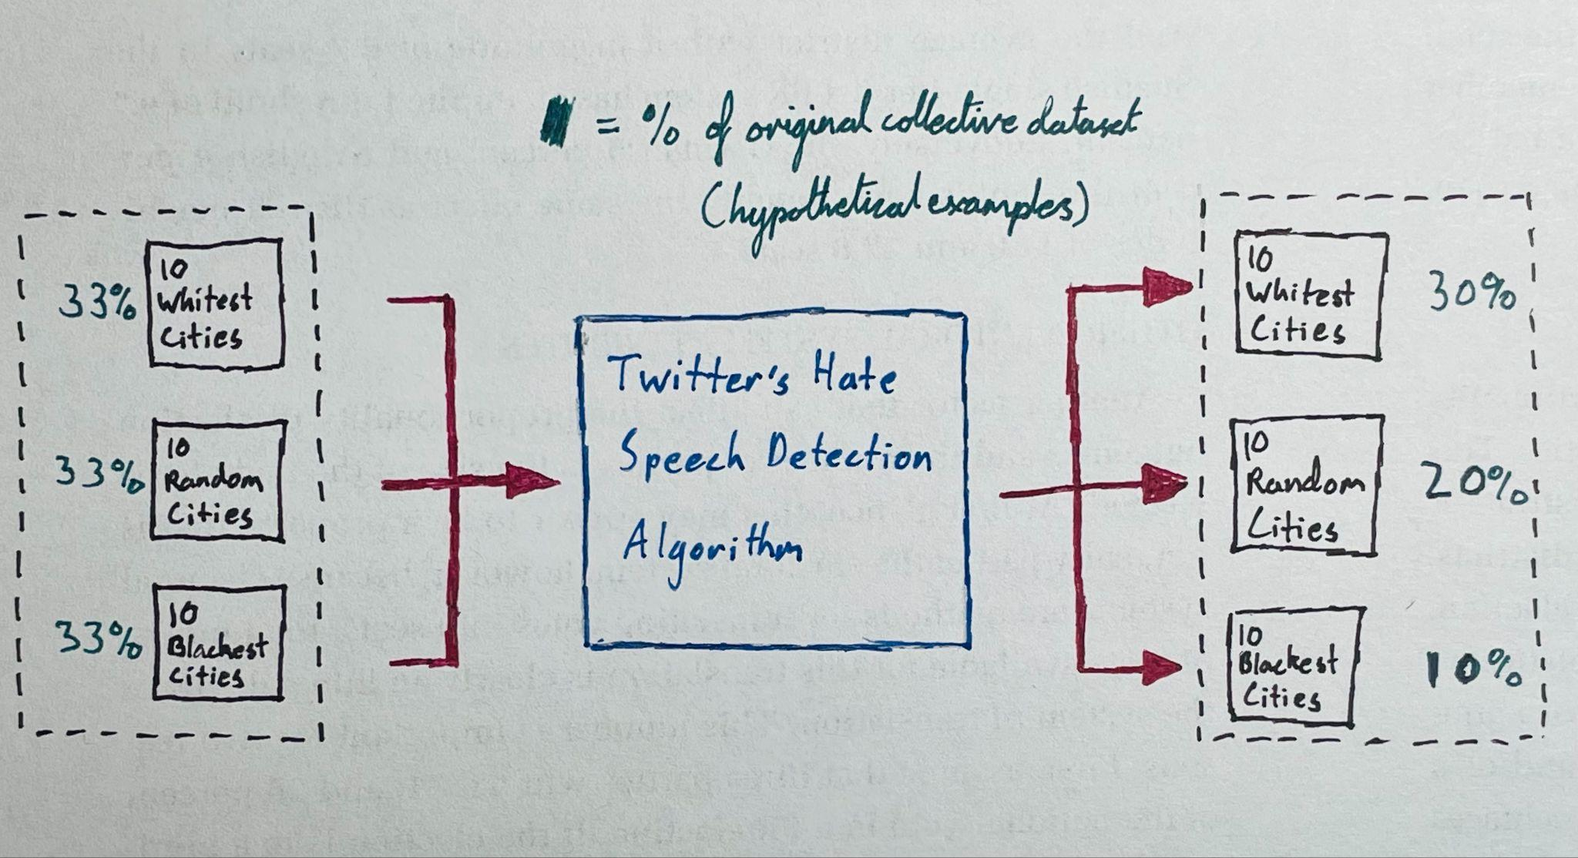
Design Draft: The Big Picture
Preliminary Assumptions:
We work at Twitter and, thus, have access to both Twitter’s tweet database and Twitter’s Hate Speech Detection Algorithm
Twitter’s Hate Speech Detection Algorithm is consistent (it has defined boundaries for what it considers hate speech, and each text is definitively either hate speech or not hate speech)
Location tracking on twitter accounts is a user-enabled feature, thus our compiled dataset of tweets comprise only of those who have enabled this feature

Slide 5
Design Draft: Method
We compile three different datasets based on location: one will be tweets sent from accounts located in the top 10 whitest cities in the US, another will be from the top 10 blackest cities in the US, and our third one will act as our reference point throughout the experiment.
This third dataset will be tweets sent from twitter accounts located in 10 random cities in the US (here we’re using randomized control trial).
At this point, we treat the three datasets as one dataset and take note of their proportions (e.g. each of them accounts for 33% of the total); we’ll use these proportions as a “before” value to compare the “after” value later.
Next, we feed the three datasets through twitter’s hate speech detection algorithm (which is our treatment) and it should come up with three post-treatment datasets of varying sizes relative to the original.
We take note of how much the random cities dataset decreased by (i.e. how many tweets there are compared to how many there used to be) and we use that as a “control” value for change.
Then we compare that control change value to how much the change was in the whitest cities dataset and in the blackest cities dataset (here we’re using the difference-in-difference design).

Slide 6
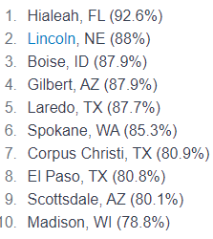
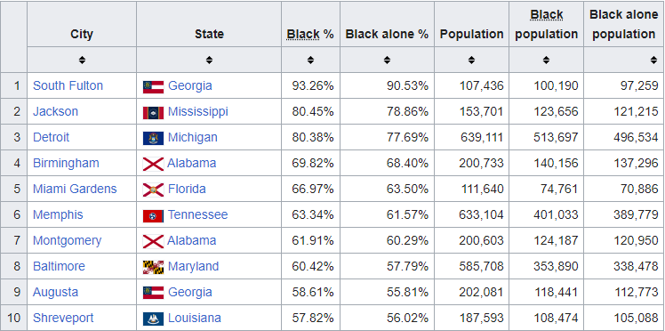
Design Draft: Datasets
Dataset W: Tweets from accounts located in US cities with the top 10 highest white population percentage
Dataset B: Tweets from accounts located in US cities with the top 10 highest black population percentage
World Population Review, 2020 census
Wikipedia, 2020 Census

Slide 7
Design Draft: Datasets (Cont.)
Dataset C: Tweets from accounts located in 10 random US cities, using a random generator
Boise, Idaho
Savannah, Georgia
Spokane, Washington
Omaha, Nebraska
Albuquerque, New Mexico
Syracuse, New York
Little Rock, Arkansas
Reno, Nevada
Fort Wayne, Indiana
Tallahassee, Florida
Timeframe:
Tweets compiled will be from 01-01-2013 to 01-01-2023, spanning 10 years. We think this sufficient to capture the breadth of hate speech and mitigate the effect of time-varying confounders
This will also capture most major events like elections, or recent movements like BLM and will eliminate potential bias towards any of them in particular.
It is important we account for this as content of tweets do differ based on the event, and certain factors like the race of those running for elections, or race-specific movements like BLM will affect both the volume of hate speech and the demographics of those engaging in it

Slide 8
Methods / Techniques Used
Random Control Trials
Difference-in-Difference
Although we are not using the Randomized Control Trials design to look for causal inference, we are randomizing which cities we pick to act as our constant as that will likely give us the least biased set of cities to pull data from.
Picking cities from a specific geographic location or even cities defined by other metrics (e.g. 10 most diverse cities) could introduce more confounding variables; meanwhile, this randomization allows for a more even and unbiased spread of US cities.
We will use the dataset collected from this randomized set of cities to use as a reference point for our difference-in-difference causal inference design, assuming that—on average—the effect of the hate speech algorithm treatment should be around the same as what we observe with this dataset.
We are using a difference-in-difference design to look for a causal relationship. The percentage decrease in number of tweets after the control dataset (randomized cities) is filtered through the hate speech detection algorithm will represent the control trend.
We operate under the key assumption that outcomes follow parallel trends in the absence of the treatment, assuming a parallel trend for counterfactual (control trend). We’ll compare the percentage decreases from datasets A and B to the control to see if the algorithm favors a particular ethnicity/race or not.
E.g. if the control dataset decreased to 50% of its original size, then the 10 Blackest Cities dataset decreasing to only 25% its original size could suggest the algorithm is biased against Black communities.

Slide 9
Potential Confounders / Issues
Socioeconomic / Structural differences between Black and White Cities
Which Twitter Users Are Actually Turning On Location Tracking?
One notable confounder could be that there simply exists more “hate speech” in predominantly Black communities than White communities, depending on how Twitter’s algorithm categorizes hate speech.
This difference in general disposition could be a result of socioeconomic inequalities or structural differences in a country where a history of discrimination runs deep and has yet to subside (e.g. people could be directing hate speech toward local government inadequacies).
Although we have access to Twitter’s entire database, including user-deleted or moderated tweets, location tracking is not enforced and it is highly likely that malicious actors would not enable this if their intent is to spread hate speech.
Location in user profiles is also largely self-reported by users.
Therefore, we would not be able to include them in our dataset; instead, we are first filtering our datasets down to whoever has turned on location tracking.

