Slide 1


Report
On
Social Buzz

Slide 2


Today's agenda
Project recap
Problem
The Analytics team
Process
Insights
Summary

Slide 3

bbbbbbb
Considering present world scenario social media is the fast growing market and one need to adapt as soon as possible to it’s global scale.
Accenture has began a 3 month POC majorly focusing on the below three activities:
Audit regarding social buzz’s big data practice.
Reconditions for suitable IPO
Analysis to find out the top most 5 content categories of Social BUZZ.
Project Recap

Slide 4

Problem
Over 100K posts a day
Close to 37M post content a year
Understanding the data and finding ways to sustain.
Getting an overview of top most content categories which gives an idea of how to approach.

Slide 5



Pavan G N
Data Analyst
The Analytics team
Marcus Rompton
Senior Principle
Andrew Feming
Chief Technical Architect

Slide 6
Process
1
Understanding of Data
2
Data Cleaning
3
Data Modelling
4
Data Analysis
5
Visualizing insights and Communication

Slide 7
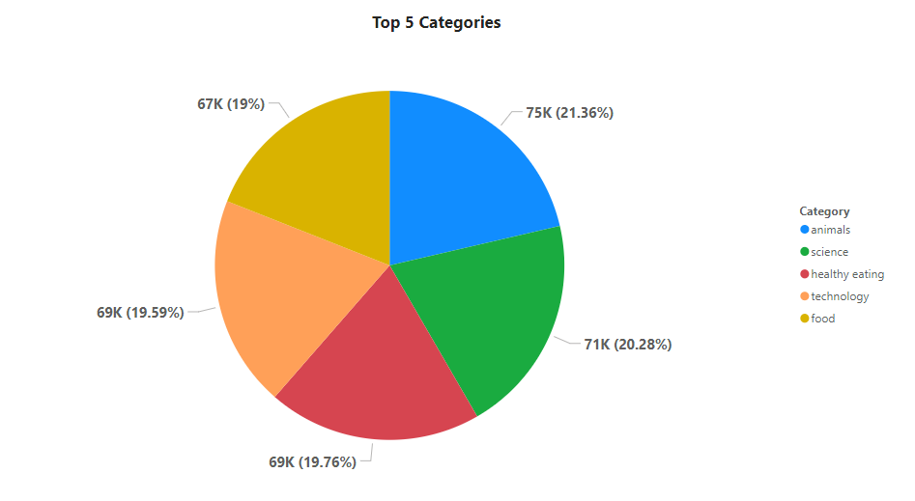

Insights

Slide 8
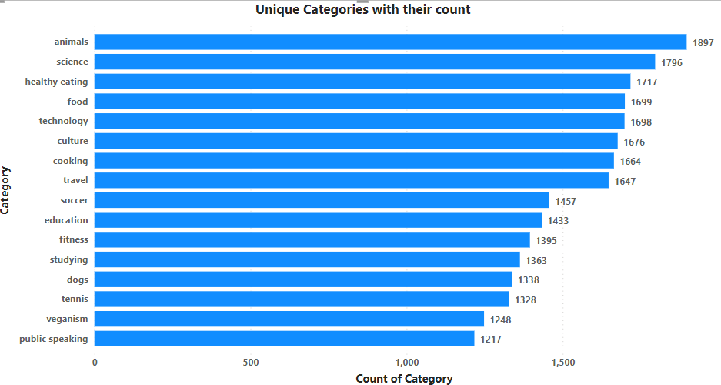

Slide 9
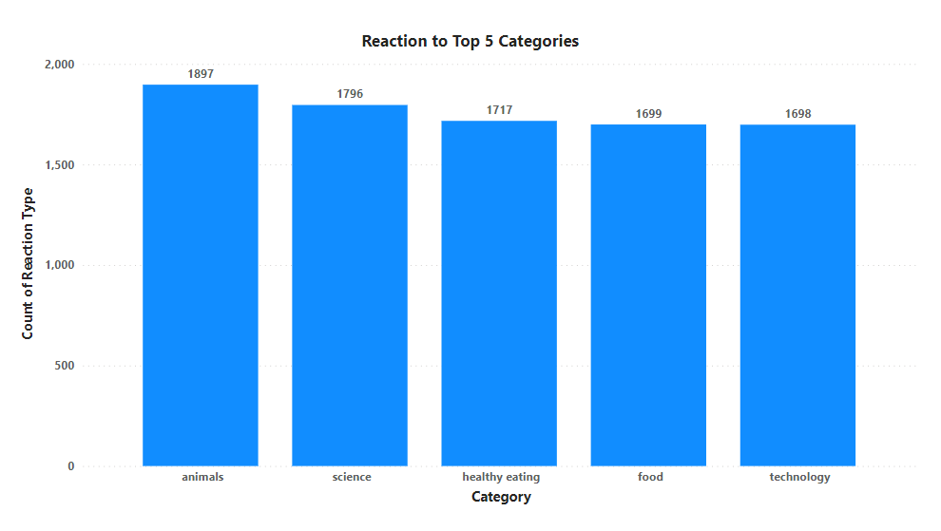

Slide 10
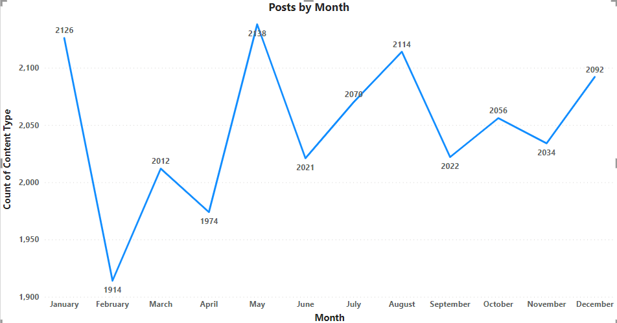

Slide 11

As per the requirements clear, meaningful and understandable insights are built.
They are as follows:
Top 5 performing categories
Posts generated for the top most performing categories.
Posts by each month
By the above visuals we get a clear understanding of what are the most popular post generators and in which most exactly.
Summary

Slide 12
Thank you!
ANY QUESTIONS?

