Slide 1
DevOps
Course Instructor
Dr.S.Gokulraj
Associate Professor / CSE
Velalar College of Engineering and Technology
Course Material

Slide 2
Unit-I Introduction to DevOps
DevOps Essentials
Introduction to AWS
GCP, Azure
Version Control Systems
Git and Github

Slide 3
What is DevOps?
DevOps represents a change in the IT Culture with a complete focus on rapid IT service delivery through adopting agile practice in the context of a system-Oriented Approach.

Slide 4
What is DevOps?
DevOps represents a change in the IT Culture with a complete focus on rapid IT service delivery through adopting agile practice in the context of a system-Oriented Approach.
Dev - Development

Slide 5
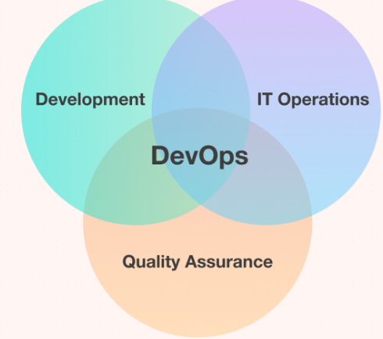
What is DevOps?
DevOps represents a change in the IT Culture with a complete focus on rapid IT service delivery through adopting agile practice in the context of a system-Oriented Approach.
Dev – Development
+
Ops - Operations

Slide 6
What is DevOps ?
It is neither an application nor a tool; instead, it is just a culture that collaboratively promotes development and operation.
As a result of DevOps implementation, the speed to deliver applications and services has increased.

Slide 7
Why DevOps?
DevOps enhances the organization's performance, improves the productivity and efficiency of development and operations teams.
Bringing the two teams together centralizes the responsibility on the entire team and not specific individuals working.
Devops is more than just a tool or a process change. It inherently requires an organizational culture shift.
This cultural change is especially difficult, because of the conflicting nature of departmental

Slide 8
Why DevOps?
roles:
1. Operations - Seeks organizational stability;
2. Developers - Seek change;
3. Testers - Seek risk reduction.

Slide 9
Why DevOps?
Adoption of Devops is driven by various factors. These factors are –
Demand for an increased rate of production release – from application and business unit stakeholders.
Increased usage of data center automation and configuration management tools.
Use of agile and other development processes and methods.
Increased focus on test automation and continuous integration methods.
Wide availability of virtualized and cloud infrastructure.

Slide 10
Where did DevOps come from?
There are many stories about the DevOps origins, but it is not created out of the whole cloth. Its seeds were planted many years ago and recently nurtured by expert IT professionals in several disciplines.
Two primary ancestors of DevOps are:

Slide 11
Where did DevOps come from?
ESM (Enterprise Systems Management):
People involved in the initial phases of DevOps are system administrators. These experts brought the critical ESM practices to DevOps like configuration management, automated provisioning, system monitoring, the toolchain approach, etc.
Agile Development:
DevOps can be considered as an outgrowth of agile. It is simply extending the Agile principles beyond the boundaries of the code to the entire delivered services.

Slide 12
What is the need for DevOps?
DevOps implementation has increased the rate of software delivery and revenue for business stakeholders. The following listed reasons are the most considerable ones that led to the creation of DevOps.
Before DevOps, operation and development teams worked in an isolated environment.
Testing and Deployment activities were primarily performed, isolated after the design-build step, which took more time than the actual project completion time.
Team members usually spend a significant amount of time in deploying, testing, designing, and building the projects
Human production errors were deployed during manual code conduction.
Operations and coding teams generally had different timelines and did not have proper synchronization, which resulted in further delay.

Slide 13
What is the need for DevOps?
To avoid the hassles mentioned above and non-collaborative performance measures, there was an urgent need for robust IT technology like DevOps to satisfy business owners and stakeholders.

Slide 14
Goals
To make simple processes increasingly programmable and dynamic.
Fast delivery of product.
Lower failure rate of new releases.
Shortened lead time between fixes.
Faster means time to recovery.
Increases net profit of organization.
To standardize the development environment.
To reduce work in progress.
To reduce operating expenses.
To set up an automated environment.

Slide 15
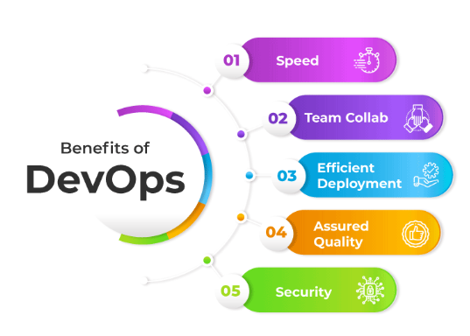
Benifits
Technical benefits
Continuous software delivery is possible
There is less complexity to manage the project.
The problems in the project get resolved faster.
Cultural benefits
The productivity of teams increased.
There is higher employee engagement.
There arise greater professional development opportunities.
Business benefits
The faster delivery of the product is possible,
The operating environment becomes stable.
The communication and collaboration gets improved among the team members and customers.
More time is available for innovation rather than fixing and maintaining

Slide 16
Comparison between Agile and DevOps
DevOps bring more flexibility than agile. With Continuous Integration (CT) and Continuous Delivery (CD), the release of software products is made often and it is ensured that these releases actually work and meet the customer needs.
Thus in DevOps there are an increased number of releases.
One goal of DevOps is to establish an environment where releasing more reliable applications, faster and more frequently, can occur. This actually brings the continuous delivery approach.
DevOps is not a separate concept but a mere extension of Agile to include operations as well to collaborate different agile teams together and work as ONE team with an objective to deliver software fully to the customer.

Slide 17
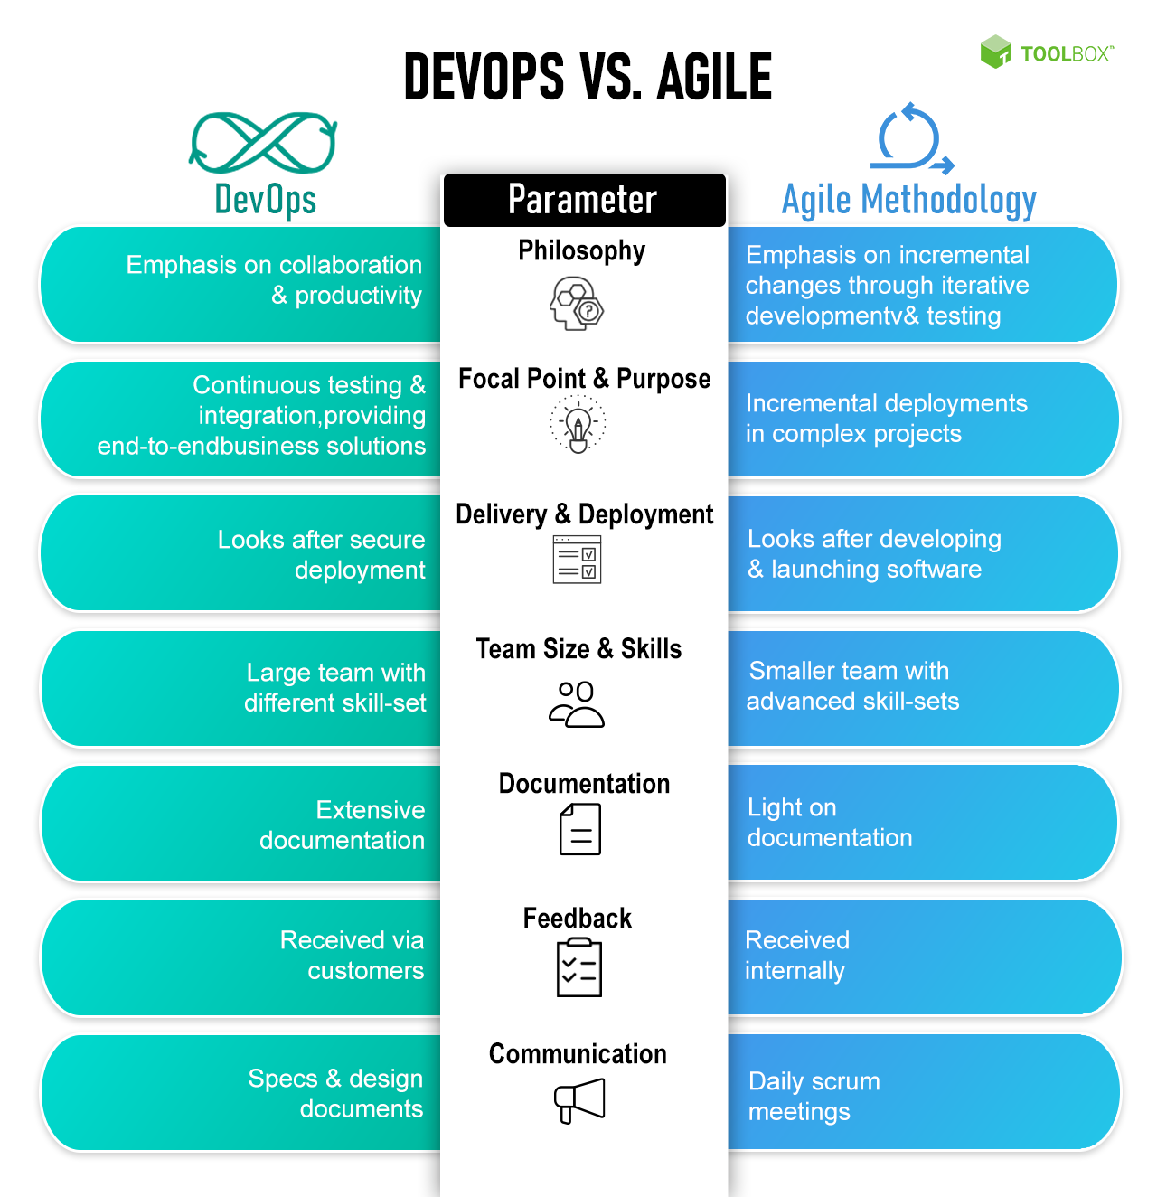

Slide 18
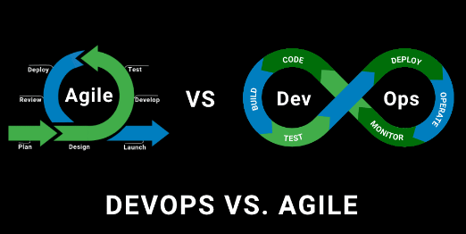
Comparision

Slide 19
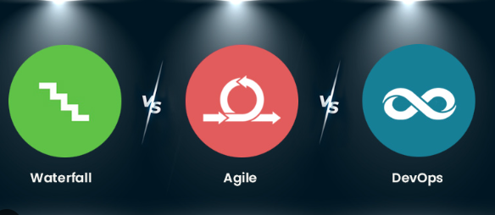
Comparision

Slide 20
DevOps Tools
Automation Tools | Pipeline (CI/CD) Tools | Version Control Tools | Configuration Management Tools | Testing Tools | Monitoring Tools
Docker | BitBucket | Git | Chef | Jenkins | PagerDuty
Kubernetes | Perforce Helix | Gitlab | Ansible | JMeter | Librato
Bamboo | IBM Urbancode | CVS | Puppet | Selenium | Prometheus
Raygun | Buddy | Bazaar | Salt | Appium | Splunk
GitHub | Circle CI | SVN | CFEngine | SoapUI | App Dynamics

Slide 21
DevOps Architecture
phases of DevOps architecture-
1.Plan: In this phase, all the requirements of the project are gathered. The schedule and cost of the project is estimated approximately.
2.Code: In this phase the code is written as per the requirements. Entire project is divided into smaller units. Each unit can be coded as a module
3.Build: In this phase, the building of all the units is done using tools such as Maven, Gradle to submit the code to a common code source
4.Test: At this stage, all the units are tested to find if there exists any bug in the code. The testing can be done using tools like Selenium, JUnit, PYtest. Some important testing techniques such as acceptability testing, safety testing, integration checking, performance testing are carried out.

Slide 22
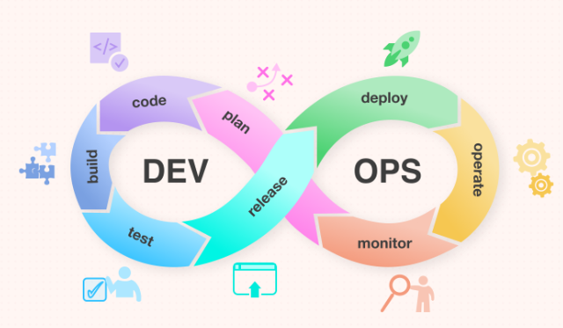
DevOps Architecture

Slide 23
DevOps Architecture
5.Integrate: In this phase, a new feature is added to the existing code and testing is performed. Continuous Development is achieved only because of continuous integration and testing.
6.Deploy: In this stage, the code is deployed in the client's environment. Some of the examples of the tools used for Deployment are AWS, Docker.
7.Operate: At this stage, the version can be utilized by the users. Operations are performed on the code if required. Some of the examples of the tools used are Kubernetes, open shift.
8.Monitor: At this stage, the monitoring of the version at the client's workplace is done During this phase, developers collect data, monitor each function and spot errors like low memory or server connection are broken. The DevOps workflow is observed at this level depending on data gathered from consumer behavior, application efficiency and other sources. Some of the examples of the tools used are Nagios, elastic stack for monitoring.

Slide 24
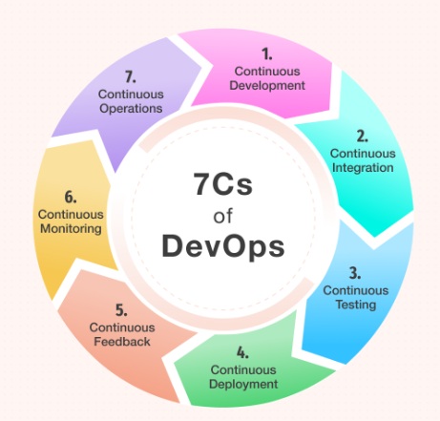
DevOps LifeCycle

Slide 25
DevOps Lifecycle
1.Continuous development: In this phase, the planning and coding of software is done. Version control mechanism is used during this phase.
2.Continuous integration : In this phase, developers are required to commit changes in the source code frequently. The code supporting new functionality is continuously integrated with the existing code. Therefore, there is continuous development of software.
3.Continuous testing: In this phase, the software is continuously tested for bugs. Many times automation testing is preferred.

Slide 26
DevOps Lifecycle
4.Continuous monitoring: By continuous monitoring, we can get notified before anything goes wrong. We can gather many performance measures, including CPU and memory utilization, network traffic, application response times, error rates and others.
5.Continuous feedback: In this DevOps stage, the software automatically sends out information about performance and issues experienced by the end-user. It's also an opportunity for customers to share their experiences and provide feedback.
6.Continuous deployment: In this phase, the code is deployed to the production servers. Also, it is essential to ensure that the code is correctly used on all the servers. The deployment process takes place continuously in this DevOps life cycle phase.
7.Continuous operations: It is the last phase which involves automating the application's release and all these updates that help you keep cycles short and give developers more time to focus on developing

Slide 27
Introduction to AWS
Amazon Web Services (AWS) began offering IT infrastructure services to businesses as web services—now commonly known as cloud computing.

Slide 28
Introduction to AWS
One of the key benefits of cloud computing is the opportunity to replace upfront capital infrastructure expenses with low variable costs that scale with your business. With the cloud, businesses no longer need to plan for and procure servers and other IT infrastructure weeks or months in advance. Instead, they can instantly spin up hundreds or thousands of servers in minutes and deliver results faster.

Slide 29
Introduction to AWS
Today, AWS provides a highly reliable, scalable, low-cost infrastructure platform in the cloud that powers hundreds of thousands of businesses in 190 countries around the world.

Slide 30

Introduction to AWS
The following video explores how millions of customers use AWS to take advantage of the efficiencies of cloud computing.

Slide 31
Introduction to AWS
Amazon Web Services offers a broad set of global cloud-based products including compute, storage, databases, analytics, networking, mobile, developer tools, management tools, IoT, security, and enterprise applications: on-demand, available in seconds, with pay-as-you-go pricing. From data warehousing to deployment tools, directories to content delivery, over 200 AWS services are available.
New services can be provisioned quickly, without the upfront fixed expense. This allows enterprises, start-ups, small and medium-sized businesses, and customers in the public sector to access the building blocks they need to respond quickly to changing business requirements.

Slide 32
Cloud Computing
Cloud computing is the on-demand delivery of compute power, database, storage, applications, and other IT resources through a cloud services platform via the internet with pay-as-you-go pricing.
Cloud computing provides a simple way to access servers, storage, databases and a broad set of application services over the internet. A cloud services platform such as Amazon Web Services owns and maintains the network-connected hardware required for these application services, while you provision and use what you need via a web application.
AWS holds 31% of the global cloud market share

Slide 33
History of Amazon Web Services
AWS platform was launched in the year 2002, and after that, it kept on evolving and offering services to Its customers without fail. As of now in 2024, it has a total of 25 geographical regions. With time, it keeps on growing and fulfilling customers’ demands in the best possible way.
2002- AWS services launched
2004- SQS was launched
2006- Launched its cloud products
2012- Holds first customer event
2015- Reveals revenues achieved of $4.6 billion
2016- Surpassed $10 billion revenue target
2016- Release snowball and snowmobile
2019- Offers nearly 175 services

Slide 34
Services Provided by AWS
Compute
Storage
Database
Migration
Networking and content delivery
Management Tools
Security and Identity Compliance

Slide 35
Services Provided by AWS?
#1. Compute
Services under the computing domain in AWS are all about high-end servers that are used to host a website, process backend data, etc.
Let us have a look at some of the essential services under compute domain:

Slide 36
Services Provided by AWS
i. EC2
AWS EC2 (Elastic Compute Cloud) offers you a server with desired OS, RAM, and processor where you have full control of OS to perform any operation.
ii. Lambda
Under lambda service, the user does not have full access to the OS and cannot host a website. It is used only for backend processing where it can receive the request, process it, and send back the result.
iii. Elastic Beanstalk
In AWS Elastic Beanstalk, the user gets a dashboard to upload websites. It is a Platform as a service, so the user does not have full access to the OS.

Slide 37
Services Provided by AWS
iv. Elastic Load Balancer
AWS load balancer balances the load among servers that are deployed at a particular instance. There are three types of load balancers -
Classic load balancer: balances traffic among servers
Application load balancer: balances traffic based on URL of applications
Network load balancer: Balances traffic based on web protocol (HTTP, FTP, etc.)
v. Autoscaling
Autoscaling helps to increase or decrease the number of servers needed based on requirements for operation such as CPU usage, memory usage, network throughput, etc.

Slide 38
Services Provided by AWS
#2. Storage
AWS offers storage plenty of choices to users for backing up information, archiving, and disaster recovery. Let us have a look at the list of the main services available under the storage domain on the AWS Cloud.

Slide 39
i. S3
Amazon Simple Storage Service (S3) stores files in the form of objects with a maximum size of 5 TB each.
ii. Glacier
AWS Glacier provides low-cost, flexible, durable, secure storage for data backup and archival where customers can store data for as little as $0.004 per GB per month.
iii. Cloudfront
Amazon CloudFront speeds up the distribution of static and dynamic web content and delivers it through data centers called edge locations with the lowest latency.
iv. Elastic File System
AWS EFS (Elastic File System) is used to mount shared drives among multiple servers in real-time.
v. Storage Gateway
AWS Storage Gateway helps users to access or store data on AWS with the lowest latency possible.

Slide 40
Services Provided by AWS
#3. Database
In this domain, AWS provides services that can help you monitor and manage your databases in the AWS infrastructure for better productivity. Services under Database are-

Slide 41
i. RDS
Amazon RDS (relational database service) is a service that manages your relational databases and keeps your information updated.
ii. DynamoDB
DynamoDB supports key-value and document data along with point-in-time recovery and on-demand backup.
iii. ElasticCache
AWS ElastiCache improves the performance of the application by caching the frequently required or queried data.
iv. RedShift
Amazon Redshift is a data warehouse service that offers mission-critical analysis for companies.

Slide 42
Services Provided by AWS
#4. Migration
This domain deals with the transferring of data to and from the AWS infrastructure. There is a service called snowball used when you need to transfer your considerable data to the AWS infrastructure physically.
For this, you will receive a physical device sent by AWS to your location, and you have to upload your data on it and send it back to the AWS office.

Slide 43
Services Provided by AWS
#5. Networking and content delivery
AWS offers the highest network availability amongst all cloud service providers to increase throughput with on-time content delivery and reduced network latency.

Slide 44
Services Provided by AWS
i. VPC
AWS VPC (Virtual private Cloud) allows users to launch their AWS resources into a virtual network.
ii. Direct Connect
AWS direct connect makes it easier to establish a network connection from the user's premises to AWS that reduces network costs and increases bandwidth throughput.
iii. Route 53
Amazon Route 53 is a scalable cloud DNS web service designed to offer a reliable way to route users to internet applications.

Slide 45
Services Provided by AWS
#6. Management Tools
Using these tools, you can manage all of your AWS resources on AWS infrastructure. There are some of the services given below that users can use to control and secure their data from getting into unauthorized hands.

Slide 46
i. CloudWatch
AWS CloudWatch is a monitoring service that helps in monitoring the AWS account and resources in it.
ii. CloudFormation
AWS CloudFormation allows us to create a bunch of AWS resources through a single click. Using this tool, we can create a large architecture with a few clicks.
iii. CloudTrail
AWS CloudTrail provides event history on each and every AWS account-related activity along with auditing, compliance monitoring, and governance.
iv. OpsWorks
AWS OpsWorks helps in managing and configuring servers on AWS using Chef and Puppet.

Slide 47
Services Provided by AWS
#7. Security and Identity Compliance
This domain deals with user rights and authenticity. Services under this domain will help you manage what access should be given to which person in your organization or team. With the below-given services, a user can give needed access to the employees and secure his/her data.
i. IAM
AWS IAM (Identity and Access Management) allows users to access the resources in the AWS ecosystem.
ii. KMS
AWS KMS (Key Management System) helps users to create and manage security keys to keep their data safe and secure.

Slide 48
Applications of AWS Services
Website hosting
Search Engines
Social Networking
Academic Computing
Media Sharing (Image/ Video)
Mobile and Social Applications
Application hosting/SaaS hosting
Development and test environments
Content delivery and Media Distribution
Storage, backup, and disaster recovery

Slide 49
Major Benefits of Using AWS
It offers cost-effective services where you have to pay only for what you use. There are no long-term or upfront commitments.
Users do not have to worry about the maintenance or running of data centers.
Offers faster deployments.
Offers high scalability, users can extend or reduce the capacity as per requirement.
Users can deploy their applications in several regions across the world within just a few clicks.
It allows organizations/companies to use already known operating systems, databases, programming models, and architectures.

Slide 50
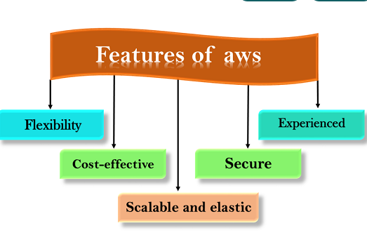

Slide 51
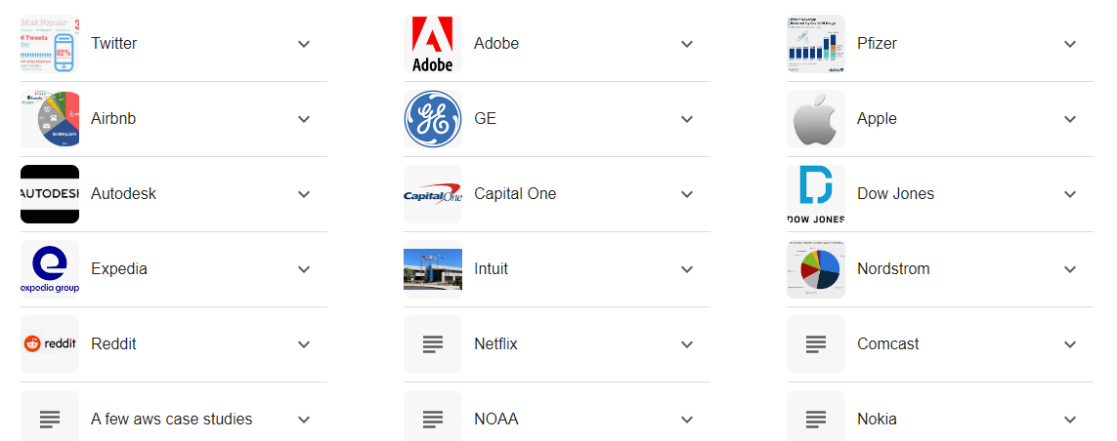
Companies that use AWS

Slide 52
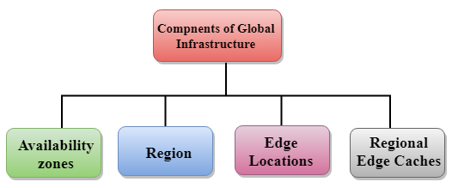
AWS Global Infrastructure
WS is a cloud computing platform which is globally available.
Global infrastructure is a region around the world in which AWS is based. Global infrastructure is a bunch of high-level IT services which is shown below:
AWS is available in 19 regions, and 57 availability zones in December 2018 and 5 more regions 15 more availability zones for 2019.

Slide 53
Availability zone as a Data Center
An availability zone is a facility that can be somewhere in a country or in a city. Inside this facility, i.e., Data Centre, we can have multiple servers, switches, load balancing, firewalls. The things which interact with the cloud sits inside the data centers.
An availability zone can be a several data centers, but if they are close together, they are counted as 1 availability zone.

Slide 54
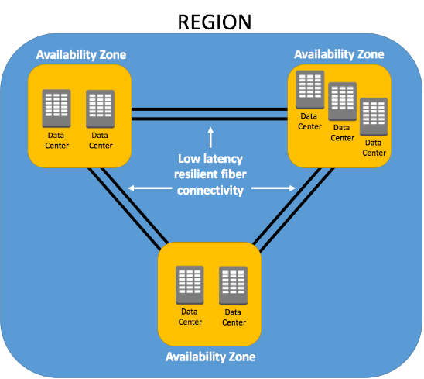
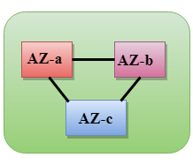
Region
A region is a geographical area. Each region consists of 2 more availability zones.
A region is a collection of data centers which are completely isolated from other regions.
A region consists of more than two availability zones connected to each other through links.
Availability zones are connected through redundant and isolated metro fibers.

Slide 55
Edge Locations
Edge locations are the endpoints for AWS used for caching content.
Edge locations consist of CloudFront, Amazon's Content Delivery Network (CDN).
Edge locations are more than regions. Currently, there are over 150 edge locations.
Edge location is not a region but a small location that AWS have. It is used for caching the content.
Edge locations are mainly located in most of the major cities to distribute the content to end users with reduced latency.
For example, some user accesses your website from Singapore; then this request would be redirected to the edge location closest to Singapore where cached data can be read.

Slide 56
Regional Edge Cache
AWS announced a new type of edge location in November 2016, known as a Regional Edge Cache.
Regional Edge cache lies between CloudFront Origin servers and the edge locations.
A regional edge cache has a large cache than an individual edge location.
Data is removed from the cache at the edge location while the data is retained at the Regional Edge Caches.
When the user requests the data, then data is no longer available at the edge location. Therefore, the edge location retrieves the cached data from the Regional edge cache instead of the Origin servers that have high latency.

Slide 57
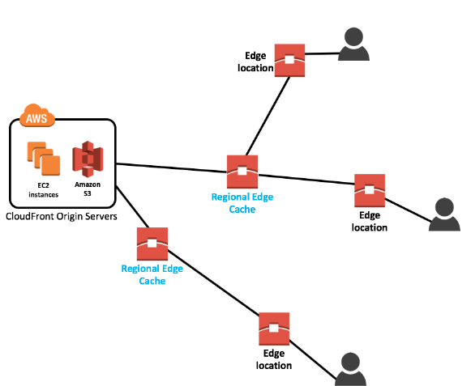

Slide 58
GCP
Google Cloud Platform (GCP) is a suite of cloud computing services provided by Google.
It is a public cloud computing platform consisting of a variety of services like compute, storage, networking, application development, Big Data, and more, which run on the same cloud infrastructure that Google uses internally for its end-user products, such as Google Search, Photos, Gmail and YouTube, etc.

Slide 59
Benefits of Google Cloud Platform
Best Pricing: Google enables users to get Google Cloud hosting at the cheapest rates. The hosting plans are not only cheaper than other hosting platforms but also offer better features than others. GCP provides a pay-as-you-go option to the users where users can pay separately only for the services and resources they want to use.
Work from Anywhere: Once the account is configured on GCP, it can be accessed from anywhere. That means that the user can use GCP across different devices from different places. It is possible because Google provides web-based applications that allow users to have complete access to GCP.
Private Network: Google has its own network that enables users to have more control over GCP functions. Due to this, users achieve smooth performance and increased efficiency over the network.
Scalable: Users are getting a more scalable platform over the private network. Because Google uses fiber-optic cables to extend its network range, it is likely to have more scalability. Google is always working to scale its network because there can be any amount of traffic at any time.
Security: There is a high number of security professionals working at Google. They always keep trying to secure the network and protect the data stored on servers. Additionally, Google uses an algorithm that encrypts all the data on the Cloud platform. This gives assurance to the users that their data is completely safe and secure from unauthorized sources.
Redundant Backup: Google always keeps backup of user's data with built-in redundant backup integration. In case a user has lost the stored data, it's not a big problem. Google always has a copy of the users' data unless the data is deleted forcefully. This adds data integrity, reliability and durability with GCP.

Slide 60
Key Features of Google Cloud Platform
On-demand services: Automated environment with web-based tools. Therefore, no human intervention is required to access the resources.
Broad network access: The resources and the information can be accessed from anywhere.
Resource pooling: On-demand availability of a shared pool of computing resources to the users.
Rapid elasticity: The availability of more resources whenever required.
Measured service: Easy-to-pay feature enables users to pay only for consumed services.

Slide 61
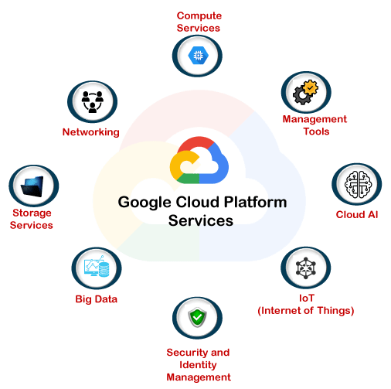
Google Cloud Platform Services
Google provides a considerable number of services with several unique features. That is the reason why Google Cloud Platform is continually expanding across the globe. Some of the significant services of GCP are:

Slide 62
Compute Services
Google App Engine: It is a cloud computing platform that follows the concept of Platform-as-a-Service to deploy PHP, Java and other software. It is also used to develop and deploy web-based software in Google-managed data centers. The most significant advantage of Google App Engine is its automatic scaling capability. This means that the App Engine automatically allocates more resources for the application when there is an increase in requests.
Compute Engine: It is a cloud computing platform that follows the concept of Infrastructure-as-a-Service to run Windows and Linux based virtual machines. It is an essential component of GCP. It is designed on the same infrastructure used by Google search engine, YouTube and other Google services.
Kubernetes Engines: This computing service is responsible for offering a platform for automatic deployment, scaling, and other operations of application containers across clusters of hosts. The engine supports several container tools like a docker, etc.

Slide 63
Networking Service
VPC: VPC stands for Virtual Private Network. The primary function of VPC is to offer a private network with routing, IP allocation, and network firewall policies. This will help to create a secure environment for the application deployments.
Cloud Load Balancing: As its name states, Cloud balancing is used to distribute workload across different computing resources to balance the entire system performance. This also results in cost-reduction. The process also helps in minimizing the availability and maximizing the capability of the resources.
Content Delivery Network: CDN is a geographically distributed network of proxy servers and their data centers. The primary aim of using CDN is to provide maximum performance to the users. Additionally, it also helps deliver high availability of resources by equally distributing the related services to the end-users.

Slide 64
Storage Services
Google Cloud Storage: It is an online data storage web service that Google provides to its users to store and access data from anywhere. The service also includes a wide range of features like maximum performance, scalability, security and sharing.
Cloud SQL: It is a web-service that enables users to create, manage, and use relational databases stored on Google Cloud servers. The service itself maintains and protects the databases, which helps users focus on their applications and other operations.
Cloud Bigtable: It is known for its fast performance and highly manageable feature. It is a highly scalable NoSQL database service that allows collecting and retaining data from as low as 1 TB to hundreds of PB.

Slide 65
BigData
BigQuery: It is a fully managed data analysis service by Google. The primary aim of Google BigQuery service is to helps businesses to analyze Big Data. It offers a highly scalable data management option. This means BigQuery allows users to perform ad-hoc queries and share data insights across the web.
Google Cloud Datastore: Google Cloud Datastore is a kind of datastore service that is fully managed, schema-less, and non-relational. This service enables businesses to perform automatic transactions and a rich set of queries. The main advantage of Google Cloud Datastore is the capability of automatic scaling. This means that the service can itself scale up and down, depending on the requirement of resources.
Google Cloud Dataproc: It is a very fast and easy to use big data service offered by Google. It mainly helps in managing Hadoop and Spark services for distributed data processing. The service allows users to create Hadoop or Spark clusters sized according to the overall workload and can be accessed whenever users want them.

Slide 66
Security and Identity Management
Cloud Data Loss Prevention API: It is mainly designed to manage sensitive data. It helps users manage sensitive data elements like credit card details, debit card details, passport numbers, etc. It offers fast and scalable classification for sensitive data.
Cloud IAM: It stands for Cloud Identity and Access Management. It is a framework that contains rules and policies and validates the authentication of the users for accessing the technology resources. That is why it is also known as Identity Management (IdM).

Slide 67
Management Tools
Google Stackdriver: Google Stackdriver service is primarily responsible for displaying the overall performance and diagnostics information. This may include insights of data monitoring, tracing, logging, error reporting, etc. The service also prompts an alert notification to the public cloud users.
Google Cloud Console App: It is a native mobile application powered by Google. The primary aim of this service is to enable users to manage the core features of Google Cloud services directly from their mobile devices anytime, anywhere. The primary functions of this service are alerting, monitoring, and performing critical actions on resources.

Slide 68
Cloud AI
Cloud Machine Learning Engine: It is another fully managed service that allows users to create Machine Learning models. The service is mainly used for those ML models, which are based on mainstream frameworks.
Cloud AutoML: It is the type of service that is based on Machine Learning. It helps users to enter their data sets and gain access to quality trained pre-designed ML models. The service works by following Google's transfer learning and Neural Architecture Search method.

Slide 69
IoT (Internet of Things)
Cloud IoT Core: It is one of the fully managed core services. It allows users to connect, control, and ingest data from various devices that are securely connected to the Internet. This allows other Google cloud services to analyze, process, collect and visualize IoT data in real-time.
Cloud IoT Edge: The Edge computing service brings memory and other computing-power resources near to the location where it is required.

Slide 70
Advantages of Google Cloud Platform
Google Cloud Offers Quick and Easy Collaboration
Higher Productivity with Continuous Development
Less Disruption with Adopting New Features
Least or Minimal Data is stored on Vulnerable Devices
Users can access Google Cloud from Anywhere:
Google provides Maximum Security with its Robust Structure
Users have Full Control over their Data
Google provides Higher Uptime and Reliability

Slide 71
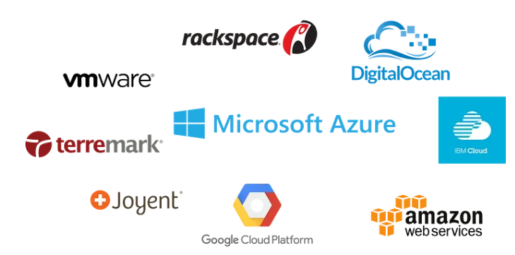
Introduction to Azure
What Is Azure?
Microsoft Azure is a cloud computing platform created by Microsoft which developers and IT professionals use to build, deploy and manage applications through their global network of datacentres.

Slide 72
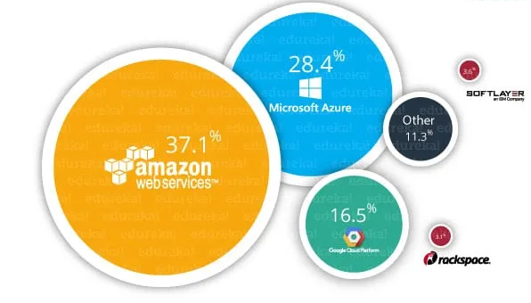
Azure Market Share
The image below shows the percentage of the companies who have adopted the respective cloud providers as their “primary” IaaS partners.

Slide 73
Service Domains In Azure
Compute It is used to process data on the cloud by making use of powerful processors that serve multiple instances at a time.
Virtual Machines
VM Scale Sets
Azure Container
Container Registry
Functions
Batch
Service Fabric
Cloud Services
Storage Services The storage as the name suggests is used to store data in the cloud with the ability to scale as and when required. This data can be stored anywhere.
Blob Storage
Queue Storage
File Storage
Table Storage

Slide 74
Service Domains In Azure
Database The database domain is used to provide reliable relational and nonrelational database instances managed by Azure.
SQL Databases
DocumentDB
Redis Cache
Networking It includes services that provide a variety of networking features such as security, faster access, etc.
Virtual Network
Load Balancer
Application Gateway
Azure DNS
Content Delivery Network
VPN Gateway
Traffic Manager
Express Route

Slide 75
Service Domains In Azure
Developer Tools It includes services which provide services that ease the ability to code for an organization. For example, it eases the teams to share code, track work, and ship software.
Visual Studio Team Services
Application Insights
API Management
Management and Monitoring Tools It includes services that can be used to manage and monitor your Azure instances.
Microsoft Azure Portal
Azure Resource Manager
Automation

Slide 76
Service Domains In Azure
Enterprise Integration Services that bring functionalities like seamlessly integrating the enterprise and the cloud.
Service Bus
SQL Server Stretch Database
Security and Identity It includes services for user authentication or limiting access to a certain set of audiences on your Azure resources.
Key Vault
Azure Active Directory
Azure AD B2C
Azure AD Domain Services
Multi-Factor Authentication

Slide 77
Service Domains In Azure
Web and Mobile Apps These are mainly used to create web apps or mobile apps for any platform and any device.
Web Apps
Mobile Apps
API Apps
Logic Apps
Notification Hubs
Event Hubs
Azure Search

Slide 78
AWS vs GCP vs Azure
AWS-Vs-Azure-Vs-GCP-Feature-wise-Comparison-Latest.pdf

Slide 79
Devops Periodic Tables
digital-ai-periodic-table-of-devsecops_dec23.pdf

Slide 80
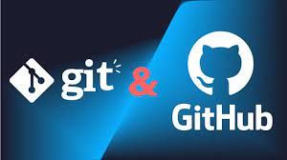
GIT & GIT HUB

Slide 81
GIT
Git is a popular version control system. It was created by Linus Torvalds in 2005, and has been maintained by Junio Hamano since then.
It is used for:
Tracking code changes
Tracking who made changes
Coding collaboration

Slide 82
What does Git do?
Manage projects with Repositories
Clone a project to work on a local copy
Control and track changes with Staging and Committing
Branch and Merge to allow for work on different parts and versions of a project
Pull the latest version of the project to a local copy
Push local updates to the main project

Slide 83
Working with Git
Initialize Git on a folder, making it a Repository
Git now creates a hidden folder to keep track of changes in that folder
When a file is changed, added or deleted, it is considered modified
You select the modified files you want to Stage
The Staged files are Committed, which prompts Git to store a permanent snapshot of the files
Git allows you to see the full history of every commit.
You can revert back to any previous commit.
Git does not store a separate copy of every file in every commit, but keeps track of changes made in each commit!

Slide 84
Why Git?
Over 70% of developers use Git!
Developers can work together from anywhere in the world.
Developers can see the full history of the project.
Developers can revert to earlier versions of a project.

Slide 85
What is GitHub?
Git is not the same as GitHub.
GitHub makes tools that use Git.
GitHub is the largest host of source code in the world, and has been owned by Microsoft since 2018.
In this tutorial, we will focus on using Git with GitHub.

Slide 86
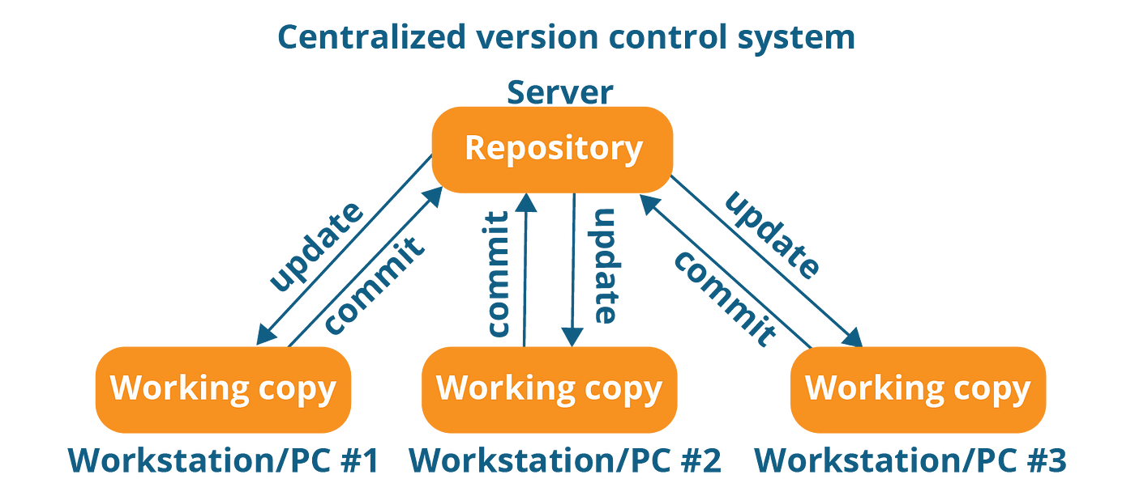
Centralized Version Control system

Slide 87
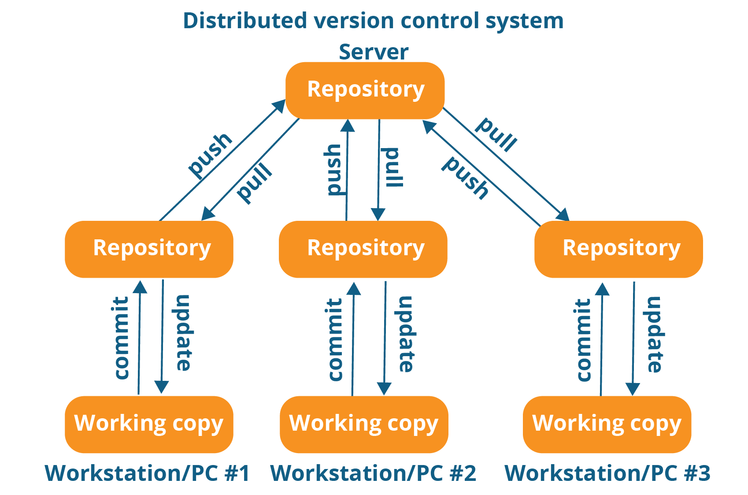
Distributed Version Control System

Slide 88
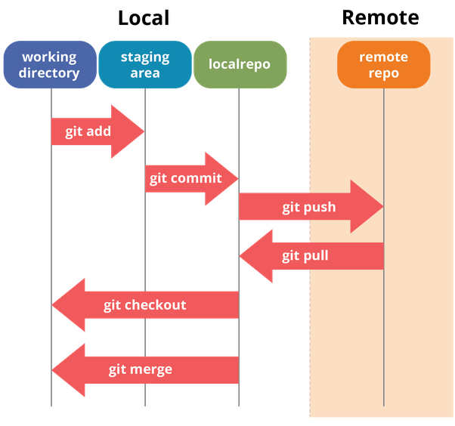
GIT Stage

Slide 89
Diff Between GIT & GITHUB
Git-Github Comparison.docx

