Slide 1
EECS 484: Database Management Systems Lecture 00 – Course Policies and Overview
Instructor: Atul Prakash
Email: aprakash@umich.edu

Slide 2
Course Goals
GOAL: Basic introduction to database management systems.
Two perspectives:
External (Database user)
Data models, ER model, relational model, SQL, database design …
Java/JDBC Project: Common platform for building database applications
Internal (Database implementer)
File organizations, access methods, concurrency control, recovery, …
Minirel Project (C++): Build components of a Database System
Textbook “Database Management Systems”, by Raghu Ramakrishnan & Johannes Gehrke. 3rd ed.
Notes:
Students typically find the first part (using a database) easier than the second part (building a database).
This means that database researchers / vendors are doing a good job!
Relational model and SQL widely-praised for their elegant simplicity
Implementation of relational database is nuanced…
Prereqs: EECS 281 or equivalent, CS / CE Major
Data structures and algorithms
Programming experience for the course project
Course project is programming intensive
2 Parts: C++, Java
Course project might be the largest that you have worked on

Slide 3
Overrides
Course is full. Overrides limited.
EECS 281 and relevant programming experience required to have a shot at an override.
Non-CS graduate students: Fill out an application form at the CSE undergrad office to apply for an override.
https://www.eecs.umich.edu/eecs/undergraduate/permission_request_form.docx
Include your transcript, highlighting relevant courses.
Provide the form to the undergrad office (or to me)

Slide 4
Teaching Staff
Atul Prakash, Professor in CSE
Kevin Eykholt, Ph.D. student in CSE
Ahmad Shahab Tajik, Ph.D. student in CSE
Yang Liu, Ph.D. student in CSE
Xieyang (Michael) Liu, CS BSE.

Slide 5
Course Communication Tools
Canvas: https://canvas.umich.edu (not yet active)
Piazza: Use this for technical or clarification questions. Look for EECS 484 Fall 2016 group. Join if you aren’t automatically enrolled.
We may not answer between 10 PM and 9 AM.
But students are encouraged to answer when they can. We will endorse good answers, and correct and clarify if your answer has a mistake.
Teaching staff email: eecs484f16@umich.edu. Generally for non-technical or administrative questions.

Slide 6
Office hours
No office hours this week for TAs.
Office hours for next week and subsequent weeks will be posted in a Canvas calendar.
I will be available from 2-3 PM today.
4741 BBB

Slide 7
Course Calendar
To be made available

Slide 8
Course Grading
Exams + graded homework quizzes | 60%
Four projects [each worth 10%] | 40%

Slide 9
Exams + quizzes (60%)
Two exams, one for each half of the course
Midterm: 25-30%
Final: 25-30%
Equal weights, not cumulative
Quizzes
Some homework will in the form of online quizzes (possibly modest coding) and will be graded. Each quiz typically 1-2% of the grade – reduces exam weightage correspondingly.

Slide 10
Homework Assignments
Some non-quiz homework assignments
Not graded.
Submit for ”brownie points” by any due date specified. Could factor in as evidence of effort and learning if grade is borderline.
Provide important intellectual experience.
Solutions sometime look “obvious” in hindsight
Doing the problems and making mistakes increases retention of how to do problem right

Slide 11
Projects
Total of 4 projects. Equal weights.
P1: ER Modeling and Database schema design (some coding + SQL)
P2: Oracle application. (Java coding, lots of SQL)
P3: Transactions and recovery (C++, data structures)
P4: Still being decided. (B+-trees or MongoDB)
Transaction and Recovery project will be an individual submission.
Hey, you should at least be able to do one serious project by yourself :-)

Slide 12
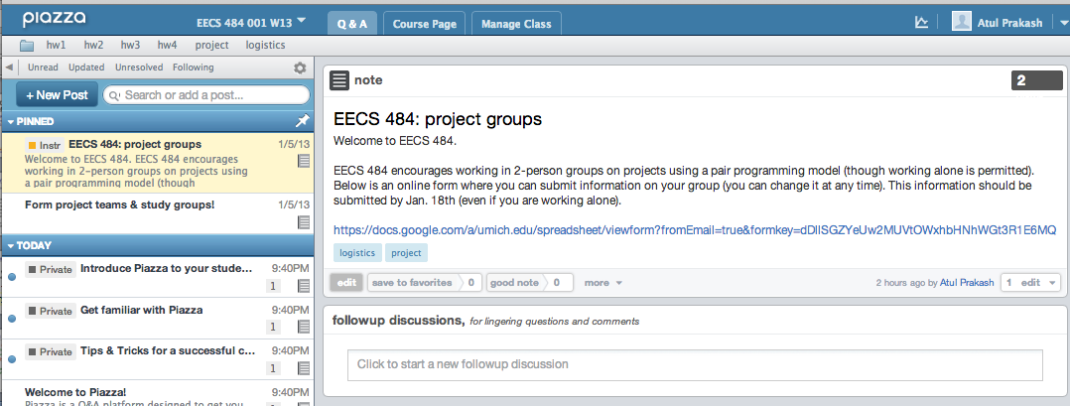
Piazza – forming groups

Slide 13
Project repository
No grace period for loosing your work to disk crashes, etc.
Thus BACK UP all files!
Ideas:
Use Google or Box drive
Use a git or subversion repository to keep older versions, especially for coding projects

Slide 14
Engineering Honor Code
No reuse of old solutions or parts of solutions from anywhere (including the Internet) is permitted
Work on projects must be entirely your own (or your partner, if working in a group). Ask TA/IA or instructor if you need help that requires looking at your project solution.
Only conceptual discussions allowed with others – similar to what you would be comfortable doing on Piazza publicly.
No sharing of code or solutions, even after the semester is over.
If in doubt about the policy, ask Professor Prakash.
Violations will be reported to the Engineering Honor Council

Slide 15
Discussion Sections
Not optional!
All discussions have identical content
If you have to miss your regular section one week, attend another. But stick to one as a rule

Slide 16
Discussion: This Week
No discussions this week. But, for those of you who haven’t programmed in C++ or Java, use the week to self-learn.
Our grading platform is Linux. Try logging into to a CAEN Linux machine, creating a small program in both languages, compiling it, and running it.
Learn about Makefiles.
Once we post information about Oracle accounts, try logging in and play with SQL.

Slide 17
Course Policies
Homeworks and Quizzes:
Due before Wednesday discussion.
Project:
typically due by 11:55 PM on Thursdays
Late policy on projects: 4 day grace period (15% late penalty fixed).
No grace period on quizzes + homeworks

Slide 18
More on grading
Reasonable performance on both projects and exams is expected to get a grade of C or higher, irrespective of your overall percentage
Grad students graded on the same curve as undergrads.

Slide 19
Work hard and be helpful
Working with a databases is an employable skill. Get the most out of this course.
Be helpful on piazza! Mistakes in answering questions are OK – Part of learning.
Strong grades give you a shot at grader, IA, and GSI positions in future semesters.
Can lead to a stronger resume for jobs and graduate school

