Slide 1

EECS 484, Winter 2016 - Database Management Systems
DBMS Overview
Chapter 1
Instructor: Atul Prakash
University of Michigan, Ann Arbor
Partly based on material by many other professors

Slide 2
What is a DBMS?
Database: Large, integrated collection of data
DBMS = Database Management System
= a software package designed to store
and manage databases
e.g. Oracle, MS SQL server, SqlLite, Postgres, MySQL.
Goal: Efficient and convenient access to data

Slide 3
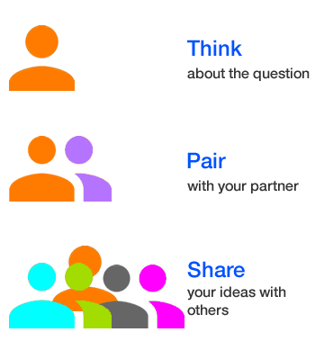
DBMS: Motivation
Scenario:
Students taking classes, and obtaining grades
Q1: Find grade in class X
Q2: Find my GPA
…
Ideas?
Think Pair Share

Slide 4


Old-time Solution: Sorted Student Folders
Advantages?
Disadvantages?

Slide 5
Old-time Solution: Sorted Student Folders
Advantages?
cheap
Disadvantages?
Large physical footprint
No sharing
No ad-hoc queries

Slide 6



Other Solution: Flat Files
Access?
using programs in C, Java, etc.
Layout for the student records?
.PY

Slide 7
Other Solution: Flat Files
Access?
using programs in C, Java, etc.
Layout for the student records?
.PY
CSV:
Brown, Lisa, lbrown, db, A, os, B
Smith, Bart, bsmith
Tompson, Mary, mtom, vis, B+, db, A-
…
…

Slide 8
Other Solution: Flat Files
Access?
using programs in C, Java, etc.
Layout for the student records?
.PY
Multiple files:
Brown, Lisa, lbrown
Smith, Bart, bsmith
Tompson, Mary, mtom
…
…
lbrown, db, A
lbrown, os, B
mtom, vis, B+
mtom, db, A-
…
…

Slide 9
Other Solution: Flat Files
Problems?
.PY

Slide 10
Other Solution: Flat Files
Problems?
Inconvenient access to data (requires programming experience and knowledge of file layout)
Data redundancy
Integrity problems
Atomicity problems (concurrent access issues)
Security problems
.PY

Slide 11

Who uses a DBMS?
Notes:
3

Slide 12





Who uses a DBMS?
Everyone!
Your bank
Your university
Your coffee shop
Your favorite hotel
Your favorite website
Your phone
Your government
How many databases have you used so far today?
Notes:
3

Slide 13
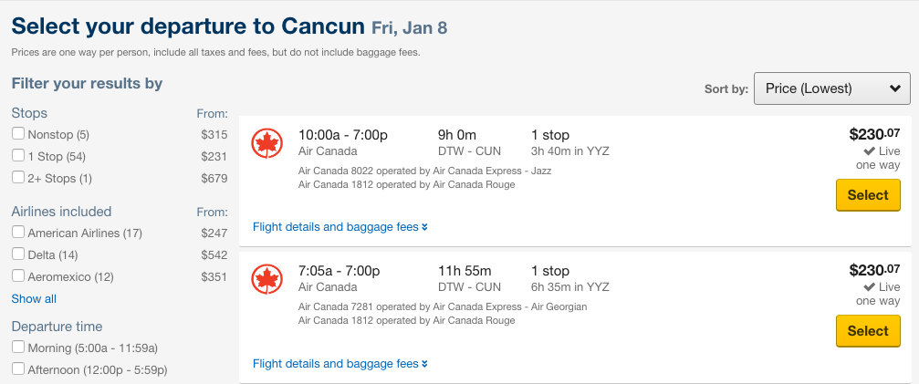
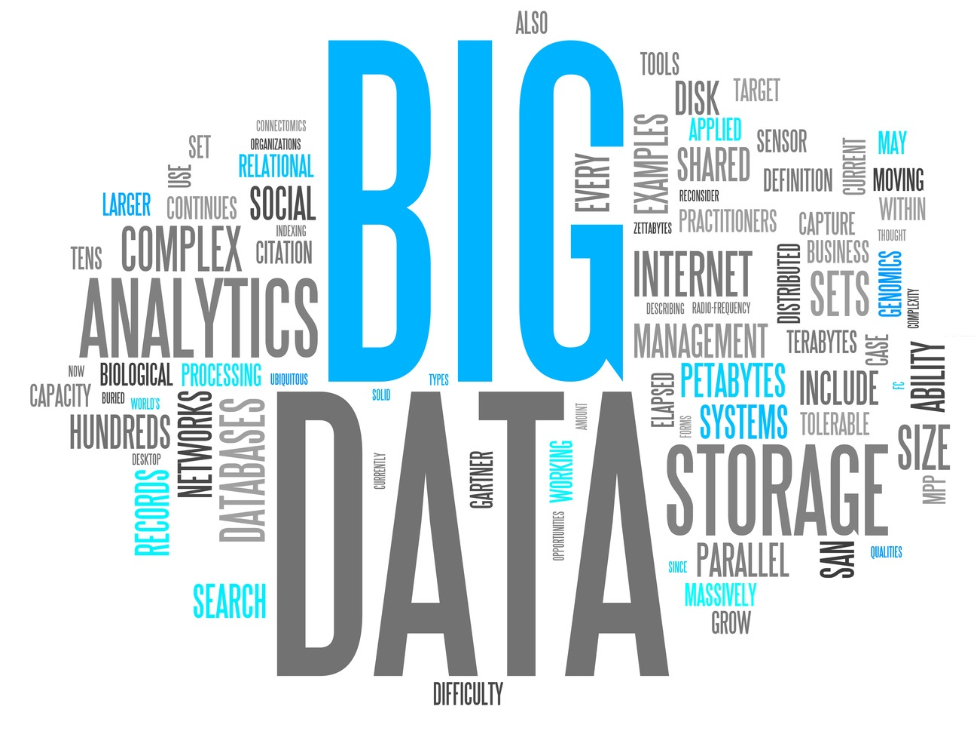
Why Study Databases?
Data is useless without the tools to extract information (queries)
“Optimal” pricing of an airline
ticket
Datasets increasing in diversity and volume
Websites, digital libraries, interactive video,
human genome project, mobile applications
Databases touch most of CS
OS, languages, theory, AI, multimedia, logic, …

Slide 14
University Database Example
Student
Enrolls in
Course
Student ID
Course ID
Credits
Login
Age
Grade
Name
Name
This is called an Entity-Relationship (ER) Model
Entities: Student, Course
Relationship: Enrolled_in

Slide 15
University Database
Relational representation. Store data in simple tables or relations.
Students(sid:integer, name:string, login:string, age:integer)
Courses(cid: integer, cname:string, credits:integer)
Enrolled(sid:integer, cid:integer, grade:string)
Students
Courses
Enrolled
sid
name
login
age
cid
cname
Cr.
sid
cid
Grade
13
Lisa
lsimp
40
1
EECS484
4
41
1
A-
41
Bart
bart
20
2
EECS584
3
13
2
A+
Notes:
7
Lecture 2 ended here.

Slide 16
CYU
In the previous slide, what course(s) has Lisa taken?
In the previous slide, what course(s) has Bart taken?
If Bart were to take both courses, what row would you add to the Enrolled table?

Slide 17
Data Models
Data model: a collection of concepts for describing data.
Schema: a description of a particular collection of data, using a given data model.
Relational model: the most widely-used model today.
Data model: Database is a collection of relations
A relation is a table with rows and columns.
Entity-Relationship (ER) model: A “semantic” data model, i.e. a higher-level more user-intuitive model
A (relational) DBMS only understands the relational model ➔ Must translate an ER schema to a relational schema
Notes:
5

Slide 18
Relational and Other Data Models
DBMS using the relational DM
IBM DB2
Informix
Oracle
Sybase
Microsoft Access
Tandem
Teradata
…
Other data models
Hierarchical
IBM IMS
Network
IDMS, IDS
Object-oriented
ObjectStore
Object-relational
Oracle
…
Notes:
5

Slide 19
Why use a DBMS?
It solves ALL the problems with other ad hoc solutions such as files of records, coding data structures, etc.!
Data independence
Apps need a view of the data, not info about internal representation and storage
Efficient storage and access
Centralized data administration
Data integrity and security
Concurrent access, recovery from crashes
Reduced application dev time
Notes:
3
We stopped here in Lecture 1.

Slide 20

Levels of Abstraction
External
Schema 1
External
Schema 2
describe how users see the data, views
Conceptual Schema
defines the logical structure (schema)
Physical Schema
describes the files and indexes used
Schemas are defined using Data Definition Language (DDL) – e.g. CREATE TABLE X (…)
Data is modified/queried using Data Manipulation Language (DML) – e.g. SELECT FROM X WHERE …
Notes:
6
Conceptual: describes the data in terms of the data model (in a relational database, it describes the tables)

Slide 21
Example: University Database
Conceptual schema:
Students(sid: string, name: string, login: string,
age: integer)
Courses(cid: string, cname: string, credits: integer)
Enrolled(sid: string, cid: string, grade: string)
Physical schema:
Relations stored as unordered files.
Index on first column of Students.
External Schema:
View: Course_info(cid: string, enrollment: integer)
View: Class_rank(sid: string, gpa: real, rank: integer)
Notes:
7

Slide 22
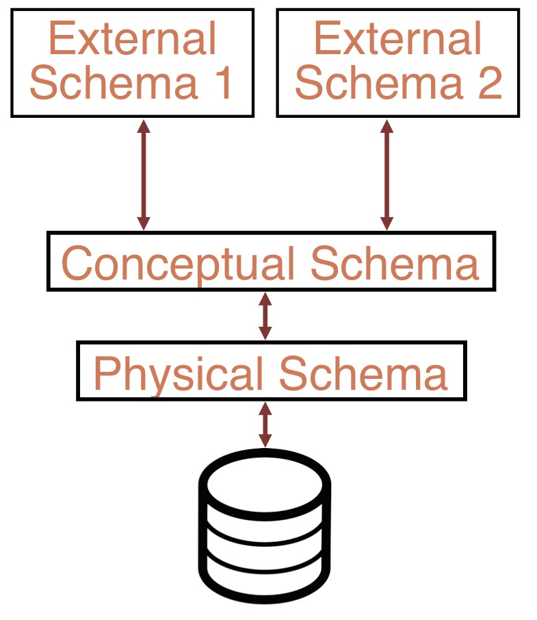
Data Independence
Applications insulated from data format and storage details
Logical data independence: Protection from changes in logical structure of data
External / Conceptual schemas
Physical data independence: Protection from changes in physical structure of data
Conceptual / Physical schemas
Other key benefits:
Declarative query processing
Transactions

Slide 23
CYU
Which of these are more suitable for storing in a DBMS rather than files in an OS?
Grades for students at the university
Source code for a program
Contents of a textbook
Think Pair Share

Slide 24
CYU
Let's say UM provides you access to a relational table that gives just your grades in various courses. Does that relation represent:
An external schema?
A conceptual schema?
A physical schema?
Think Pair Share

Slide 25
CYU
The relational table with student grade information is very large and stored on multiple servers for performance. Does the storage scheme represent:
An external schema?
A conceptual schema?
A physical schema?
Think Pair Share

Slide 26
Transactions (I)
Bank Balance : $100
Bank Balance : $100
Transaction: any one execution of a user program
in a DBMS
Inconsistency caused by incomplete operations
DBMS ensures atomic operations!
i.e. all or nothing!
Automatic recovery from crashes!
Read Balance: $100
Read Balance: $100
Sufficient funds?
Sufficient funds?
Yes
Yes
Pay $25
Pay $25
New balance: $75
Server Crash

Slide 27
Transactions (II)
You
Bank Balance : $100
Your Spouse
Read Balance: $100
Read Balance: $100
Sufficient funds?
Sufficient funds?
Yes
Yes
Pay $25
Pay $25
New balance: $75
New balance: $75
Bank Balance : $75!
Inconsistency caused by interleaving actions of different user programs
DBMS provides the illusion of a “single-user” system
Key concept: Transaction, an atomic sequence of R/W
Concurrency control, transaction management

Slide 28

Lots of People use DBMS ...
DBMS vendors
DB application programmers
e.g. smart webmasters
Database administrator (DBA)
Designs logical /physical schemas
Handles security and authorization
Data availability, crash recovery
Database tuning as needs evolve
Must understand how a DBMS works!
Notes:
21

Slide 29
Summary
DBMS used to maintain & query large datasets
Benefits include
recovery from system crashes,
concurrent access,
quick application development,
data integrity and
security
Levels of abstraction give data independence
DBAs hold responsible, interesting,
well-paid jobs
Notes:
Integrity: accuracy and consistency of the data

Slide 30
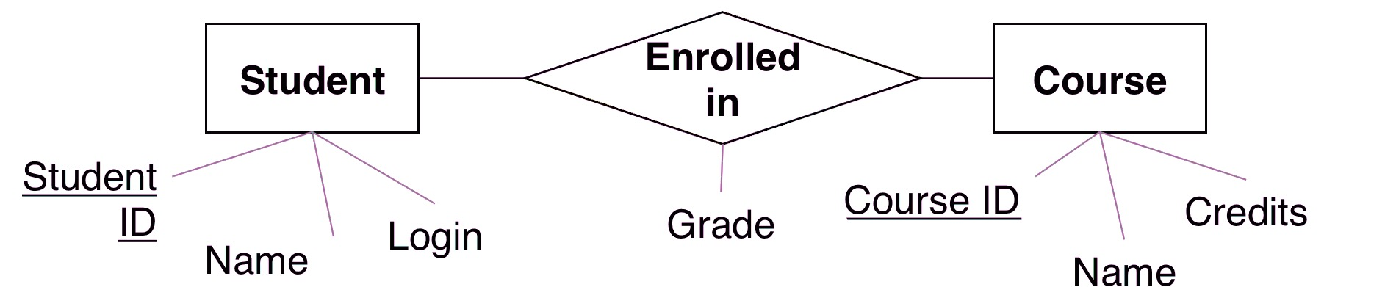
Next
The Entity-Relationship (ER) Model
Notes:
21

