Slide 1
Relational Algebra
Chapter 4
Notes:
1

Slide 2
“Formal” Query Languages
Foundation for commercial query languages like SQL
Two types
Declarative: Relational Calculus
Describe what a user wants, rather than how to compute it.
Procedural : Relational Algebra
Operational, very useful for representing execution plans.
Query Languages != programming languages!
QLs not expected to be “Turing complete”.
QLs not intended to be used for complex calculations.
QLs support easy, efficient access to large data sets.
Understanding Algebra & Calculus is key to understanding SQL, query processing!

Slide 3
Relational Algebra Preliminaries
Query:
Input: Relational instances
Output: Relational instances!
Specified using the schemas.
May produce different results for different instances.
But schema of the result is fixed.
The algebra assumes “set semantics” for relations. OK – this is a formal model!
Relational Algebra is
“closed”
Notes:
4

Slide 4
Relational Algebra
Basic operations on relations:
Selection ( ) Selects a subset of rows from relation.
Projection ( ) Deletes unwanted columns from relation.
Cross-product ( ) Allows us to combine two relations.
Set-difference ( ) Tuples in reln. 1, but not in reln. 2.
Union ( ) Tuples in reln. 1 and in reln. 2.
Additional operations (constructed from basic ops):
Intersection, Join, Division, Renaming
Not essential, but (very!) useful.
Because algebra is closed, we can compose operators
U
Notes:
6

Slide 5
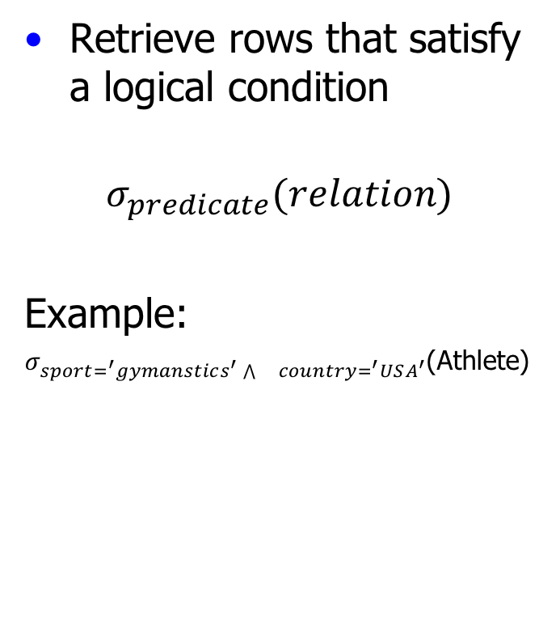
Selection
Athlete
Retrieve rows that satisfy a logical condition
$$σ_{predicate}(relation)$$
Example:
$σ_{sport=^{′}gymanstics^{′}\bigwedge{}country=^{′}USA^{′}}$(Athlete)
aid | name | sport | country
1 | Mary Lou Retton | gymnastics | USA
2 | Jackie Joyner-Kersee | track | USA
3 | Michael Phelps | swimming | USA
4 | Johann Koss | skating | Norway
5 | Natalie Coughlin | swimming | USA
6 | Gabby Douglas | gymnastics | USA
aid | name | sport | country
1 | Mary Lou Retton | gymnastics | USA
6 | Gabby Douglas | gymnastics | USA

Slide 6
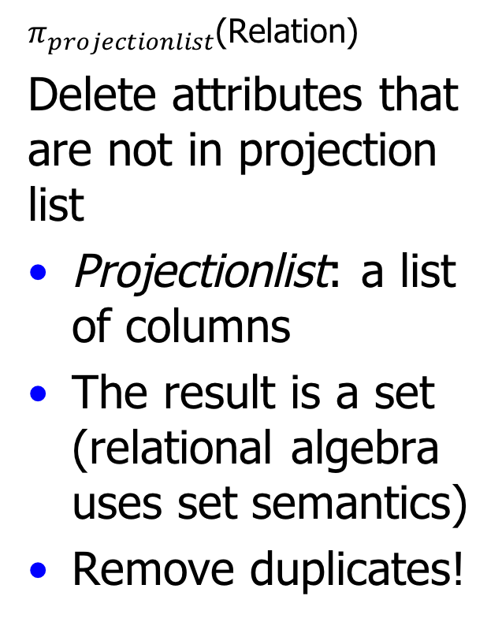
Projection
Athlete
$π_{projectionlist}$(Relation)
Delete attributes that are not in projection list
Projectionlist: a list of columns
The result is a set (relational algebra uses set semantics)
Remove duplicates!
aid | name | sport | country
1 | Mary Lou Retton | gymnastics | USA
2 | Jackie Joyner-Kersee | track | USA
3 | Michael Phelps | swimming | USA
4 | Johann Koss | skating | Norway
5 | Natalie Coughlin | swimming | USA
6 | Paul Hamm | gymnastics | USA
sport | country
gymnastics | USA
track | USA
swimming | USA
skating | Norway

Slide 7
Set Operations: Union (∪), Intersection(∩), Set-Difference (-)
Input: Two union-compatible relations
Same number and type of attributes, in same order
Field names of result: uses the name from the FIRST input
name
Mary Lou Retton
Jackie Joyner-Kersee
Michael Phelps
Johann Koss
Natalie Coughlin
Gabby Douglas
AthleteName
Mary Lou Retton
Jackie Joyner-Kersee
Apollo Ono
Picabo Street
Natalie Coughlin
Bode Miller
name
Michael Phelps
Johann Koss
Gabby Douglas
Duplicates? Relational algebra uses set semantics.
So no duplicates. Difference from SQL
Notes:
Field names of result are the same as names in FIRST input

Slide 8
Cross-Product (Cartesian Product) X
Result Schema
One field from both relations (Names inherited)
If both input relations have a field with the same name, can use the rename operator
ρ. (See 4.2.2 and 4.2.3
in textbook)
Athlete
Venue
aid | name | sport | country
1 | Mary Lou Retton | gymnastics | USA
2 | Jackie Joyner-Kersee | track | USA
vid | venue
1 | Los Angeles
2 | Barcelona
aid | name | sport | country | vid | venue
1 | Mary Lou Retton | gymnastics | USA | 1 | Los Angeles
2 | Jackie Joyner-Kersee | track | USA | 1 | Los Angeles
1 | Mary Lou Retton | gymnastics | USA | 2 | Barcelona
2 | Jacki Joyner-Kersee | track | USA | 2 | Barcelona
Notes:
----- Meeting Notes (9/17/14 10:29) -----
Lecture 1. Slide 8

Slide 9
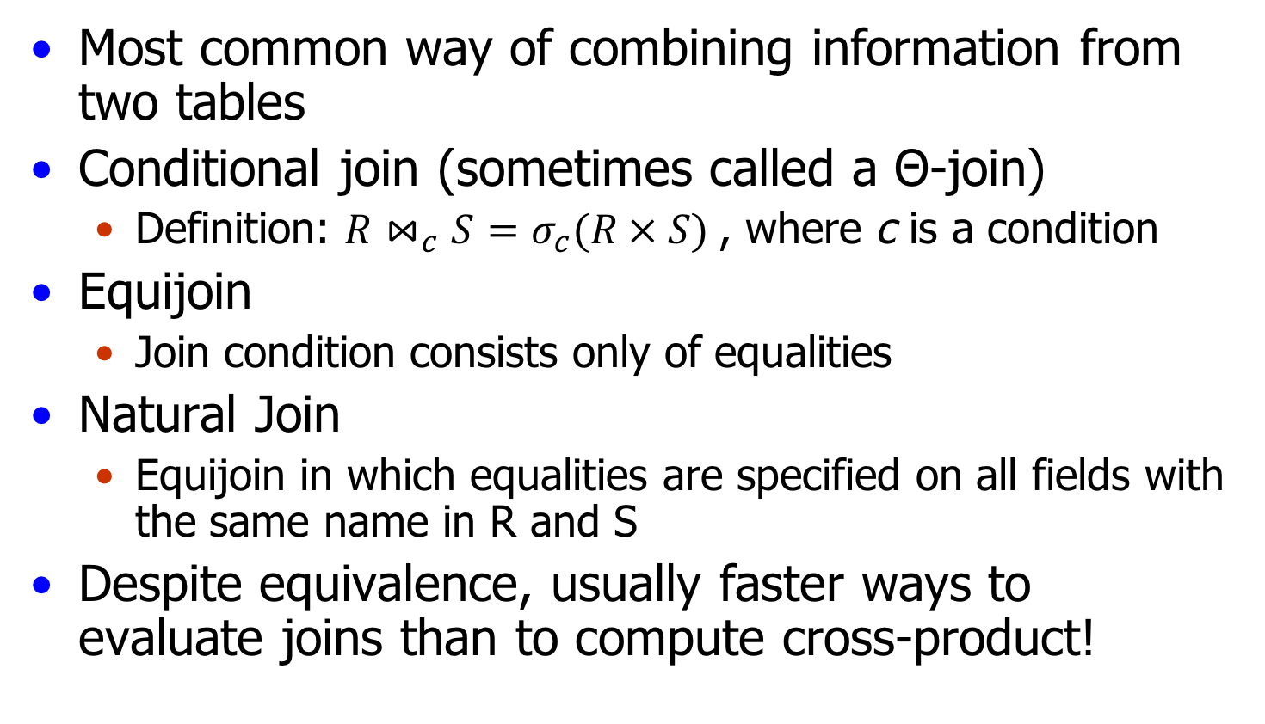
Derived Operators: Joins
Most common way of combining information from two tables
Conditional join (sometimes called a Θ-join)
Definition: $R⋈_{c}S=σ_{c}(R × S)$, where c is a condition
Equijoin
Join condition consists only of equalities
Natural Join
Equijoin in which equalities are specified on all fields with the same name in R and S
Despite equivalence, usually faster ways to evaluate joins than to compute cross-product!

Slide 10
Examples: Writing Queries in RA
Example Schema:
Sailors (sid, sname, rating, age)
Reserves (sid, bid, day)
Boats (bid, bname, color)
Sailors
Reserves
Boats
sid | sname | rating | age
22 | Dustin | 7 | 45.0
29 | Brutus | 1 | 33.0
31 | Lubber | 8 | 55.5
32 | Andy | 8 | 25.5
58 | Rusty | 10 | 35.0
64 | Horatio | 7 | 35.0
71 | Zorba | 10 | 16.0
74 | Horatio | 9 | 35.0
85 | Art | 3 | 25.5
95 | Bob | 3 | 63.5
sid | bid | day
22 | 101 | 10/10/98
22 | 102 | 10/10/98
22 | 103 | 10/8/98
22 | 104 | 10/7/98
31 | 102 | 11/10/98
31 | 103 | 11/6/98
31 | 104 | 11/12/98
64 | 101 | 9/5/98
64 | 102 | 9/8/98
74 | 103 | 9/8/98
bid | bname | color
101 | Interlake | blue
102 | Interlake | red
103 | Clipper | green
104 | Marine | red

Slide 11
Find names of sailors who’ve reserved boat #103
Solution 1: (1) Extract reservations for boat ID 103
(2) Join with sailors and project on sname
Solution 2: Same as 1, but give temp names to
intermediate results
Solution 3: (1) Join Reserves and Sailors
(2) Select on bid = 103
(3) project on sname
Notes:
Solution at the end.

Slide 12
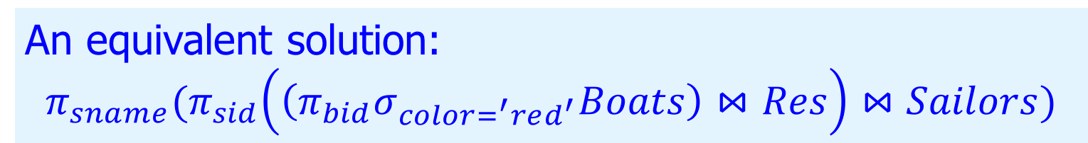
Find names of sailors who’ve reserved a red boat
An equivalent solution:
$$π_{sname}(π_{sid}\left(\left(π_{bid}σ_{color=^{′}red^{′}}Boats\right)⋈Res\right)⋈Sailors)$$
Query optimizer chooses from the (equivalent) expressions and chooses one for efficiency of evaluation.

Slide 13
Find the names of sailors who’ve reserved at least one boat
Sailor appears in this intermediate relation only if there is at least one Reserves tuple with same sid.

Slide 14
Derived Operators: Division
Useful for queries like: Find customers with accounts at all branches in Brooklyn.
Let A have 2 fields, x and y ; B have only field y :
A/B = {<x> | ∀<y>∈ B, <x, y>∈A}
A/B contains all x tuples (customers) such that for every y tuple (branches in Brooklyn) in B, there is an <x,y> tuple in A
In general, x and y can be lists of fields; y is the list of fields in B, and x y is the list of fields of A.
Notes:
13
Y has the same domain in A and B

Slide 15
Examples of Division A/B
B1
B2
B3
A/B1
A/B2
A/B3
A
Notes:
14

Slide 16
Expressing A/B Using Basic Operators
Can be equivalently expressed using basic operators
Idea: For A/B, compute all x values that are not disqualified by some y value in B.
x value is disqualified if by attaching y value from B, we obtain an <x,y> tuple that is not in A
Can you express this operator using basic operators?
A/B:
Disqualified x values
Notes:
15

Slide 17
Examples of Division A/B
cid
bname
c1
b2
c1
b4
B
c2
b2
A/B
c2
b4
c3
b2
c3
b4
c4
b2
c4
b4
A
-A
Notes:
14

Slide 18
Find names of sailors who’ve reserved a red OR green boat
Identify all red or green boats, then
find sailors who’ve reserved one of these boats:
Equivalent:

Slide 19
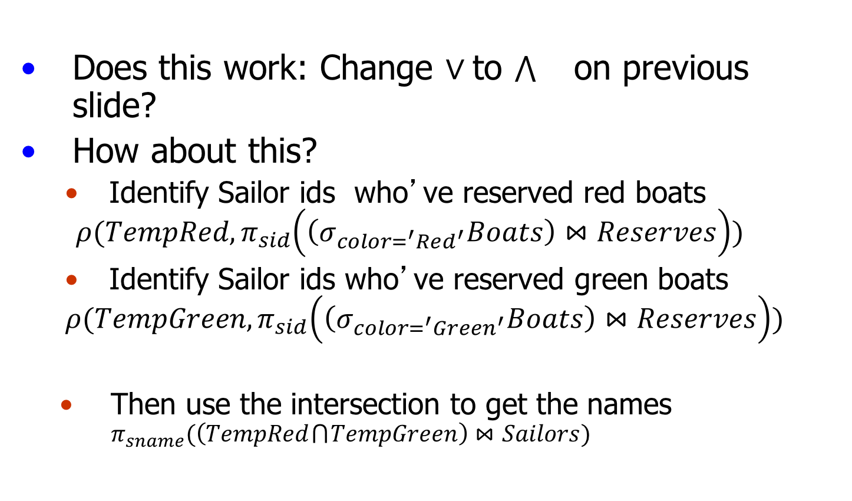
Find names of sailors who’ve reserved a red AND green boat
Does this work: Change $∨$to on previous slide?
How about this?
Identify Sailor ids who’ve reserved red boats
$$ρ(TempRed, π_{sid}\left(\left(σ_{color=^{′}Red^{′}}Boats\right)⋈Reserves\right))$$
Identify Sailor ids who’ve reserved green boats
$$ρ(TempGreen, π_{sid}\left(\left(σ_{color=^{′}Green^{′}}Boats\right)⋈Reserves\right))$$
Then use the intersection to get the names $π_{sname}(\left(TempRed ⋂ TempGreen\right)⋈Sailors)$

Slide 20
Find the sids of sailors over age 20 who have not reserved a red boat
$$π_{sid}\left(σ_{age>20}Sailors\right)−π_{sid}(\left(σ_{color=^{′}Red^{′}}Boats\right)⋈Reserves)$$

Slide 21
Find the names of sailors who’ve reserved all boats
Uses division; schemas of the input relations must be carefully chosen:

Slide 22
Suggested Review
Exercises 4.1, 4.3, 4.5
Only RA required for the last two.

Slide 23
Find names of sailors who’ve reserved boat #103
Solution 1:
Solution 2:
Solution 3:

