Slide 1
Introduction to MongoDB – a noSQL Database System

Slide 2
NoSQL Systems
Alternative to traditional relational DBMS
Flexible schema
Quicker/cheaper to set up
Massive scalability
Relaxed consistency → higher performance & availability
No declarative query language → more programming
Relaxed consistency → fewer guarantees
Examples: MongoDB, Hadoop/Hive, Cassandra, Apache SPARK

Slide 3
NoSQL Systems
Drivers:
Massive growth of data
Joins are expensive across multiple machines
Licensing fees of traditional databases

Slide 4
Scalability
Traditional databases and NoSQL databases take different approaches:
Traditional databases use vertical scaling: more CPUs, more RAM, and more storage
NoSQL databases use horizontal scaling or sharding
Decompose data across multiple computers and do distributed queries

Slide 5
NoSQL: The Name
“SQL” = Traditional relational DBMS
Recognition over past decade or so:
Not every data management/analysis problem is best
solved using a traditional relational DBMS
“NoSQL” = “No SQL” =
Not using traditional relational DBMS
“No SQL” ≠ Don’t use SQL language

Slide 6
NoSQL: The Name
“SQL” = Traditional relational DBMS
Recognition over past decade or so:
Not every data management/analysis problem is best
solved using a traditional relational DBMS
“NoSQL” = “No SQL” =
Not using traditional relational DBMS
“No SQL” ≠ Don’t use SQL language
“NoSQL” = “Not Only SQL”

Slide 7
NoSQL Systems*
Several incarnations
Key-value stores
Document stores
Graph database systems
MapReduce framework
Column stores
* For a more comprehensive survey, refer to
http://web.eecs.umich.edu/~mozafari/winter2014/eecs684/papers/nosql-book.pdf

Slide 8
Key-Value Stores
Extremely simple interface
Data model: (key, value) pairs
Operations: Insert(key,value), Fetch(key),
Update(key), Delete(key)
Implementation: efficiency, scalability, fault-tolerance
Records distributed to nodes based on key
Replication
Weak (no?) transactional semantics (to achieve high availability)
No atomicity: Single-record atomicity only. No notion of grouping multiple updates into one transaction.
Weak durability: (In MongoDB) Writes are only “durable” after 100 ms by default. Thus, a crash could lose updates that appear to be "committed"
Weak consistency across replicas: Replicas not guaranteed to remain in sync between updates and reads. Update at replica 1 is not atomically propagated. Subsequent reads at other replicas may get old values!

Slide 9
Key-Value Stores
Extremely simple interface
Data model: (key, value) pairs
Operations: Insert(key,value), Fetch(key),
Update(key), Delete(key)
Some allow (non-uniform) columns within value
Some allow Fetch on range of keys
Example systems
Google BigTable, Amazon Dynamo, Cassandra,
Voldemort, HBase, …

Slide 10
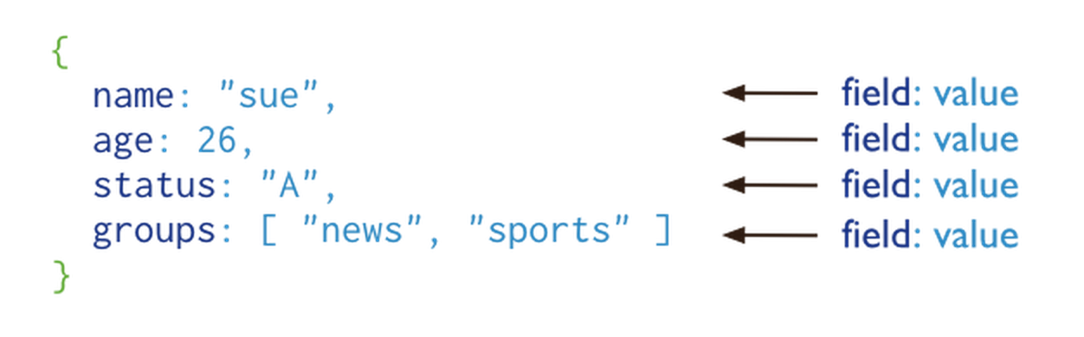
Case Study: MongoDB
Document corresponds to a tuple in a relation
(source: MongoDB tutorial)
Documents are simply JSON objects in JavaScript syntax, consisting of field:value pairs.
Documents can be hierarchical – a value can be a JSON object or a list.

Slide 11
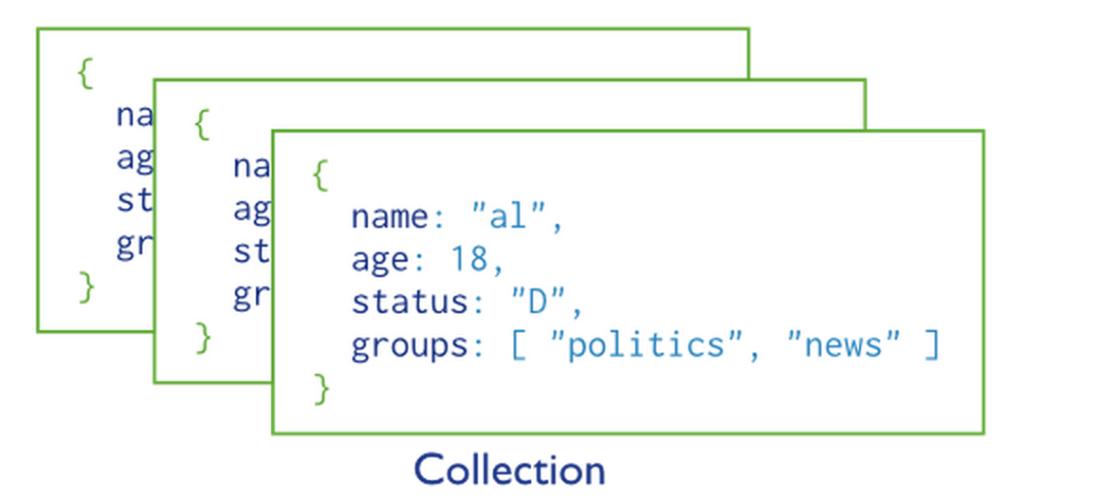
Collections
A collection corresponds to a table in relational databases. It is a set of documents (common structure among documents in the same collection is NOT enforced!)

Slide 12
Key commands
db.collectionname.insert(json_object)
db.collectionname.find(predicate)
db.collectionname.aggregate(operators)
The best way to learn is to simply follow the tutorial. Install Community Edition as in the tutorial.
http://docs.mongodb.org/manual/tutorial/getting-started/

Slide 13
Example
After installing the community edition:
Import sample.json from Canvas -> Files into your local instance of mongo.
% mongoimport --collection users --file sample.json --jsonArray
To pretty-print the json file, look for online pretty-printer on Google.
More generally, to import into a mongo DB at a remote server with userid and password:
% mongoimport <dbname> --host <hostname> -u <userid> -p <password> --collection <collectionname> -- file <filename> --jsonArray

Slide 14
Example queries
Type “mongo” to connect to local mongo.
Or: mongo <dbname> --host eecs484.eecs.umich.edu -u <userid> -p <password>
“SELECT * from users”: Mongo equivalent:
> db.users.find();
It returns a cursor object and prints10 tuples at a time.
Type “it” to see additional tuples.
Using Javascript variables:
> var x = db.users.find();

Slide 15
Iterate over a cursor
var mycursor = db.users.find();
while (mycursor.hasNext()) {
var w = mycursor.next(); // next document
print(w.user_id, w.DOB); // print fields
}
// mycursor now points to the end.

Slide 16
Selections: Predicates in Find
Find users born on 21st Nov.
var mycursor = db.users.find({"DOB" : 21, "MOB" : 11});
Find users born on 21st Nov. in state ”Rohan”:
> var mycursor = db.users.find({"DOB" : 21, "MOB" : 11, "hometown.state" : "Rohan"});
Note that the structure of the document is:
{user_id: …,
DOB: … ,
MOB : ... ,
hometown : {city : ... state : ..., country : ...},
...
}

Slide 17
find
See the Getting Started guide for:
Predicates with greater than, less than, etc.
And conditions
Or conditions
Sorting (equivalent to ORDER BY in SQL)

Slide 18
Projections
Find can also include projections.
Find first_name and last_name of users born in state Rohan on Nov. 21st:
var mycursor = db.users.find({"DOB" : 21, "MOB" : 11, "hometown.state" : "Rohan"}, {first_name : 1, last_name : 1});
> mycursor
{ "_id" : ObjectId("5664e69d270b10887550707d"), "first_name" : "Isabel", "last_name" : "THOMAS" }
{ "_id" : ObjectId("5664e69d270b1088755071d0"), "first_name" : "Gimli", "last_name" : "ANDERSON" }
{ "_id" : ObjectId("5664f005270b108875507398"), "first_name" : "Isabel", "last_name" : "THOMAS" }
{ "_id" : ObjectId("5664f005270b1088755074ea"), "first_name" : "Gimli", "last_name" : "ANDERSON" }
>

Slide 19
Projections
_id is a special value, which serves as a key.
Mongo automatically creates an _id value for inserted values in a collection. Dropping it in a projection requires an explicit projection to 0 for _id:
> var mycursor = db.users.find({"DOB" : 21, "MOB" : 11, "hometown.state" : "Rohan"}, {first_name : 1, last_name : 1, _id : 0});
> mycursor
{ "first_name" : "Isabel", "last_name" : "THOMAS" }
{ "first_name" : "Gimli", "last_name" : "ANDERSON" }
{ "first_name" : "Isabel", "last_name" : "THOMAS" }
{ ”first_name" : "Gimli", "last_name" : "ANDERSON" }

Slide 20
Counting
Counting tuples: apply count() to results from find()
> var mycursor = db.users.find({"DOB" : 21, "MOB" : 11, "hometown.state" : "Rohan"}, {first_name : 1, last_name : 1});
> mycursor.count()
4
The find command returned 4 documents.

Slide 21
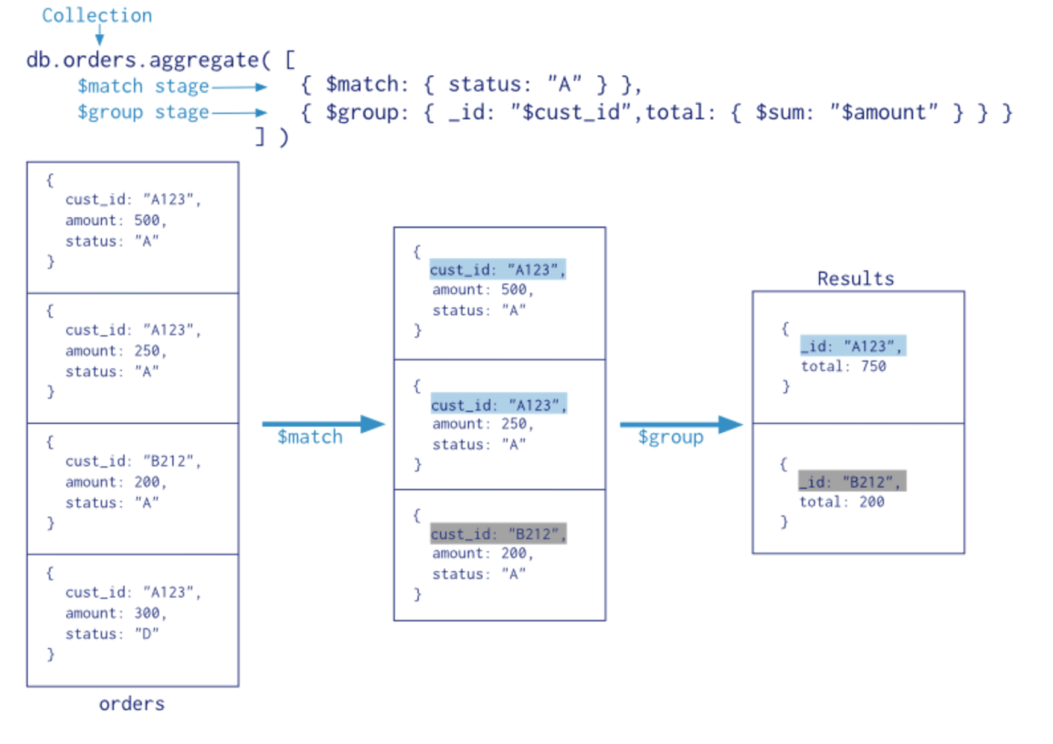
Aggregations -- Pipeline

Slide 22
Other Aggregate stages
$group: similar to GROUP BY
$sort : for sorting data
$unwind <arrayfield>: flattens arrays. See docs.
$out <out_collection>: to put the result into a output collection.
See documentation for other aggregate stages

Slide 23
Trying it out
Go to
http://docs.mongodb.org/manual/tutorial/getting-started/
If you have installed mongodb, run “mongo”. Else, click on “Try it out” at the above URL and follow the tutorial along.

Slide 24
Joins
Joins are not available in current NoSQL databases for “scalability” reasons
Expensive to do when a table is split across multiple nodes
What should a developer do?
Denormalize the database so that all the data is in one collection
Problem: updates can be difficult
Or, write procedural code to simulate the join across multiple collections

Slide 25
So, why mongodb?
Lower licensing fees (especially compared to commercial relational databases)
For huge datasets. Sharding is well supported to allow horizontal scaling
Richer document model may simplify programming
Less of a need for a DBA perhaps (??)

Slide 26
Why not mongodb (or NoSQL in general)?
Poor transactional semantics
Procedural language
No language standards
Traditional databases are starting to introduce sharding:
See postgres_fdw extension in 9.3 version
Traditional databases are catching up on performance, e.g., see following:
//blogs.enterprisedb.com/2014/09/24/postgres-outperforms-mongodb-and-ushers-in-new-developer-reality/

Slide 27
Overall…
One perspective: Why you should never use a NoSQL database (e.g., mongoDB):
http://www.sarahmei.com/blog/2013/11/11/why-you-should-never-use-mongodb/
Another perspective: Mongo enables applications that are difficult to achieve on traditional DBs
http://docs.mongodb.org/ecosystem/use-cases/

