Slide 1
Advanced Join Strategies
Chapter 12 and 14
Notes:
1

Slide 2
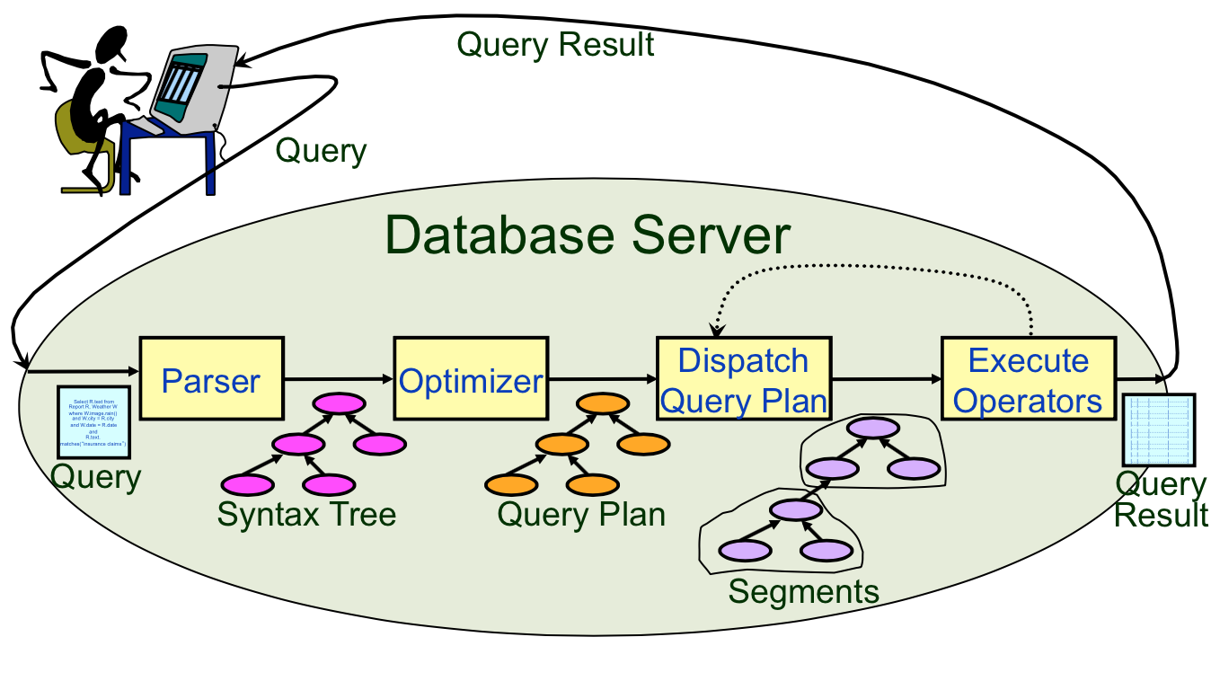
Query Execution Life-Cycle

Slide 3
Join strategies seen so far
Simple nested loops
Page nested loops
Block nested loops
Today:
Take advantage of hashing
Take advantage of sorting

Slide 4
Block Nested Loops
Can we exploit available memory?
Suppose we have B buffer pages available.
R & S
Join Result
(B-2 pages total)
. . .
. . .
. . .
Input buffer for S
Output buffer
Notes:
9

Slide 5
Block Nested Loops
Can we exploit available memory?
Suppose we have B buffer pages available.
Use B-2 pages to hold a block of outer R.
foreach block of B-2 pages of R do
foreach page of S do
for all matching in-memory tuples r in R and s in S:
add <r, s> to result
Can we speed up the
CPU cost?
I/O Cost:

Slide 6
Block Nested Loops – CPU cost
Use an in-memory hash table for R to speed up equality searches on common attributes with S.
R & S
Join Result
Hash table for each block of R
(B-2 pages total)
. . .
. . .
. . .
Input buffer for S
Output buffer
Notes:
9

Slide 7
Index Nested Loops
foreach tuple r in R do
Probe Index on S.sid
foreach matching tuple s, add <r, s> to result
Let’s say there is an index available on S.
Use index on join attribute of the inner relation
Cost: |R| + ( ||R|| * cost of finding matching S tuples)
Cost of finding matching S tuples per R tuple
Index cost: typically, 1-2 I/Os for hash index
Index cost: typically, 2-4 I/Os for B+ tree.
Record retrieval cost
Clustered index: one I/O (typical) for all S tuples per R tuple
Unclustered Index: Up to one I/O per matching S tuple.

Slide 8
Sort-Merge Join
Sort R on the join attribute (if necessary)
Sort S on the join attribute (if necessary)
Merge
Sorted R
Sorted S
Note: formula for Sort can vary, depending
on sorting method used.
Sort:
Merge Cost: (|R|+|S|)
Merge Worst Case: (|R|*|S|)
When?
Backups needed if #duplicates in S exceeds buffer size
Notes:
Use all sqrt (|R|) and sqrt (|S|) buffer pages during the sort, and 3 pages (2 input, 1 output) during the merge phase
Worst case happens when all tuples in R and S have the same value for join attribute (unlikely)

Slide 9
CYU: SM, Page NL, Block NL
|R| = 128 |S| = 64 B = 8
Find the cost of R S
Sort-Merge (use two-way merge sort)
Sort R: 2 * 128 (log₂128 + 1) = 2048
Sort S: 2 * 64 (log₂64 + 1) = 896
Merge: 128 + 64 = 192
TOTAL: 3136
Page NL
Scan outer: 64
Join: 64 * 128 = 8192
TOTAL: 8256
In NL, which rel. is the outer?
Block NL
Scan outer: 64
Join: ⌈64/6⌉* 128 = 1408
TOTAL: 1472
Notes:
Note: S is the outer relation

Slide 10
CYU: SM, Page NL, Block NL
|R| = 128 |S| = 64 B = 8
Find the cost of R S
Sort-Merge (use all the buffers for sort)
Sort S: 2*64*(1+⌈log₇⌈ 64/8 ⌉⌉)= 384
Sort R: 2*128*(1+⌈log₇⌈ 128/8 ⌉⌉)= 768
Merge (input): 64+128 = 192
TOTAL: 1344
Page NL
Scan outer: 64
Join: 64 * 128 = 8192
TOTAL: 8256
log₇ 8=1.07
log₇ 8=1.42
Block NL
Scan outer: 64
Join: ⌈64/6⌉* 128 = 1408
TOTAL: 1472
Notes:
Note: S is the outer relation

Slide 11
Grace Hash Join
Step 1: (Build) Hash both relations, R and S, on the join attribute, producing k disk-based partitions
Guarantees that R tuples can only join with S tuples in the same partition
Step 2: (Probe) Read in complete partition of (smaller relation) R, and scan S partition for matches. Use a different hash function h2

Slide 12
Original
Relation
OUTPUT
Partitions
1
1
k = B-1 (# of buckets)
h1 ≠ h2
INPUT
2
hash
function
h1
2
. . .
B-1
k
Disk
B main memory buffers
Disk
Partitions
of R & S
Join Result
Hash table for partition
Ri (< B-1 pages)
hash
fn
h2
h2
Input buffer
for Si
Output
buffer
Disk
B main memory buffers
Disk
Notes:
14

Slide 13
Cost Analysis: Grace Hash Join
Partition phase, read+write both relations; 2(|R|+|S|), assuming one partition round is enough.
In probe phase,
read each partition of relation R once:
For that, read the corresponding partition of S once
Total cost for all partitions: |R|+|S| I/Os.
Assumes each R partition fits in memory in probe phase
This is Grace hash join. 3(|R| + |S|) I/Os.
The purpose of h2: reducing CPU costs
Notes:
16

Slide 14
Cost Analysis: Grace Hash Join
Grace Hash Join can sometimes require additional partitioning rounds (use additional hash functions on both R and S). The goal is to make all the partitions of the smaller of R or S fit entirely in B-2 buffers.
Notes:
16

Slide 15
Sort-Merge in 3(|R|+|S|) I/Os
Sort-merge can be optimized to 3(|R|+|S|) I/Os
When larger relation |S| ≤ B
In other words, sufficient memory to do internal sort.
Rationale:
Since R fits in memory, 2*|R| to sort R.
Since S fits in memory, 2*|S| to sort S.
Once both are sorted, assuming no backups are required, merge would take an additional |R| + |S| read cost.
Notes:
We ended up here on 11/23/15 lecture.

Slide 16
Sort-Merge in 3(|R|+|S|) I/Os
Sort-merge can be optimized to 3(|R|+|S|) I/Os
When larger relation |S| ≤ B²
In other words, sufficient memory for only square root of the # of pages in the larger relation.
Rationale:
Let’s say |R| is 400, |S| is 10,000, B is 100 pages.
Produce runs of 196 pages long (2*M). Let’s call it 200 page long runs (approx).
We end up with 2 runs of R, and 50 runs of S.
Read in one page from each run into memory (52 pages total needed), merge and on-the-fly apply join condition, producing the output (one output page needed).

Slide 17
Join Algorithms
Hash-Join vs. Sort-Merge Cost:
Hash join costs 3(|R|+|S|) I/Os
if each partition of the smaller relatoin fits in memory
Sort-merge can be optimized to 3(|R|+|S|) I/Os
When larger relation |S| ≤ B² (details omitted)
Memory requirements (rough):
Sort-merge: Larger relation |S| ≤ B²
Hash join: Smaller relation |R| ≤ B²
Hash Join superior if relation sizes differ greatly.
Hash Join is highly parallelizable.
Hash join poor if partitioning is skewed
Sort-Merge better if relations already sorted
Notes:
16

Slide 18
General Join Conditions
Equalities over several attributes e.g., R.sid=S.sid AND R.rname=S.sname:
Block Nested Loop
That will always work.
Index Nested Loop:
Index on <sid, sname> or sid or sname.
Sort-merge join:
sort the Reserves table on <sid, rname>; and
the Sailors table on <sid, sname>
Hash join:
hash the Reserves table on <sid, rname>; and
the Sailors table on <sid, sname>

Slide 19
Inequality conditions
Inequality conditions (e.g., R.rname < S.sname):
Block Nested Loop: That should still work.
Sort-Merge and Hash Join not applicable
Index nested-loop, need B+ tree index.
Hash index will not help.

Slide 20
Announcements
Optional Exercises:
12.1 (1-4), 12.3, 12.5
13.1, 13.3
14.1 (2, 3, 4, 6, 7, 8, 9, 10), 14

