Slide 1
Projections
Chapter 12 and 14
Notes:
1

Slide 2
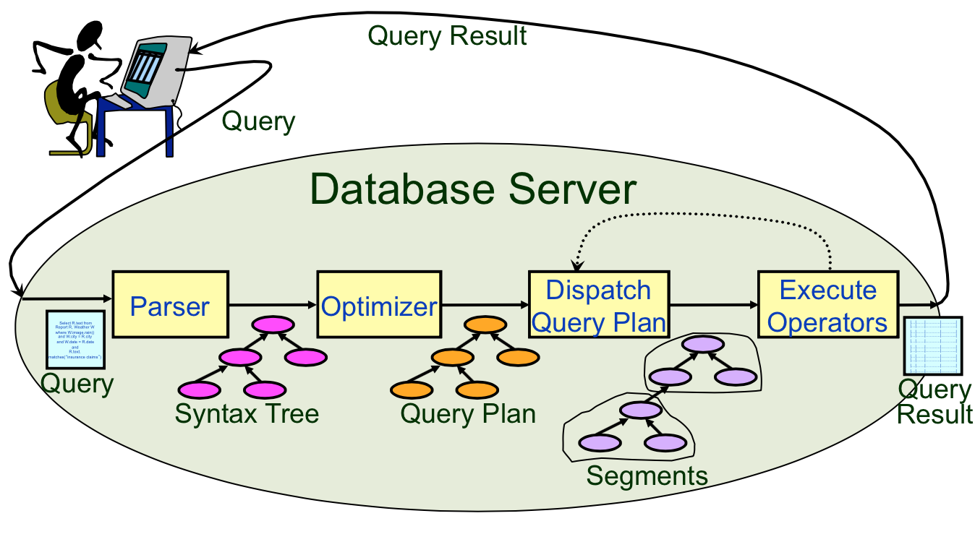
Query Execution Life-Cycle

Slide 3
Projection
Select R.a, R.d
Straightforward implementation!
Select DISTINCT R.a, R.d
Remove attributes
Eliminate duplicates
Algorithms for Projection DISTINCT:
Sorting: Sort on all the projected attributes
Pass 0: eliminate unwanted fields. Tuples in the sorted-runs may be smaller
Eliminate duplicates in the merge pass & sort
Hashing: Two phases
Partitioning
Duplicate elimination
Notes:
Projection is really easy if we aren’t eliminating duplicates!

Slide 4
Hashing
Original
Relation
OUTPUT
Partitions
1
1
INPUT
2
Hash on projected
Attributes to
Eliminate duplicates
hash
function
h1
2
. . .
B-1
B-1
Disk
B main memory buffers
Disk
Partitions
Result
Hash table for partition i
Recursively apply hash-based projection technique to handle partition overflow problem
hash
fn
h2
h2
Input buffer
for partition i
Output
buffer
Disk
B main memory buffers
Disk
Notes:
14
When is this a bad strategy? When a single partition is larger than the # of available of buffers.
In that case, recursively apply hash-based projection technique to any partition that overflows

Slide 5
Projection
Sort-based approach for SELECT DISTINCT
better handling of skew
result is sorted
Thus, more commonly used than hash-based approach
Notes:
18

Slide 6
Index-only Scans
Index-only scan can be much more efficient if
Projection attributes subset of index attributes
Apply projection techniques to data entries (much smaller!)
For handling SELECT DISTINCT, an additional optimization possible if the ordered (i.e., tree) index contains all projection attributes as prefix of search key:
Retrieve index data entries in order (no sorting necessary)
Discard unwanted fields
Compare adjacent entries to eliminate duplicates (if required)

Slide 7
Set Operations
∩ and Ⅹ special cases of join
∪ and − similar; we’ll do ∪
Both require duplicate elimination
Duplicate elimination algorithms for ∪:
Sorting:
Sort both relations (on all attributes).
Merge sorted relations eliminating duplicates.
Hashing:
Partition R and S
Build hash table for R_{i}.
Probe with tuples in S_{i}, add to table if not a duplicate
Notes:
19

Slide 8
Aggregates
Sorting Approach
Sort on GROUP BY attributes (if any)
Scan sorted tuples, computing running aggregate
Min, Max
Count
Sum
Average: compute from sum and count
During scan, when the group by attribute changes (e.g., 2, 2, 2, 3), output aggregate result

Slide 9
Aggregates
Hashing Approach
Hash on GROUP BY attributes (if any)
Hash entry: grouped attributes + running aggregate
Scan tuples, probe hash table, update hash entry
Scan hash table, and output each hash entry
Cost: Scan relation!

Slide 10
Using an Index for Aggregation
Usually, index is not useful for aggregation operators.
But sometimes it is:
When the search key contains all the relevant attributes: index-only scan may be feasible, rather than fetching all the data records.
If the GROUP BY attribute list is a prefix of the search key, we can retrieve data records in the order required for the grouping operation and thereby avoid the sorting step.

Slide 11
Announcements
Optional Exercises:
12.1 (1-4), 12.3, 12.5
13.1, 13.3
14.1 (2, 3, 4, 6, 7, 8, 9, 10), 14

