Slide 1
Searching for k nearest neighbours using Quadtree
CSO-102
Data Structures
By:
16074008: Khush Chopra
16074010: Raghav Kabra
16074012: Saurabh Chauhan
16074014: Suyash Shukla

Slide 2
Problem Definition: Nearest Neighbor Search
Given: a set P of n points in R^{d} over some metric
Find the nearest neighbors p of q in P
Q?
Distance metric
Notes:
The solution strategy is:
Select Features → feature space R^{d}
Select distance metric → for example l₁ or l₂
Build data-structure for fast near-neighbor queries
Scale-ability with n & with d is important

Slide 3
Methods used for comparative study of the problem
Brute Force
Quadtrees

Slide 4
Brute Force
for all points in space P
do
if points in queue < k:
push point in priority queue
else
if(priority(current point)>priority(pop(queue))
pop()
push(current point)
end
print queue
Time Complexity: O(n)
*priority increases as distance from query point q decreases

Slide 5
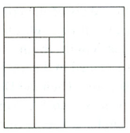
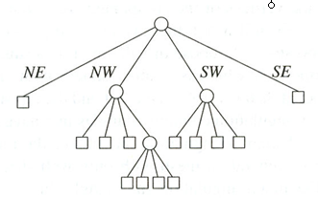
Quad Trees
N
A tree in which each internal node has up to four children.
Every node in the quadtree corresponds to a square.
The children of a node v correspond to the four quadrants of the square of v.
The children of a node are labelled NE, NW, SW, and SE to indicate to which quadrant they correspond.
W
E
S
Notes:
Extension to the K-dimensional case

Slide 6
Quadtree Construction
(data stored at leaves)
400
a
Input: Set of points P
while Some cell C contains more than “k” points do
Split cell C
end
Time Complexity: log(n)
b
c
d
e
Y
g
f
h
l
j
i
k
X 50, Y 200
0
X
100
SW
SE
NE
NW
i h
X 75, Y 100
c e
X 25, Y 300
j k
f
g l
d
a b

Slide 7
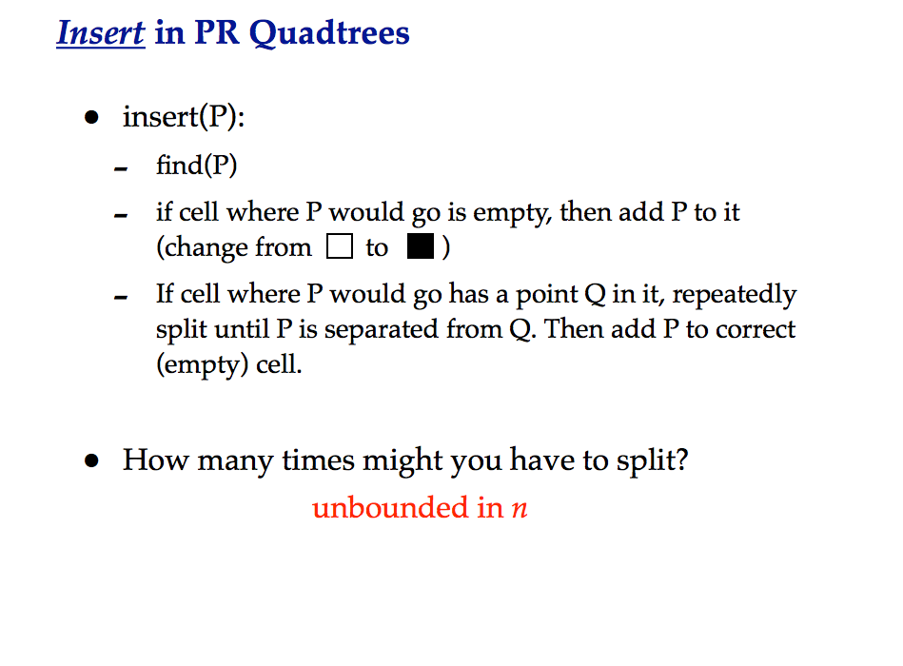

Slide 8
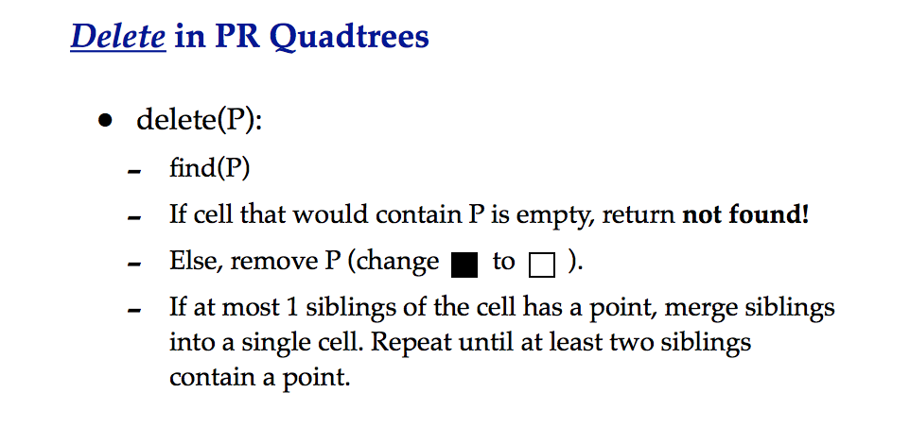

Slide 9
Quadtree – Exact Match Query
Partitioning of the plane
The quad tree
D(35,85)
A(50,50)
•
•
B(75,80)
P
SE
NE
•
NW
C(90,65)
SW
B(75,80)
•
NE
A(50,50)
E
D
SE
SW
NW
•
C
E(25,25)
To search for P(55, 75):
Since X_{A}< X_{P} and Y_{A} < Y_{P} → go to NE (i.e., B).
Since X_{B} > X_{P} and Y_{B} > Y_{P} → go to SW, which in this case is null.
Notes:
Multimedia Technologies
7/17/97
Kien A. Hua
9

Slide 10
Quadtree – Nearest Neighbor Query
X₁,Y₁
SW
SE
NE
NW
X₂,Y₂
Y
X
Notes:
Extension to the K-dimensional case

Slide 11
Quadtree – Nearest Neighbor Query
X₁,Y₁
SW
NE
NW
SE
X₂,Y₂
Y
NW
X
Notes:
Extension to the K-dimensional case

Slide 12
Quadtree– Nearest Neighbor Query
X₁,Y₁
SW
NE
NW
SE
X₂,Y₂
SW
Y
NW
SE
NE
X
Notes:
Extension to the K-dimensional case

Slide 13
Quadtree– Nearest Neighbor Search
Algorithm
Initialize range search with large r
Put the root on a stack
Repeat
Pop the next node T from the stack
For each child C of T
if C intersects with a circle (ball) of radius r around q, push C to the stack
if C is a leaf, examine point(s) in C and
update r
q
Whenever a point is found, update r (i.e., current minimum)
Only investigate nodes with respect to current r.

Slide 14
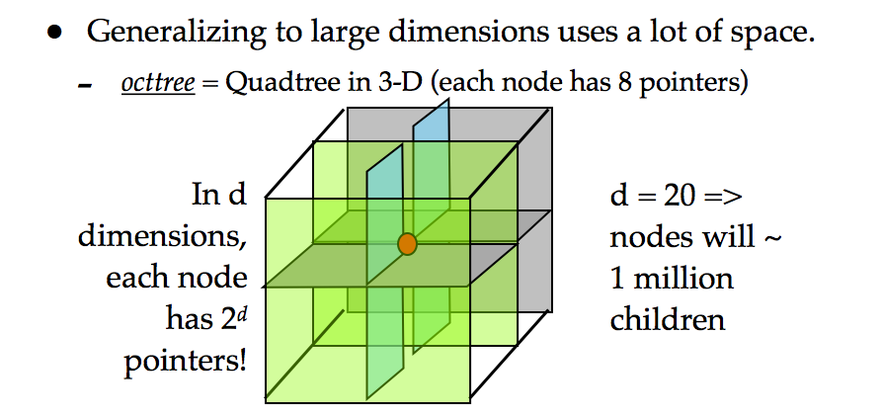
Quadtree (cont’d)
Simple data structure.
Easy to implement.
But, it might not be efficient: two close points may require a lot of levels in the tree to split them

Slide 15
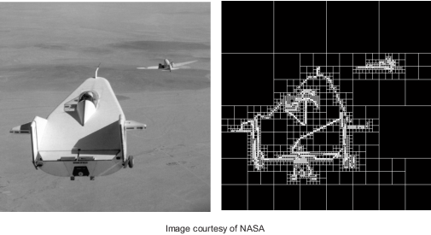
The following image shows original image and its PR quad tree decomposition.

Slide 16

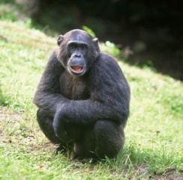
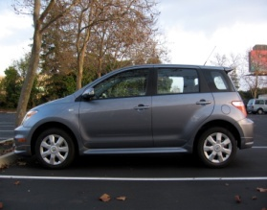
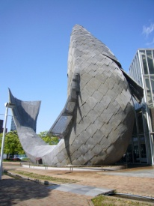
Large Scale Image Search in Database
Find similar images in a large database

Slide 17
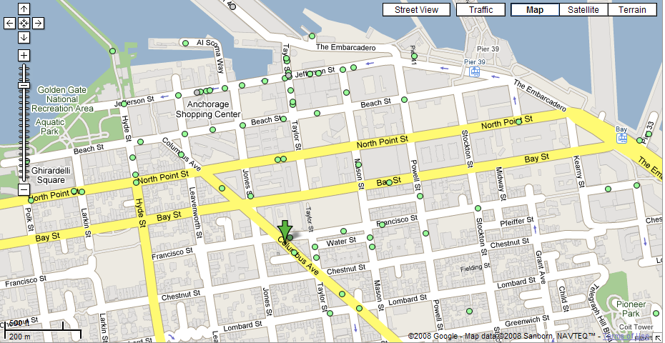
Nearest Neighbor(s) Query
What is the closest restaurant to my hotel?

Slide 18


Other Applications
Classification
Clustering
Indexing
Copyright violation detection
Weight
q ?
color

