Slide 1
Distributed map reduce with GPU acceleration
Milestone 1
Edward Atter, Siyu Zheng, Yan Wu

Slide 2
MapREduce
What is MapReduce?
Why is it important?
What is it used for?
Why GPU?

Slide 3
MapREduce
Map reduce is an important algorithm in the age of big data. It serves as a template, allowing other programmers to efficiently build a program capable of processing enourmous amounts of data using the power of distriuted computing. The basic example is word count, but it's applications expand much further to other well known algorithms such as Google's PageRank and friend recommendation systems.
Traditionally, this is accomplished on a CPU using software such as Hadoop. To achieve true paralellism, thousands of computers are often used together in a cluster. By utilizing the native paralellism present in GPU architecture, we theorize many less computers can be clustered together to yield the same performance; resulting in a much better performance per dollar.

Slide 4
MAPREDUCE
Reference: cis 505
CountStack
Worker
Filter+Stack
Worker
blue: 4k
CountStack
Worker
green: 4k
Filter+Stack
Worker
CountStack
Worker
cyan: 3k
Filter+Stack
Worker
CountStack
Worker
gray: 1k
Filter+Stack
Worker
CountStack
Worker
orange: 4k

Slide 5
Word Count
Read parts of files (from certain lines to certain line, for later milestone)
Load files into GPU memory
Run a custom mapper function
Sort the output and group by key
Run a custom reducer function
Output

Slide 6
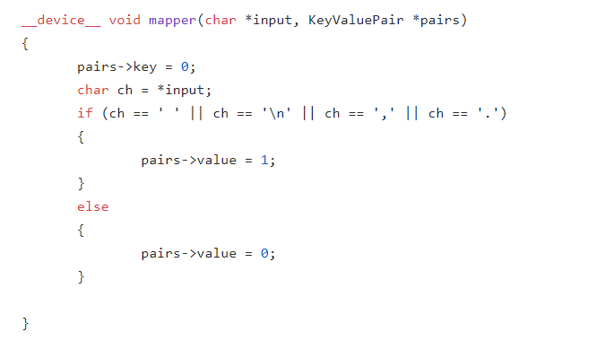
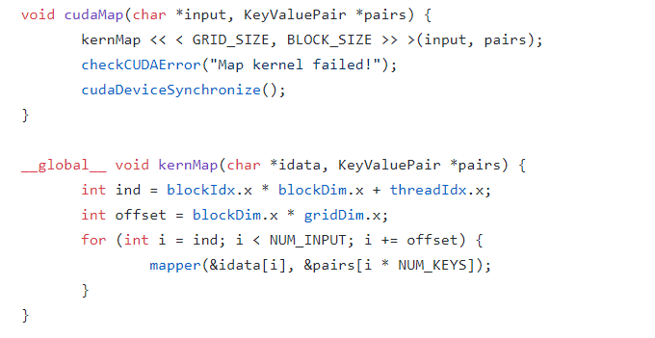
Map stage

Slide 7
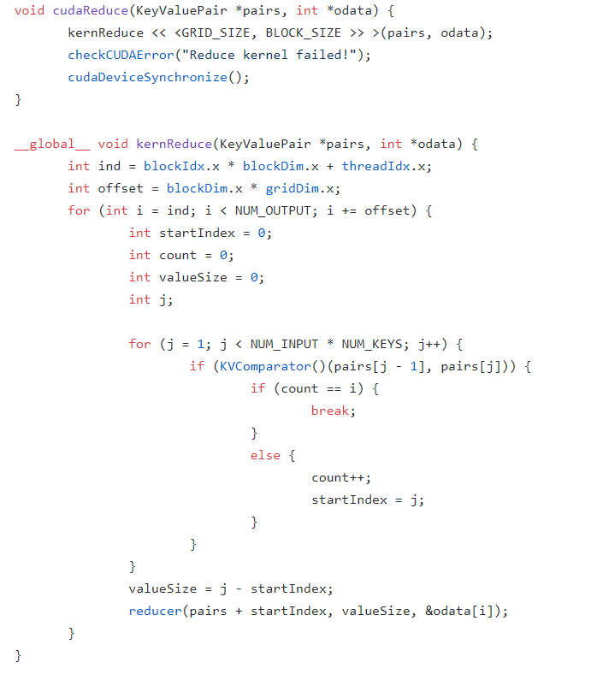
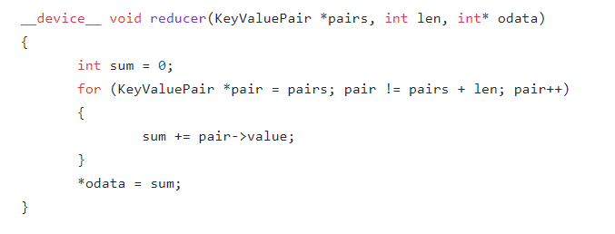
Reduce stage

Slide 8

Use thrust library for sorting

Slide 9
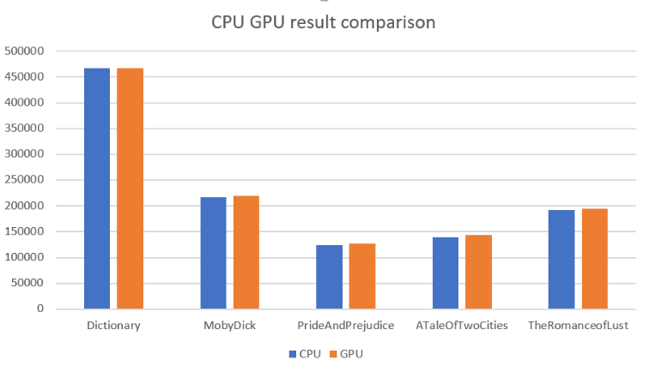
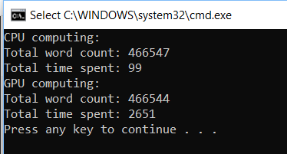
RESULT

Slide 10
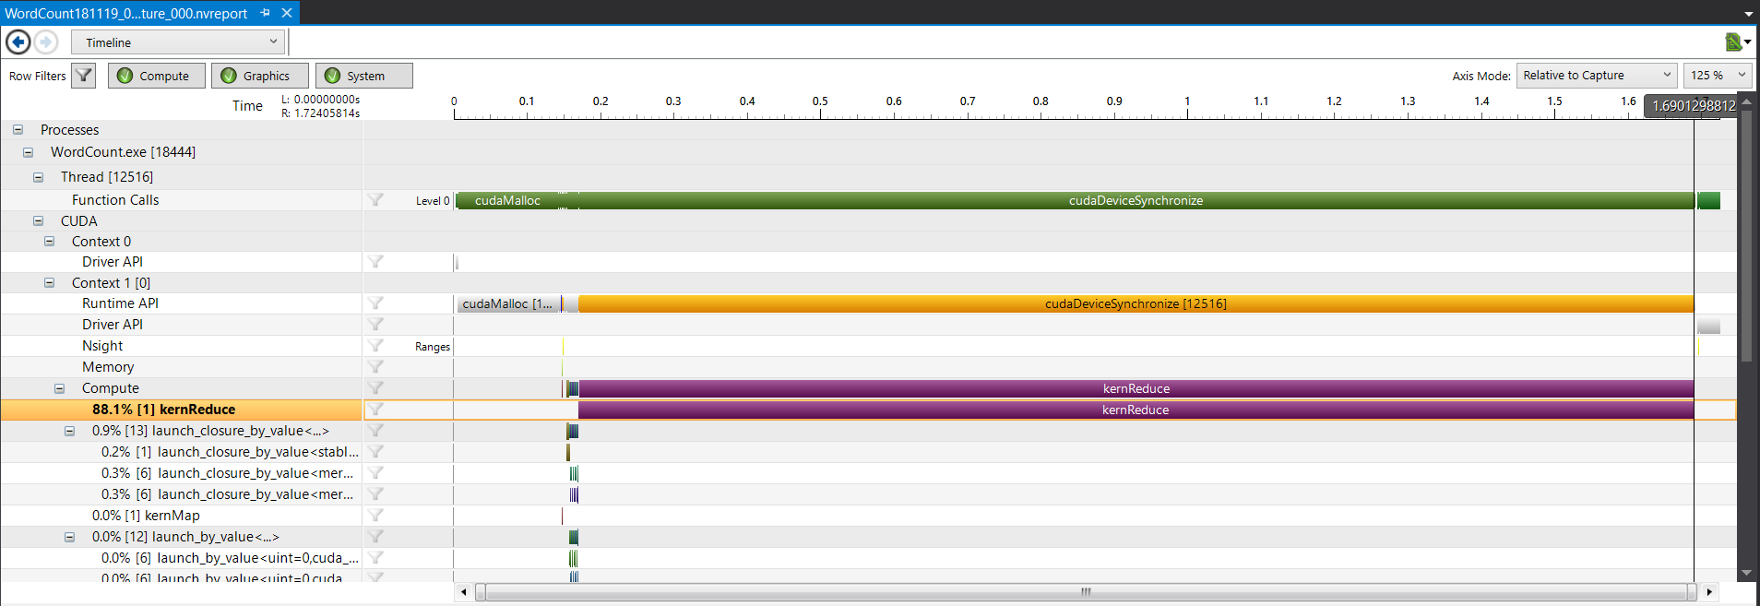
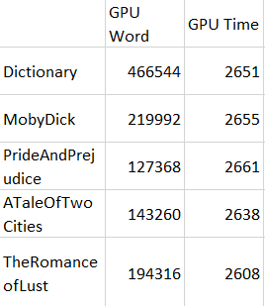
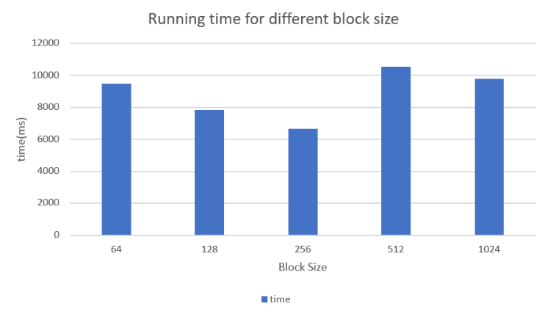
Time performance
NUM_INPUT 6 * 10^6

Slide 11
NEXT Milestone
11/26
Improve Word Count example
Map reduce working distributed across 2 different computers
PageRank or similar algorithm that has more work per thread than word count

Slide 12
Further Milestones
  12/03
  Scales to 3+ computers
  Measure network traffic / estimate network bottleneck
  Shared memory
  12/10
  Deep dive into efficiency
  Pegged memory
  Other advanced CUDA topics
  Compare with traditional MapReduce programs eg. Hadoop

