Slide 1

Distributed map reduce with GPU acceleration
Team: Eddie Atter, Siyu Zheng, Yan Wu

Slide 2
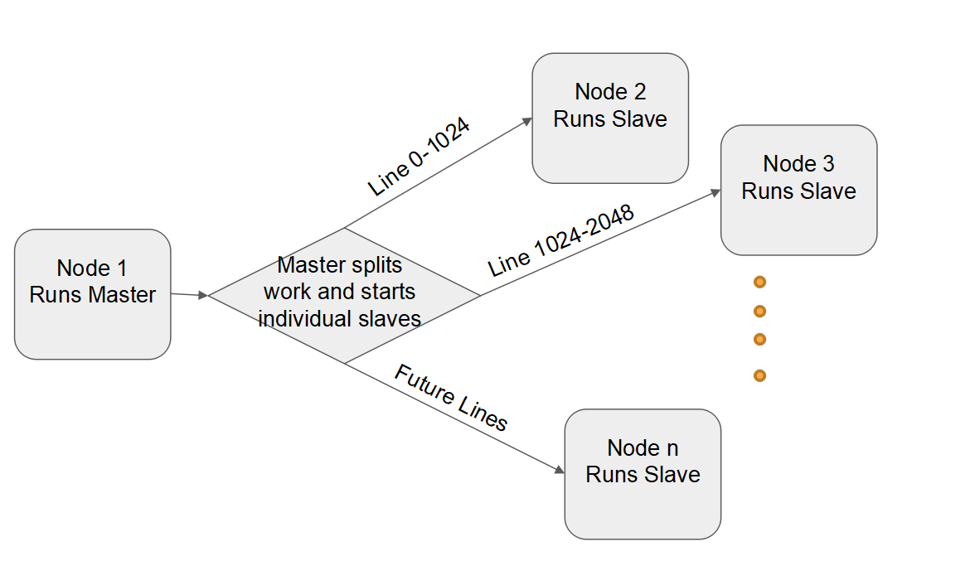
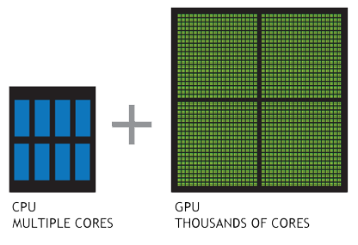
1.Why&How
Why MapReduce
-An important algorithm in the age of big data
-Already accomplished on CPU, e.g. Hadoop, but
not mature enough on GPU
How we decide to do this
MapReduce is perfect for parallelism, after dealing with the tricky part and boundary issues, it should be much faster than CPU version
CPU GPU

Slide 3
2. Our Pipeline
FINISH!
START!
Stage1 File loading
Stage2 Mapping
Stage3 Sort by Key
Stage4 Reducing
Read file and convert to key-value pairs with line numbers as keys, lines as values
Construct new pairs, each word as key, and set the value to 1.
Sort the key-value pairs according to their keys preparing for the final reduce stage
Find indexes of key-value pairs with same keys and get their count, then output as final results.

Slide 4
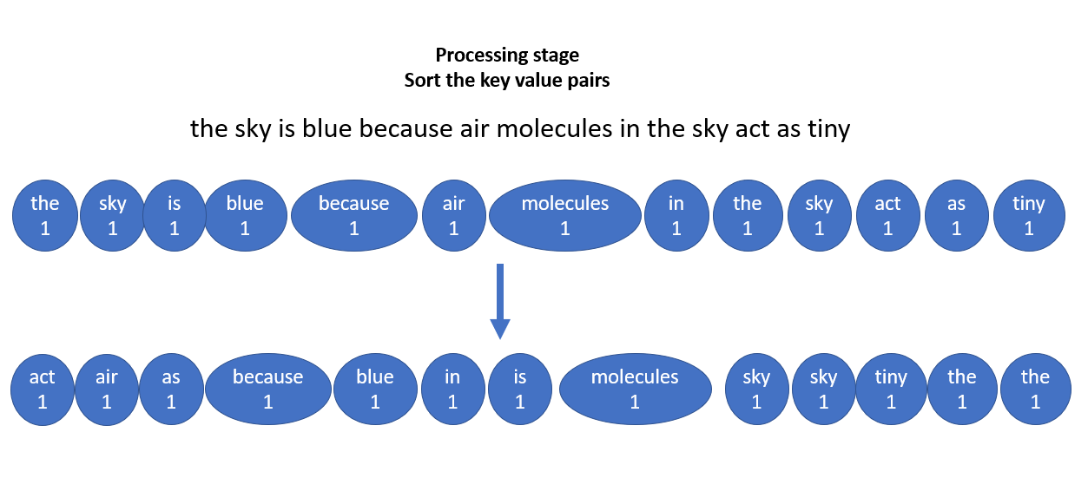
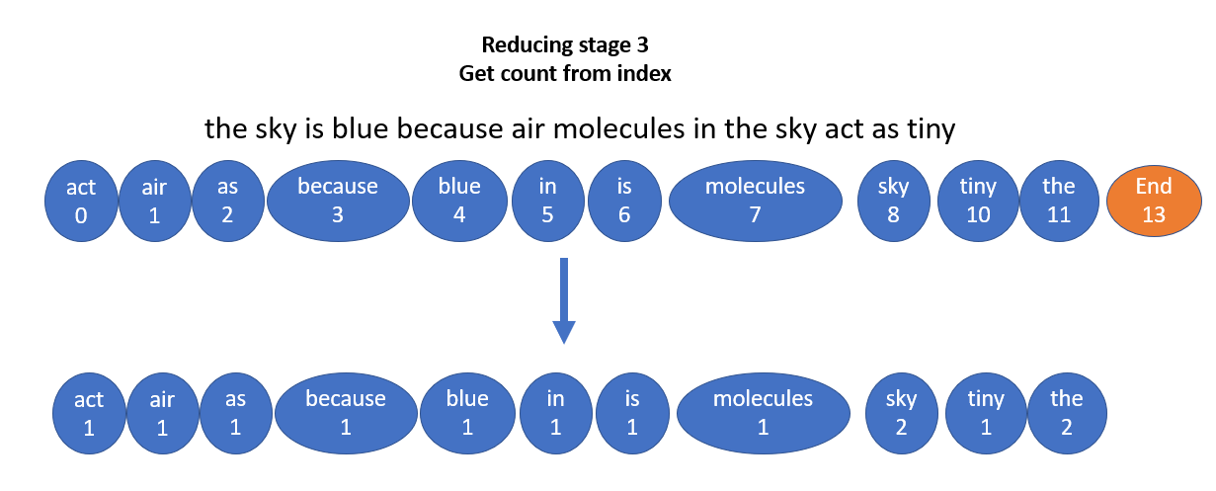
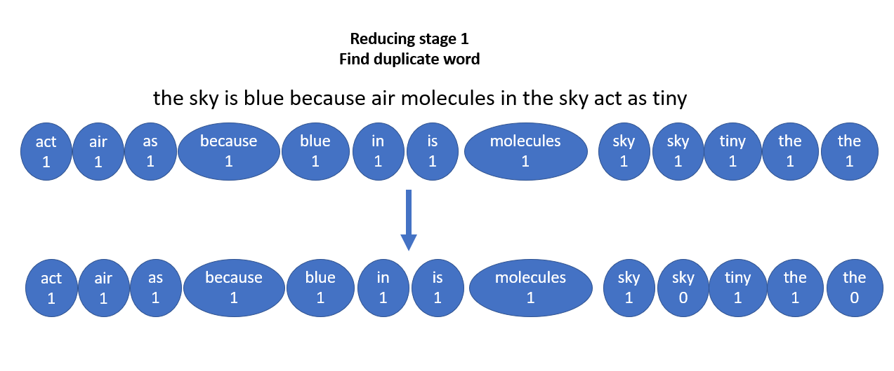
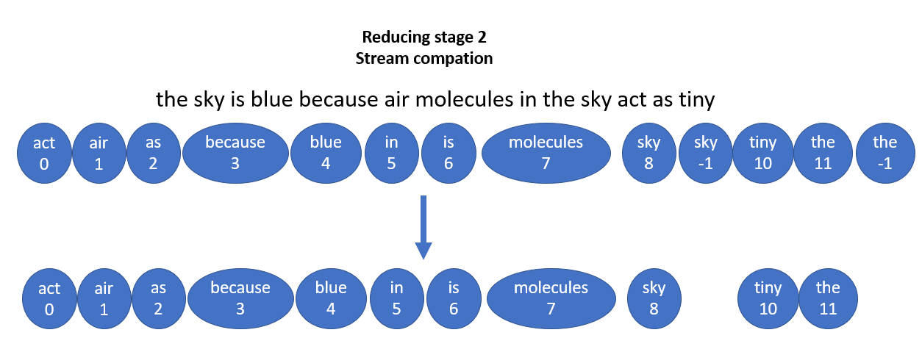
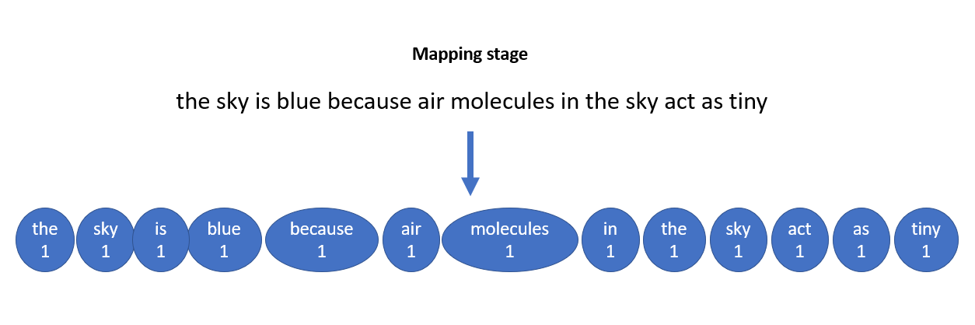
2. Our Pipeline
FINISH!
START!
Stage1 File loading
Stage2 Mapping
Stage3 Sort by Key
Stage4 Reducing
Read file and convert to key-value pairs with line numbers as keys, lines as values
Construct new pairs, each word as key, and set the value to 1.
Sort the key-value pairs according to their keys preparing for the final reduce stage
Find indexes of key-value pairs with same keys and get their count, then output as final results.

Slide 5
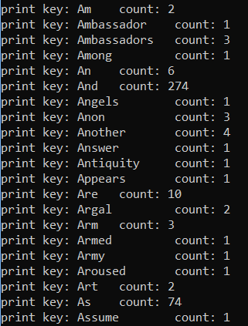
3 Results
After the whole pipeline of work, the output should be like this. Each pair consists of a word and its appearance count. And this is the realization of Word Count using MapReduce on the GPU.

Slide 6
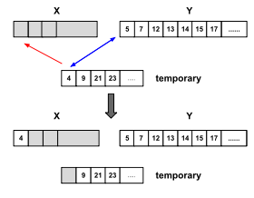
* Now we get it distributed
Master keeps track of all "slave" nodes:
-Automatically sends the next stage on completion of one
-We use timsort (CPU level) to recombine the
intermediate file outputs from map stage(this is
required because we need to make sure that keys are 1
to 1)
IE the key "apple" can't be split across two separate
machines
Timsort is selected because it's specifically built to sort sequences that already contain large sorted chunks, which is exactly what we have

Slide 7
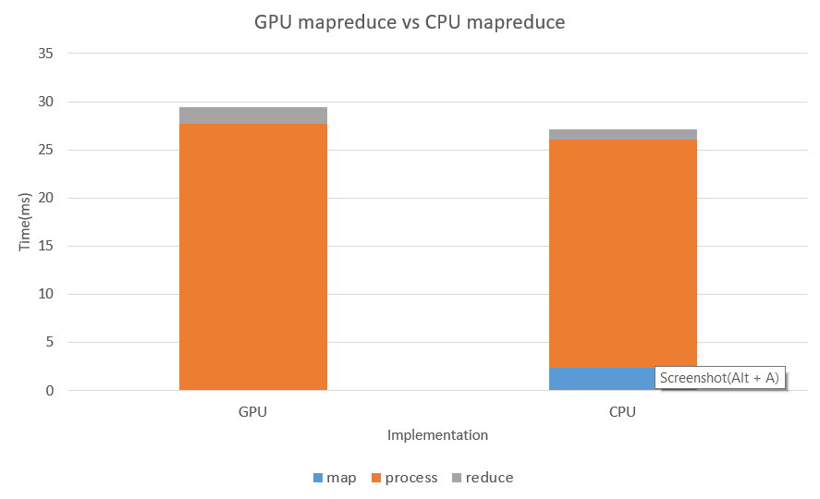
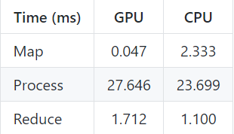
4. Performance
On single machine
This is based on an input file at around 1000 line

Slide 8
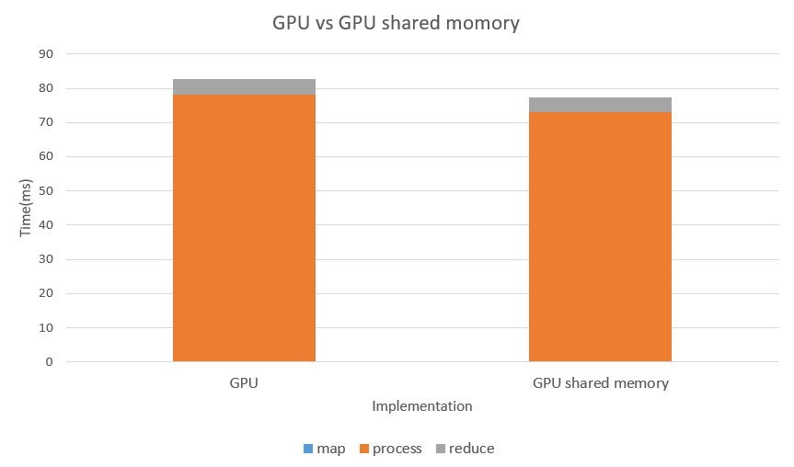
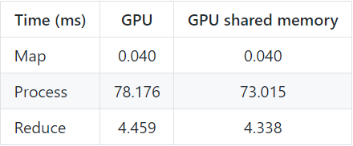
4. Performance
On single machine
This is based on an input file at around 5000 line

Slide 9
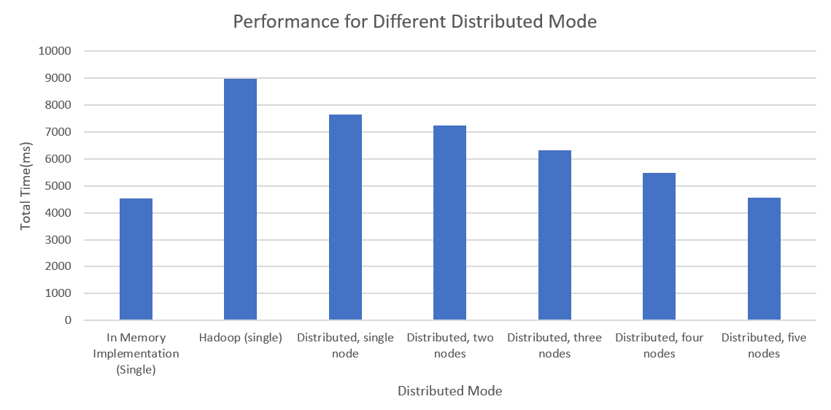
4. Performance
After distributed
* file was ~200mb, GPU implementation
Mode | Total Time(sec)
In Memory Implementation (Single) | 4.537445
Hadoop (single) | 8.98
Distributed, single node | 7.657204
Distributed, two nodes | 7.243546
Distributed, three nodes | 6.33232
Distributed, four nodes | 5.47232
Distributed, five nodes | 4.55232

Slide 10
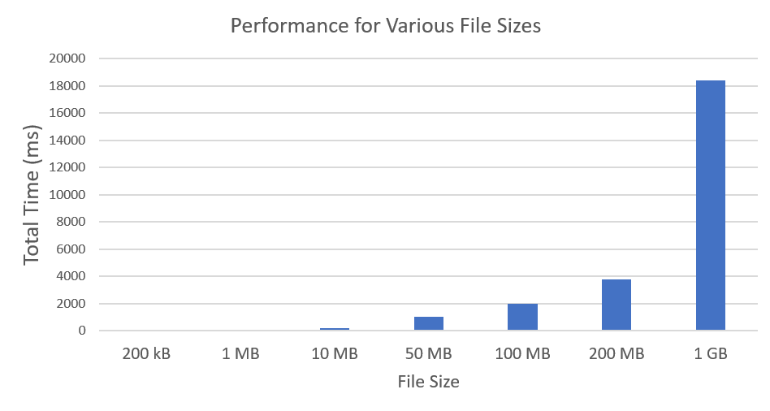
4. Performance
After distributed
In Memory, Various file sizes | Total Time(milisec)
200KB | 4.3764
1 MB | 23.2534
10MB | 200.468
50MB | 1008.2909
100MB | 1995.424
200MB | 3785.5232
1GB | 18377.8889

