Slide 1
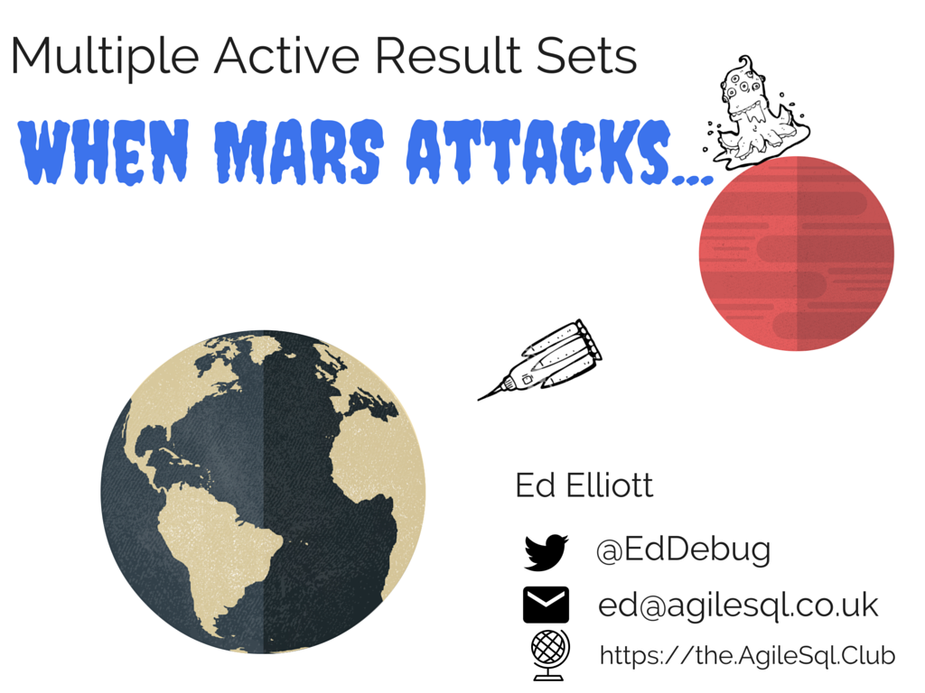
Notes:
My name is Ed Elliott
I am a SQL developer who has two passions – CI / improving database development and networking (and debugging)
I have worked with sql since sqlserver 2000 in 2005 so almost 10 years but spent about 4 years decoding TDS the protocol SQL uses and have been stung by MARS more than once

Slide 2
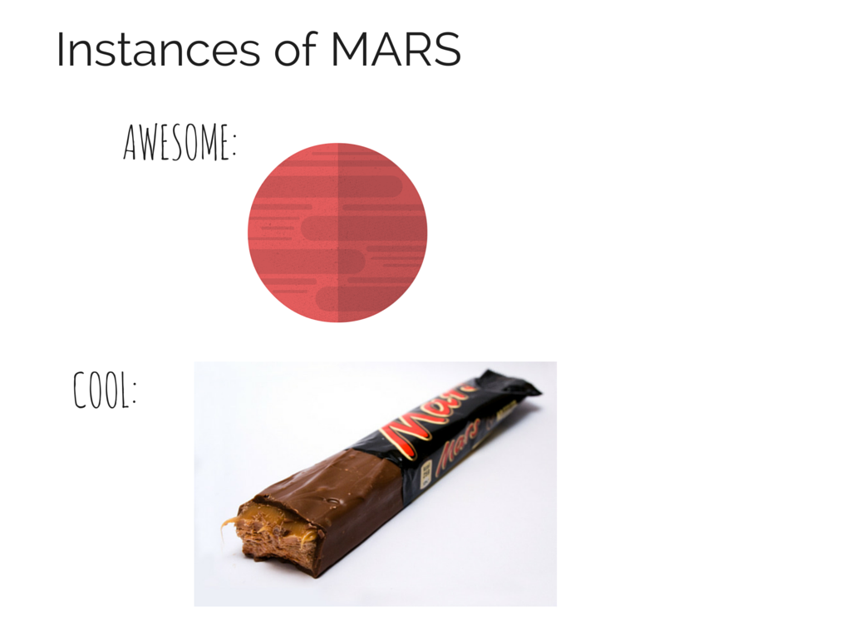
Notes:
Isn’t the red planet the most awesome place that could possibly exist??
Mars bars are pretty cool

Slide 3
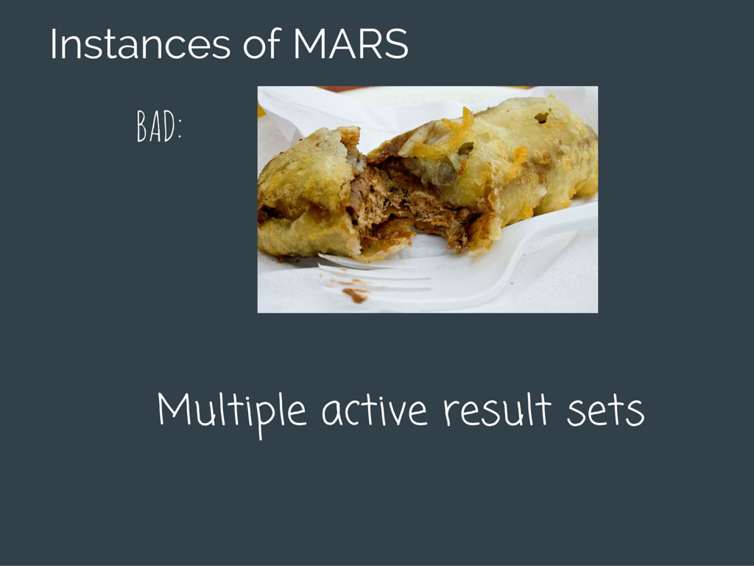
Notes:
I lived in glasgow for a couple of years and didn’t actually eat any deep fried mars bars but they seem pretty gross to me!
Then we have multiple active result sets – I’ve written it in comic sans to show my distaste for it!
Normally I try to give a balanced opinion, say what is good, what is bad where things could be used or should be avoided but I was told that to speak at a sql supper you need to be opinonated so I am giving you my opinionated view of MARS

