Slide 1

Notes:
My name is Ed Elliott
I am a SQL developer and I get really excited by sql development, continuous integration/deployment and networking with a sideline in debugging
I have worked with sql since sqlserver 2000 in 2005 so almost 10 years but spent about 4 years decoding TDS the protocol SQL uses and writing tools using that and have been stung by MARS more than once
Who here knows what mars is and who has used it knowingly?
I have seen it used in quite a few places and no one really knew why they had it.

Slide 2
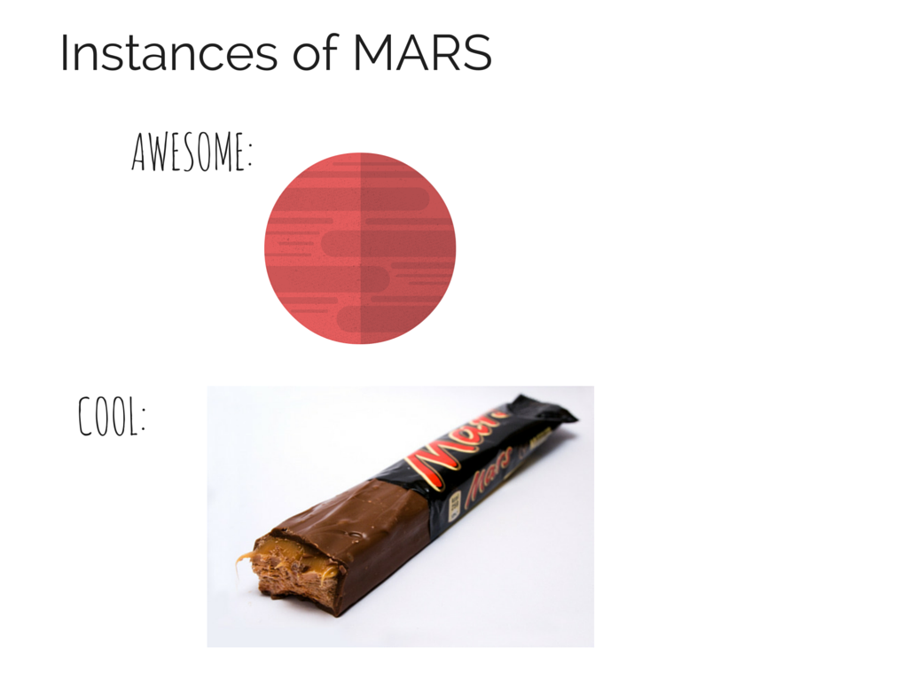
Notes:
Lets look at the types of MARS that exist, these are some cool instances of MARS…
The planet up here - isn’t the red planet the most awesome place that could possibly exist??
Plus Mars bars are pretty cool

Slide 3
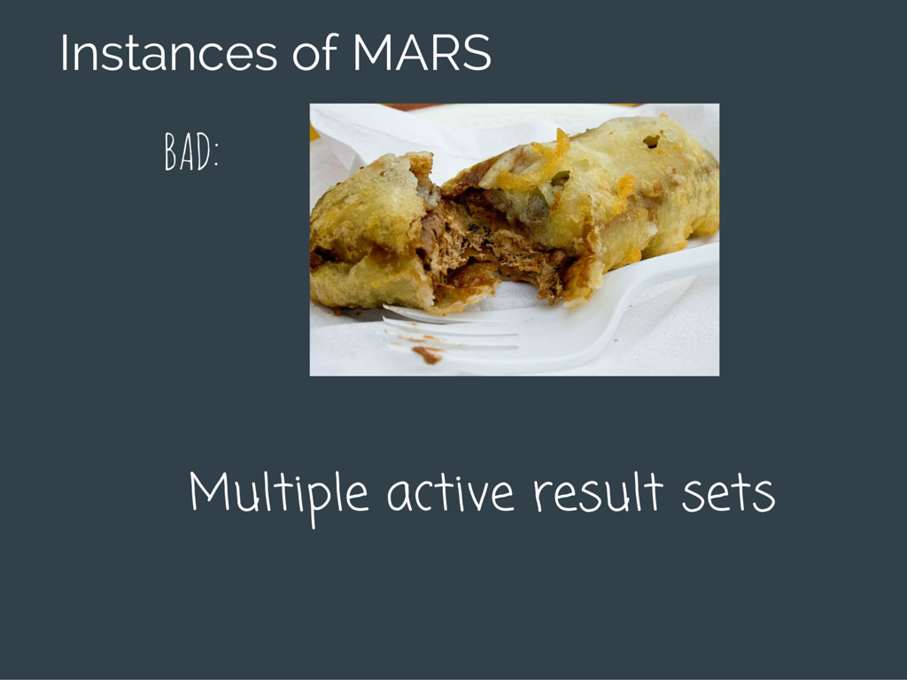
Notes:
I lived in glasgow for a couple of years and didn’t actually eat any deep fried mars bars but they seem pretty gross to me!
Then we have multiple active result sets – I’ve written it in comic sans to show my distaste for it!
Normally I try to give a balanced opinion, say what is good, what is bad where things could be used or should be avoided but I was told that to speak at a sql supper you need to be opinonated so I am giving you my opinionated view of MARS – if anyone has any actual use cases for it please say so

Slide 4
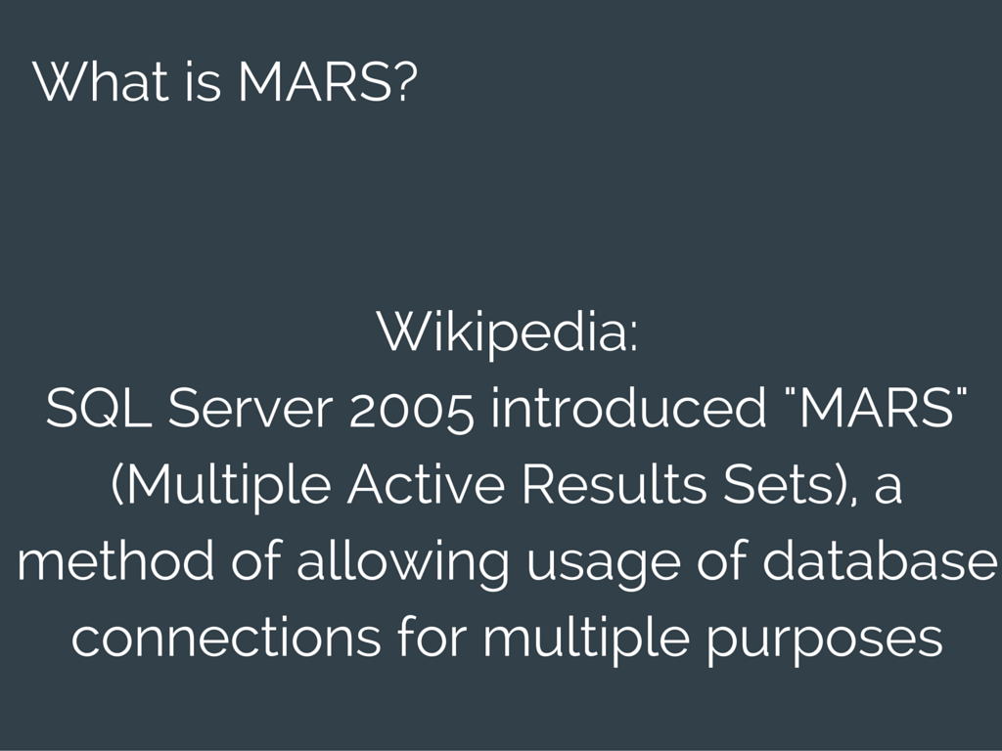
Notes:
What MARS does is it lets you take a single connection and run multiple queries at the same time – sounds pretty useful hey?

Slide 5
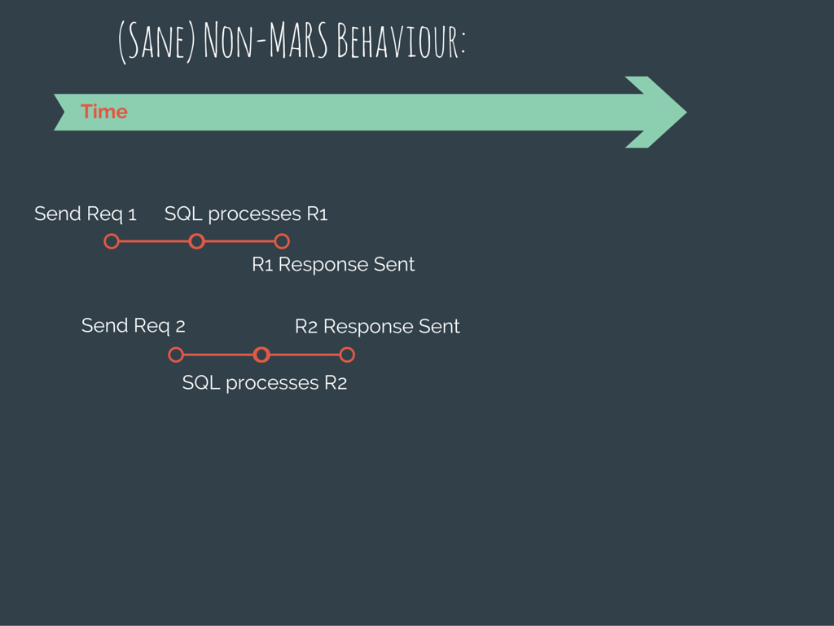
Notes:
This is the typical scenario, you have two queries you send the first and then you send the second – they will take as long as they take and you get a response.
Each line is one spid – standard rules about locking and transactions apply

Slide 6
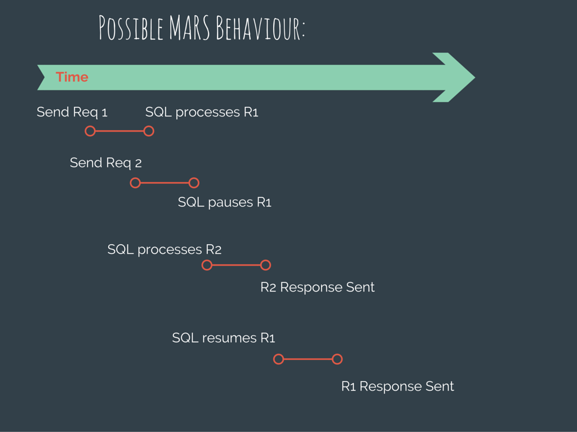
Notes:
So this is the same thing but instead of two spids there is now one spid over a mars connection.
Request 1 is sent, sql starts processing it
Request 2 is sent, sql pauses request 1
Sql processes request 2 and sends the response
Sql finally resumes request 1 and sends that response
EXCEPT that it isn’t obvious what gets paused and what doesn’t – some thing do and some don’t (SELECT does, INSERT doesn’t etc) so if you have a stored procedure that does a few different things – who knows where and when it will be paused (or nor)

Slide 7

Notes:
Lets see a demo – the powerpoint and code for the demos is all in github, I’ll link at the end or get on my blog
In this demo we will send two queries which do not block each other but do block each other (forget what you know about locking)
Because everything is on the same spid, I don’t even know where to start looking if you get performance issues and randomly slow queries.

Slide 8

Notes:
The first benefit

Slide 9
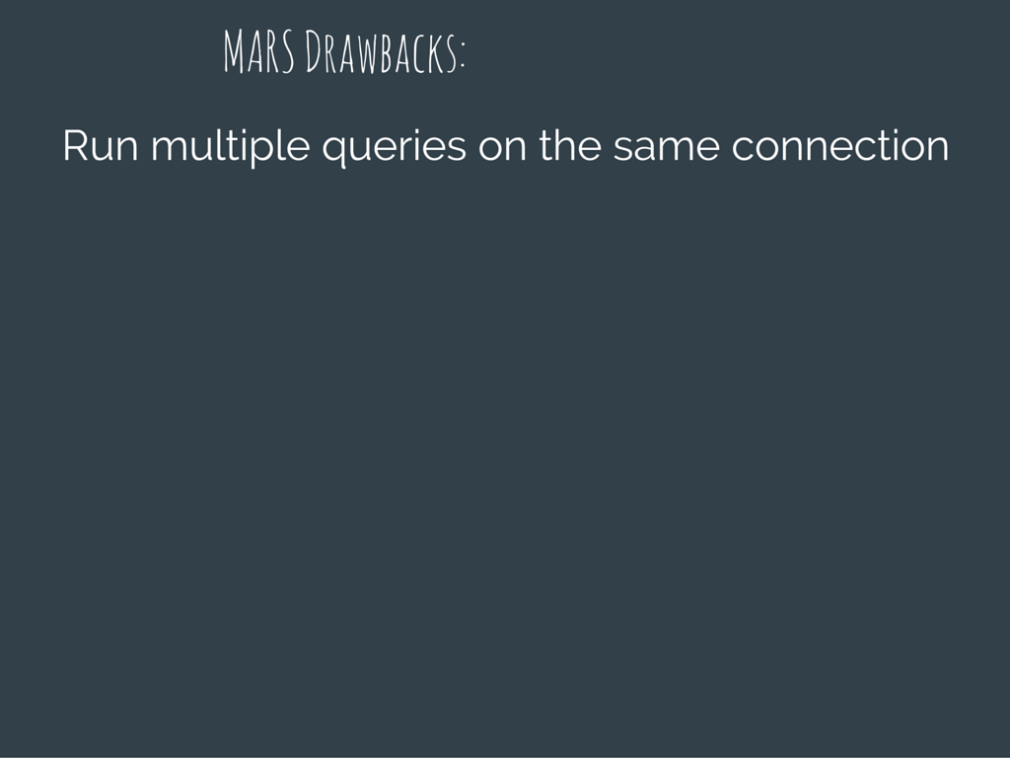
Notes:
The first drawback ho ho ho

Slide 10
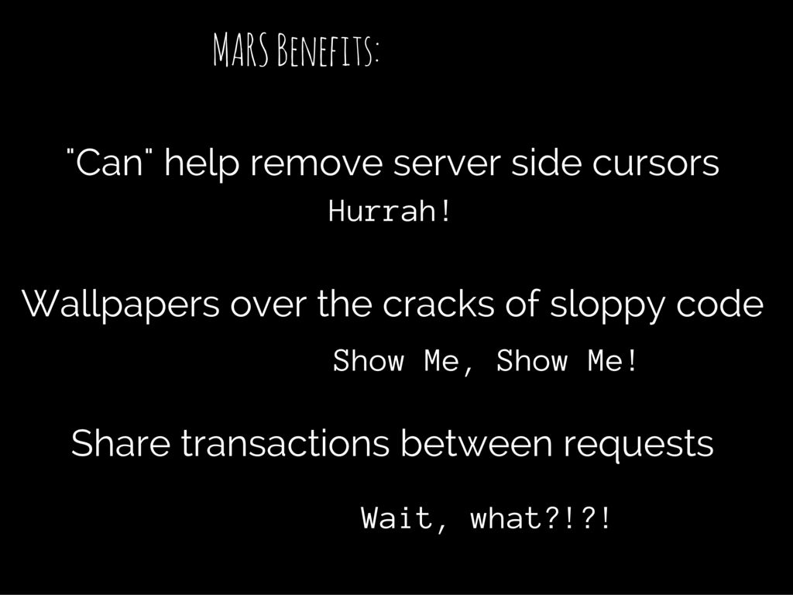
Notes:
Here are the actual benefits
- I am not entirely sure why it can help remove server side cursors because I very rarely use them and never in code that needs to be fast.
It may be a bit harsh to call it wallpapering over the cracks of sloppy code but where I have seen mars enabled is to fix bugs where sqlconnections have been re-used without being re-opened, one example was a ,net app have a number of forms and on each form they had a Sqlconnection that all the methods used – as the users did different things, occasionally they got an exception and they fixed it by enabling MARS. It did fix their issue but the correct fix would have been for everyone to create their own connections – with connection pooling there is no need to share connections and it usually points to do something else wrong and covering it up by sharing connections.
This last point, sharing transactions between connections – I am not sure why you would want to do it and if you really needed to then there is a system stored procedure that lets you bind one spid’s transaction context to another.

Slide 11
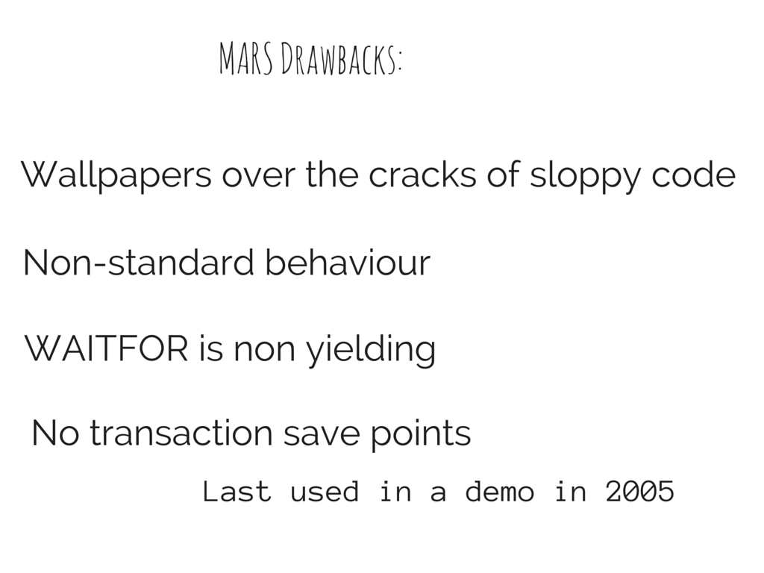
Notes:
The first one we have covered
NoN-Standard behaviour – this is a big one for me, with a statement or stored procedure it is easy to reason about – you can look at it and figure out what is going on with it, what locks it has and how they are used – you throw all that away with MARS and need to bear in mind all the possible states from all the possible queries, not fun.
If one query does a waitfor then all the other requests just sit there chilling and not doing anything until that finishes – waitfor and mars really do not mix
No transaction save points, I have seen these used these but don’t see them used very often – does anyone use them? This is a case of enabling mars by adding MultipleActiveResultsSets=true to the connection string and now you lose functionality.

Slide 12
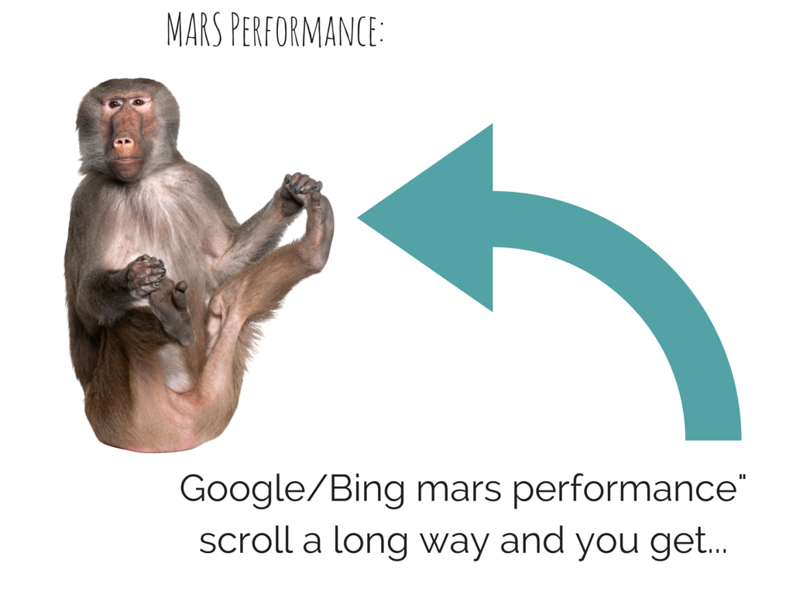
Notes:
Which brings me onto MARS performance – the app I use to create these slides, if you search for mars performance you get this and it really is appropriate.

Slide 13
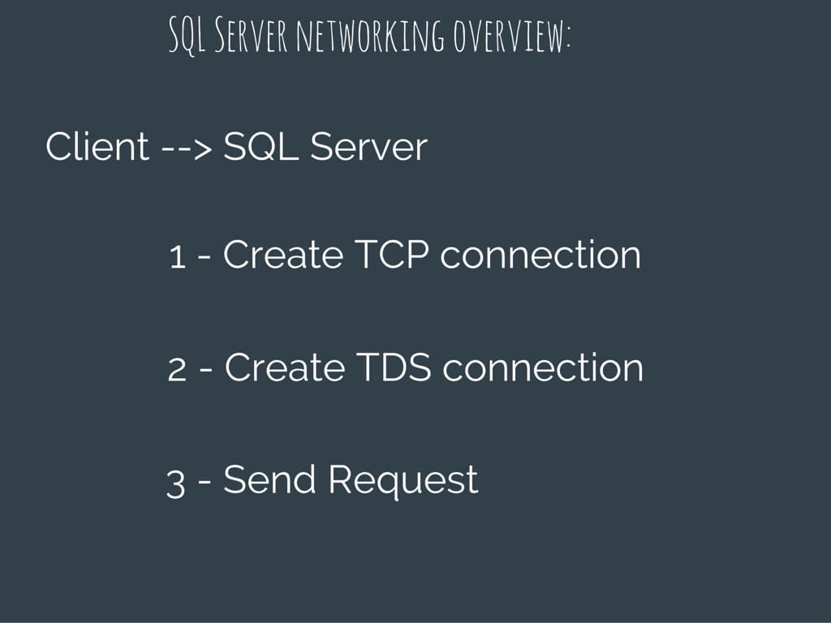
Notes:
Perf of mars is also affected by the network so a quick overview of sql server networking.
Client creates a tcp connection, creates a tds connection and then sends the request
Creating a tcp connecting involves the client sending a syn packet, the server responsing with its own syn and and ack of the clients syn and then it is ready
Creating a TDS connection involves the client sending a pre-login packet, receiving back a pre-login response, some auth packets which depend on the type of auth chosen, a login7 packet and then the client can send requests.
When data is sent to or form sql it is split into tds packets which by default are 4k but can be anywhere from 512 bytes to 32k. These packets are then split up by tcp/Ethernet so onl slow connections the less data we send the better but once we have to send a packet we might as well fill it up as the size of packets makes no difference, it is the amount that matters.
There is quite a lot of backwards and forwards with sql and a connection with internet type latency you should expect it to take about a second or so – so mars looks like it could actually have a benefit in this scenario, it doesn’t but looks like it might!

Slide 14
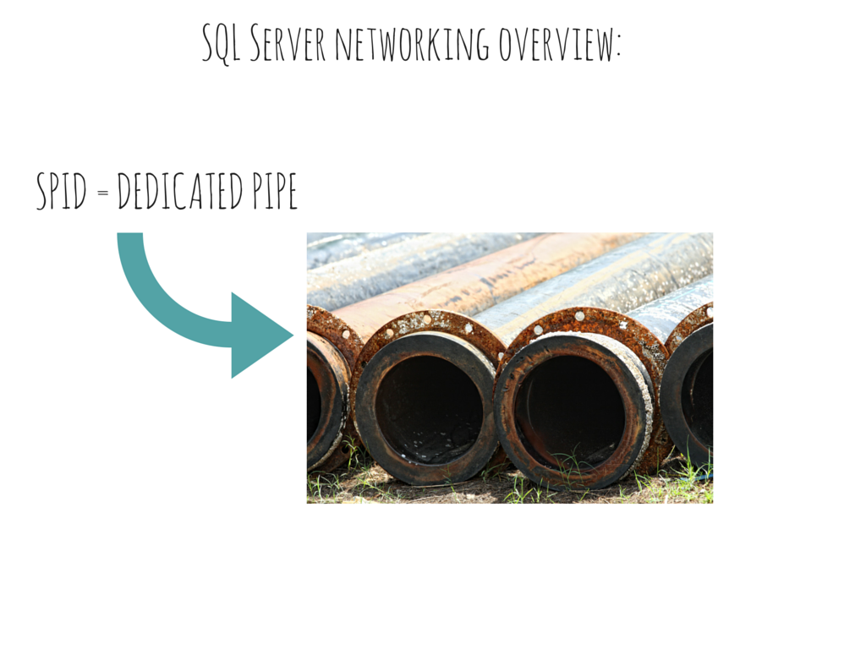
Notes:
This is how pure tds works, each spid is its own pipe and data is literally flushed down as quick as possible, it is a really fast way to get a lot of data over links with high latency

Slide 15
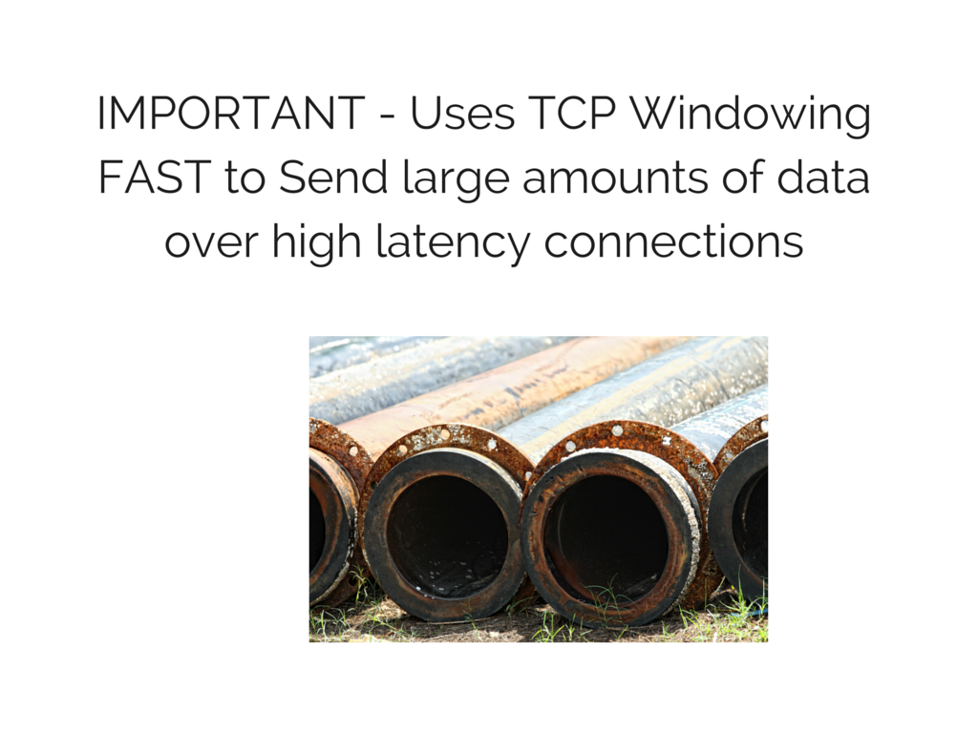
Notes:
Windowing basically means send x bytes before waiting for confirmation that they have been received, when you get it (or if you have already had it) send more
If we have slow links and lots of data we want a larger window, but if the connection loses packets (the internet!) then we will not know for a while so it is better to have a smaller window – it is an old fashioned trade-off but luckily every router in the world knows how to deal with it and tcp has has a great deal of investment into making it better.

Slide 16
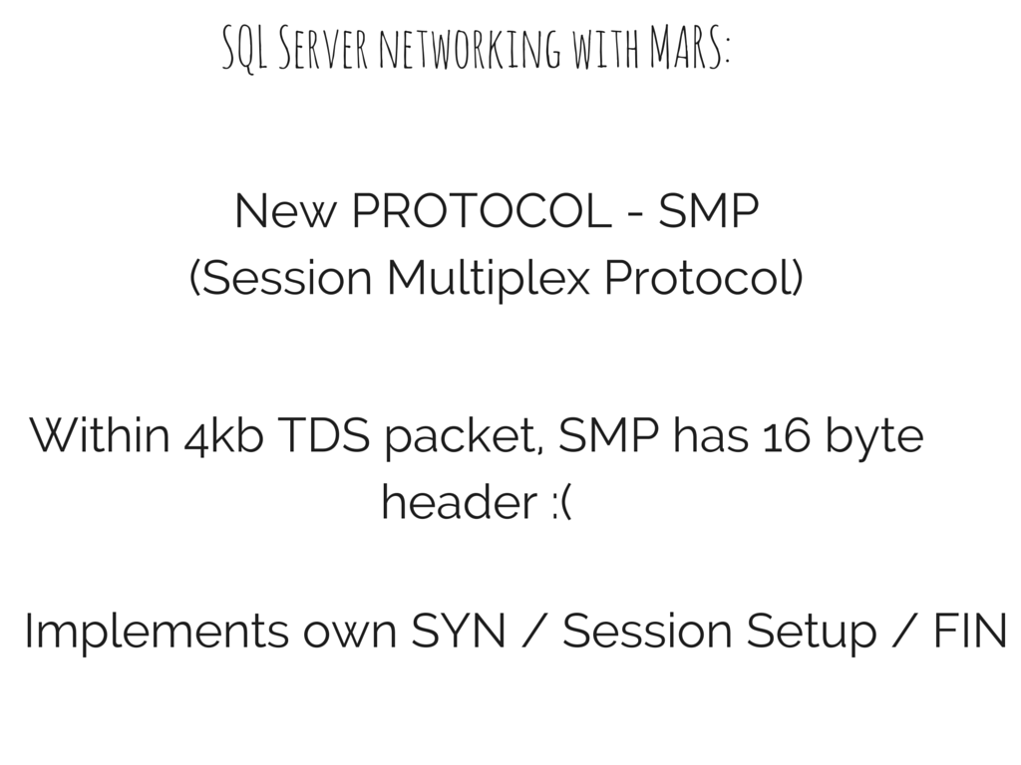
Notes:
To implement mars we get a new protocol called SMP.
It has it’s own session setup for each connection so we still have a connection setup overhead + we potentially send more packets as we have a 16 byte header on each packet.

Slide 17
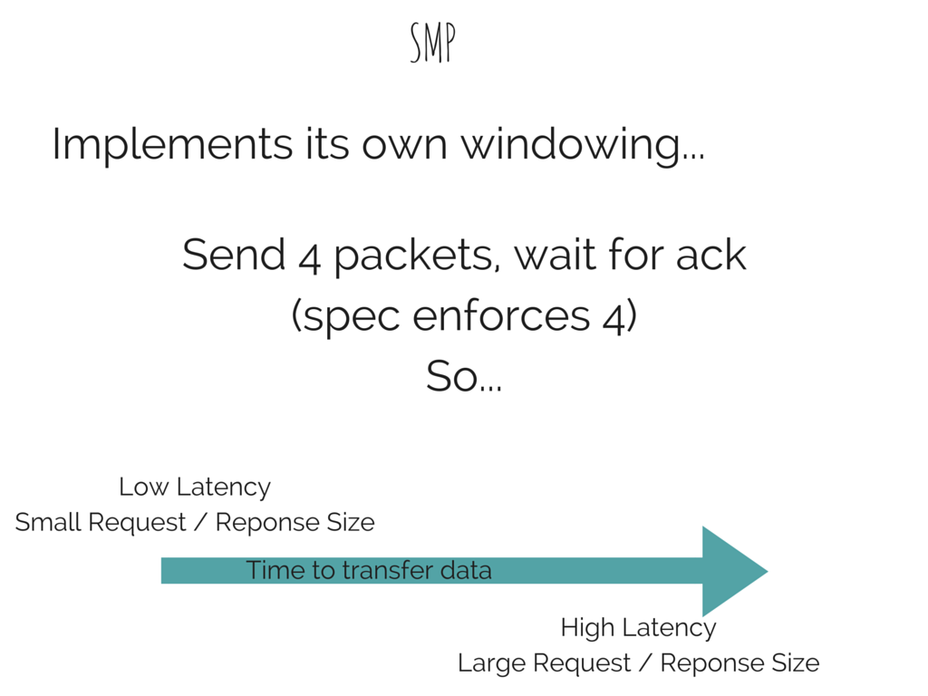
Notes:
This is the real problem with MARS, because it implements its own windowing and defaults it to 4 packets, any request or response over 4 packets where you have high latency will take a lot longer than tds.
There are no options to configure the window but if you can intercept the packets you can actually change it to something more useful which makes it a lot faster – but to intercept it you need to man in the middle the connection request and so it isn’t really realistic (it is certainly a drastic measure to a simple fix)

Slide 18
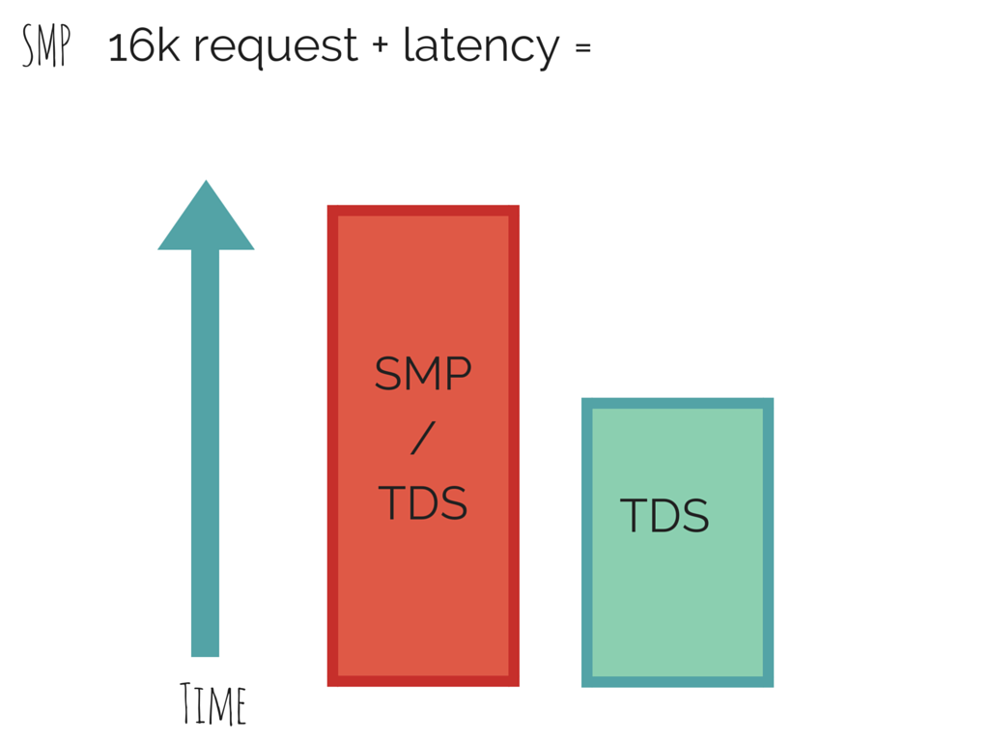
Notes:
I setup a demo of sending large requests / responses over the internet (from my house in sussex to the azure data centre in the us) – just a single request so there is no pausing and non yielding waitfor’s etc and it took just over half the time to make the requests using tds as it did mars.
The demo was designed to be bad for MARS but not completely unrealistic.

Slide 19

Notes:
Incidentally seeing mars packets but only ever a request_id of 1 has to be the saddest thing and I have seen this from more than one application where the devs likely didn’t even know they had mars enabled or enabled it to fix a bug they saw and googled for an answer and found it was to enable mars (that wasn’t the correct answer by the way)

Slide 20
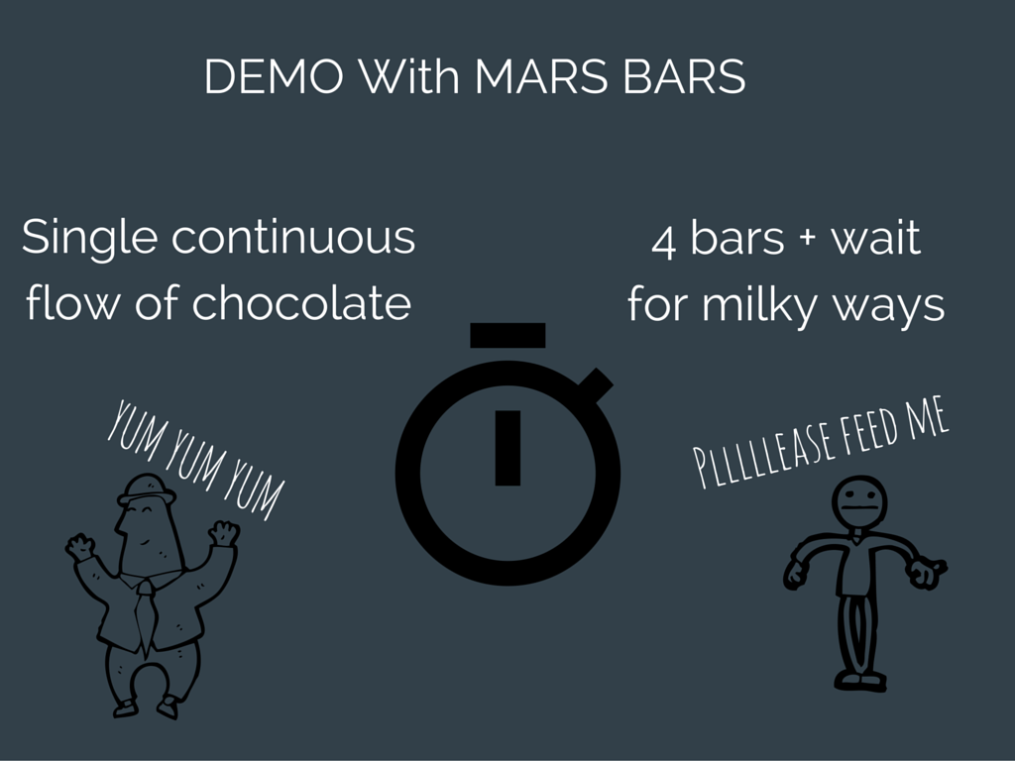

Slide 21


