Slide 1
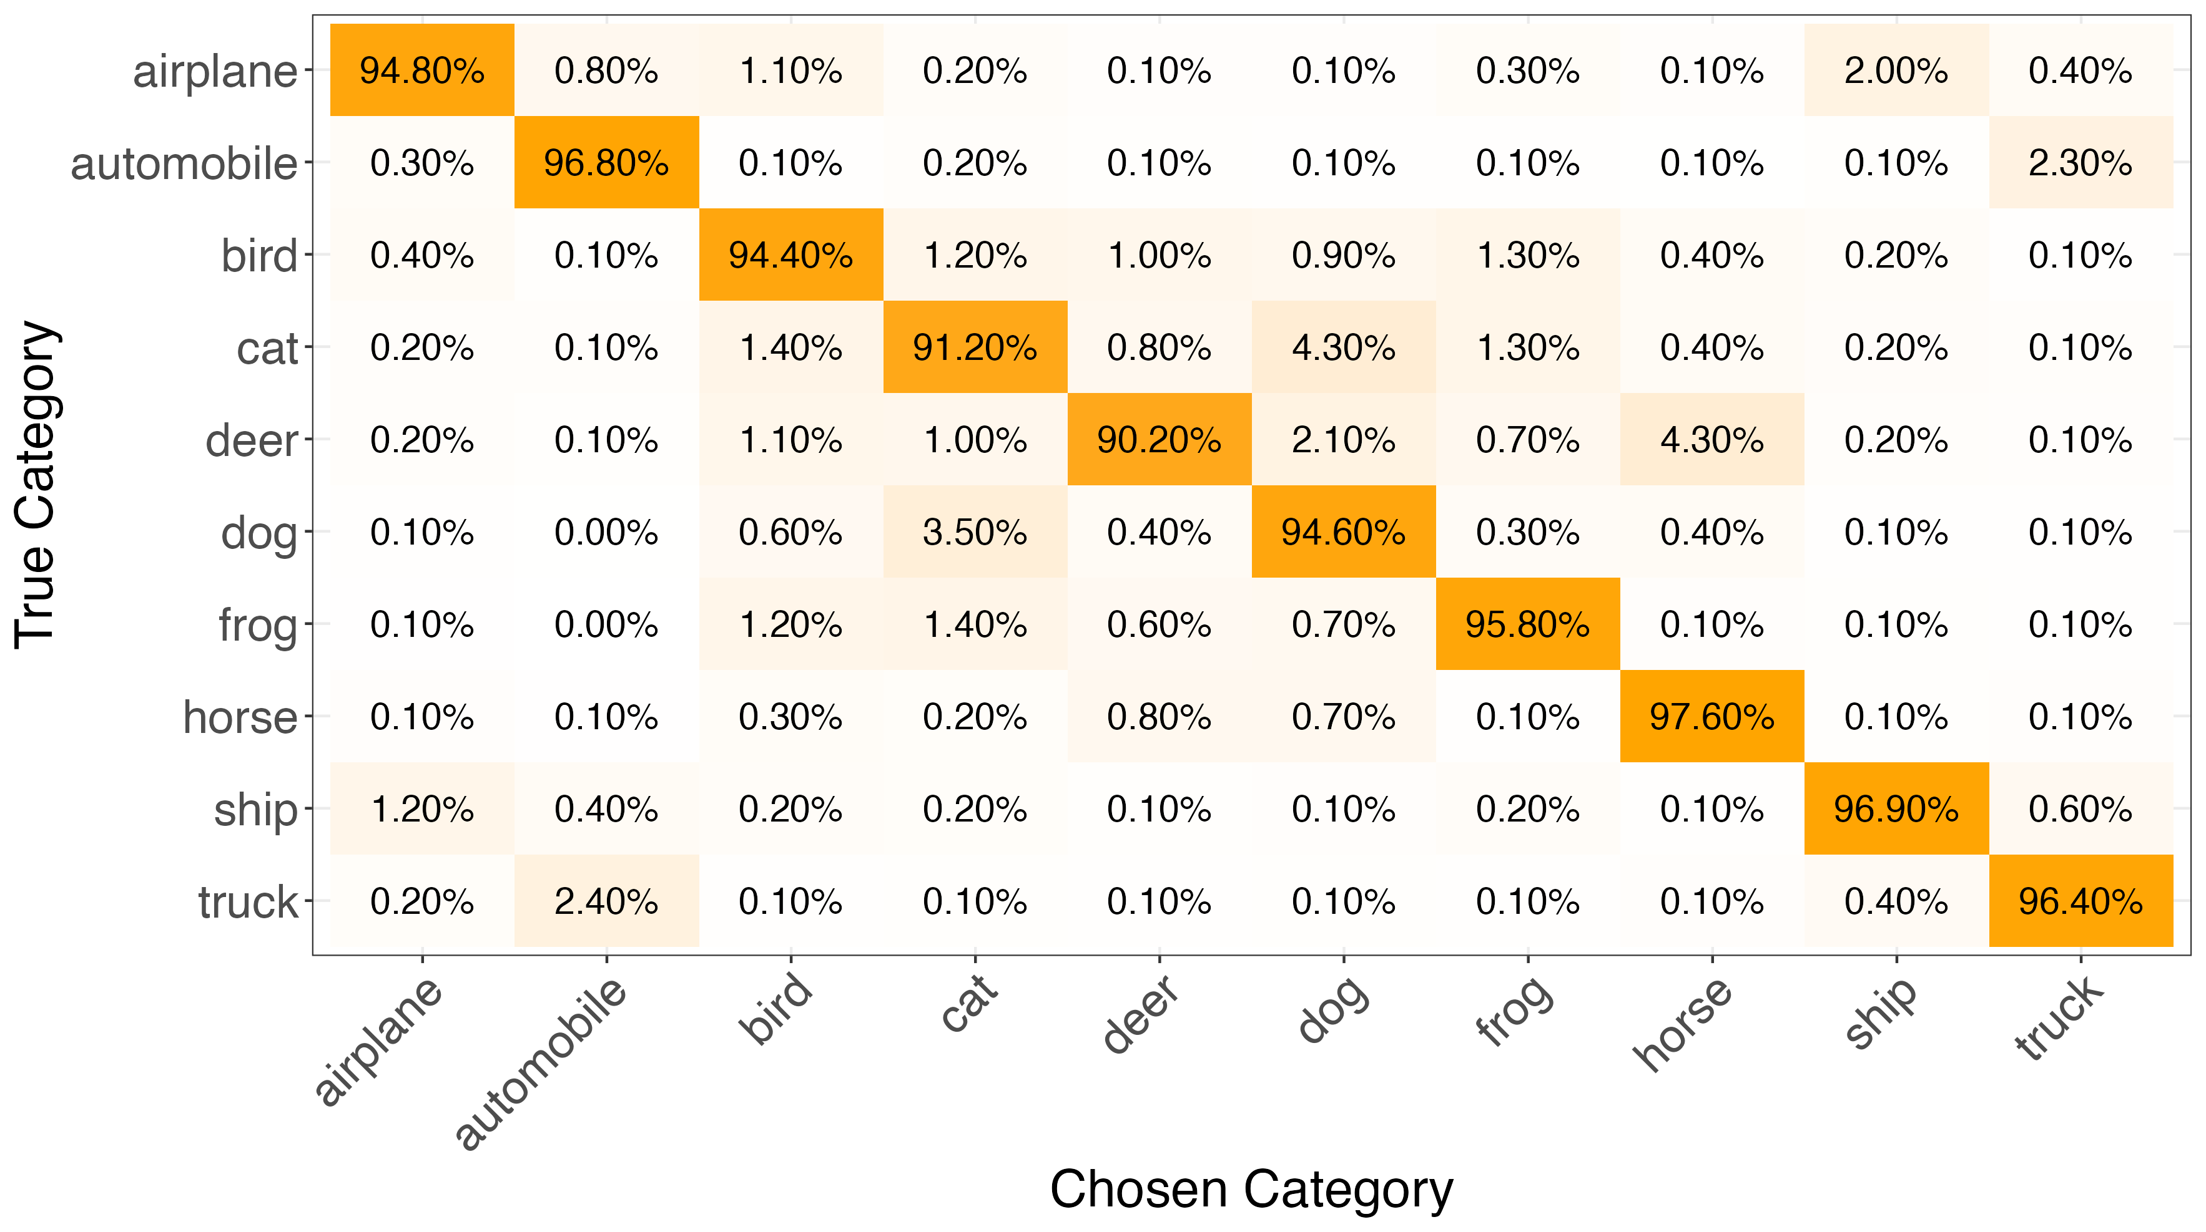
Quantifying Labelling Uncertainty in Image Data
Bachelor’s Thesis at the Department of Statistics LMU
Supervisor
Prof. Göran Kauermann
Cornelia Gruber
Katharina Hechinger
Submitted by
Eugen Gorich

Slide 2
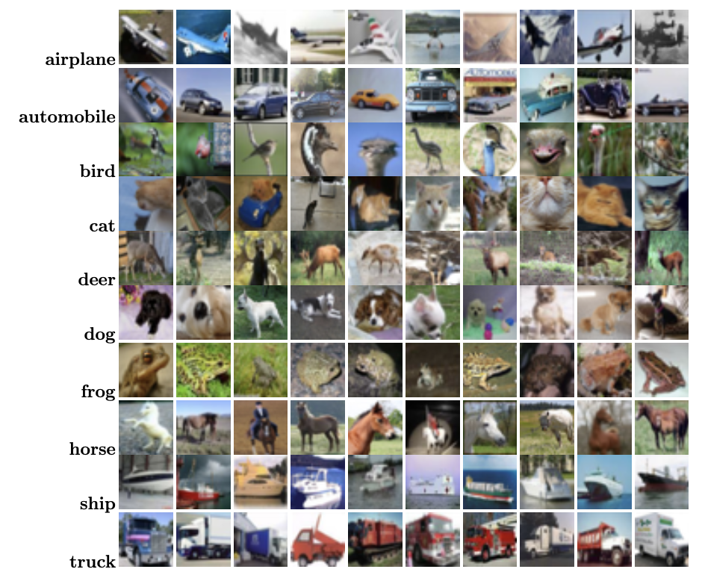
Quantifying Labelling Uncertainty in Image Data
Bachelor’s Thesis at the Department of Statistics LMU
Supervisor
Prof. Göran Kauermann
Cornelia Gruber
Katharina Hechinger
Submitted by
Eugen Gorich

Slide 3
Quantifying Labelling Uncertainty in Image Data
Bachelor’s Thesis at the Department of Statistics LMU
Supervisor
Prof. Göran Kauermann
Cornelia Gruber
Katharina Hechinger
Submitted by
Eugen Gorich

Slide 4
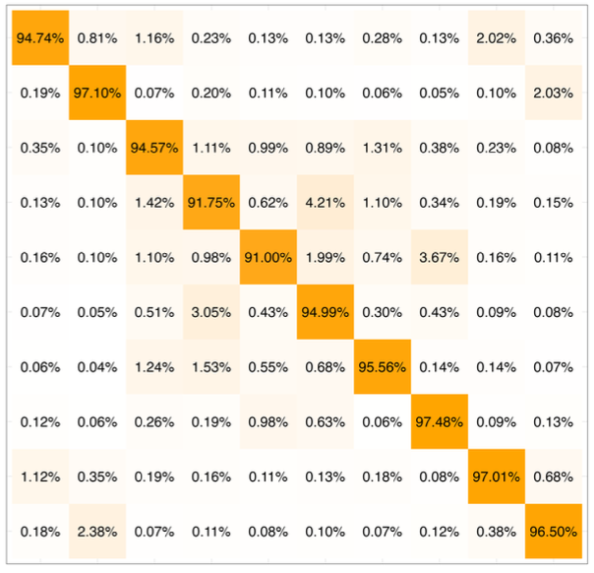
Quantifying Labelling Uncertainty in Image Data
Bachelor’s Thesis at the Department of Statistics LMU
Supervisor
Prof. Göran Kauermann
Cornelia Gruber
Katharina Hechinger
Submitted by
Eugen Gorich

