Slide 1
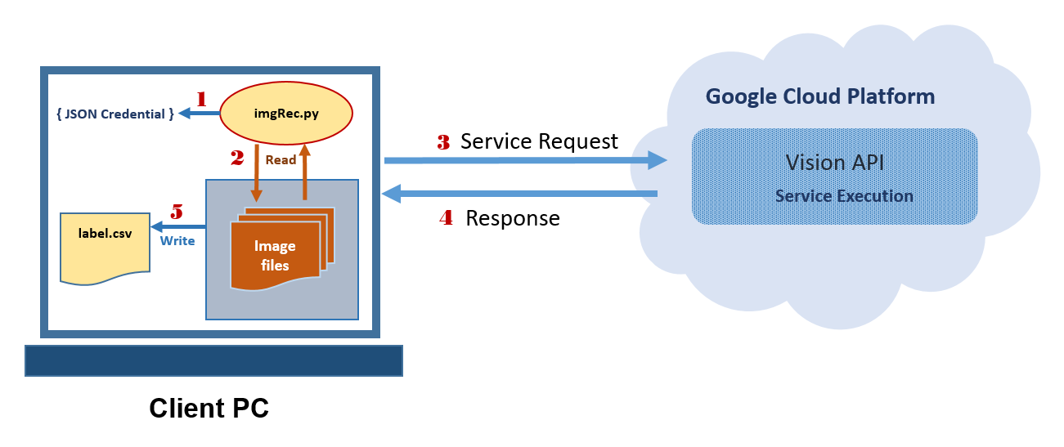
System Overview
Image Recognition Automation Prototype

