Slide 1
Ad-Hoc Reporting – Data Dictionary
Some Ideas

Slide 2
Links to visual concepts
http://arborjs.org/
https://www.chuongduong.net/thinkmap/demo/
http://gojs.net/latest/samples/radial.html
http://gojs.net/latest/samples/decisionTree.html
http://gojs.net/latest/samples/conceptMap.html

Slide 3
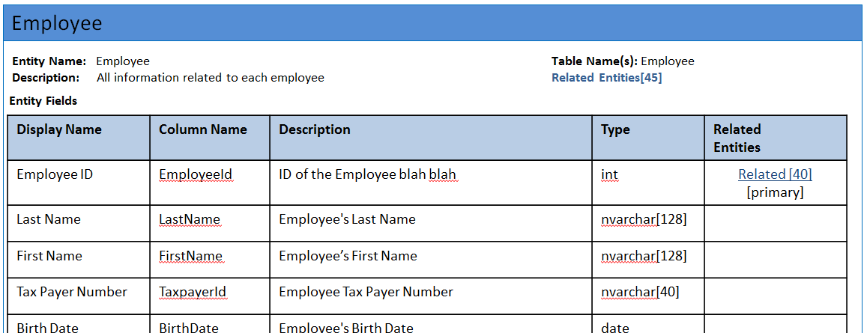
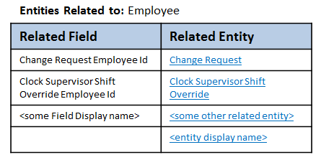
Topic Explorer
Topics By Category
Entity Relationship Diagram
Payroll
Payroll – Deduction Details
Payroll – Pay Run Summary
Payroll – Tax Details
…
Human Resources
Safety and Health Incidents
Terminated Employees
…
…
Terminated Employees
Employee
Employee ID
Employee Manager
Employee ID
Employee Ethnicity
Employee ID
Employee Marital Status
Employee Work Assignment Employee ID
Employee Work Assignment
…

Slide 4
Entities Categorization Data Dictionary Navigator v 2.0
Categories: (Tree View)
Entities
Entity Details
Global
Employees
Balances
Deductions
Dependents
Jobs & Positions
Tenure
Compensation
Org Structure
…
WFM
Scheduling
Attendance Tracking
Labor Budgeting
….
Benefits
Elections
Plans
Utilizations
Payroll
…
Recruiting
Candidates
Job Reqs
Employee Deduction
Employee Deduction Audit
Employee Deduction Balance
Employee Deduction in Arrears
Employee Deduction
Related Entities (40)
<Description of the Entity>
Display Name | Description | Data Type | Related
Field Name 1 | Description for this field | int
Field Name 2 |  | nvarchar(50) | 20
New Metadata to be added to Entities.xml

Slide 5
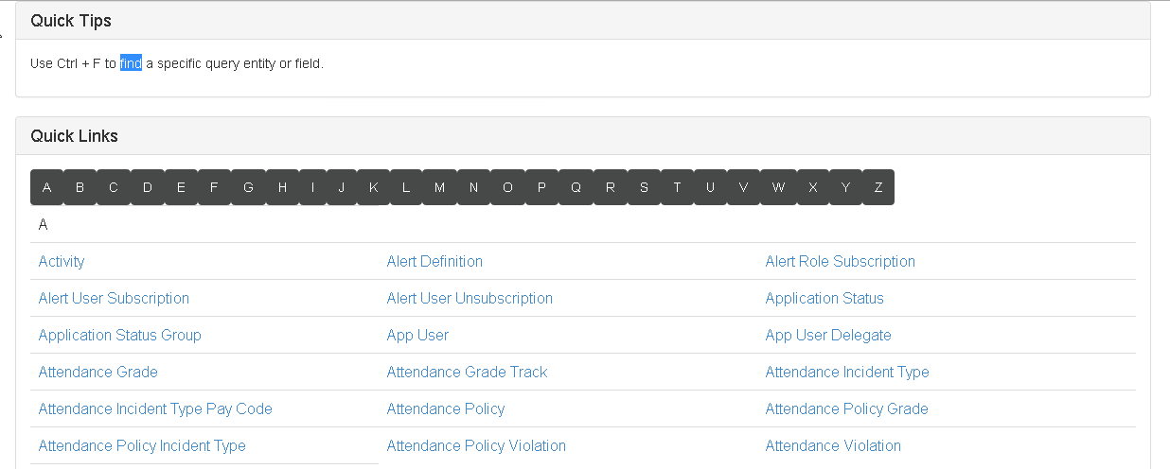
Current Prototype

Slide 6
New - Query Entity Data
Employee
Entity Name: Employee Table Name(s): Employee
Description: All information related to each employee Related Entities[45]
Entity Fields
Display Name | Column Name | Description | Type | Related Entities
Employee ID | EmployeeId | ID of the Employee blah blah | int | Related [40] [primary]
Last Name | LastName | Employee's Last Name | nvarchar[128]
First Name | FirstName | Employee’s First Name | nvarchar[128]
Tax Payer Number | TaxpayerId | Employee Tax Payer Number | nvarchar[40]
Birth Date | BirthDate | Employee's Birth Date | date
Gender | Gender | Employee's Gender | nvarchar[2]
Badge | BadgeNumber | Employee's Badge Number | nvarchar[80]
Display Name | DisplayName | Employee's Display Name | nvarchar[510] | Related [7]
Hide this column in final version – we don’t want to expose the underlying DB schema

Slide 7
Query Entity Data - Detailed
Employee
# of entities referencing this field
Entity Name: Employee Table Name: Employee
Description: All information related to each employee
Entity Fields
Display Name | Column Name | Description | Type | Related Entities
Employee ID | EmployeeId | ID of the Employee blah blah | int | Related [40] [primary]
Click on link brings up Related Entities dialog as a modal Popup

Slide 8
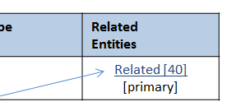
Related Entities Dialog
Lists all fields that have Related Entities in the current entity
- Defaults to the one clicked on to invoke this popup
Click brings up this dialog
Closes the pop-up dialog
Current entity
Display Name
Entities Related to: Employee
Field:
Employee ID
Related Entity | Related Field | Field Description
Change Request | Change Request Employee Id | <description of that field>
Clock Supervisor Shift Override | Clock Supervisor Shift Override Employee Id | <description of that field>
<some other related entity> | <some Field Display name> | <description of that field>
<entity display name>
Lists all entities and fields that contain a reference to the selected entity and field
Click Closes this dialog and returns to the Data Dictionary – at the section that describes the entity clicked

