Slide 1
Data for SFQ project
U. Patel

Slide 2
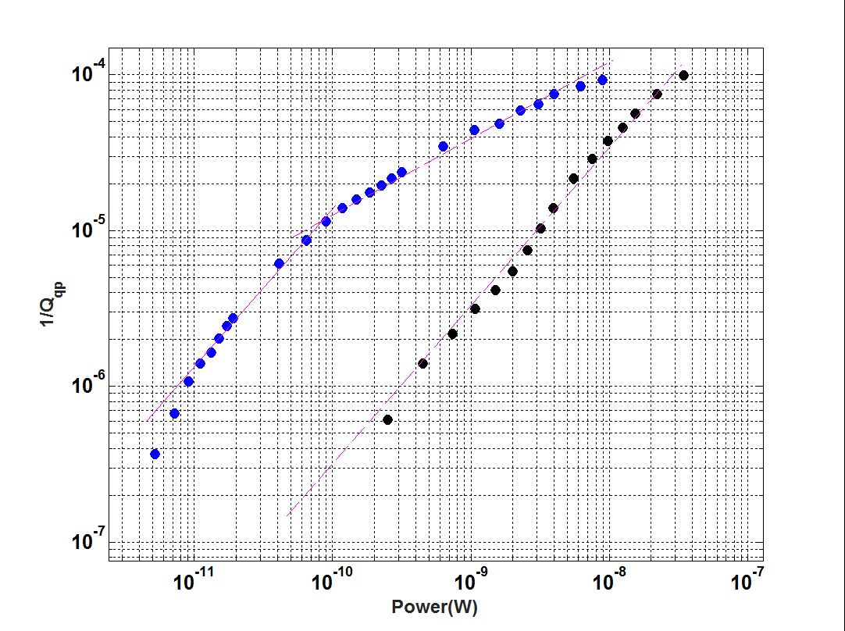
No Trap
Trap

Slide 3
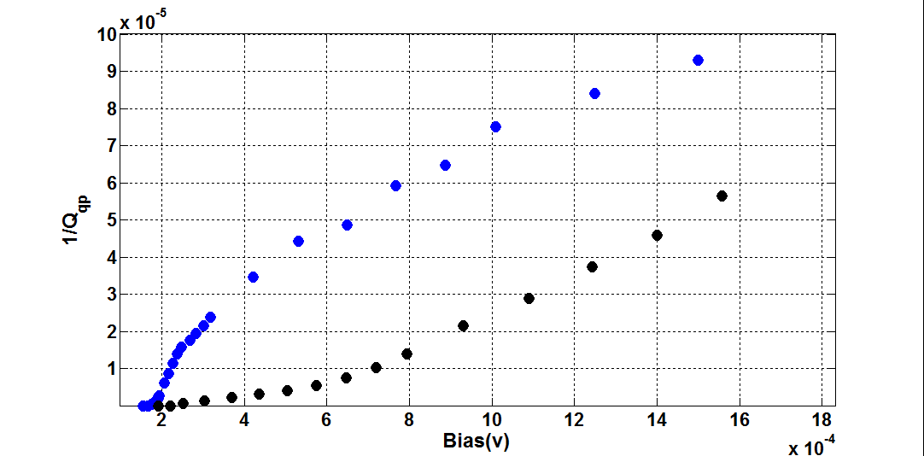
No Trap
Trap

Slide 4
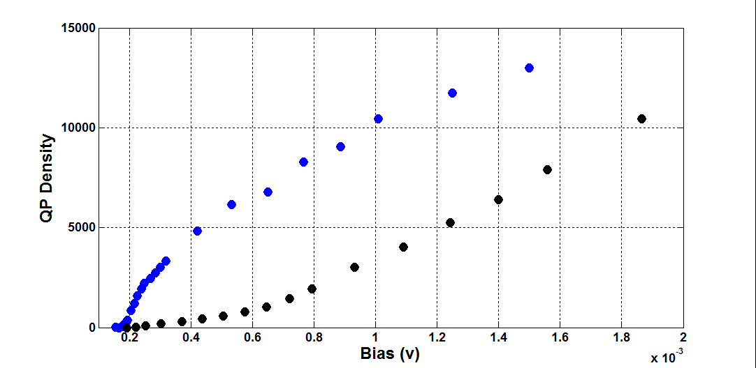
No Trap
Trap

