Slide 1


MINDCARE STEP INTO THE LIGHT WITH MINDCARE.
KAVIYA PRIYA
HARIKISHORE

Slide 2



AGENDA
WHAT IS MINDCARE?
BACKGROUND
PROBLEM
SOLUTION
MINDCARE IN BLOCKCHAIN
SOLUTION ARCHITECTURE

Slide 3
WHAT IS MINDCARE?
People who are experiencing stress, sadness, or anxiety can use the services offered by Mindcare, a decentralised healthcare platform, at any time and from any location.
The major objective of Mindcare is to establish a global market for people who are in good mental health

Slide 4
BACKGROUND
Globally, there is an increase in mental health issues.
In the past ten years, there has been a 13% increase in both mental health illnesses and substance use disorders (to 2017).
All aspects of life, including school or work performance, relationships with family and friends, and participation in society, can be significantly impacted by mental health issues.
The fundamental reason is that if depression and other mental health conditions don't receive effective care at the appropriate time, because their illness is invisible to the outside world.

Slide 5
PROBLEM
The most popular therapies for treating depression and anxiety disorders are ACT (Acceptance and Commitment Therapy) and CBT (Cognitive Behavioral Therapy), which are more expensive per session.
The person with mental health concerns has no time convenience.
Due to the lack of qualified therapists, a person must look for a service provider to determine whether they are available in their area at the appropriate time and meet with them in person.

Slide 6
SOLUTION
The finest platform for treating people with mental illnesses at the proper time and place for their convenience is called Mindcare.
For those who require these services, this platform offers counselling, coaching, and therapy sessions online. For ex, a Web CBT, for instance.
Since Mindcare is a global application, anyone from anywhere can use the services at their own convenience in terms of availability and price for the clients.

Slide 7
MINDCARE IN BLOCKCHAIN
Private Blockchain is used to store health records and assessment information that will be used for future consultations with other therapists.
We introduce Mindcare Token as a means of payment for the consultation that customers have requested because Mindcare is a global application.
The details of completed transactions are kept in a blockchain.

Slide 8
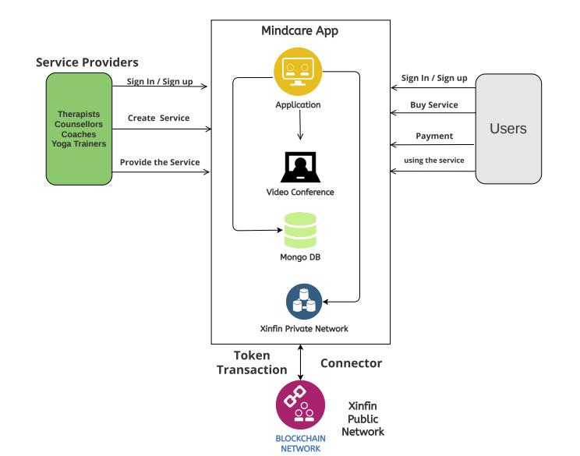
SOLUTION ARCHITECTURE

Slide 9
THANK YOU

