Slide 1

Be sure to install the font Cera Pro if not already installed*
Cera Pro is the official LEGO brand typeface. It was auto-rolled out onto most employees’ computers, but if you don’t have the font:
On PC, go to IT Toolbox > LEGO Fonts
On Mac, open Universal Type Client and ensure it’s turned on.
External Partners can download from the External Brand Package.
*call Global IT if you experience issues with this
Now you’re ready to make a custom presentation!
IoT Data Storage and Distribution

Slide 2
Focused Architectural Components
Component ID | Layer | Component/Service | Purpose & Rationale
3 | Persistence | Azure Storage Account (Blob Storage) | Serves as the immutable, centralized data lake landing zone. Utilizes Lifecycle Management for cost-effective Hot/Cold tiering.
4 | Real-Time Distribution | Managed Apache Pulsar Streaming Platform (AMMA Async API) | A pre-existing, unified messaging and streaming service. It provides durable topic management, governed by LEGO AsyncAPI specifications, and reliably decouples producers from diverse consumer teams.
5 | Integration/ETL | I/O Connectors & Pulsar Tpoics | Serverless compute and pre-built connectors to manage data flow between IoT Hub/Event Hubs and the Pulsar topics, and between Pulsar and Databricks/Delta Lake.

Slide 3
Data Flow Pipeline: Persistence and Distribution Focus
Phase 1: Dual-Path Ingestion (Starting Point)
The single stream of raw IoT telemetry (JSON) is routed by IoT Hub to two destinations simultaneously:
Path A (Persistence): To the Azure Storage Account (Data Lake).
Path B (Real-Time): To a dedicated Azure Event Hubs instance, which acts as the high-throughput bridge into Apache Pulsar.
Phase 2: Path A - Persistence (Hot and Cold Tiers)
The persistence layer ensures all raw data is immutable and available for historical analysis, model training, and compliance, while optimizing storage costs.
Feature | Implementation Detail | Rationale
Hot Storage (Immediate Access) | Blob Storage Container raw-iot-data configured for the Hot access tier. Data lands here initially. | Allows for immediate, low-latency reads required for debugging, recent operational analysis, or re-processing the last 30-45 days of data.
Cold Storage (Cost Optimization) | Azure Storage Lifecycle Management Policy is configured on the container. The policy is set to transition blobs older than N days (e.g., 30-45 days) from the Hot tier to the Cold tier. | This significantly reduces storage costs for archival data that is accessed infrequently but must remain quickly available (in hours).
Archival (Long-term Compliance) | An additional Lifecycle policy moves data older than 90 days to the Archive tier (if extreme long-term retention is mandated). | Provides the lowest possible storage cost for compliance and deep historical modelling, with a higher retrieval time (up to 15 hours).

Slide 4
Data Flow Pipeline: Persistence and Distribution Focus
Phase 3: Distribution
Ingestion into Pulsar:
Topic: persistent://production/moulding/raw-machine-data (The Bronze Layer Stream).
Real-Time Data Segregation
Raw Topic: Subscriptions are offered to operational monitoring and Quality Assurance teams.
Databricks Sink (Integration/ETL):
LEGO Nexus implementation consumes raw persistent://production/moulding/raw-machine-data
Dumps JSON into Bronze layer tables.

Slide 5
Security Considerations
1. Pulsar Authentication and Authorization
Adhere to LEGO Pulsar implementation in terms of access management.
2. Access Control (AuthZ): Enforce strict ACLs (Access Control Lists) on all Pulsar topics. This is crucial to ensure that only authorized consumers (e.g., the Databricks Sink Connector) can read from high-value streams like the enriched-analytics-data topic.
3. Identity and Credential Management
Azure Managed Identities: Use Managed Identities for Azure services to securely access other Azure resources, such as Event Hubs and the Azure Storage Account. This eliminates the need to manage secrets or hardcoded credentials (secretless).
4. Data Encryption
Data in Transit: Mandate mTLS (mutual TLS) for all internal communication between Pulsar components. Additionally, enforce TLS 1.2 for all client connections to guarantee that data streams are fully encrypted while moving across the network

Slide 6
Scalability
LEGO Pulsar Pre-configured scalable external system maintained by external teams.
Storage Tiers (Component 3): Blob Storage is inherently scalable. The Lifecycle Management policy is the core mechanism for cost-efficient scaling, preventing high-cost Hot storage from growing indefinitely.
Decoupled Processing (Component 4/5): Pulsar's subscription model is highly decoupled. If the Databricks sink slows down due to complex processing, the Pulsar broker simply holds the backlog in its persistent storage (BookKeepers) without putting backpressure on the ingestion process.

Slide 7
Monitoring and Support
Storage Auditing: Enable Blob Storage logging and use Azure Monitor to track lifecycle management actions (tier shifts) and ensure cost policies are functioning correctly.
Lego Nexus: Add ample logging to jobs for proper troubleshooting.
.

Slide 8
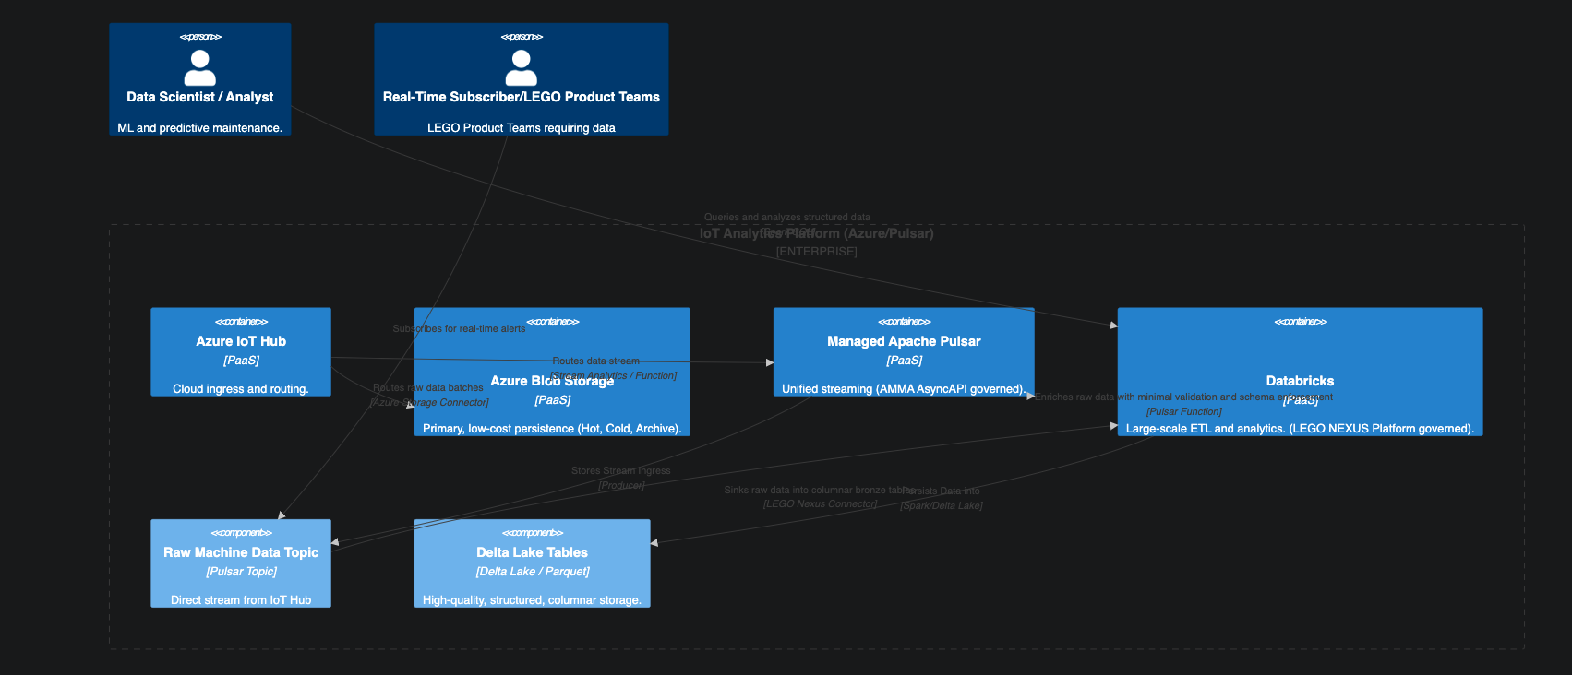
Architectural Diagram

