Slide 1



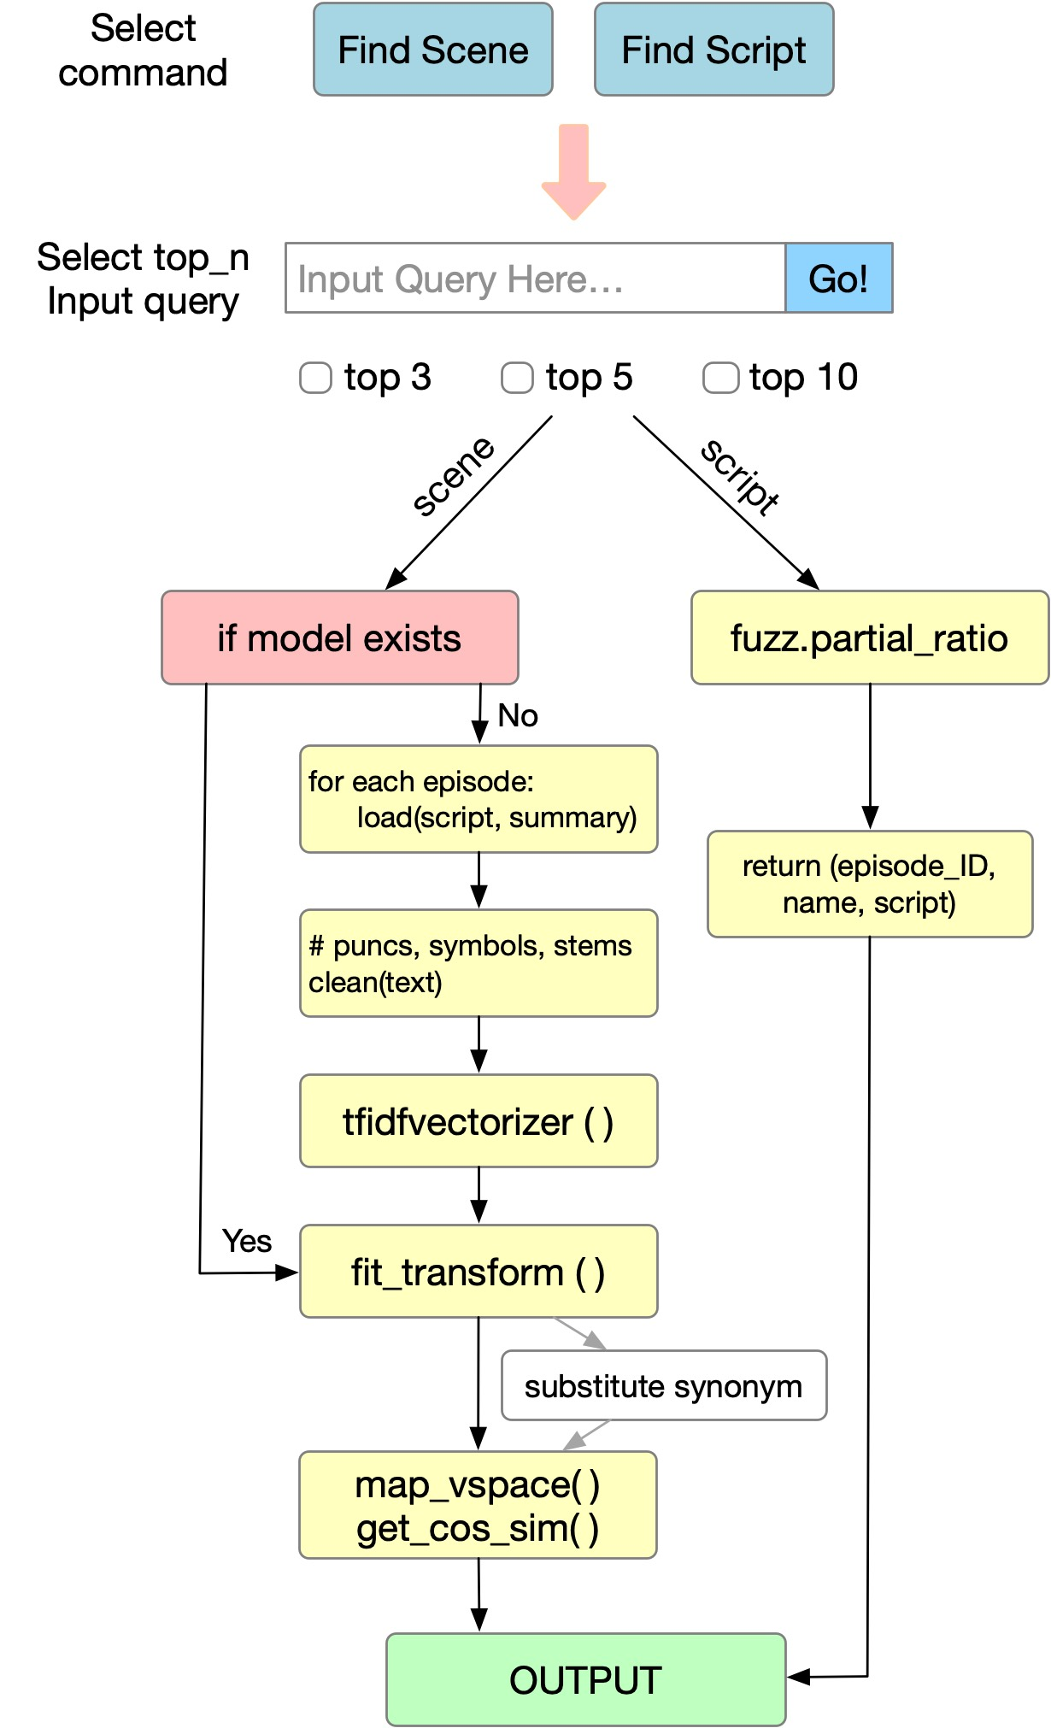

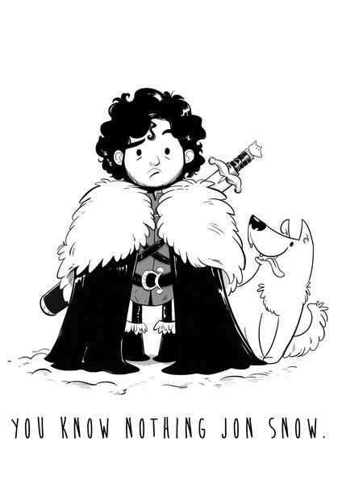
Game of Throne Episode Search
Tianyi Ge, Yueyuan Li, Lingyun Guo
¹ School of Information, University of Michigan
Introduction
We build a search engine for the TV series ​Game of Thrones​. Our search engine could help users find the episodes that have matched details which with the queries, such as ​revenge​, ​battle​, etc. For example, one may search for “the Red Wedding”, and get the result “s03 e09”.
Objectives
Search for the specific episodes where all the query characters show up.
Search for the specific episodes that have required details such as ​revenge​, ​battle​, etc.
For ​battle​, those episodes are not necessarily contain this term. But relative terms could be observed and make a conclusion that it’s relevant to our query.
Search for the specific episodes where query lines occur (e.g. “​You know nothing”)​ .
Provide spell correction suggestions for special terms.
Support a fuzzy search of the scripts (approximate string matching).
Model Specification
Method The core algorithm for our search engine is TF-IDF. When first initialized, our model will load the dataset, process the text data and build TF-IDF index based on the corpus. Upon input, our model first process the query, transform it into the pre-built vector space and compute similarity of query with each episode. In the end, the top k (k specified by user) episodes will be returned.
Component Our model is composed of two parts: the front end, which is a UI interface for users to specify command and produce input; the back end, which is the TF-IDF algorithm computing the similarity of the input query with all the episodes.
Usage To search for an episode, the user first select the function he or she want to use (find scene/script). Then a new window is prompted with the input query box and entries selection. The system is ready to provide results for input queries.
Figure 1. Algorithm for our model
The blue part is front end, and the rest is the back end text processing and computation.
Evaluation
Method for evaluation:
We plan to use two different criteria to evaluate our engine’s performance: Google and the Game of Thrones W​iki. Our goal is to be more specific and to locate information directly to relevant episodes. We will evaluate our search engine by testing the same queries on the three platforms and comparing the accuracy of query location and how direct the results connect with correspondent episodes.
Conclusion
What we achieve in this project;
What we learn from this project;
What can we improve in future.
Reference
Source: Game of Thrones Episode Scripts. https://www.springfieldspringfield.co.uk/episode_scripts.php?tv-show=game-of-thrones
This is a final project presentation of SI 650: Information Retrieval

