Slide 1

Track anytime, anywhere!

Slide 2
Problems
Concept
A lot of data sources exist and user find difficulty in matching the relationship between all the data. More over, user spend al lot of time to match the relationship between data. As a result, the report has limited information and suspicious activity has been committed.
Matching data with primary data resource such as: Terrorist List, Politically Exposed Person, Interpol and Other Primary Data and connect to citizen database to find out their family information.
Apply a fuzzy match method to get all of possibilities and get unified profile.
Grabbing data with secondary data such as: Social Media and News Media to find out "links" and adding values to the reports.
Display the visualization to make it easier to understand.

Slide 3
What is goTrack?
Investigation tool to match the relationship between primary and secondary data and enrich the report by combing to open source data such as social media.
The unified profile are generated from relationship of primary and citizenship data which provides citizenship profile.
The unified profile will be enrich with secondary data or open source data by implementing fuzzy match method. As result the linkage will be produced.

Slide 4

Source of Data
Terrorist List (Domestic and International Data; UNSCR1267)
PEP Data;
Consolidate List;
Indonesian Citizenship (can be added with other countries citizenship data) and
Other resources.
PRIMARY
DATA
Twitter;
Facebook;
LinkedIn;
Site News;
etc
OPEN SOURCE
DATA
For FIU use:
STR/CTR/IFTI
Intelligence Report
Can be added with other information.
SECONDARY
DATA

Slide 5










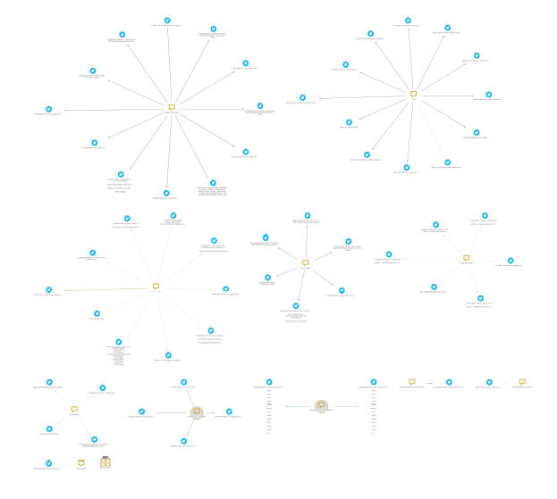

How It Works?
Fuzzy Match
Scraping
CITIZENSHIP
DATA
KEYWORDS
1. CASE MANAGEMENT
PRIMARY
DATA
SOCIAL MEDIA,
NEWS MEDIA
Scraping
SECONDARY
DATA
2. MAPPING VISUALIZATION

Slide 6

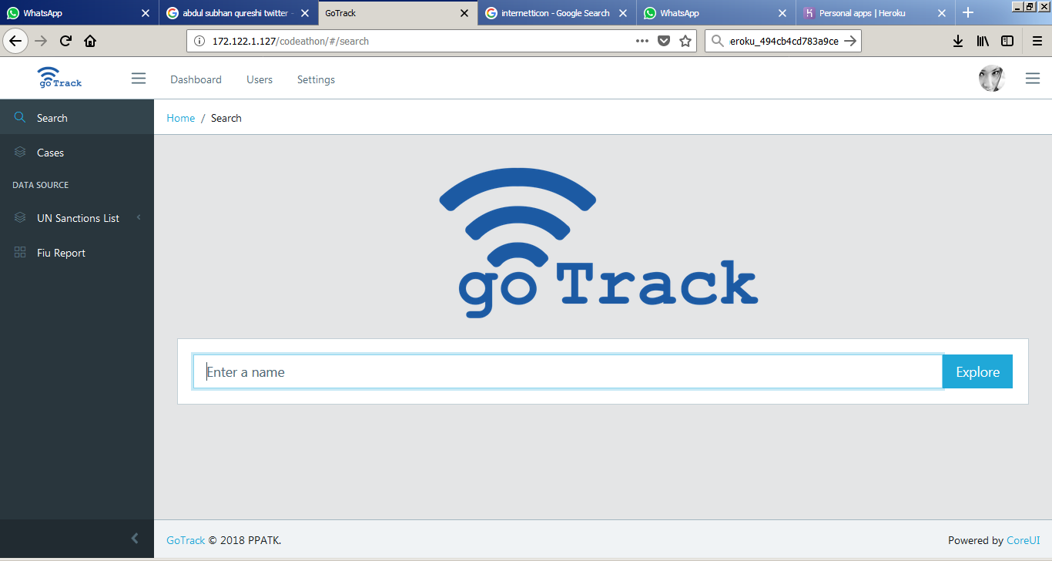
Front page

Slide 7
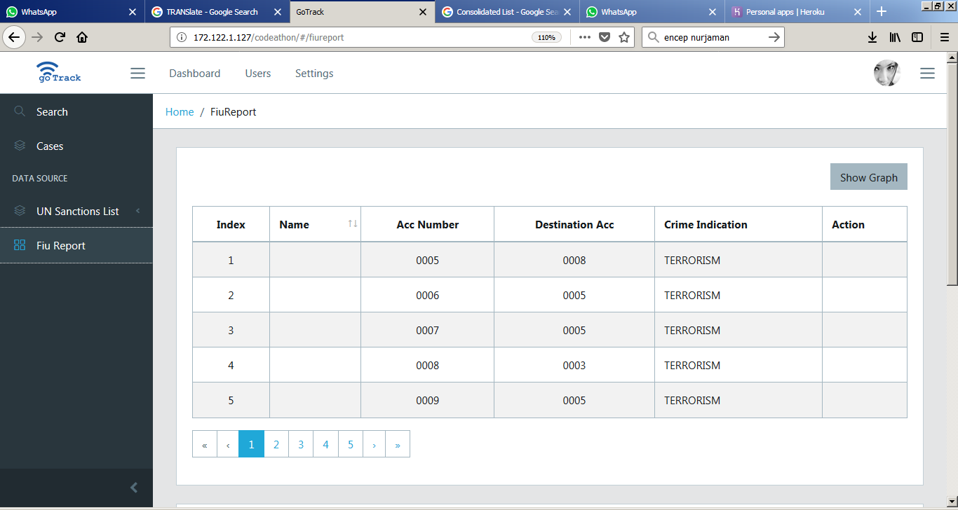
Searching

Slide 8
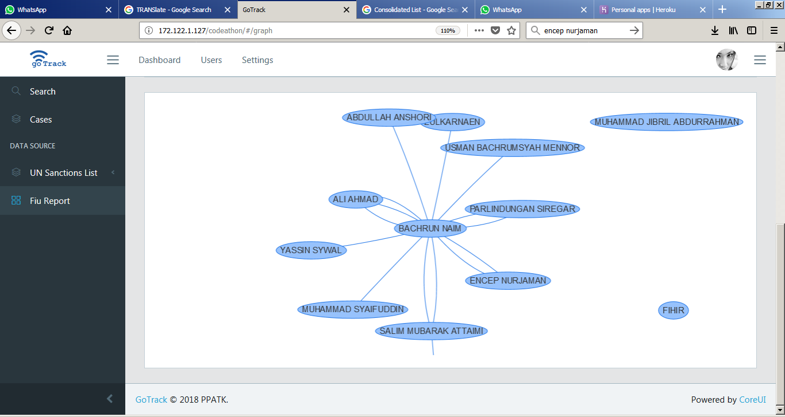
Visualization

Slide 9
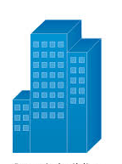






Infrastructure
Ministry of Internal Affairs
Scraping Machine
VPN
goTrackApp Server
Firewall
Citizenship DB Server
STR/CTR/IFTI
DB Server
Primary Data

