Slide 1

.NET Maui
MVVM
Data binding and MVVM - .NET MAUI | Microsoft Learn

Slide 2
MVVM (Model – View Model – View)

Slide 3
What is MVVM
Model = Data
View Model = The “brain”
View = Page and Xaml
Presents the Data
Classes includes properties
Match the DTO server classes
Sometimes includes logic (like in games)
One VM class per UI Page!
Usually this class is the binding context of the Page class in the UI
Includes a property for evert piece of data in the UI Page
Includes a Command for every page interaction (like buttons)
Implement INotifyPropertyChanged interface and uses ObservableCollection to store collections

Slide 4
MVVM in an Internet App Scenario
Model = Data
View Model = The “brain”
View = Page and Xaml
Services = Web Service Proxies

Slide 5
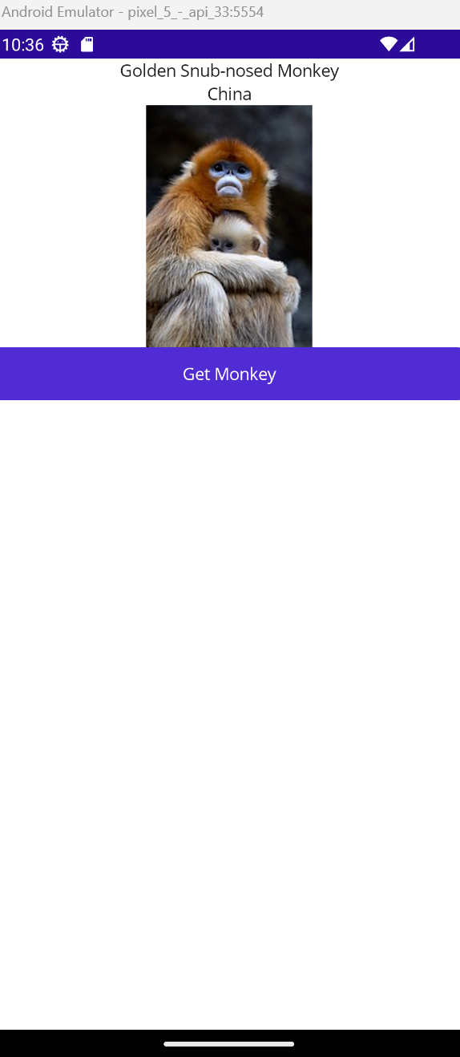
MVVM example – The Monkeys Exercise Solution
Demo – Code at https://github.com/oferzad/MonkeysMVVM

Slide 6
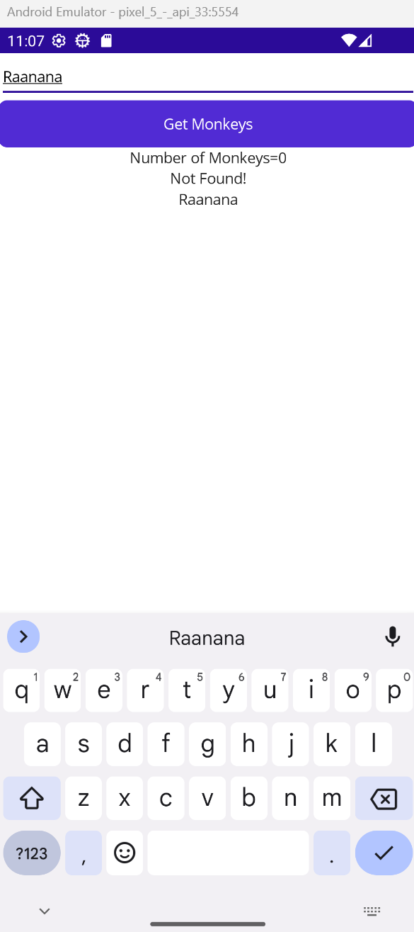
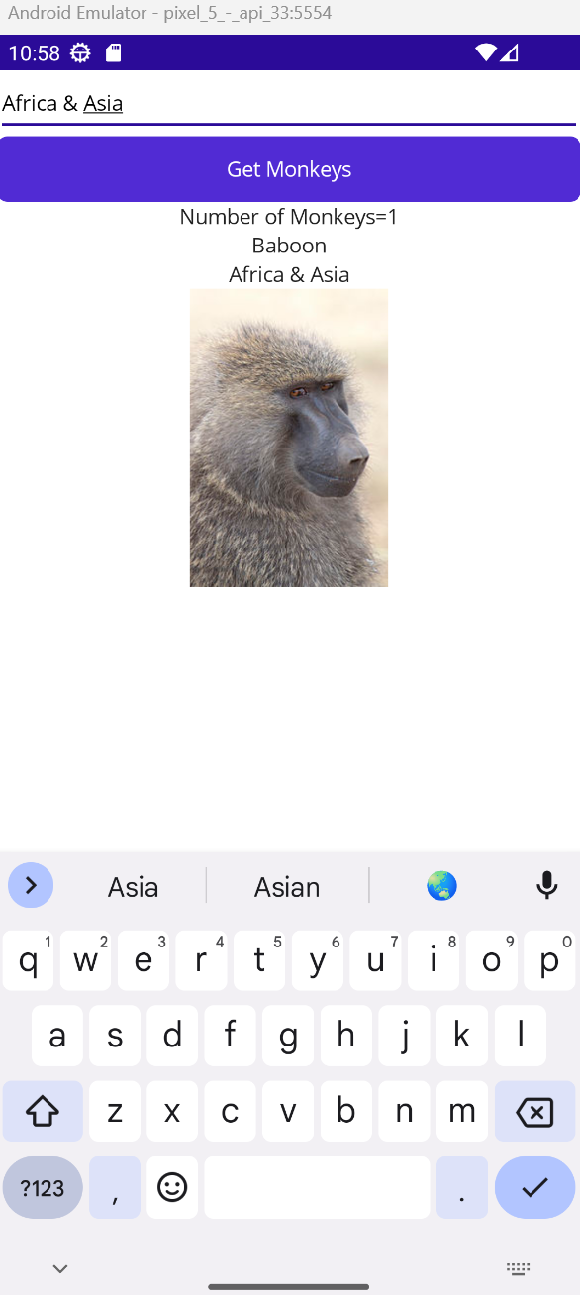
Exercise
Add a new page to the MonkeysMVVM demo app. The page should look like the page on left! The page includes an Entry, a button, two labels and image. Upon writing a location in the entry and clicking the button, the app should show the number of monkeys exist in the location and present the first monkey name, location and image!
Steps:
Add a method to the MonkeysService class that will get a location string and return a list of monkeys from this location.
Add a view model class that will have proper properties and commands based on the page definition
Add a page and develop the XAML. Make sure to bind every tag to the proper view model class property / command. DO NOT forget to connect the page class binding context to the view model that was created!

Slide 7
Exercise 2
Write an app with a working Login page!
Steps:
Design the Login page on paper. It should include labels and Entries for user name and password. It should also include buttons for login and cancel, and another label for messages. Upon clicking the login button the message label should be green if the login succeeded and say: “Login succeeded!” or red if the login failed and say “Login Failed!”
Write a User class with username and password properties.
Write a service class. In the class define a list of users and initialize the list with few users. The class should include a Login method that gets a User object and return true if login succeeded or false otherwise
Write a View Model for the page with all the logic
Write the page Xaml and class

