Slide 1
Jasmine « JasMight» Wright
PERSONA

Slide 2
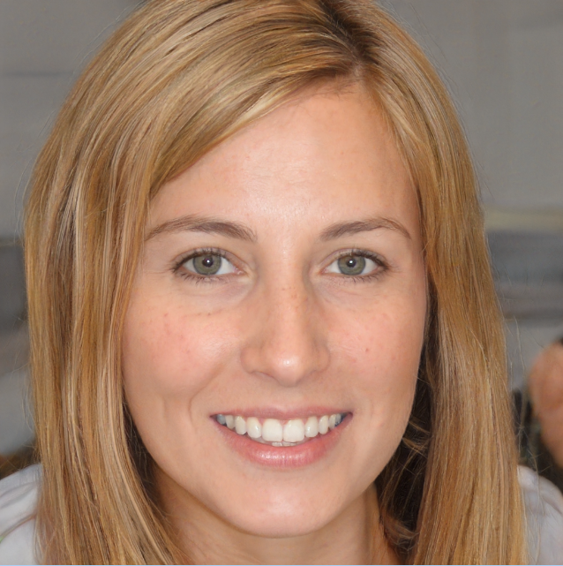
Jasmine « JasMight » Wright
Women
36 ans
In a relationship
A profesional swimmer
Physical Therapist License
2500€ Brut
2200 Sheration Place, San Mateo, Californie

Slide 3
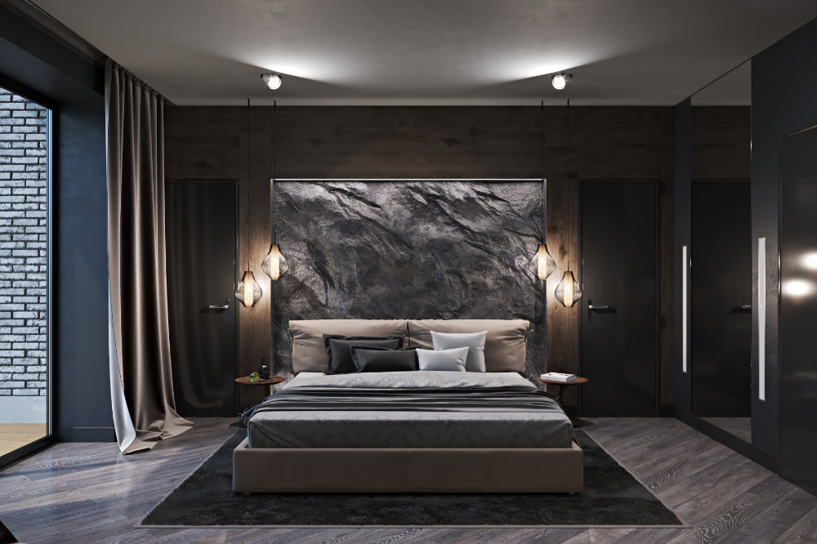
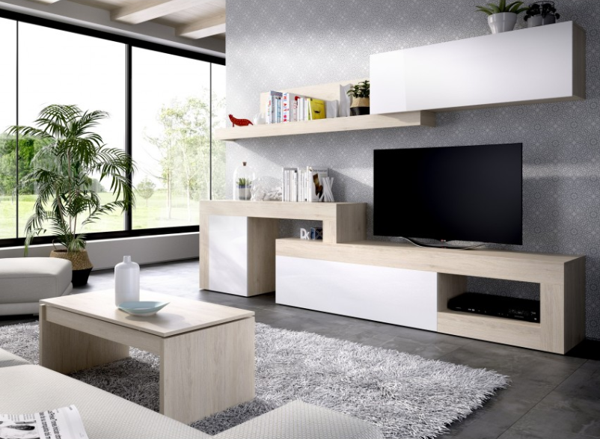
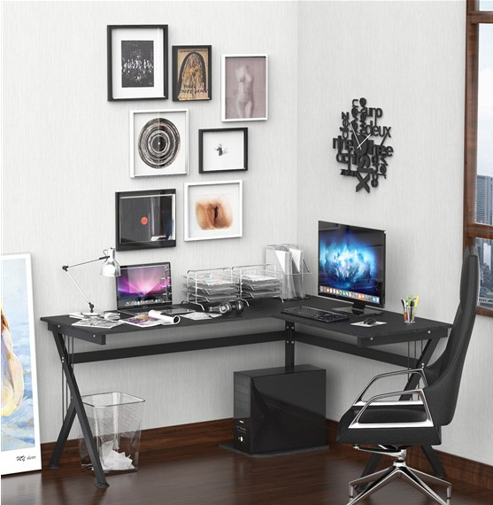
Geographical localization
2200 Sheration Place, San Mateo, Californie
Bedroom
Living room
Desk

Slide 4
Archetypes
Player Theories
Behaviors : Explorer - Achiever
Fun : Easy (Explore) – Serious (Narrative)
Skills : Intrapersonal - Spatial
Expérience : Kinetic - Dynamic
Goals : Narrativism - Experimentalism
Personality Key Words
Introvert / Imaginative / Goal-Oriented

Slide 5
Motivations
Gaming Goals ? Why ?
Interactive stories ;
Resolve Puzzle ;
Understand / Resolve the most quickly the story ;
Hopes / What he wants
full narrative aspect ;
Explore all spaces ;
Cooperative
Similar gaming products / Likes / References
Superliminal
A Way Out
Sherlock Holmes The Devil’s Daughter
We Were Here
The Room

Slide 6
Frustrations
General frustrating elements
Mechanical not reusable ;
Easy to find clue ;
Distracted player ;
Puzzles too easy
Dislike in similar products
Don't have the time ;
Non-Original Riddle ;
Game with more than 2 players ;

Slide 7
Gaming Experience
When ? Periods ?
Week-End
Afternoon
After Work (9PM-11PM)
3 times a week
Where ?
Desk
Gaming Setup (Mid-Low Config)
Living Room
PS5 w/ TV & Sound System
Desk
Living room

Slide 8
Media consumption
Which media does she enjoy ?
Watch :
Action – Adventure movies : ex: Avatar, Indiana Jones, etc.
TV Shows : ex : Game of Thrones, Sherlock Holmes, etc.
Ghibli : Ponyo sur la falaise, Le tombeau des lucioles, Ocean Waves
Youtube-Twitch Channels : ex: Puzzle guy, Mr.Puzzle,

Slide 9
Media consumption
Which media does she enjoy ?
Read :
Books : ex : Le Hobbit, Harry Potter series, Les lieux sombres de Gillian Flynn,
Comics / Manga : ex : Black Butler, Death Note, Detective Conan
Magazines : ex : The Sacramento Bee

Slide 10
Online identity
Channels | Methods | Identity
Facebook | Stories, Posts, Photos | Name, Localisation, Diplomas, Tags
Instagram | Photos, Stories, Videos | Pseudo, Localisation
Twitter | RT | Pseudo « JasMight »
What Apps | Photos, Videos | Name

Slide 11
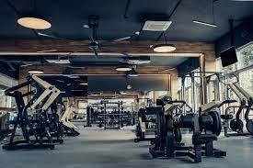
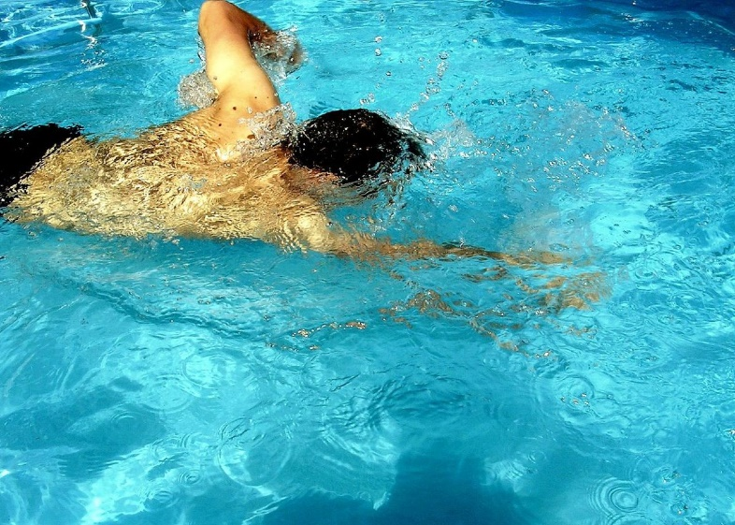
Hobbies
Gym
{Experimented}
2 per week
1h30
Swimming
{Profesional swimmer}
5 per week
2h

